Slide 1
Russian Bellwork
When you hear the term Russian Empire what comes to mind?
Opinion
When you hear Siberia what comes to mind?
Opinion

Slide 2
Objective
WWBAT: Introduce the Russian Empire and discuss characteristics of its expansion

Slide 3
Interactive Notebook Setup
3/10/2016
Qing Spice Chart
This will be one page

Slide 4
Interactive Notebook Setup
3/10/2016
Russian Empire Notes
This will be one page

Slide 5
Background
Peter the Great
Motivations and Russian Empire
Russian Serfdom
Economics in Russia

Slide 6
Background
The Golden Horde selected one of the Russian Princes as the Grand Prince, and authorized him to keep the other rulers in line
The position of Grand Prince did not pass from father to son though often lead to extreme abuses of power by certain Grand Princes

Slide 7
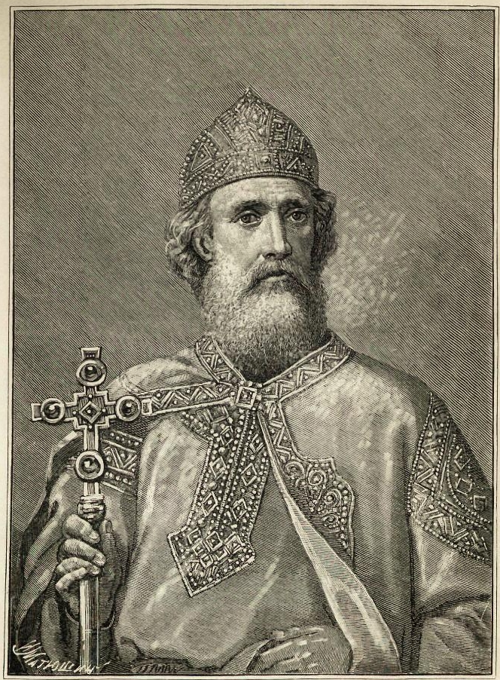
Background
The princes of Moscow gradually proved their loyalty to the Golden Horde
Leaders from Moscow most commonly elected as grand princes as a result Moscow to became the most important Russian city

Slide 8
Background
The Russians became vassals of the khan of the Golden Horde, a domination which lasted for 250 years
Peasants had to meet the demands from both their own princes and the Mongols
Many peasants sought protection by becoming serfs, changing the Russian social structure until the 19th century

Slide 9
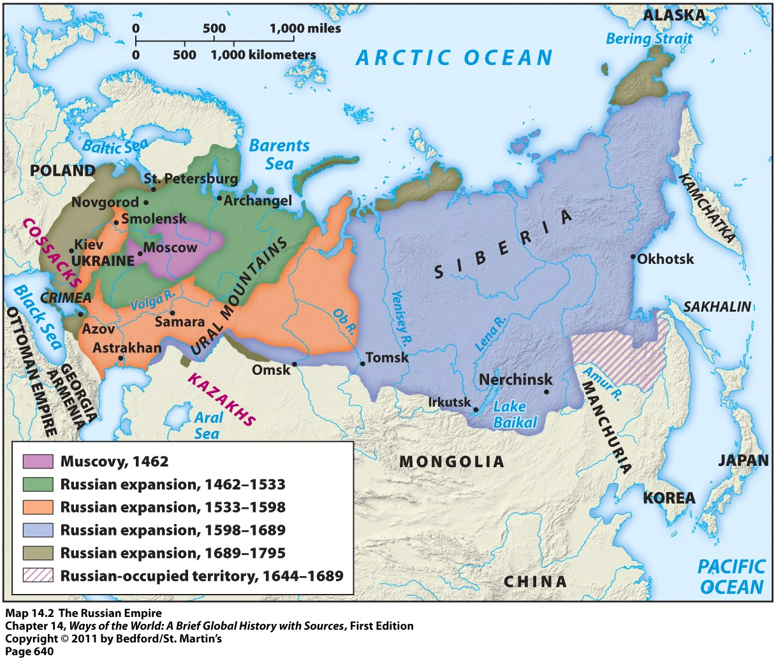
Making the Russian Empire

Slide 10
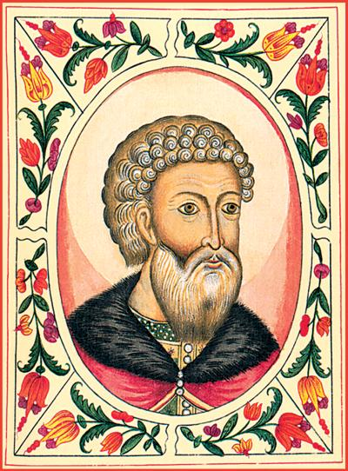
Background
1480: Russia gained independence from Mongol control (Golden Horde).
Led by Duchy of Moscow and Ivan III
Mongols left Russia weak and isolated in connections, especially with Western Europe.
Mongols reduced vitality of Russian culture.
Ivan III

Slide 11
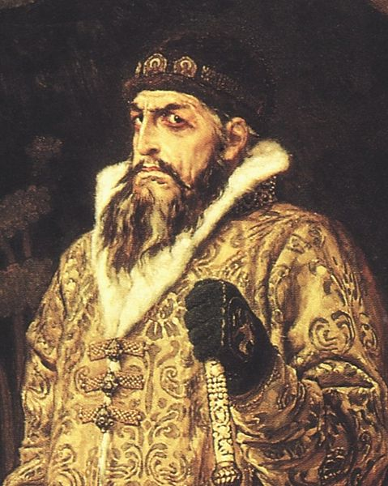
Background
Russian leaders began to call themselves tsars during the reign of Ivan IV
Russian nobility were called boyars
Served as advisors and military leaders for princes and Tsars

Slide 12
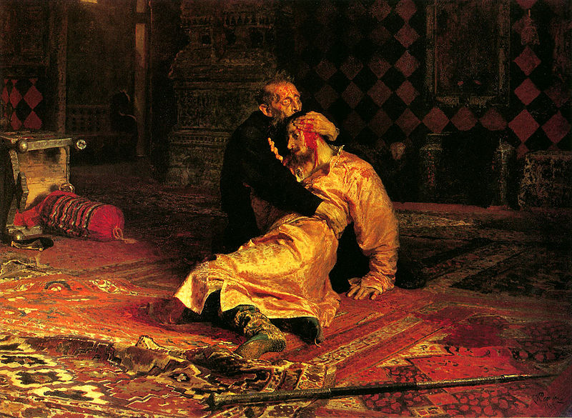

Slide 13
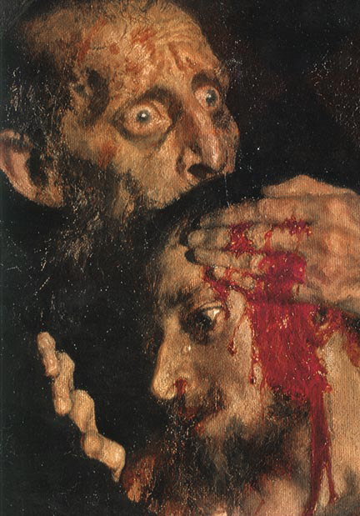

Slide 14
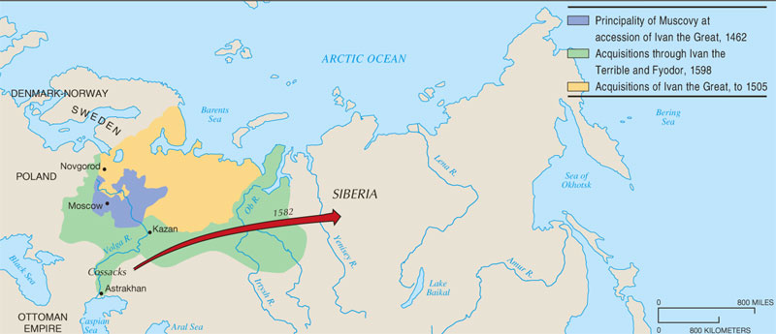
Russian Expansion Under the Early Tsars
From its base in the Moscow region, Russia expanded in three directions (N; W; S); the move into Siberia under Ivan the Terrible involved pioneering new settlements, as the government encouraged Russians to push eastward.

Slide 15
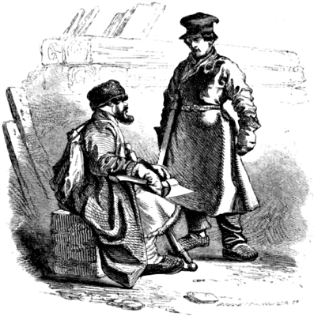
Russian Serfdom
17th and 18th: serfs’ rights decreased
1649: serfdom becomes hereditary
By 1800, ½ people in Russia were serfs.
Struggling Russian economy leads peasants to fall into debt and accept serf status.
Subordinate to western economy
Power of nobles over serfs steadily increased
Way for government to satisfy the nobility and regulate peasants
Serfs paid high taxes, were illiterate and poor causing recurring serf rebellions

Slide 16
Economics in Russia
95% of Russia was rural.
Russian economy produced enough money to support an expanding state and empire
Agricultural methods were highly traditional and limited (old technology)
Serfs were unmotivated because extra production was taken by landlords
No merchant class; most merchants are Westerners stationed in Russia
Government has greater role in economy than West because of lack of merchants

Slide 17
Peter the Great
Peter I (Peter the Great) (reign 1689-1725)
Built up tsarist control over bureaucracy and military; absolute monarch
Chancery of Secret Police
Wanted to move Russia into Western sphere, but didn’t want Russia to become entirely Western
Expanded territory
Shifted focus westward:
Attacked Sweden in the Great Northern War; secured an ice-free port on Baltic Sea and created a navy
Moved capital from Moscow to the new St. Petersburg

Slide 18
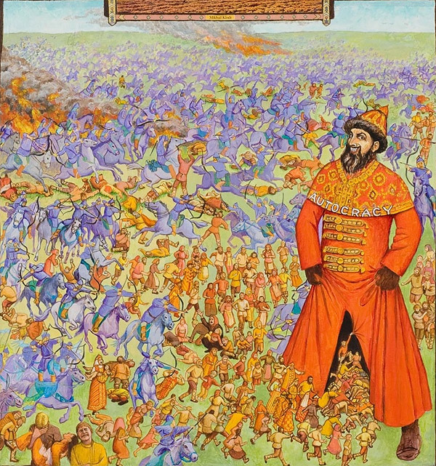

Slide 19
Peter the Great
Opens Russia up to Western influence
Improvements in political organization
Specialization of Russian bureaucracy
Revision of law codes
Improved weaponry and navy
Revised tax system (lower peasant taxes)
Economic developments (inherited a Russia that was largely agricultural)
Built up mining industries so Russia will not need to import metal for weapons
Used Western technology knowledge
Landlords rewarded for using a serf system
Cultural change from his trips to Western Europe
Brought Western science, technology, ballet, gender attitudes
Encouraged Western-styled clothing among boyars
Limited to the elite; no wide-spread cultural change

Slide 20
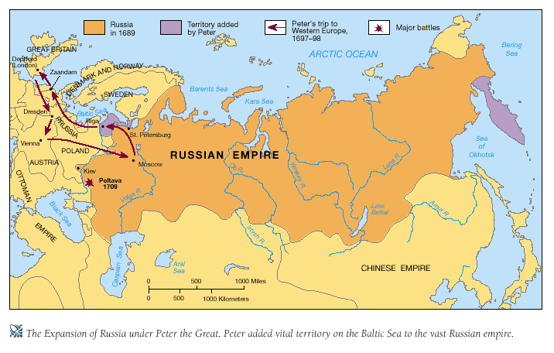
Russia Under Peter the Great
From 1696 to 1725, Peter the Great allowed his country only one year of peace. For the rest of this reign he pursued war. By the end, he had established territory on the southern shores of the Baltic Sea, where he founded the new city of St. Petersburg.

Slide 21
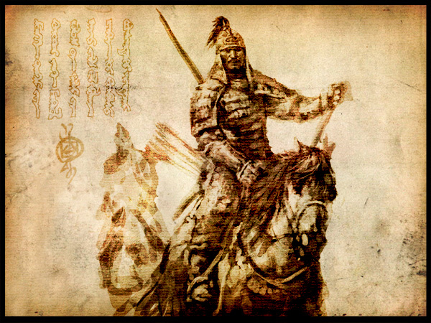
Motivations for Russian Expansion
Motivation #1 = security from the nomadic pastoral peoples
Lived in the grasslands south and east of the Russian heartland
Russians were afraid one of these groups will rise to power like the Mongols
These nomads frequently raided Russia’s neighbors and sold many of them into slavery

Slide 22
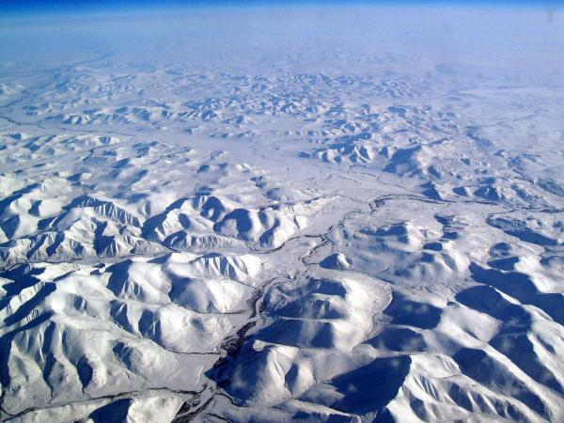
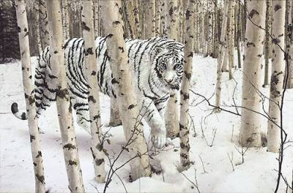
Motivations for Russian Expansion
Motivation #2 = Pelts of fur-bearing animals
To the east across the vast expanse of Siberia
Very valuable and in-demand item
Nickname = “soft gold”

Slide 23
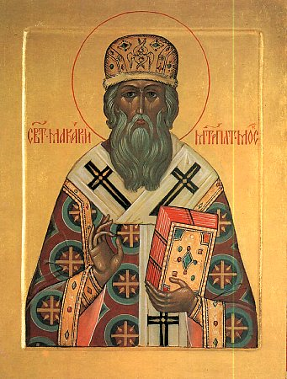
Motivations for Russian Expansion
To Russians, their empire meant:
Defending the Russian frontiers
Enhancing the power of the Russian state
Bringing Christianity, civilization, and enlightenment to “savages”

Slide 24
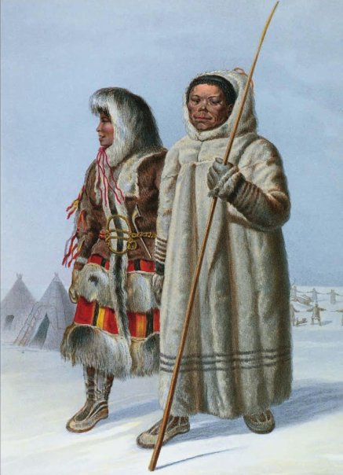
The Russian Empire
Conquered peoples had to swear an oath of allegiance to the grand tsar
Serbians had to pay yasak = tribute paid in cash or valuable goods
New diseases accompanied Russian conquest → ex: smallpox and measles

Slide 25
The Russian Empire
People felt the pressure to convert to Christianity
Tax breaks, tribute exemptions, and the promise of land if they did
Huge influx of Russian settlers to conquered territories within the empire
Began to outnumber the native peoples
Ex: By 1720 = population of Siberia = 70% Russian and 30% native Siberian

Slide 26
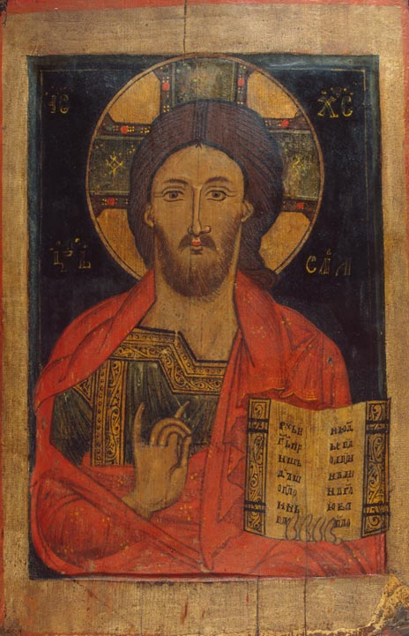
The Russian Empire
Native peoples were “Russified” = adopted the Russian language and culture, converted to Christianity, gave up their traditional hunting & gathering lifestyle, etc.

Slide 27
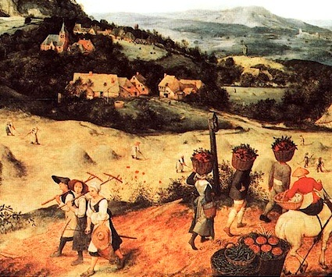
The Russian Empire
Loss of hunting ground and pasturelands to Russian agricultural settlers
Result = native peoples became dependent on Russian markets for crops and luxury goods

Slide 28
The Russian Empire
By the 18th century = Russia became one of the great powers of Europe
Power stemmed from wealth found in: rich agricultural lands, valuable furs, and mineral deposits
Russia became a highly militarized state as well
Russian Empire stayed intact until the collapse of the Soviet Union in 1991

Slide 29
Russian Empire vs. those of other Western European Countries
Russian Empire
Other Europeans
Acquired territories next to them that they had been in contact with for a long time
Acquired territories at the same time that a Russian state was taking shape
“Russia was an empire.”
Acquired territories far away from them that they didn’t know about until 1492
Acquired overseas empires AFTER establishing themselves as solid European states
“The British had an empire.”

