Slide 1
Objective
WWBAT: Discuss the Rise of Russia and what makes a nation-state

Slide 2
Interactive Notebook Setup
12/11/2017
Rise of Russia
This will be one page

Slide 3
Early Russia
Russian Empire Develops

Slide 4
Early Russia
The Golden Horde selected one of the Russian Princes as the Grand Prince, and authorized him to keep the other rulers in line
The position of Grand Prince did not pass from father to son though often lead to extreme abuses of power by certain Grand Princes

Slide 5
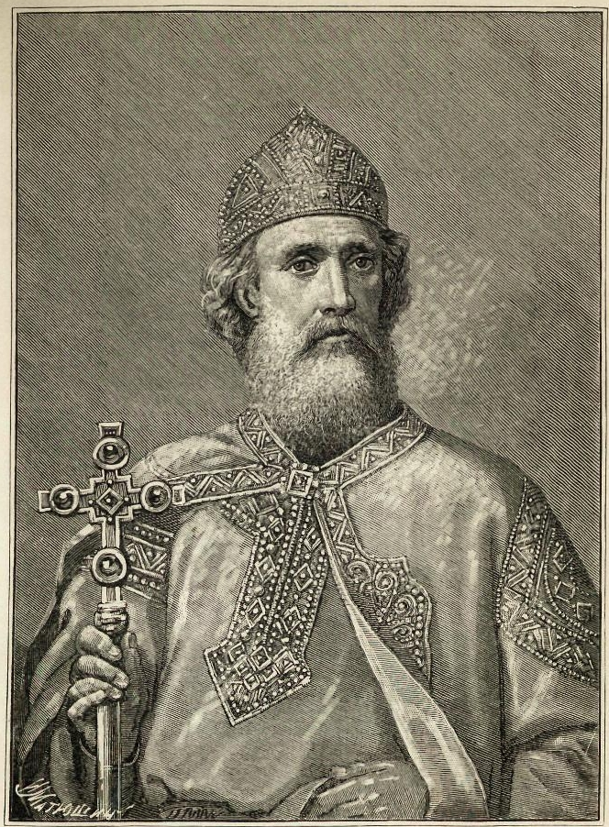
Early Russia
The princes of Moscow gradually proved their loyalty to the Golden Horde
Leaders from Moscow most commonly elected as grand princes as a result Moscow to became the most important Russian city
It was further away from the Golden Horde

Slide 6
Early Russia
The Russians became vassals of the khan of the Golden Horde, a domination which lasted for 250 years
Peasants had to meet the demands from both their own princes and the Mongols
Many peasants sought protection by becoming serfs, changing the Russian social structure until the 19th century

Slide 7
RANDOM REVIEW ATTACK!!!
In China, the development of civil service examinations and a belief in filial piety reflect the influence of
(1) Shinto
(2) Jainism
(3) Confucianism
(4) Buddhism

Slide 8
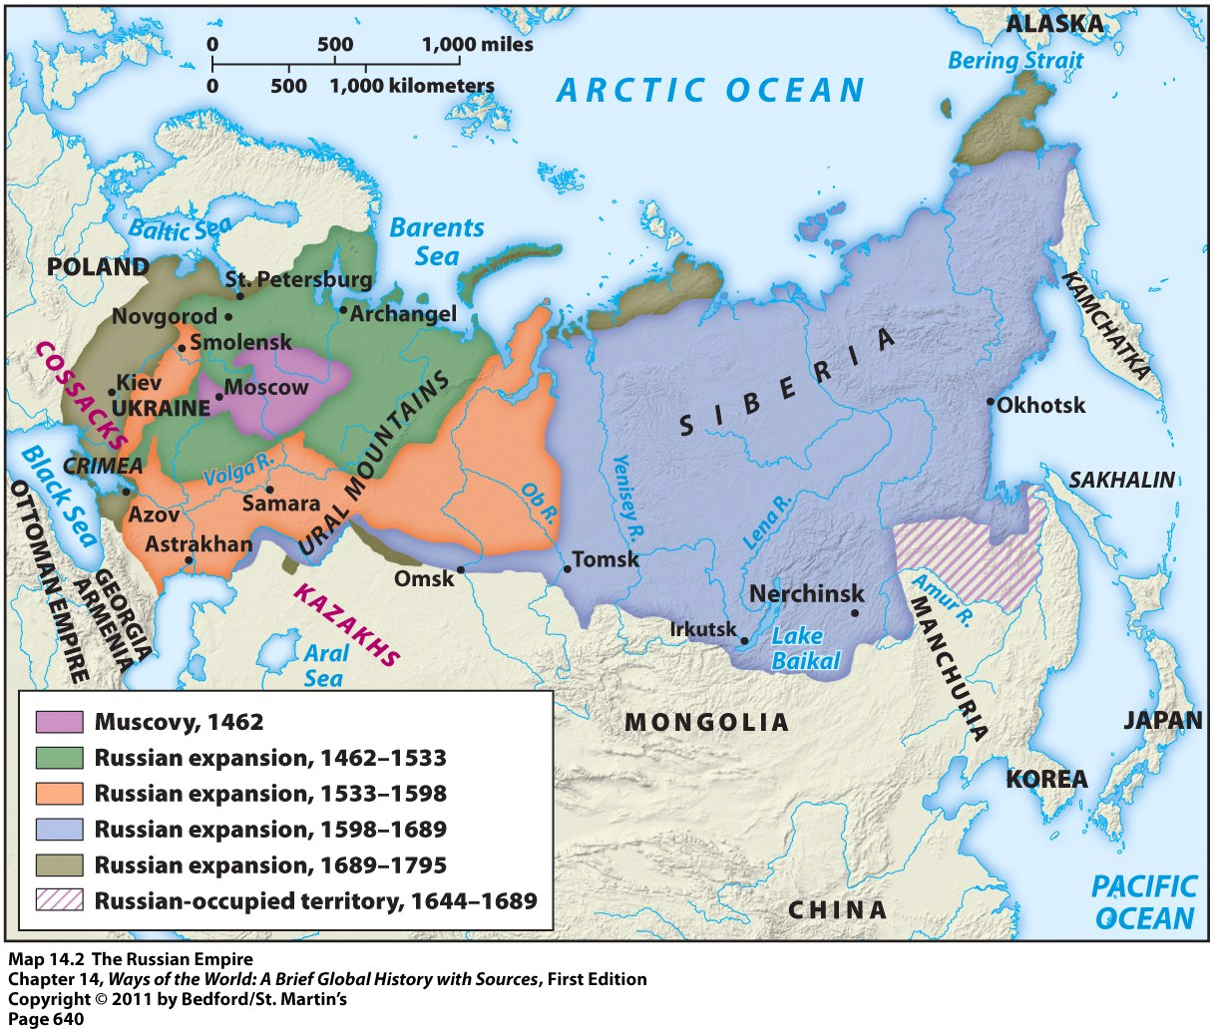
Making the Russian Empire

Slide 9
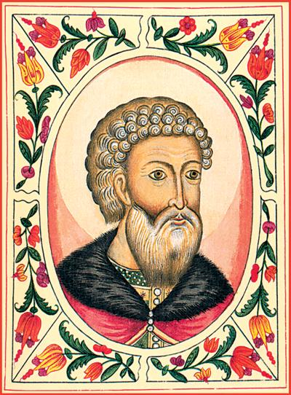
Russian Empire Develops
1480: Russia gained independence from Mongol control (Golden Horde).
Led by Duchy of Moscow and Ivan III
Mongols left Russia weak and isolated in connections, especially from Western Europe.
Mongols reduced vitality of Russian culture.
Ivan III

Slide 10
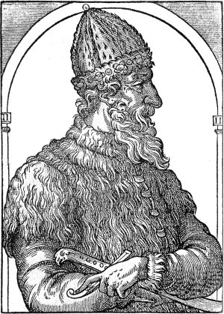
Russian Empire Develops
Russian leaders began to call themselves Tsars(Czars) during the reign of Ivan IV
Established a land empire
Boyars served as advisors and military leaders for princes and Tsars
Often mistrusted by Tsars

Slide 11
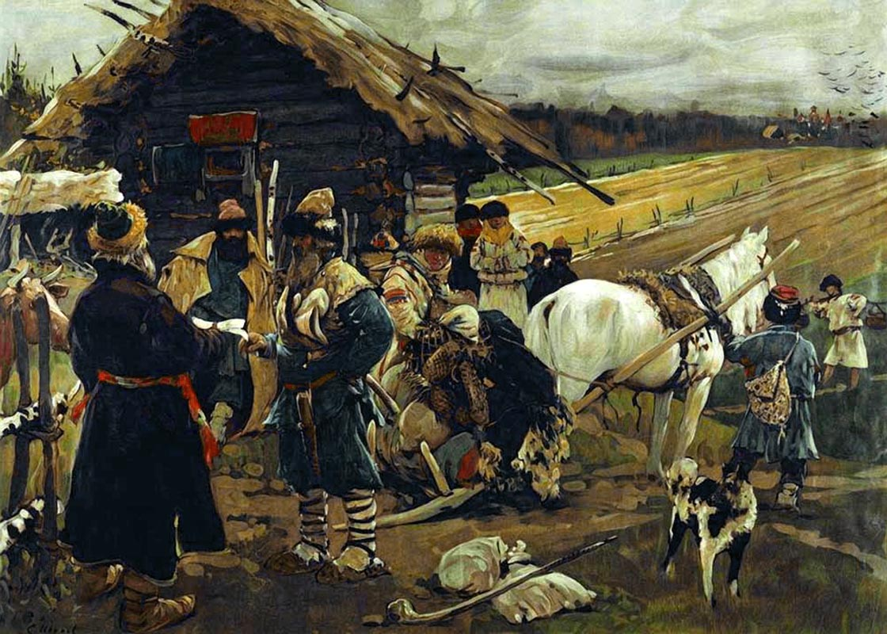
Russian Empire Develops
Expanded into Siberia in the 16th century
Government was very concerned with controlling this newly conquered areas
Government sent peasants to secure the frontier with promises of grain, seed, and farming tools

Slide 12
WHO IS IT?
Considered by believers to be the last prophet of God
God’s revelations to him were recorded in the Quran
Teaching and sayings were recorded in the Hadiths
Converted and unified the Arab people prior to his death

Slide 13
Muhammad
Considered by believers to be the last prophet of Allah
Allah’s revelations to him were recorded in the Quran
Teaching and sayings were recorded in the Hadith
Converted and unified the Arab people prior to his death

Slide 14
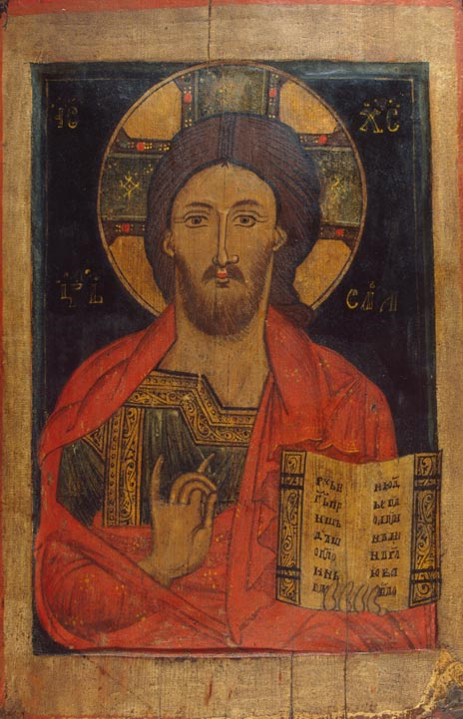
Russian Empire Develops
Native peoples were “Russified” = adopted the Russian language and culture, converted to Christianity, gave up their traditional hunting & gathering lifestyle, etc.

Slide 15
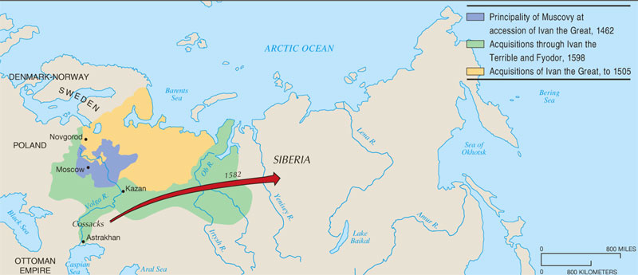
Russian Expansion Under the Early Tsars
From its base in the Moscow region, Russia expanded in three directions (N; W; S); the move into Siberia under Ivan the Terrible involved pioneering new settlements, as the government encouraged Russians to push eastward.

Slide 16
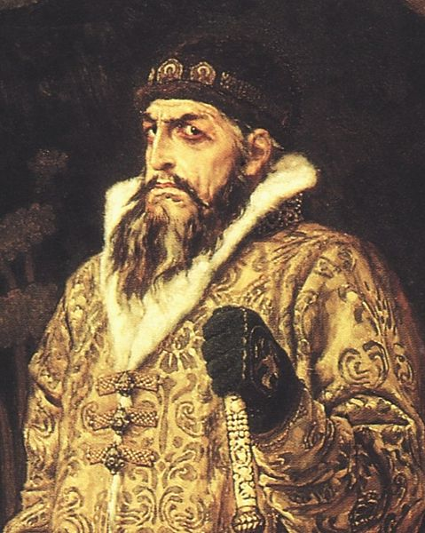
Russian Empire Develops
Tsars establishes absolute monarchy while weakening authority of boyars with violence and deportation
Created special police unit called Oprichnina
Lead the progression from a medieval state to an empire and emerging regional power

Slide 17
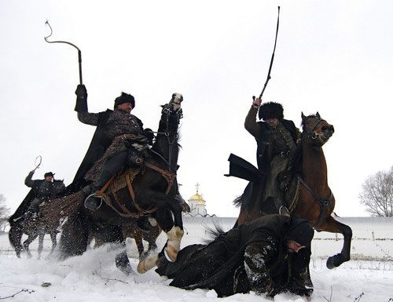

Slide 18
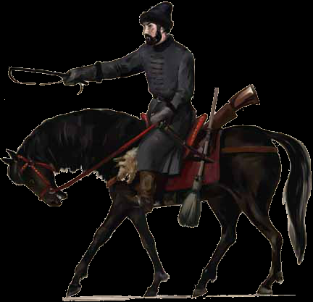

Slide 19
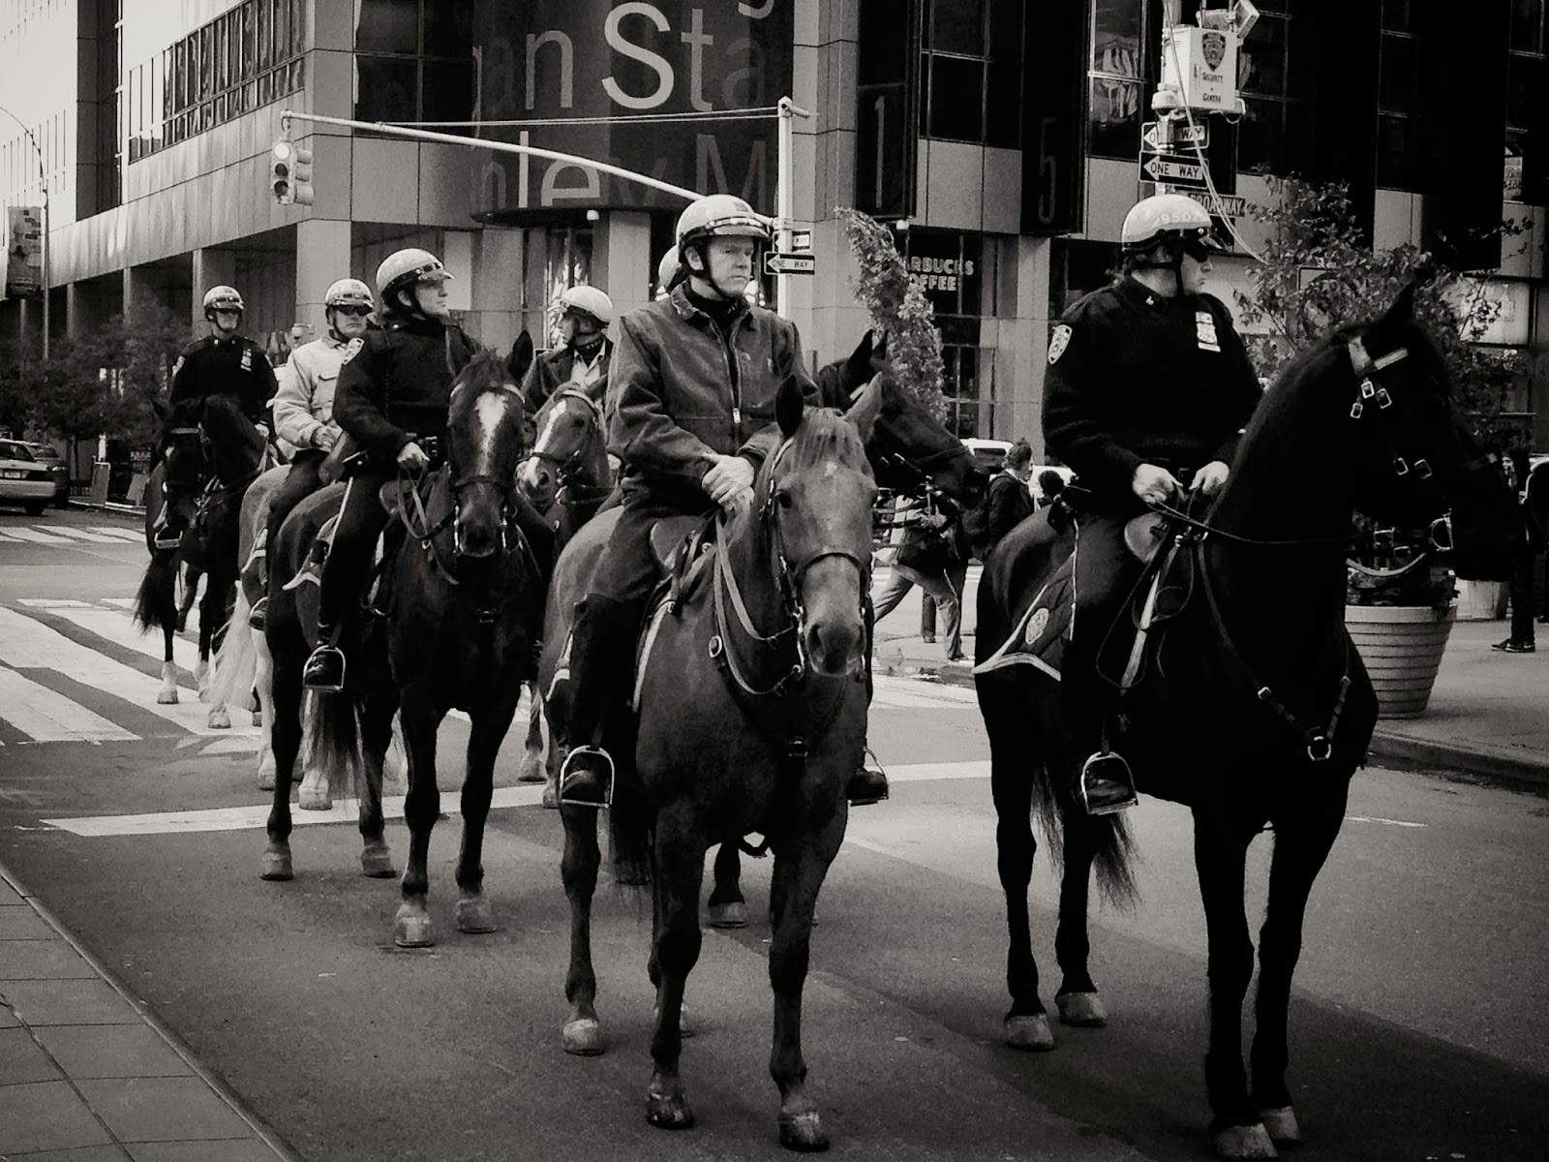

Slide 21
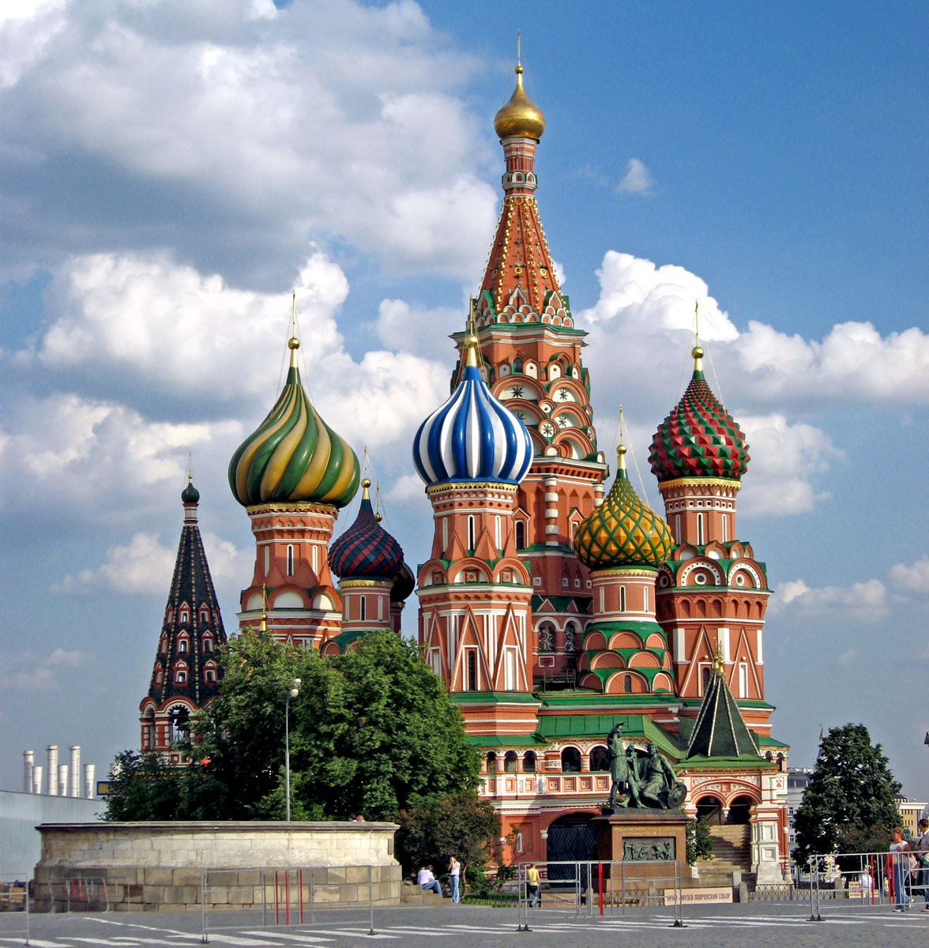

Slide 22
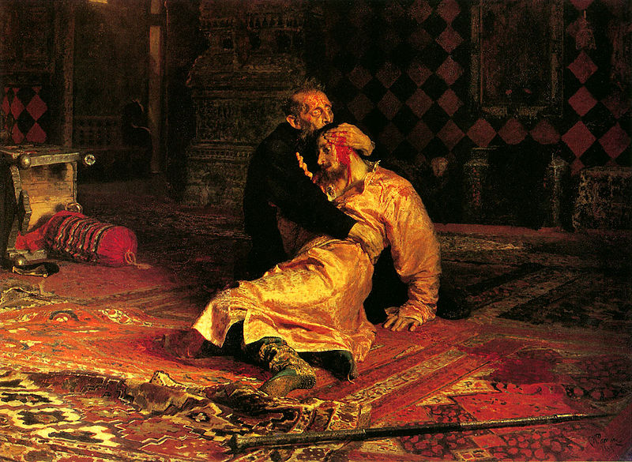

Slide 23
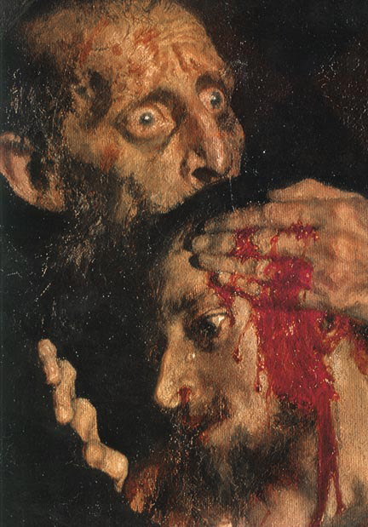

Slide 24
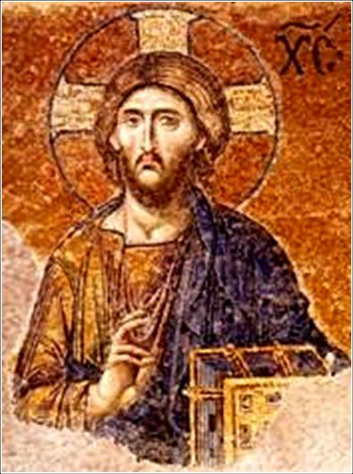
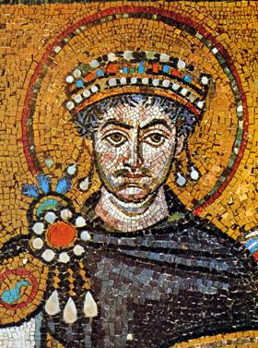
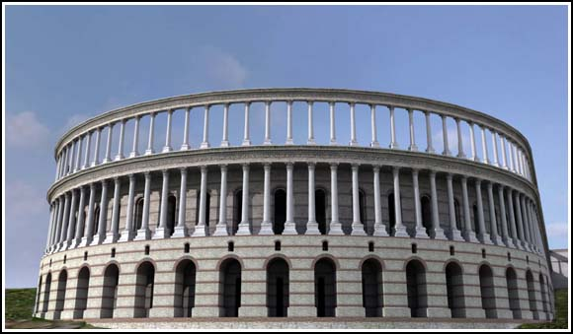
WHAT REGION/EMPIRE MADE THESE?

Slide 25
WHAT REGION/EMPIRE MADE THESE?
THE BYZANTINE EMPIRE!
Byzantine mosaic,
Hagia Sophia,
The Hippodrome
Mosaics of Justinian & Jesus)

Slide 26
NATIONS Questions
What are three nations that you are a part of?
Explain why these are nations and what your connection with each is
Is the United States of America a Nation-State? Why or why not?

