Slide 1
Wait, What else was happening? Bellwork
Russia gained independence from the Golden Horde in 1480 and Ivan the Terrible reign ended in 1584 (1480-1584)
What are three things that were happening in other parts of the world at this time? (CONTEXTUALIZATION!)
Answers Vary

Slide 2
Objective
WWBAT: Introduce the complaints of Luther and the Major teaching of Lutheran Protestantism

Slide 3
Interactive Notebook Setup
3/1/2017
Protestant Reformation
This will be one page

Slide 4
Protestant Reformation
Calvinism
Luther’s Beliefs & Spread of Protestantism
Church of England

Slide 5
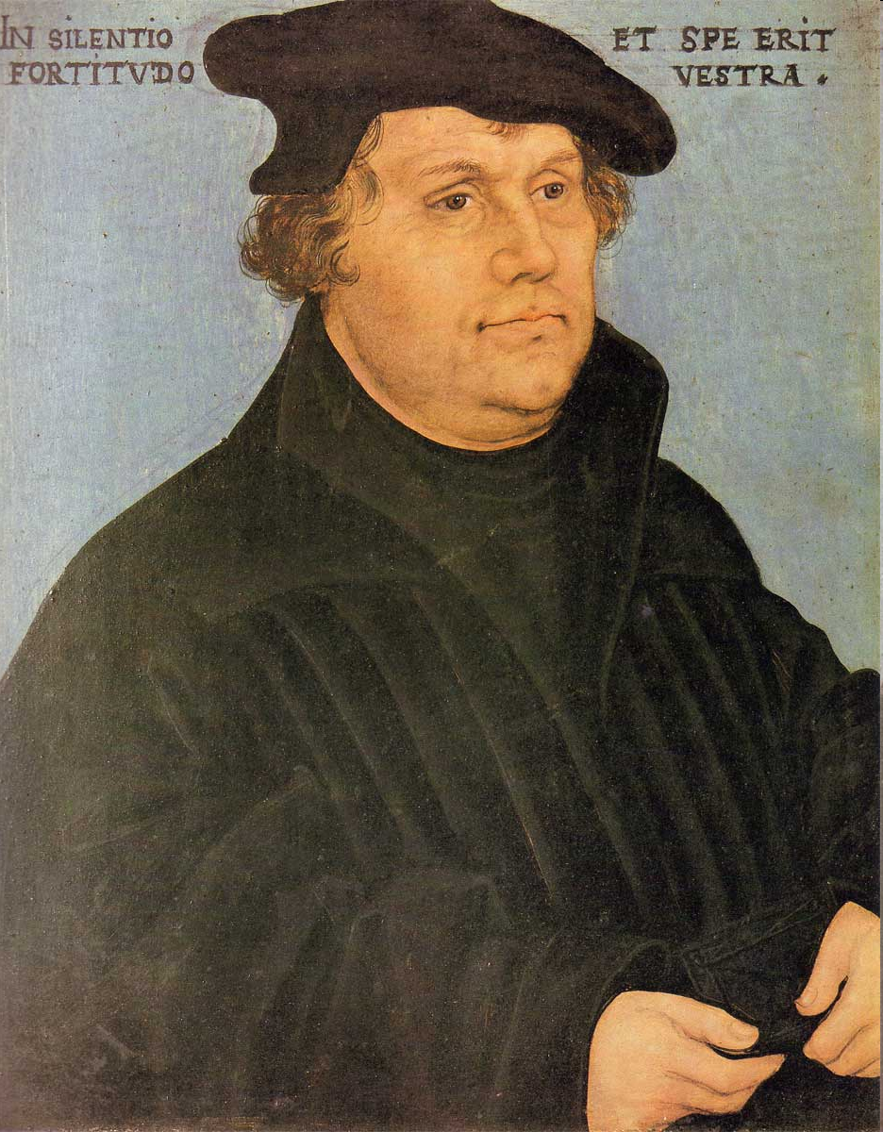
Luther and the 95 theses

Slide 6
The Protestant Reformation
Martin Luther was born in Nov. 1483
He was a scholar at the University of Wittenburg as well as a monk
Luther was a professor and scholar of theology

Slide 7
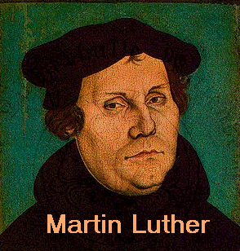
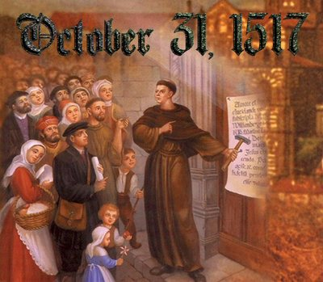
The Protestant Reformation
Luther wrote the “95 Theses on the Power and Efficacy of Indulgences” in October 1517
These were 95 complaints and thoughts about the state of the Catholic Church
The 95 Theses became a rallying point for those people who had problems about the Catholic Church

Slide 8
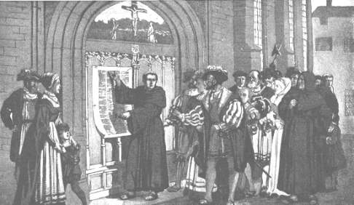
Luther nailing the 95 Theses

Slide 9
Now the Truth
The story of Luther nailing his 95 These to the Church door is exciting and dramatic
…but unfortunately this likely did not happen, at least not how it commonly remembered
Luther wrote his theses in Latin and mailed them to prominent scholars and eventually the Archbishop of his diocese

Slide 10
Think About It
Why do you think the story of Luther nailing his theses to the church door is remembered, even though it is likely untrue?
What value does a story like this filled with drama have?

Slide 11
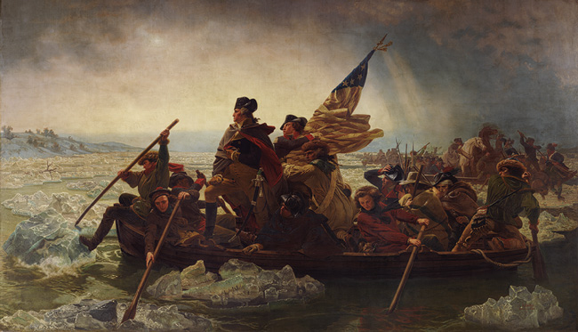

Slide 12
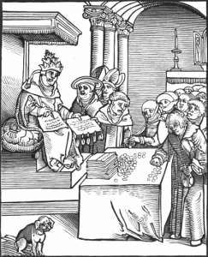
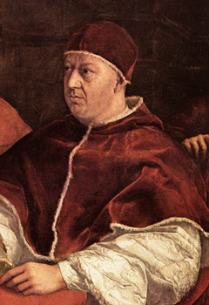
The Protestant Reformation
Martin Luther was critical of abuses by the Catholic Church:
Selling church positions
Luxurious life of the popes
Corruption and immorality of some clergy
The selling of indulgences
Pope Leo X (above) sold church positions and indulgences to raise money to rebuild St. Peter’s Basilica in Rome

Slide 13
The Protestant Reformation
Most importantly Luther questioned the practice of indulgences
Certificates issued by the church that reduced or canceled punishment for a person’s sins
Indulgences could be given in exchange for prayer, good works, and worst of all money

Slide 14
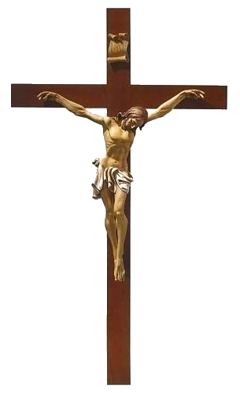
Luther’s Beliefs
Salvation came through faith alone; God’s grace is freely and directly granted to believers
Source of religious authority was the Bible as interpreted by the individual, not the Pope or church leaders
Luther taught of something called the Priesthood of All Believers

Slide 15
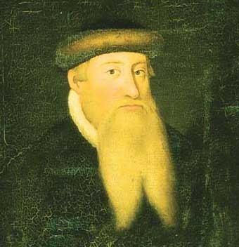
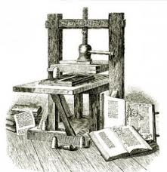
Spread of Protestantism
Reformation thinking spread quickly within and beyond Germany thanks to the invention of the printing press by Johannes Gutenberg
Luther’s 95 Theses, many pamphlets, and his German translation of the New Testament were soon widely available

Slide 16
Spread of Protestantism
Luther translated the Bible into German allowing more people access to its message
As the movement spread to the rest of Europe, it splintered, creating a variety of different Protestant churches
Ex: Lutheran, Calvinist, Anglican, Quaker, Anabaptist, Puritan, etc.

Slide 17
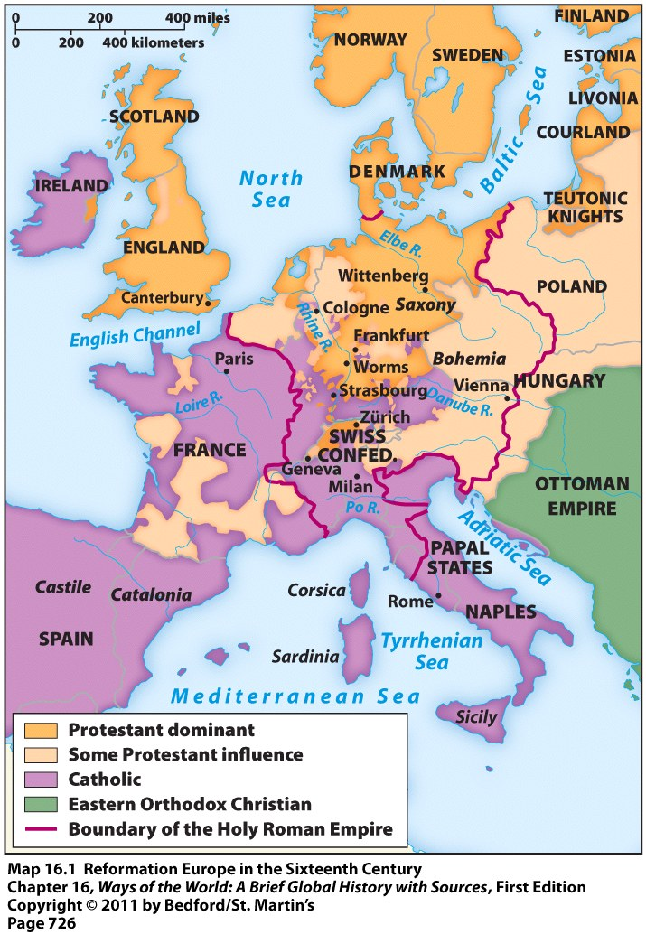
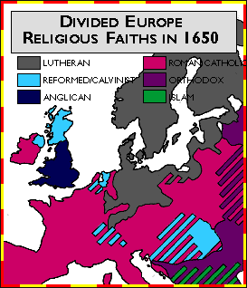
Spread of Protestantism

Slide 18
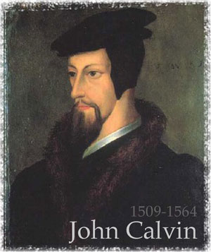
Calvinism
Established by John Calvin in Switzerland
Anti-Catholic
Taught God was all powerful
Preached predestination = God determines the fate of every person

Slide 19
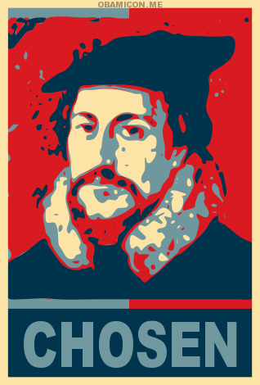
Faith was a signifier of salvation

Slide 20
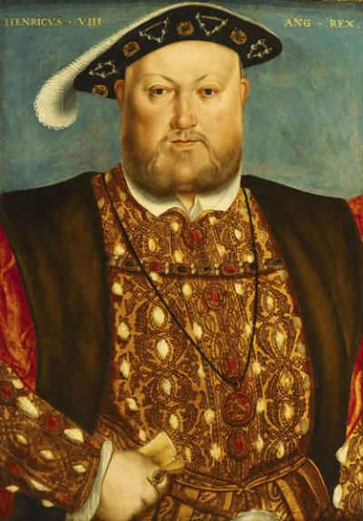
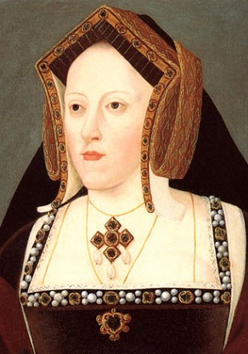
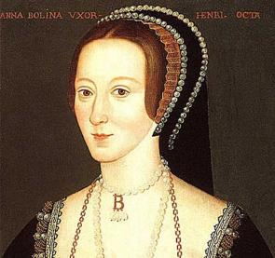
The Church of England
King Henry VIII (ruled from 1509-1547) wanted a divorce from his first wife (Catherine of Aragon)
She had 6 children -- only 1 survived (a girl named Mary)
King wanted a male heir to the throne
King thought Catherine of Aragon was too old and he wanted to marry the young, beautiful Anne Boleyn instead
Problem = the Pope refused to grant the King a divorce

Slide 21
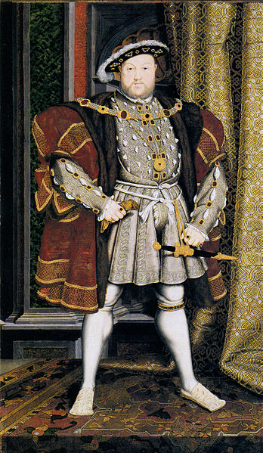
The Church of England
Result = Henry VIII separated England from the Pope and the Catholic Church
Made himself head of the new “Church of England”
Kept Catholic practices & traditions, but denied authority of the Pope
Had supporters of the old religion killed

Slide 22
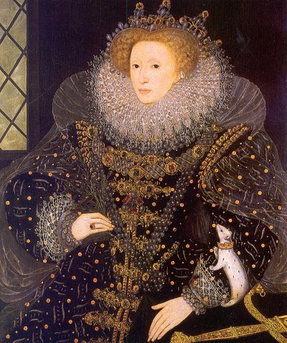
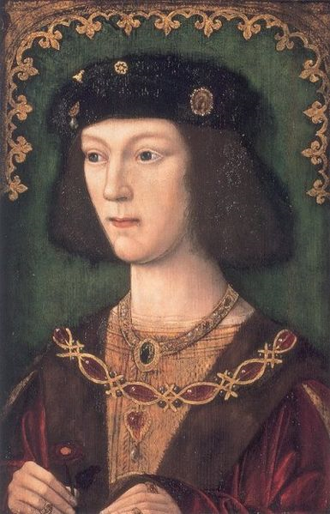
The Church of England
King Henry VIII had the Church of England end his marriage with Catherine & he married Anne Boleyn
Anne bore him a daughter = Elizabeth I
Henry VIII married 4 more times after this & only got 1 son = Edward VI (got the throne, but died in his teens)

Slide 23
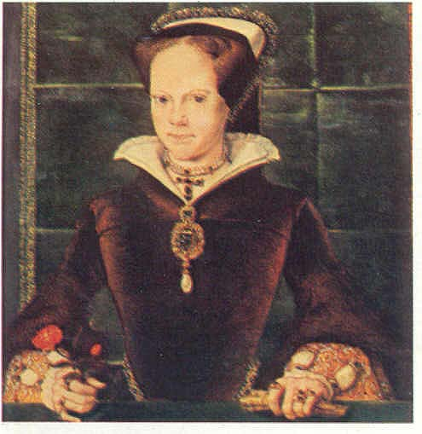
The Church of England
Henry’s daughter Mary tried to restore Catholicism when she became Queen
Burned hundreds of Protestants at the stake
Nicknamed “Bloody Mary”

Slide 24
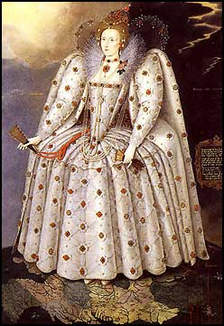
The Church of England
Mary’s sister Elizabeth I became Queen when Mary died → blended features of the Church of England and Catholicism
Religion called Anglicanism
Pleased most people
Radical Protestants called “Puritans” wanted to purify the English Church of all its Catholic elements → ended up leaving for North America where they could have more religious freedom

Slide 25
Thesis Thursday
Write a thesis statement for the following prompt on a half sheet of paper
Compare and contrast the Tran-Saharan Trade Network and the Indian Ocean Trade Network
CORRECT ANSWER: THESIS ACTIVITY CORRECT ANSWER: THESIS ACTIVITY

Slide 26
Objective
WWBAT: Discuss the spread of Protestantism and introduce Main ideas of Calvinism and the English Reformation

Slide 27
Reformation Bellwork
What creation helped spread the information about Luther’s idea?
Guttenberg Printing Press
What is the most important belief of Calvinism?
Predestination
What was the biggest issue for Henry VIII had with the Catholic Church?
The authority of the pope

Slide 28
Objective
WWBAT: Gather information about the political impacts of the Reformation in Europe

Slide 29
DIET????
A formal general assembly of the princes or estates of the Holy Roman Empire

