Slide 1
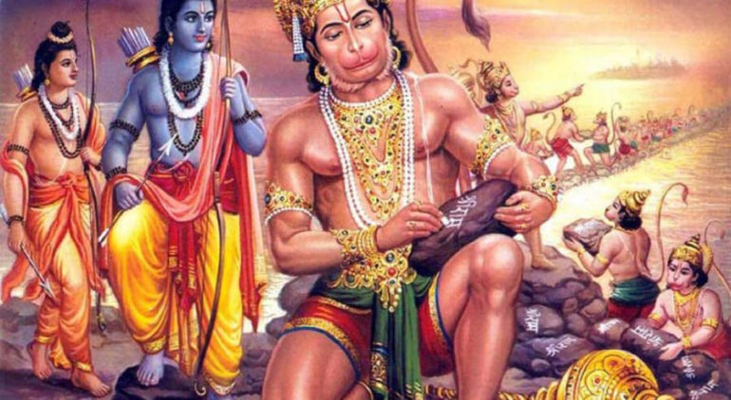
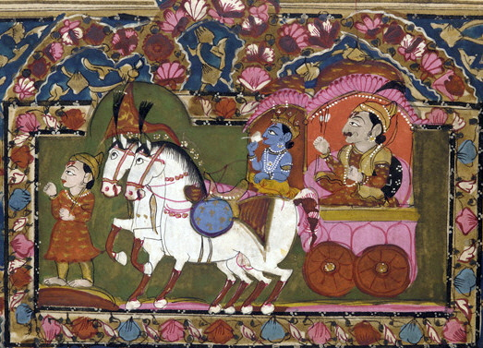
Hindu art and architecture
Epic poetry was very important, carrying influence from the time of the Vedic Indian
Focused on stories of the divine and actions of warriors/ kings courts
Also reinforced the caste system and dharma

Slide 2
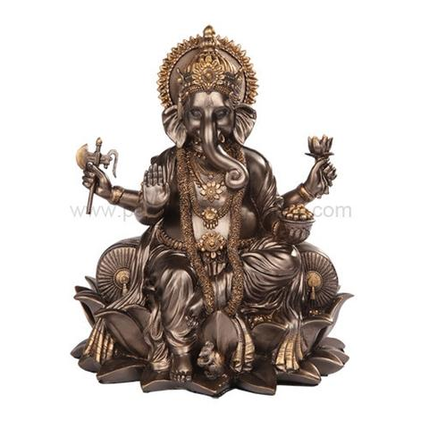
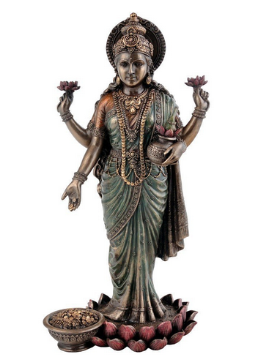
Hindu art and architecture
Painting/Statues have human and divine characteristics
Represents the idea that Brahmin(the divine!) is in all things

Slide 3
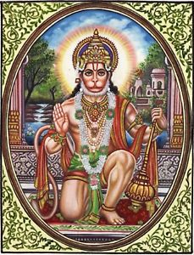

Slide 4
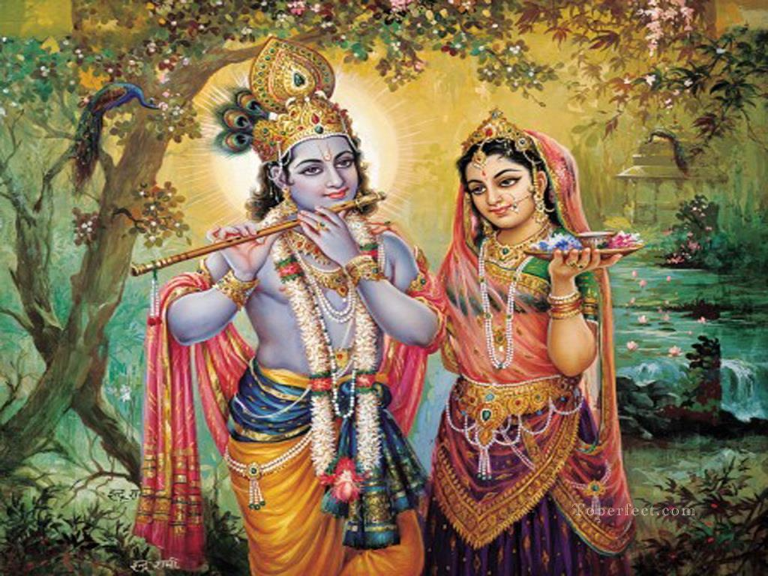

Slide 5
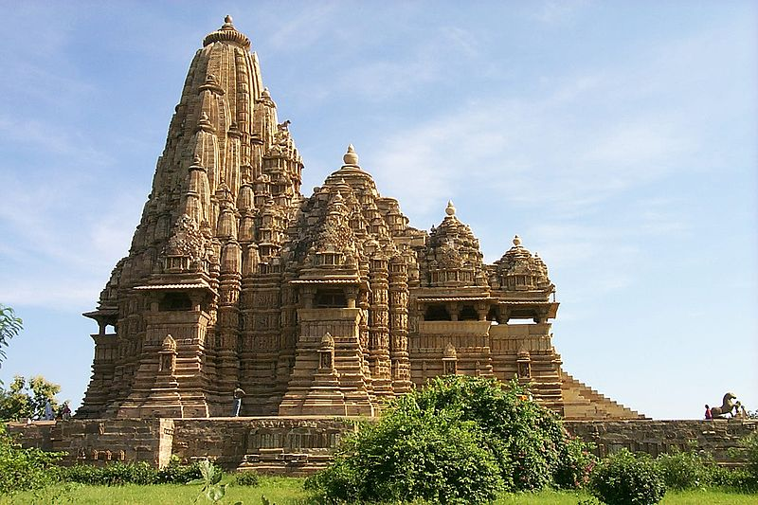
Hindu art and architecture
Temples=multiple rooms/areas and repetition of shapes, some more holy than others
Represent the caste system and cyclical religious beliefs

Slide 6
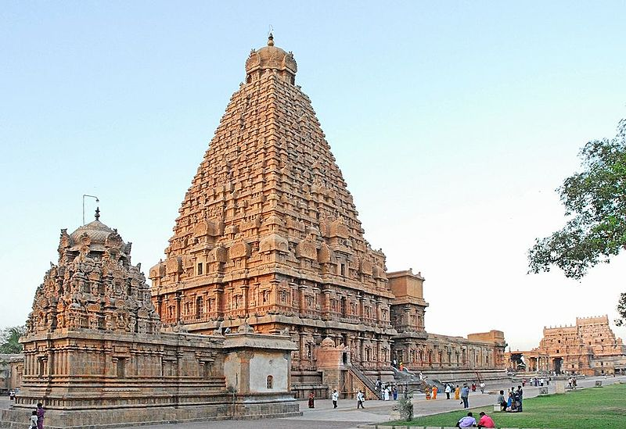

Slide 8
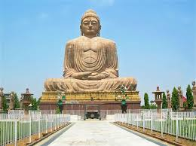
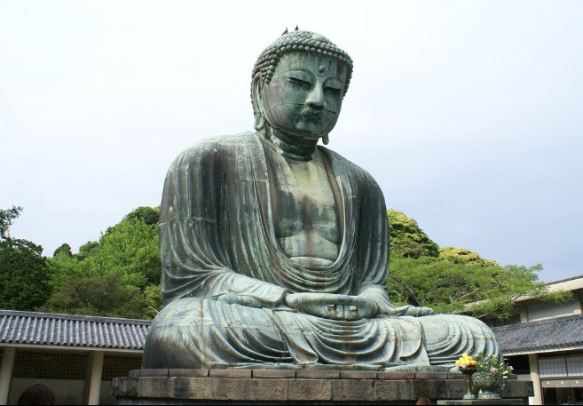
Buddhist art and architecture
Statues and painting depict Buddha after Enlightenment, yet very human

Slide 10
Buddhist art and architecture
Stupas=places of worship:
Symbolize the buddha meditating
Gates at cardinal points and other connections to nature/universe

Slide 11
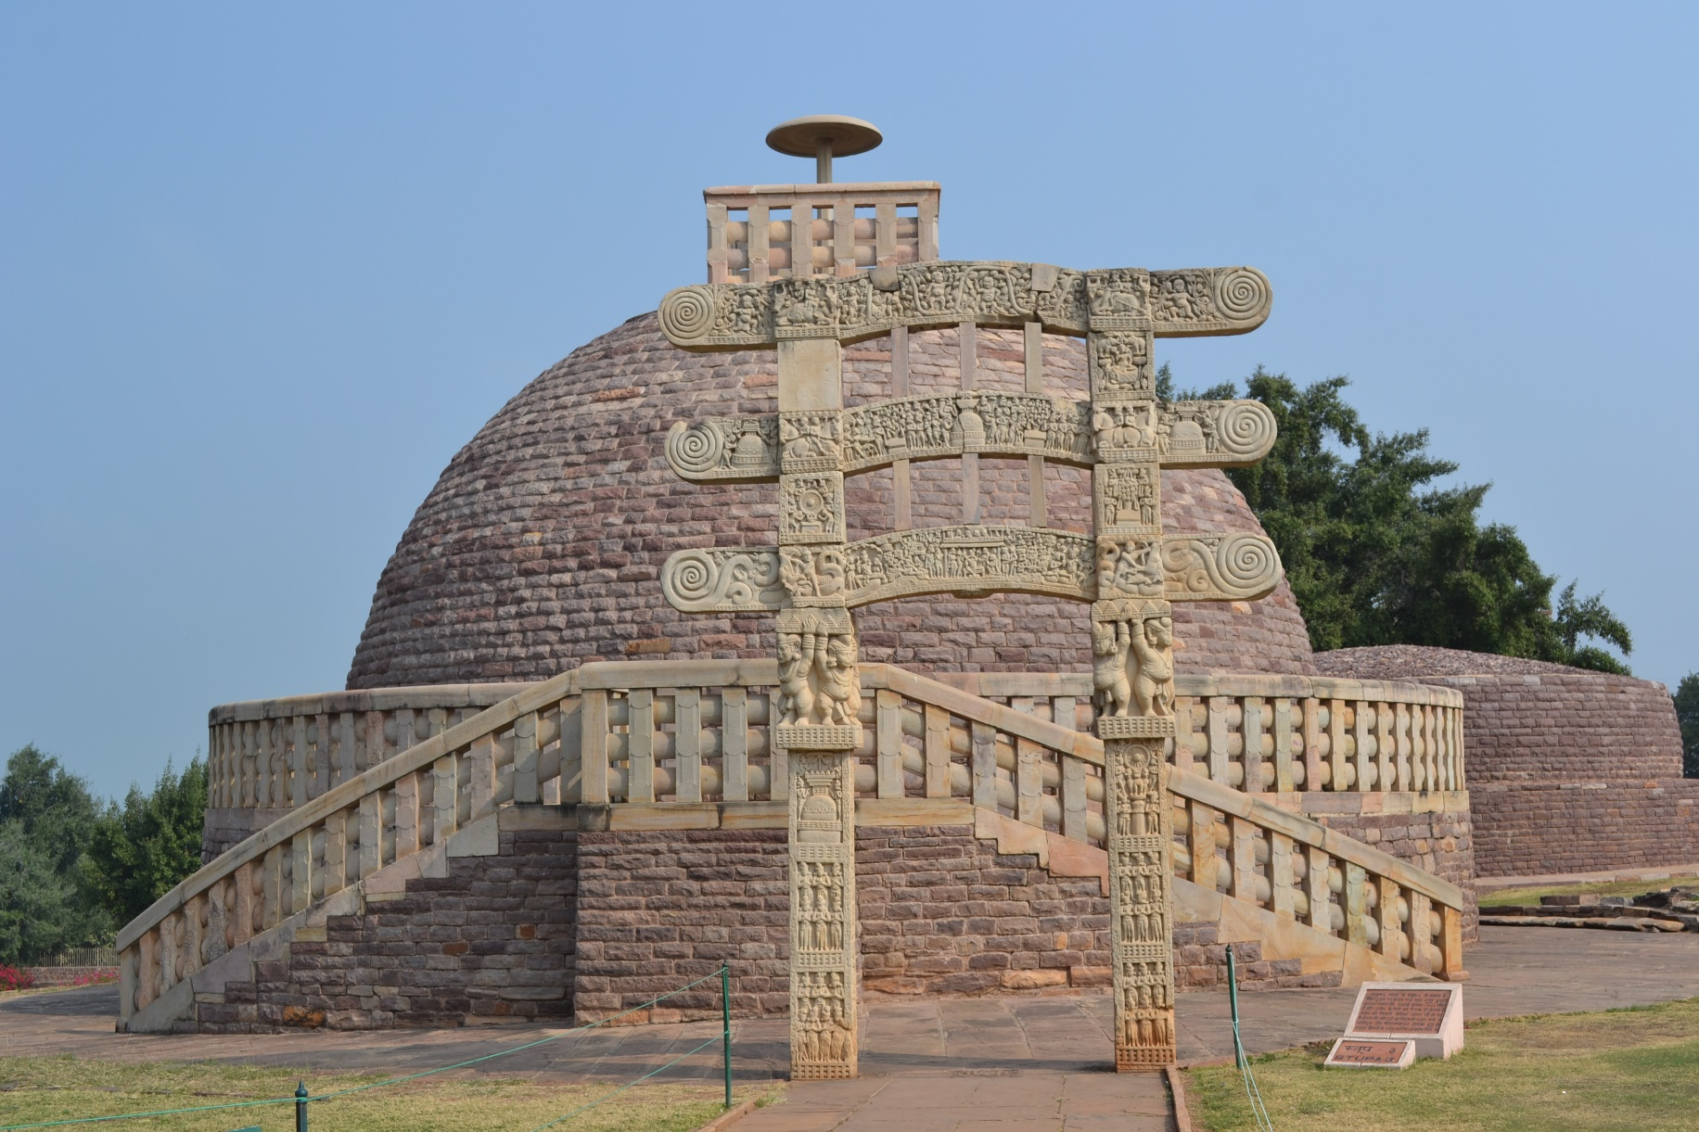

Slide 12
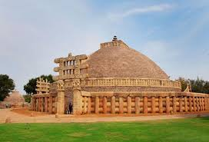
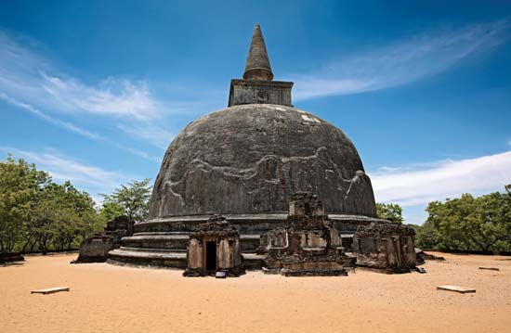

Slide 13
Monasteries

Slide 14
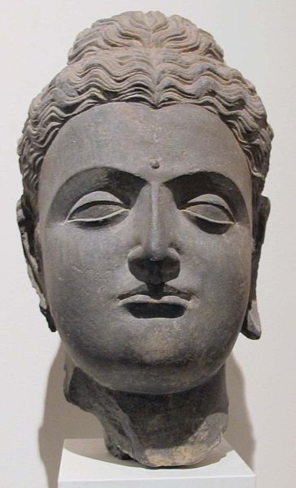
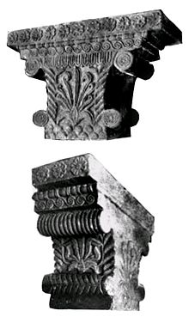
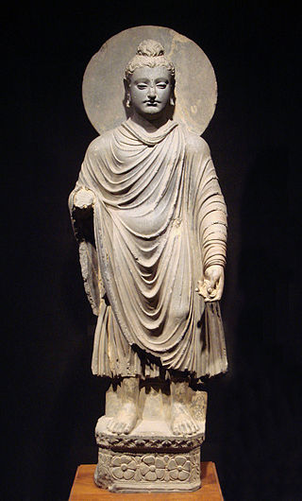
Buddhist art and architecture
Sculpture blended with Hellenistic art
Called Greco-Buddhism

Slide 15
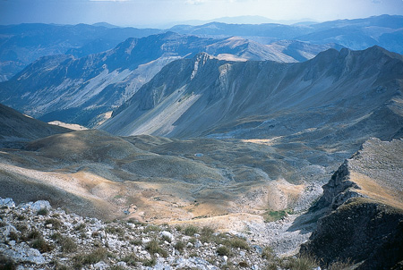
Greco-Roman Art and Architecture
3/4 of Greek mainland = mountains
Protected Greeks from foreign invaders/attackers
Kept Greeks isolated from other communities
Prevented Greeks from uniting under one government
Between the mountain ranges = fertile plains good for farming

Slide 16
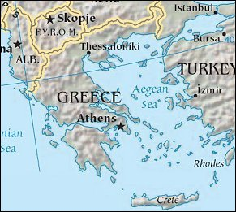
The Aegean Area
Ancient Greece included the Balkan Peninsula & small rocky islands in the Aegean Sea

Slide 17
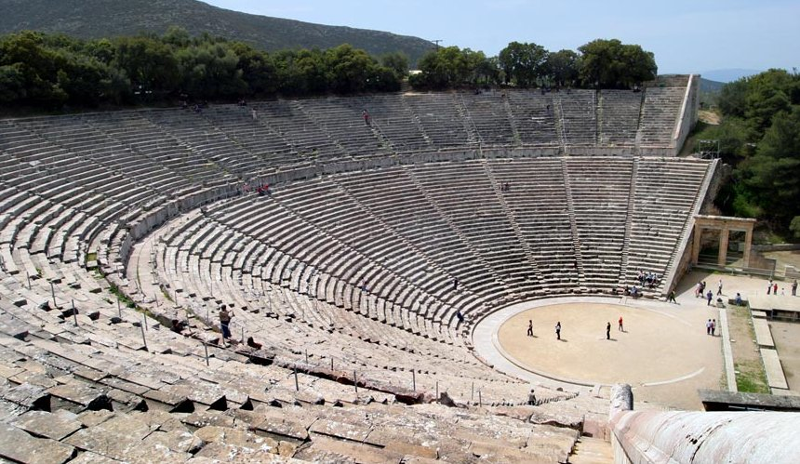
Background
Mild climate
So people spent much of their time outdoors
Meetings held in public squares
Teachers met students in public gardens
Actors performed in open theaters

Slide 18
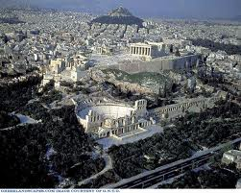
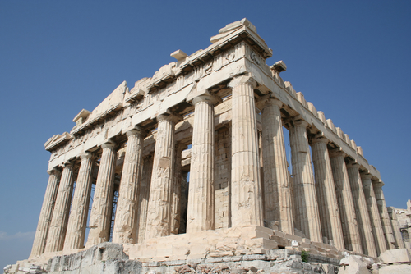
Greco-Roman Art and Architecture
City-States called polis
Polis included: a city and the surrounding villages, fields, and orchards
At the center of the city = an Acropolis = fortified hill
On top of Acropolis = temple of the local god or goddess
Foot of Acropolis = the agora = public square

Slide 19
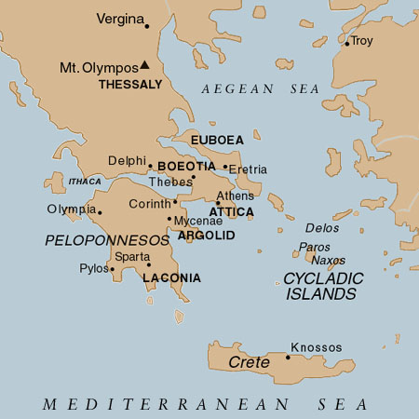
City-States Characteristics/Accomplishment
Each polis developed independently, but shared certain features with other city-states

Slide 20
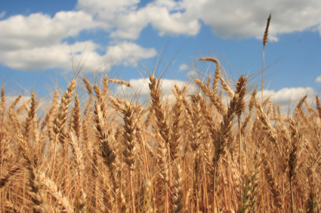
Greco-Roman Art and Architecture
Increase in population after the “dark ages” --> farmers couldn’t grow enough grain to feed everyone
Each polis sent out groups of people to set up colonies
Colonists sent grain back to the “parent city”
Colonies allowed polis to gain wealth and focus on arts and science

Slide 21
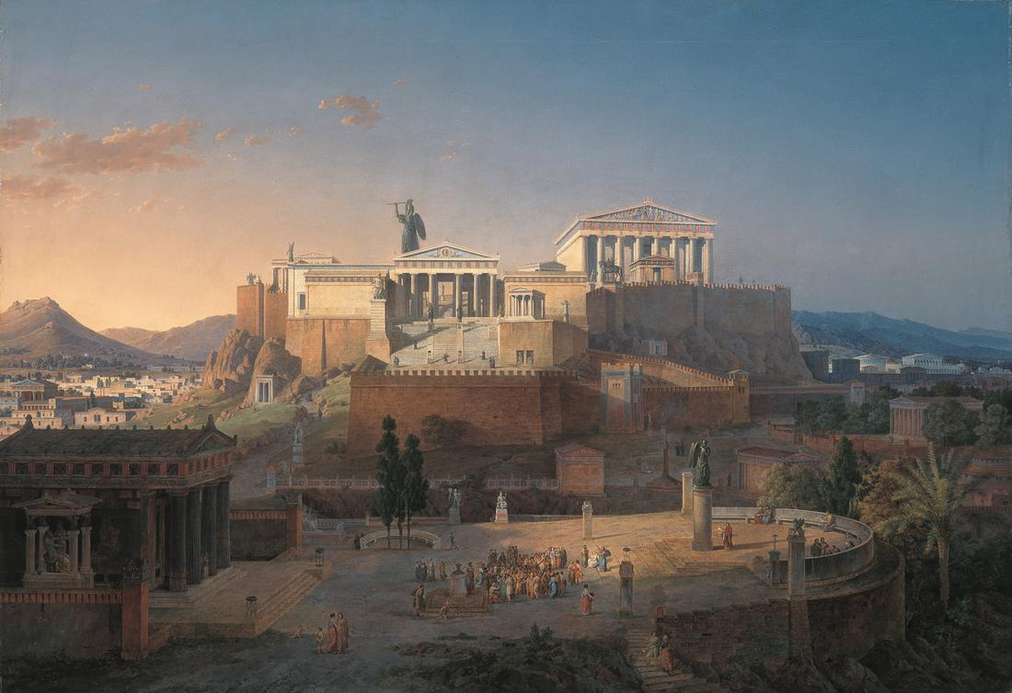
City-States Characteristics/Accomplishment
EXAMPLE: ATHENS
Athens had major trade markets, for local and international trade
Athens build major temples to attract pilgrims of religious worship
Athens was the governing center of its polis

Slide 22
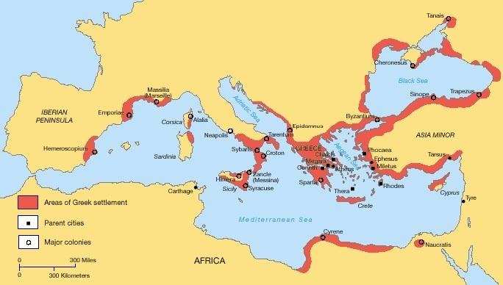

Slide 23
Greco-Roman Art and Architecture
Theater and history were most important form of literature
Celebrated values and glory of polis/Rome
Theater was public and outdoors
Theater and history was used to establish and reinforce values of Greece and Rome

Slide 24
Greco-Roman Art and Architecture
The Greeks believed the world to be rational & guided by natural laws that dictated order
Philosophers worked to explain this
Major philosophers were:
Socrates
Aristotle
Plato

Slide 25
Greco-Roman Art and Architecture
Art/Architecture reflected their values of symmetry, rationalism, and proportionality
Greek statues and painting do not so much depict an individual person as they do celebrate an ideal form
FOR EXAMPLE:
Most temples and statures kept proportions of 6x1

Slide 26
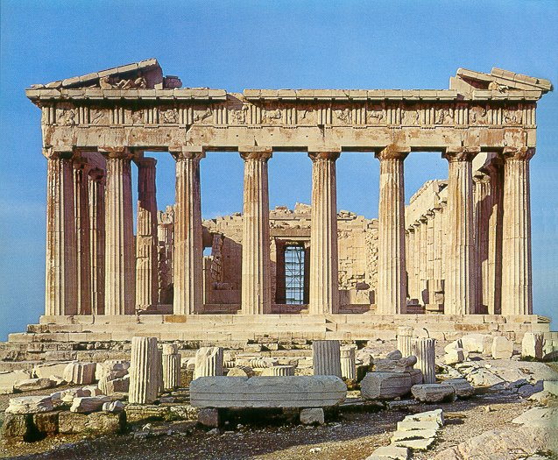
Parthenon
Architecture

Slide 27
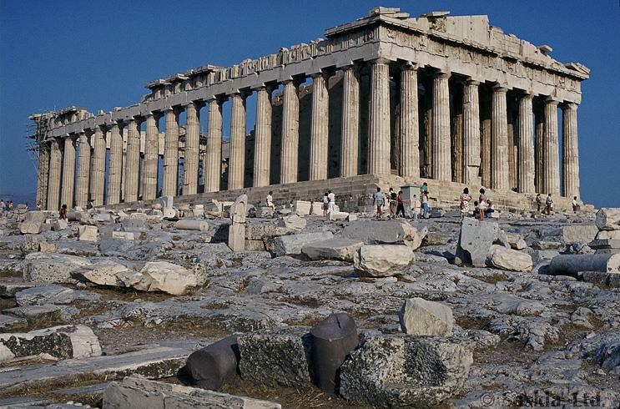
Architecture
Parthenon

Slide 28
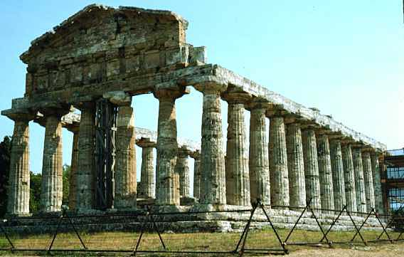
Architecture
Doric: Temple of Athena

Slide 29
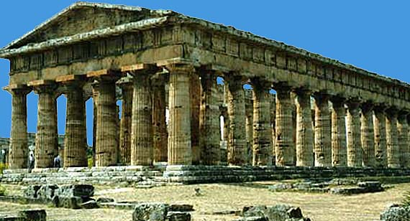
Doric: Temple of Hera

Slide 30
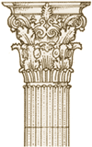
Corinthian

Slide 31
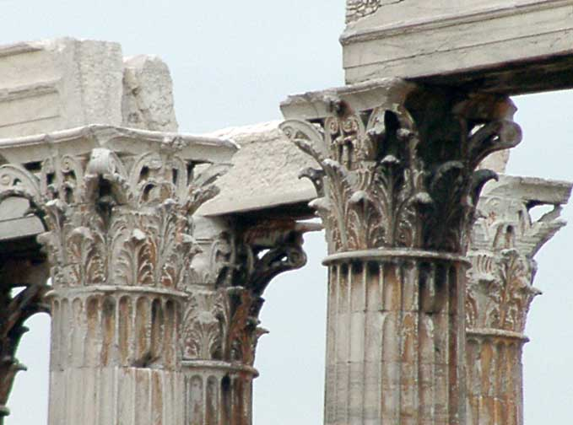
The temple of Zeus at Athens Detail

Slide 32
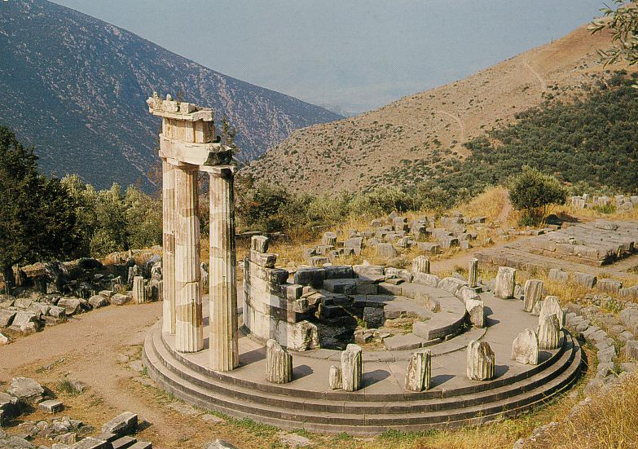
Architecture
Delphi

Slide 33
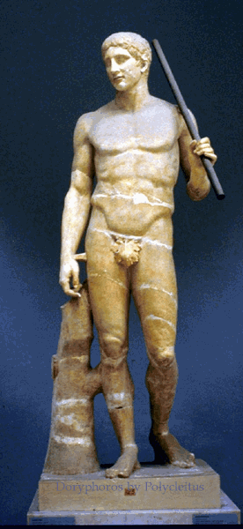
Polyclitus Doryphoros (Spear carrier) 440 BCE

Slide 34
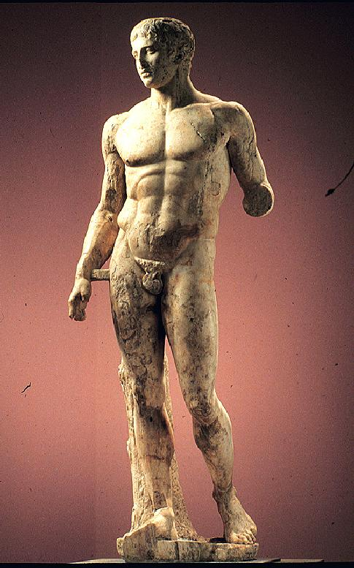
Polyclitus (Roman Copy)

Slide 35
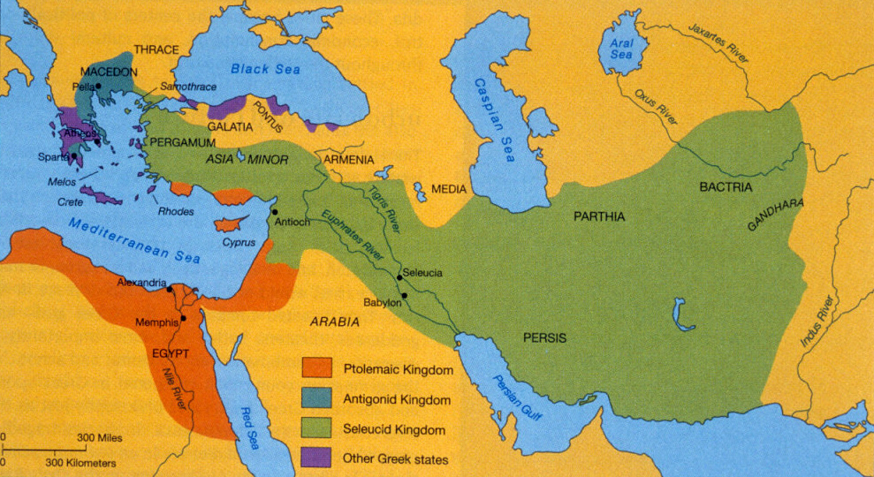

Slide 36
Greco-Roman Art and Architecture
Greek language and culture spread in the lands Alexander had conquered
Greek (Hellenic) ways of life mixed with Persian culture of Middle East= Hellenistic Culture
Greek+Persian/Indian Culture=Hellenistic Culture
Hellenistic culture was concentrated in cities

Slide 37
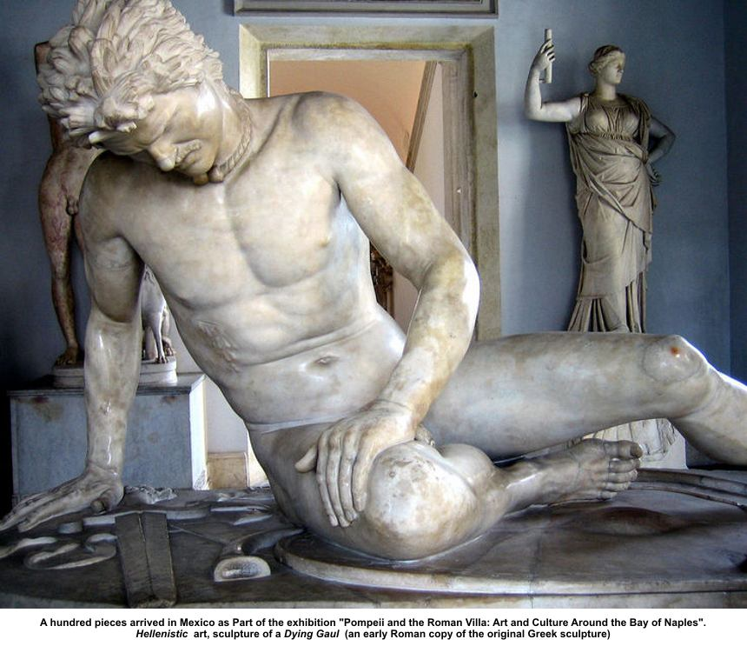
Greco-Roman Art and Architecture
Art often showed people in the grip of emotions
Wrote comedies about everyday life

Slide 38
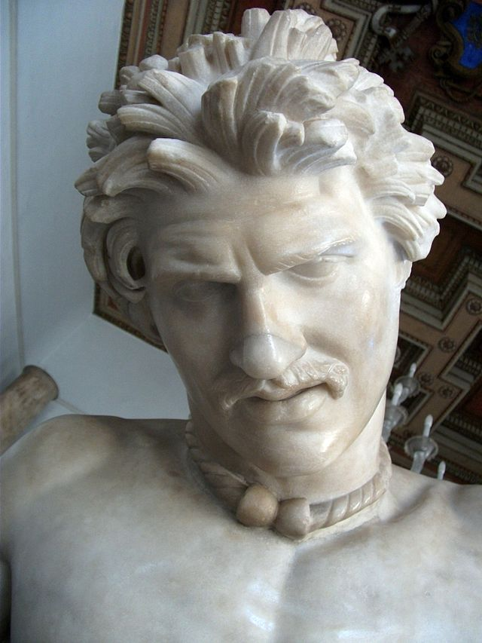
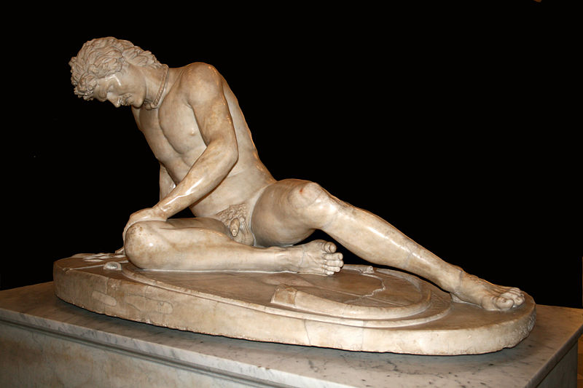

Slide 39
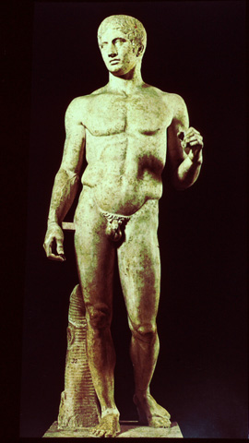
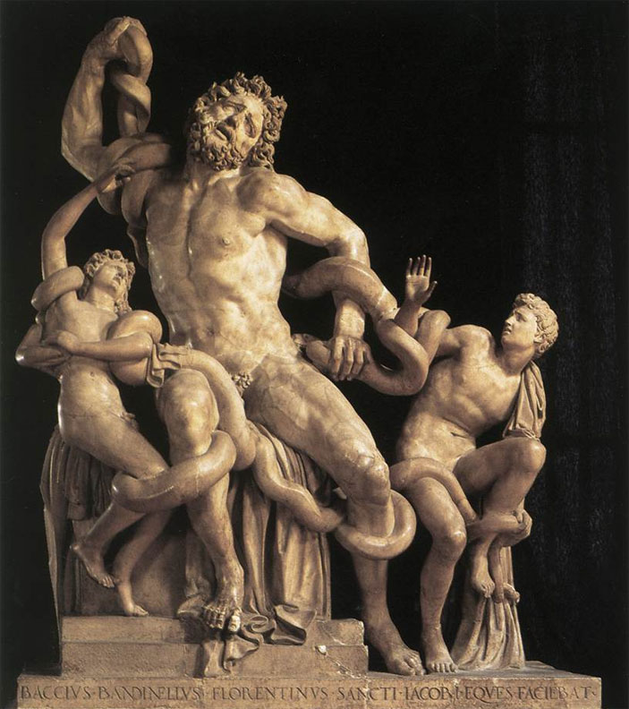

Slide 40
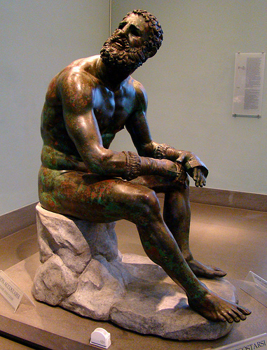

Slide 41
Greco-Roman Art and Architecture
Roman art thrived during the Pax Romana
Rome:
Painting and statues focused on realistic human form/stoic beliefs
Architecture focused on displaying power of empire and PRACTICAL public use
Theaters, public baths, arenas, temples, ect
Notable architectural features:
Arch, dome, concrete, ect

Slide 42
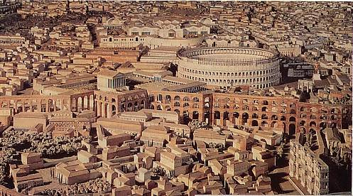
Model of Rome

Slide 43
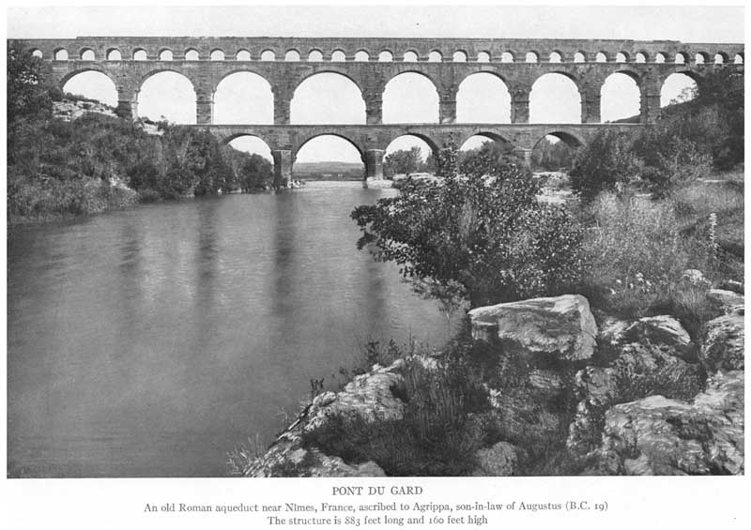
Greco-Roman Art and Architecture
One of the Romans’ greatest engineering feats was channeling water to their cities throughout the Empire
Roman engineers built the aqueducts to move the cold, clear water from springs to towns; sometimes they would be up to 250 miles long

Slide 44
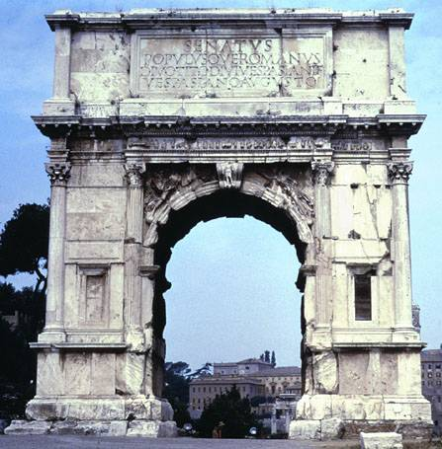
Triumphal Arch of Titus

Slide 45
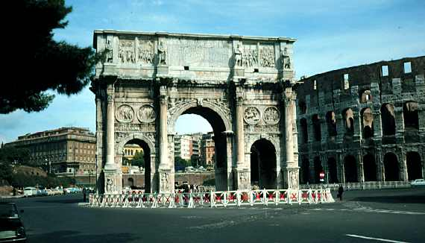
Arch of Constantine

Slide 46
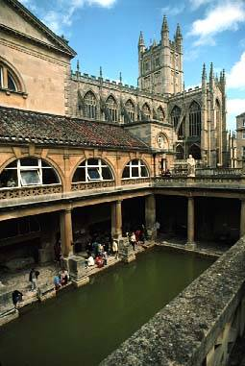
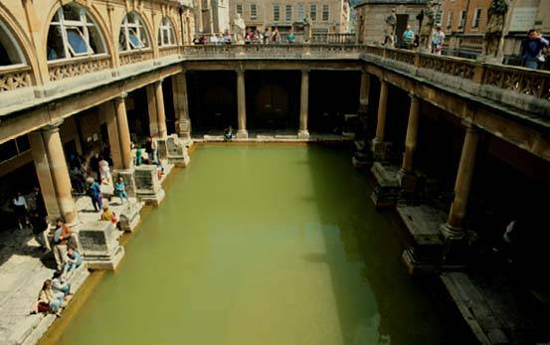
Roman Bath in England

Slide 47
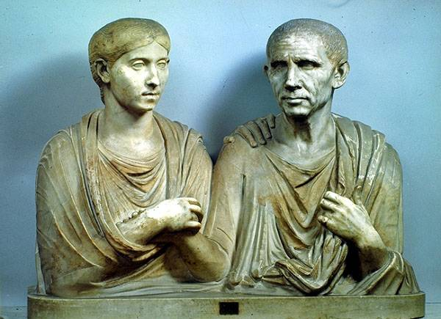
Republican Couple
Realistic portraits – like Hellenistic Greek style.

Slide 48
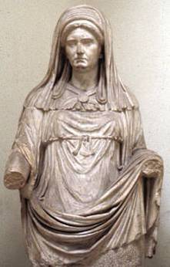
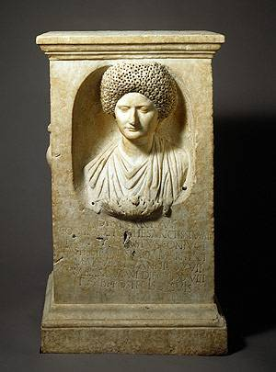
Roman Citizens

