Slide 1
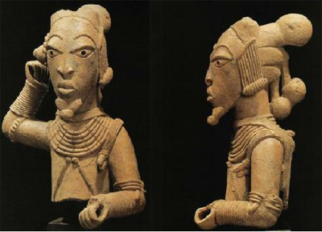
Causes of Migration - bantu
Bantu “the people” (sub-Saharan Africa)
Population pressure (over population)
agricultural advancements
climate change (desertification)
Population growth due technology (iron metallurgy)

Slide 2
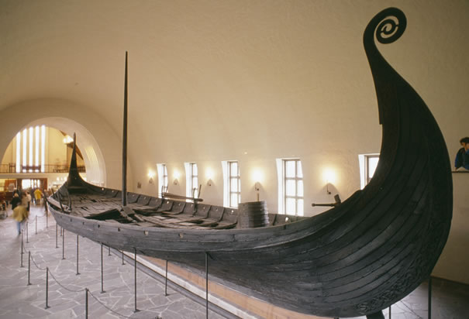
Causes of Migration- vikings
Vikings “Northmen or Norsemen” (Scandinavia)
Population pressure due to climate change (food shortage)
Love of adventure and desire for treasure
Superiority on the seas – shipbuilding techniques and seafaring skills
Vikings did not seek new land to settle initially; rather to raid and plunder
Gokstad ship, Norway

Slide 3
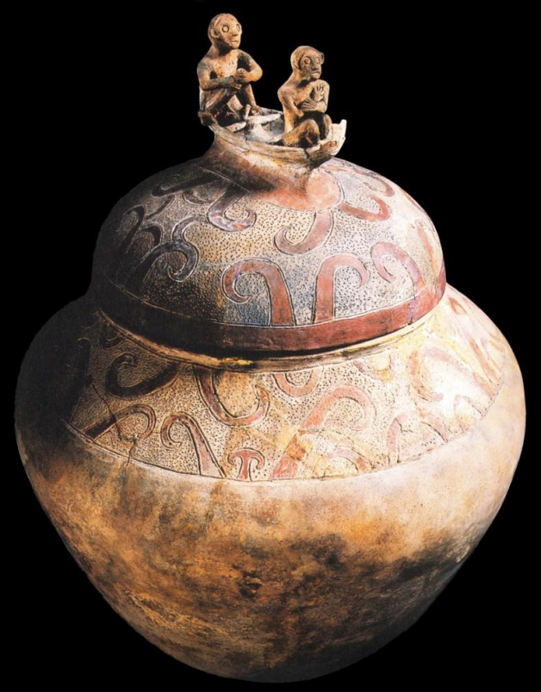
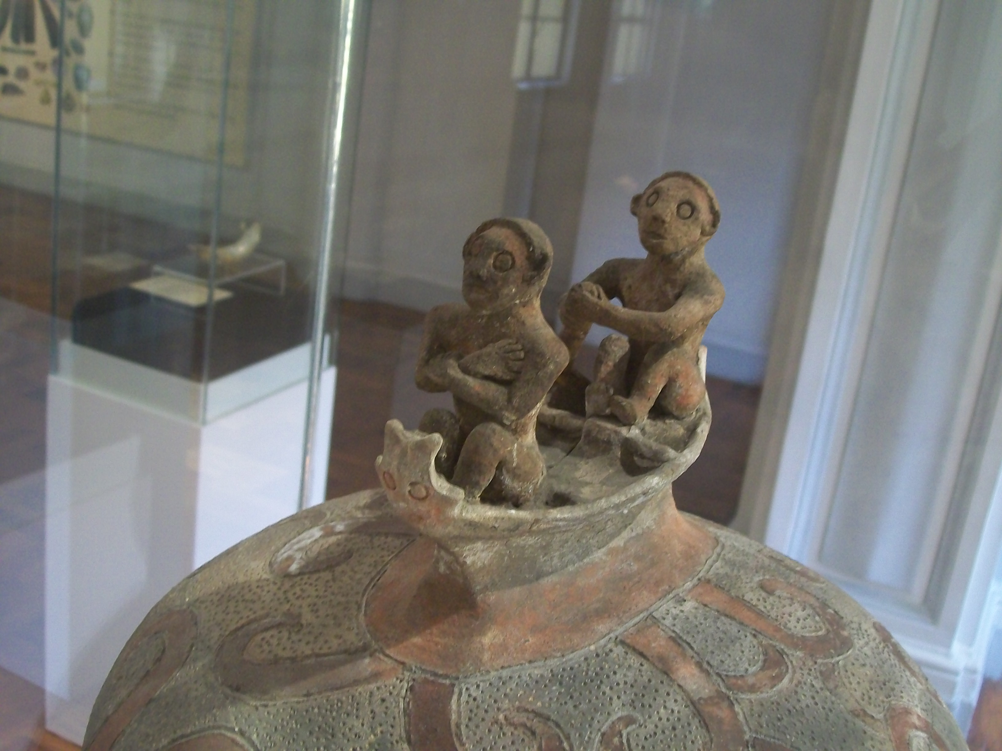
Causes of Migration- polynesian
Polynesian/Austronesian (Pacific Islands)
Contests for power and influence led to tension – migration offered an alternative to conflict
Manunggul Jar, Phillipines

Slide 4
Course of Migration - Bantu
1500 years from just south of Sahara to southern tip of Africa
Superiority over local adversaries due to technology (iron weapons)
Migrated slowly and established new settlements
Used canoes to follow rivers through Congo rain forests, settled on riverbanks
Then eastward into savannas, adapting herding goats to raising cattle and adding new crops (bananas)

Slide 5
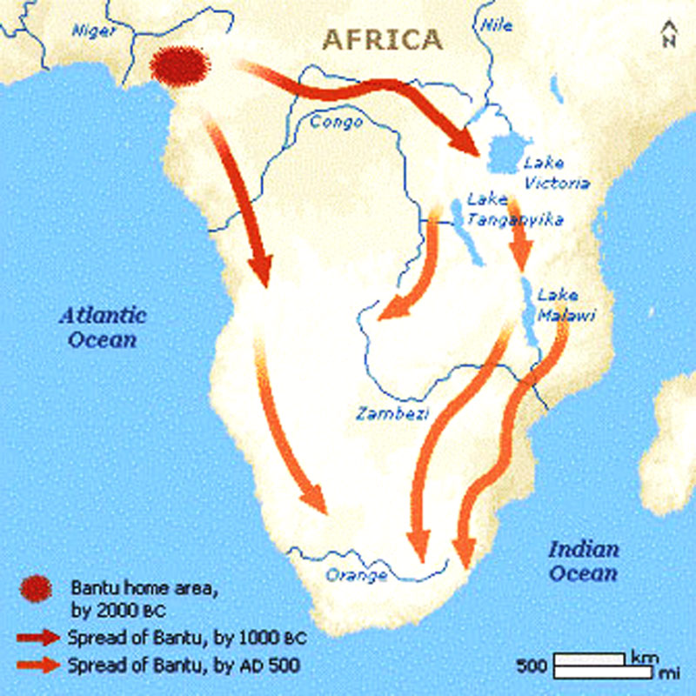
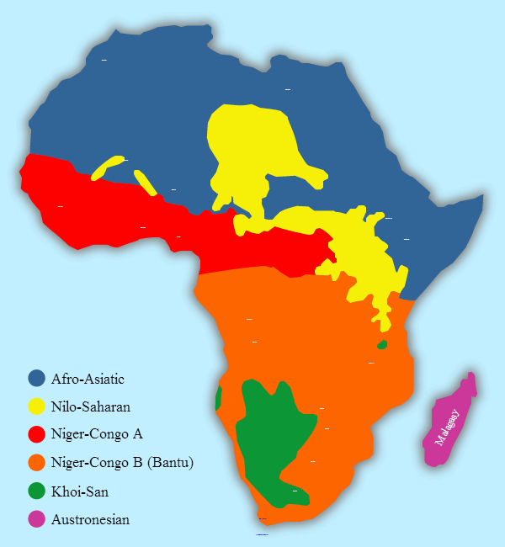
Bantu Migration - Maps
Bantu Migrations
Language Groups of modern Africa – notice Madagascar – why is it Austronesian?

Slide 6
Course of Migration - Vikings
Superiority on the seas – shipbuilding techniques and seafaring skills
Vikings did not seek new land to settle initially; rather to raid and plunder
Viking Age 790-1066
Initially west to Iceland 874CE, Greenland, N America (Leif Erickson first European on North American soil?)
Norwegians raiding and settling in Western England and Ireland
Swedish to North-South Russian Rivers (all the way to Caspian and Black Seas – eventually to Constantinople)
Raid, pillage, plunder – eventually settle and convert
“From the wrath of the Northmen, O Lord, deliver us!”

Slide 7
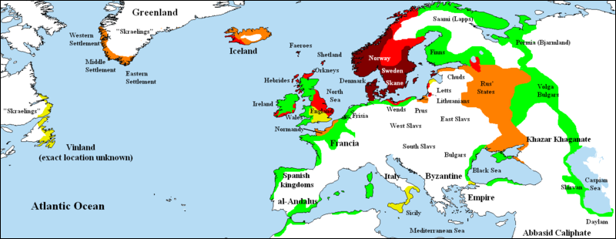
Viking Migration Maps
8th Century
9th Century
10th Century
11th Century
Green denotes areas subjected to frequent Viking raids but with little to no Scandinavian settlement

Slide 8
Course of migration - polynesian
East towards Pacific and West towards Africa
Sailed outrigger canoes over “blue water”
In 800 years - from New Guinea to Hawai’i, Madagascar, and New Zealand

Slide 9
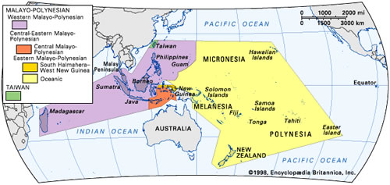
Polynesian Migration maps

Slide 10
Effects of Migration - Bantu
Gradual spread of Bantu languages
Today there over 60 million people who speak Bantu languages
Superior iron technology allowed Bantus to dominate and assimilate indigenous (local) groups
Cultural diffusion through exchange of ideas and intermarriage
Religious beliefs
Technology (agriculture, iron metallurgy)
Social

Slide 11
Effects of Migration - Vikings
Destruction of villages and towns and many churches and monasteries (700-800CE)
Breakdown of centralized governments into FEUDALISM
Later, occupying and ruling large parts of France and British Isles (900-1000CE)
Swedes settling in Russia (Rus for ruddy)
Converted to Christianity and get assimilated into European civilization

Slide 12
EFFECTS- POLYNESIAN/AUSTRONESIAN
Established agricultural villages in unihabited or lightly inhabited islands
Built strong chief-ruled societies
Eventually rulers and aristocracy viewed themselves as divine or semidivine
Adapted to new environments (ex. Maori)

