Slide 1
The Haitian Revolution (1791 – 1804)
AP World History Notes
Chapter 17
“Atlantic Revolutions and their Echoes”

Slide 2
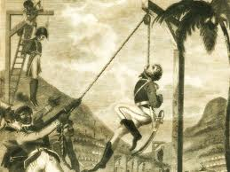
The Haitian Revolution
Mulattoes in Haïti possess limited freedom.
Mulattoes were required to enlist for a mandatory three-year term in the military establishment known as the marechaussée. *gave them military training*
They were then forced to serve in their local militia without compensation *gave them organization* a*required to provide their own supplies*
Mulattoes were angered by the fact that they were outlawed from holding office and were totally excluded from Haitian society. (could hold land but govt. restraints disabled them from really doing anything with it) Lead them to begin plotting revenge/an uprising as retribution to the way the whites treated them. *waited for right moment*

Slide 3
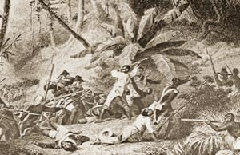
Results
Successes:
Socially:
Slaves had freedom
Whites fled or were killed
Politically:
Independent country
Second independent republic in the Americas
Napoleon unable to control over Haiti -> did not have the money to keep up with Louisiana (French territory) -> sold it to the American government
Economically:
No longer a country based on a plantation system
Became small-scale farmers
Racial divides and sectional politics ended the idealism of the Revolutionary period

Slide 4
Timeline
1789 Saint Domingue (Haiti): First revolts (led by whites, mulattos)
1790 Saint Domingue: “Night of Fire”—well-organized slave revolt
1791 France: National Assembly declares full civil rights for mulattos (free men of color) –Slaves still revolt
1792 Saint Domingue: Commissioner Sonthonax grants freedom to slaves in the North Province who fought for the French Republic, then orders general abolition
1793 France: National Assembly extended freedom to slaves in all its colonies in the Emancipation Decree of 1794. Saint Domingue: Toussaint l’Ouverture leaves alliance with British & Spanish to help France drive them from the island
1799 France: Napoleon Bonaparte seizes power Saint Domingue: British expelled from Saint-Domingue

Slide 5
Timeline
1801 France: Napoleon dispatches General Leclerc to subdue Haiti
1802 France : Reestablishment of slavery (May), Bonaparte named Consul for life -Saint Domingue: Death of LeClerc (November)
1803 Saint Domingue: General Dessalines proclaims independence of Haiti (August 29) -France/U.S.: Signature of treaty of purchase, Louisiana Territory
1804 France: Implementation of the Civil Code; declaration of empire (Dessalines declared independence and renamed the Island Haiti)

Slide 6
Declarations Bellwork
Which two Enlightenment thinkers do you feel had the greatest impact on the American and French Revolution?
Opinion
What would you say was the GREATEST similarity in idea between the Declaration of Independence and Declaration of Rights of Man?
Opinion
But probably power is derived from the people

Slide 7
French Revolution Bellwork
What action by King Louis and Marie lead to the creation of the French Republic?
They tried to leave France/Paris
What group ruled France during the Reign of Terror?
The Committee of/for Public Safety

Slide 8
Objective
WWBAT: Discuss the causes and impacts of the Haitian Revolution
WWBAT: Introduce the similar causes of the revolutions in Latin American colonies

Slide 9
Interactive Notebook Setup
Haitian and Latin American Revolutions
4/1/2016
This will be two pages

Slide 10
Haitian Revolution Background
Latin American Revs Background
Haitian Revolution

Slide 11
Brazilian Independence
Mexican Independence
Simón Bolívar
Gran Colombia
Successes & Failures

Slide 12
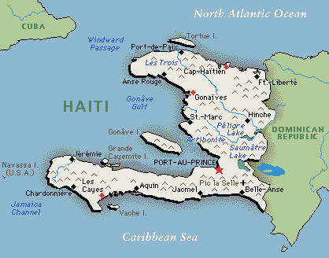
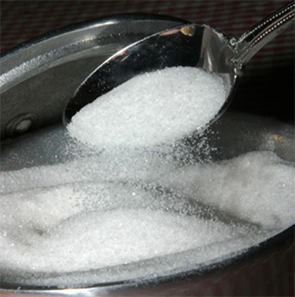
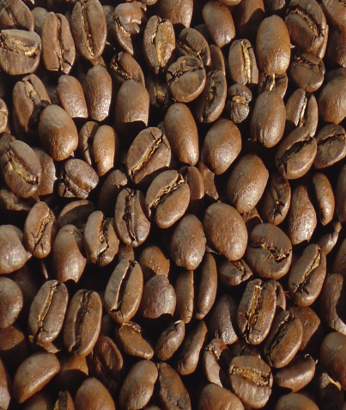
Haitian Revolution Background
Was originally called Saint Domingue by the French
French colony in the Caribbean
Colony’s purpose = plantations
Richest colony in the world at the time
8,000 plantations
Produced 40% of the world’s sugar
Produced 50% of the world’s coffee

Slide 13
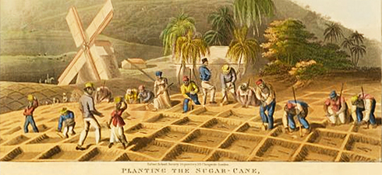
Haitian Revolution Background
500,000 of the 570,000 people living in the colony were slaves
There were also 30,000 free people of color
Majority were small landowners

Slide 14
Haitian Revolution Background
Slaves in Haiti suffered under some of the harshest treatments found in the Caribbean
So many died from harsh conditions that 40,000 new slaves needed to brought a year
Slaves in Haiti were legally considered to be property of the public
This treatment evoked an often resentful and disobedient demeanor among the slaves

Slide 15
Haitian Revolution Background
White population was quite divided
40,000 white people in the colony
Divided into two groups:
“Grands blancs” = wealthy plantation owners, merchants, and lawyers
“Petits blancs” = poor whites

Slide 16
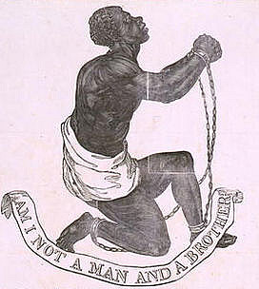
Haitian Revolution Background
All of these social groups were inspired by the French Revolution
For “grands blancs” meant greater independence for the colony from France and fewer trade restrictions
For “petits blancs” meant equality of citizenship and economic opportunities
For free people of color meant equal rights and treatment for all free people, regardless of race
For slaves meant personal freedom

Slide 17
The Haitian Revolution
Earliest revolts were lead by mulattoes and “petit blancs”
These groups were seeking greater rights and more economic opportunities
The chaos lead to the eventual slave uprising that would define the Haitian Revolution

Slide 18
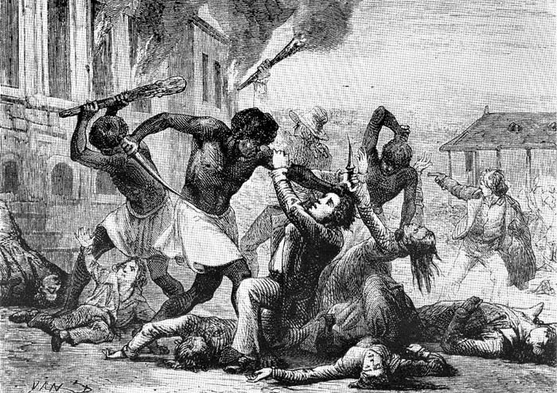
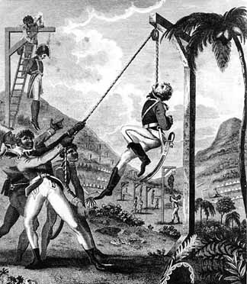
The Haitian Revolution
First slave revolt took place in 1790
Triggered by rumors that the French king had declared an end to slavery
Slaves burned around 1,000 plantations and killed hundred of white and mixed-race people

Slide 19
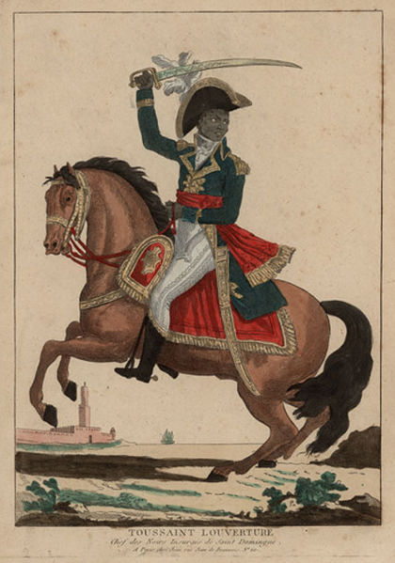
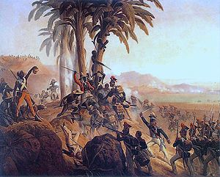
The Haitian Revolution
First revolt was followed colony wide salve revolt
As the revolution continued, power gravitated toward the slaves
Leader became a former slave named Toussaint Louverture

Slide 20
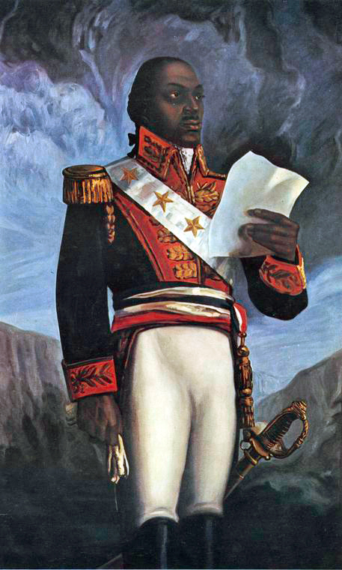

Slide 21
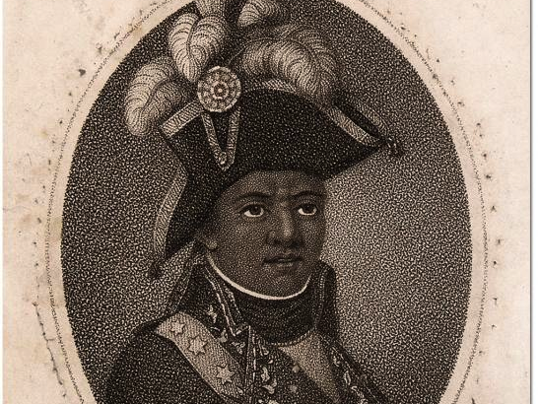
Toussaint Louverture(Revolution)
Son of an educated slave
Inspired by Enlightenment ideas and French Rev.
Very inspirational and charismatic
He formed his own army, inspiring hundreds to join him and displayed an impressive talent for designing and leading militaristic strategies and tactics that would enable him to make the slave insurgency one of the most successful in history.
Achieved aid from the Spanish and actually became an officer in the Spanish Military then when the slave were emancipated switched allegiance to French

Slide 22
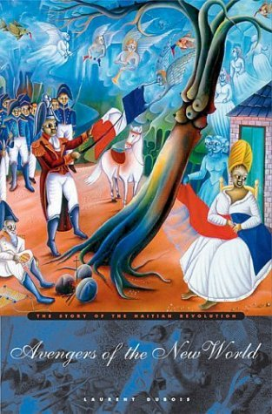
The Haitian Revolution
Only completely successful slave revolt in world history
Slaves became equal, free, and independent citizens almost immediately
Renamed area Haiti
means “mountainous” or “rugged” in the language of the original inhabitants

Slide 23
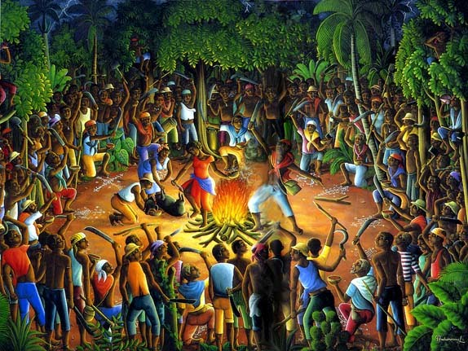
The Haitian Revolution
Formal declaration of independence January 1, 1804
Effects:
Plantations destroyed
Most whites fled or were killed
Private and state lands redistributed among former slaves and free black people
Haiti became a nation of small-scale farmers producing for their own needs
A Celebration!

Slide 24
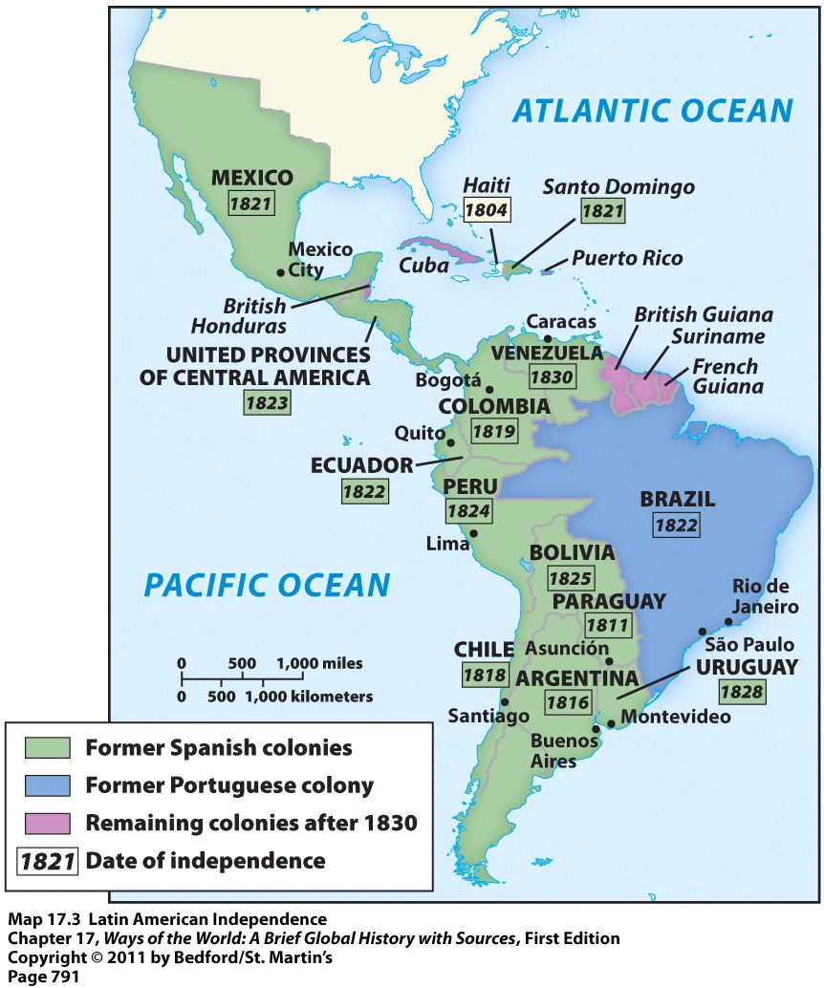
Latin American Revs Background
Inspired by the American, French, and Haitian Revolutions
Intellectuals had become familiar with ideas from the European Enlightenment

Slide 25
Latin American Revs Background
Complaints of people in Latin America:
Trade restrictions meant could only trade with the “motherland”
Greatly limited economic possibilities
High taxes they had to pay
Spain had a 20% tax on most its colonies
Rigid colonial social structure that limited rights and privileges for many people

Slide 26
Latin American Society
30,000 peninsulares, colonial officials from Iberian peninsula
3.5 million criollos (creoles), born in the Americas of Spanish or Portuguese descent
Privileged class, but grievances with peninsulares
1810-1825 led movements for creole-dominated republics
10 million others
African slaves, mixed-race populations

Slide 27
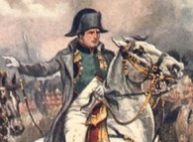
Latin American Revs Background
Latin Americans took action and started working toward independence when Napoleon invaded Spain and Portugal in 1808
Royal authority in disarray
NOW would be the time to gain independence
Almost every Spanish American colony had achieved independence by 1826

Slide 28
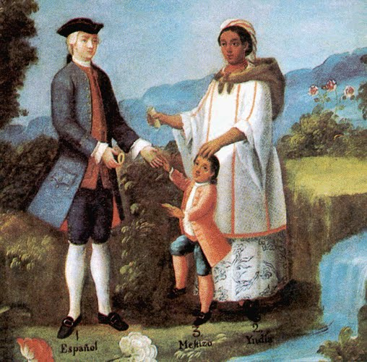
Latin American Revs Background
The struggle for Latin American independence was lengthy because these societies were so conflicted and divided by class, race, and region
Internal violent conflict often broke out as they were trying to fight against Spanish rule simultaneously
Example: Creole elites versus peasants

Slide 29
Revolution Bellwork
What was the largest group on the French colony of San Domingue?
Slaves
The Haitian Revolution is the only_________________________ in history
Completely Successful slave rebellion
Why did it take a long time for Latin American Independence movements to be organized?
Society was incredibly divided

Slide 30
Objective
WWBAT: Introduce and discuss the Mexican and Brazilian Independence Movements
WWBAT: Gather information about the South American Independence Movements and the successes and failures

Slide 31
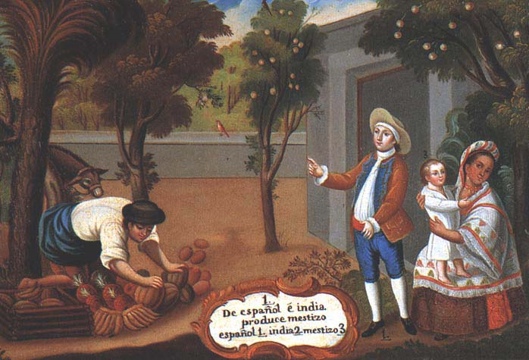
Latin American Revs Background
It took the Spanish American colonies much longer to mobilize and move toward revolution than the colonies of North America
Had little tradition of self-government
Societies much more authoritarian and divided by class

Slide 32
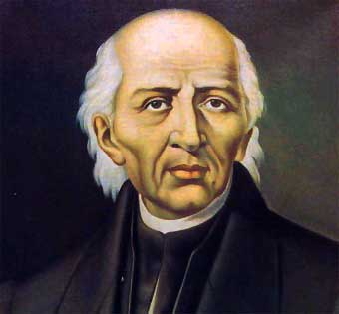
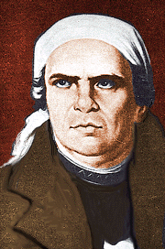
Mexican Independence
Starting in 1810 Priests Miguel Hidalgo and Jose Morelos led the fight against Spanish rule in Mexico
Led a peasant insurrection
Believed revolt was the only way to achieve their 2 goals for Mexico:
1. Political freedom
2. End of slavery & improved living conditions for Mexico’s poor

Slide 33
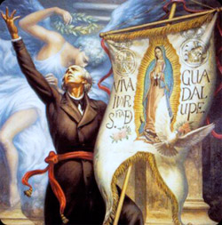
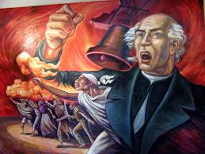

Slide 34
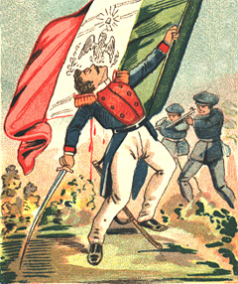
Mexican Independence
An alliance of Church leaders and Creole elites raised an army and stopped this “radical” peasant rebellion
They brought Mexico to a more controlled independence

Slide 35
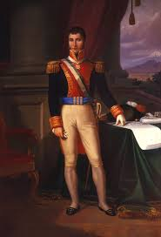
Mexican Independence
1821 Mexico declared its independence
Creole general Augustin de Iturbide (1783-1824) declares independence in 1821
Installs self as Emperor, deposed in 1823
1823 Mexico became a republic

Slide 36
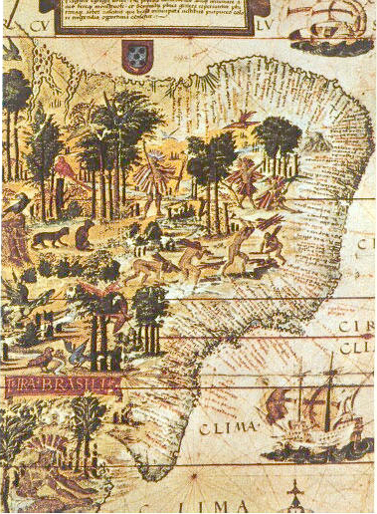
Brazilian Independence
Brazil’s quest for and achievement of independence is different than the rest of Latin America
It is different for one major reason…
…Brazil was a Portuguese colony

Slide 37
Brazilian Independence
1807 Napoleon’s forces invaded Portugal largely to tighten the European blockade of Great Britain
Future king of Portugal, Prince Regent Dom João VI of Portugal decided to move the Portuguese Monarchy to their colony of Brazil
He, his family, and 10,000 others moved from Portugal to Brazil

Slide 38
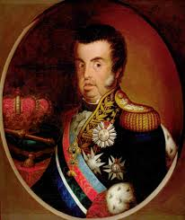
Dom Joao VI of Portugal

Slide 39
Brazilian Independence
Dom João VI implemented multiple popular policies and changes upon his arrival in Brazil
He canceled mercantile policies and opened Brazilian ports to allies
He also moved the capital of the Portuguese Kingdom to Rio de Janeiro
Manufacturing, a printing industry, and a major art scene developed after the arrival of the royal family

Slide 40
Brazilian Independence
Many in Portugal were upset by the policies of Dom João VI, feeling they favored Brazil over Portugal
There were also groups in both Portugal and Brazil that opposed the Absolute Monarchy of the Royal Family
There were calls a constitutional monarchy in the Portuguese Empire

Slide 41
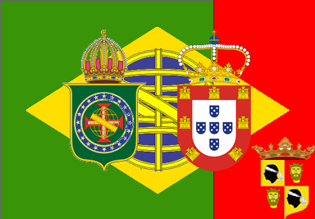
Brazilian Independence
In 1815 Dom Joao elevated Brazil to a status of Kingdom, making it equal to Portugal
This meant that Brazilians could be elected to the parliament in Portugal, known as the Cortes

Slide 42
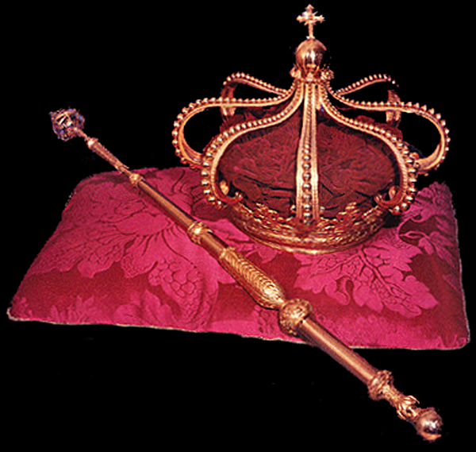
Brazilian Independence
After the end of the Napoleonic Wars the Cortes requested the Dom Joao return to Portugal
In 1816 Dom João VI was crowned King as his mother died
Joao only agreed to return when a revolt attempting to end his absolute monarchy broke out in 1820

Slide 43
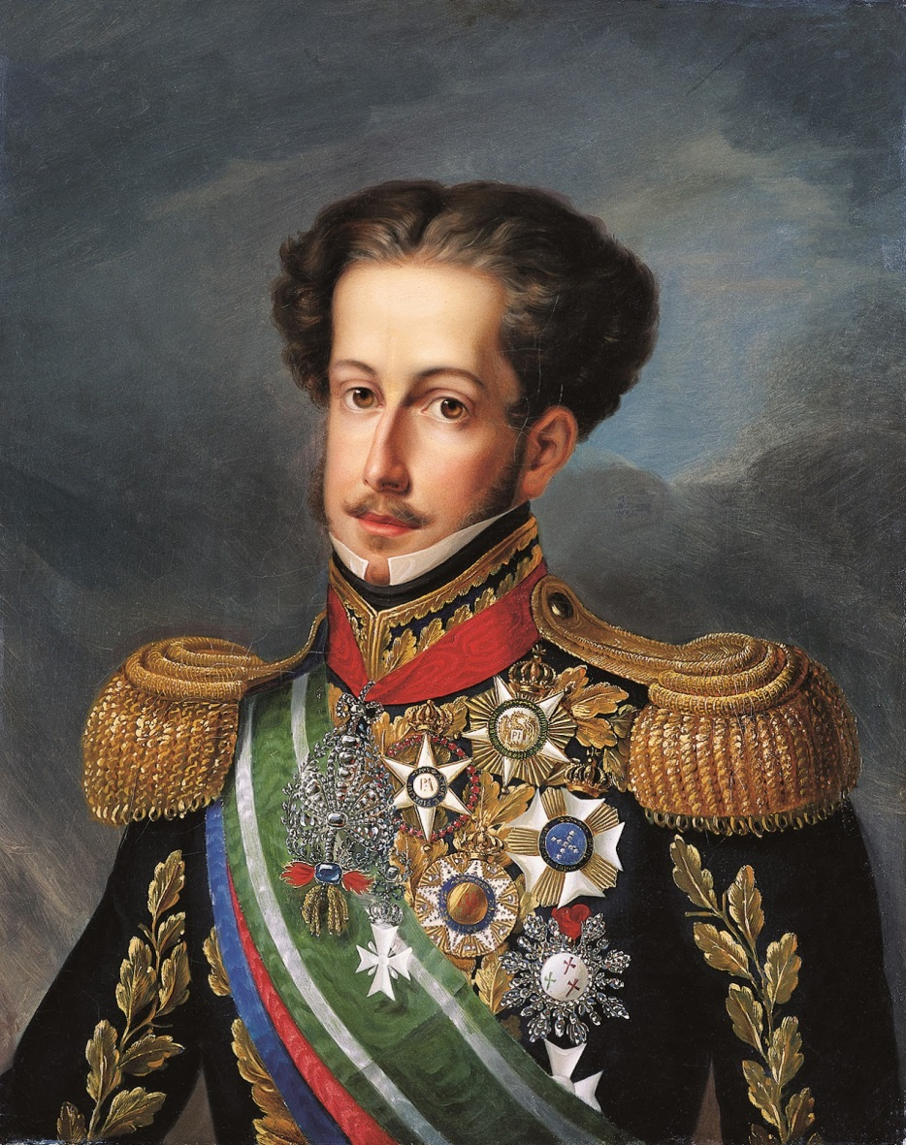
Brazilian Independence
King Joao left his son Dom Pedro in charge of Brazil
The now more powerful Cortes began passing laws hostile towards Brazil, and even returned its status to that of a colony

Slide 44
Brazilian Independence
The Cortes asked Dom Pedro to return to Portugal
Dom Pedro refused and Portugal sent troops to bring him back
Dom Pedro’s forces meet them, but the Portuguese surrendered
All this happened while Brazilians Creoles in the Cortes called for independence

Slide 45
Brazilian Independence
In 1824 Dom Pedro made the Cry of Ipiranga: “by the blood that flows in my veins and upon my honour, I swear to God to free Brazil!”
In 1824 Pedro was crowned Emperor of Brazil
By 1825 the U.S., Portugal, and Great Britain had all recognized Brazil as an independent country

Slide 46
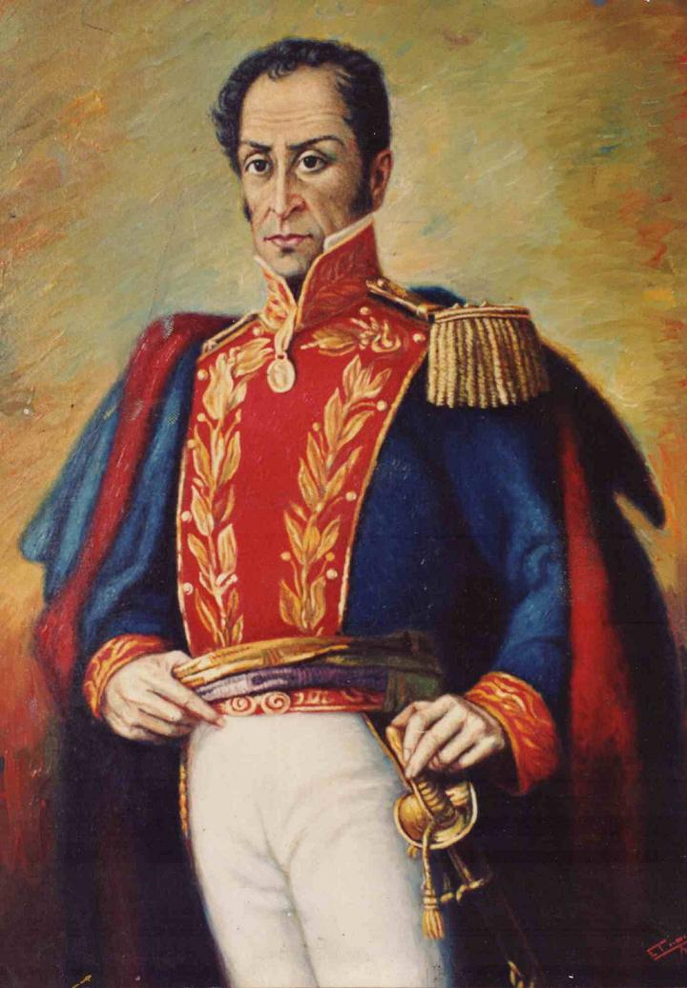
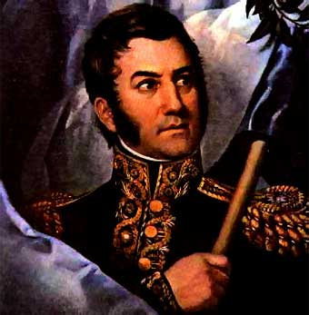
Spanish South America
Leaders of the South American independence movement against Spain = Simon Bolivar & Jose de San Martin
Bolivar’s nickname = “the Liberator”
Started revolts in 1810 → by 1826: they had liberated all of South America

