Slide 1
Latin American Industrialization

Slide 2
Causes
As colonies Latin American territories had been prevented from developing manufacturing
Reliance on slave labor had prevented agricultural technology
Latin American states had history of successful agricultural production and access to natural resources

Slide 3
Causes
Latin American states gained independence AFTER W. Europe began industrialization
By the mid-1850’s, many countries in Latin America became more stable integrated into the world economy driven by the industrialization of the U.S. and Western Europe
Industrialized countries needed food products, raw materials, and markets to sell goods
New Latin American state served as all 3
This made it hard to compete copy W. European industrialization

Slide 4
Characteristics
Quickly developed in Export Economies providing:
Huge amounts of cash crops/food items
Such as wheat, beef, sugar, coffee, fruits, ect
Mined natural resources
Such as silver, copper, tin, ect
In exchange for these goods, Latin American countries received:
textiles, machinery, tools, weapons, and luxury goods from Europe and the U.S.

Slide 5
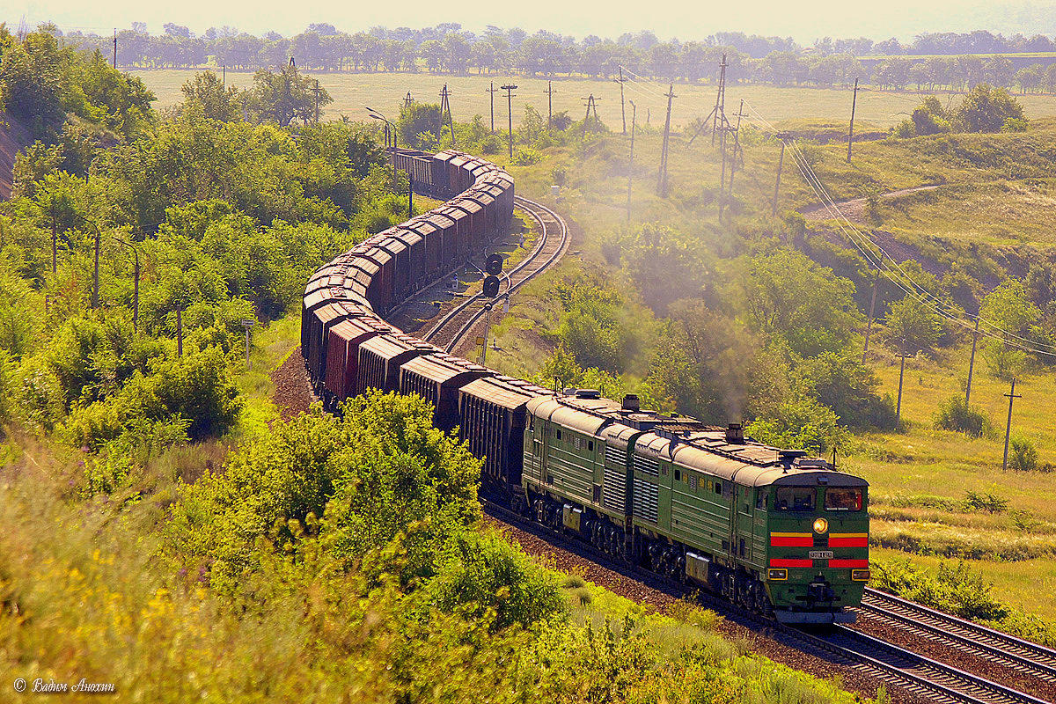
Characteristics
European countries and the U.S. also invested capital in Latin America
Mostly to build railroads there to help funnel exports to the coast
Many U.S. companies allied with landowners and politicians in Latin America to set up businesses there
“New form of colonialism” → indirect, behind the scenes power exercised by foreign investors

Slide 6
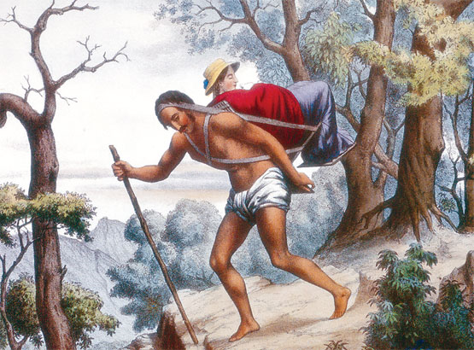
Characteristics
90% of its population in an impoverished lower class
Very small market for manufactured goods
Landowners benefitted so much from exporting goods=little incentive to invest in manufacturing
No tariffs on foreign products – so domestic manufacturing companies couldn’t compete
Depiction of the lower class supporting the upper classes

Slide 7
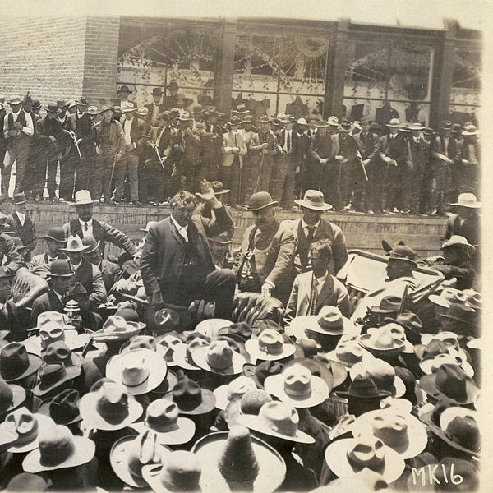
Characteristics
Latin American urban workers created mutual aid societies, organized unions, and engaged in strikes to protest their harsh work environment and conditions
Authoritarian governments acted harshly to crush unions and strikes
Wanted stability and progress in Latin America
A crowd of Mexican workers being addressed during the miners’ strike in 1906

Slide 8
Russian Industrialization

Slide 9
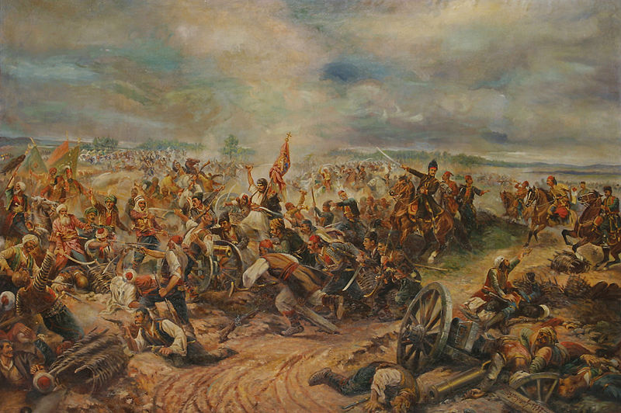
Causes
Russian Empire lost the Crimean War to an alliance of Western Europe, largely due to their industrial and technological weakness
Motivated Russian government to initiate industrialization

Slide 10
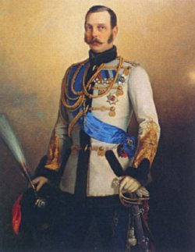
Causes
1861 = Russian state abolished serfdom (by Alexander II)
Stimulated by its defeat in the Crimean War
Tsar Alexander II saw the defeat of Russia’s serf-army at the hands of FREE British and French troops as a sign to end serfdom
Hoped that recently free peasants would succeed in agriculture and created capital for industrialization

Slide 11
Causes
After the abolition of serfdom, Russia began a program of industrial development
Government Supported Industrialization:
Began the Trans-Siberian Railroad
Encouraged foreign investment
Switched to the gold standard
STATE-GUIDED INDUSTRIALIZATION!!!!

Slide 12
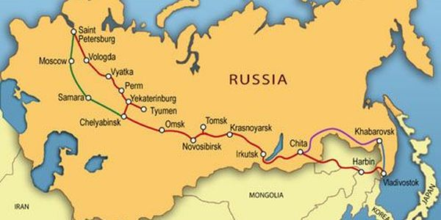

Slide 14
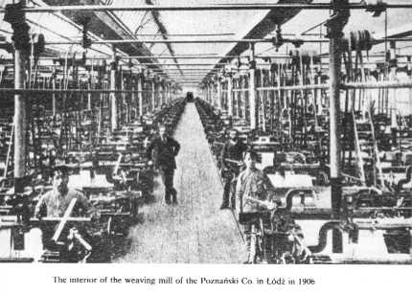
Characteristics
1890s = industrialization under way and growing rapidly
Focused on railroads and heavy industry
By 1900 = Russia ranked 4th in the world in steel production

Slide 15
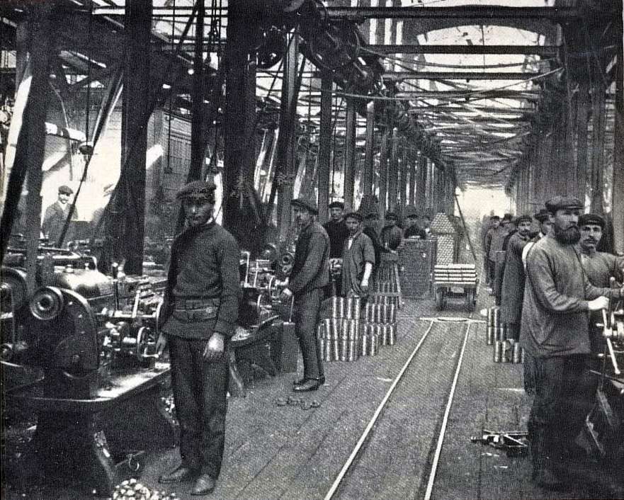
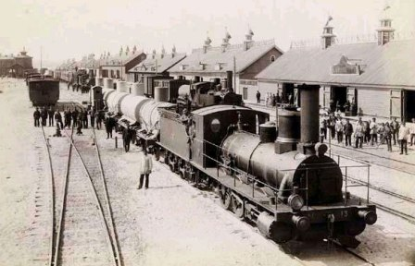
Characteristics
Had major industries:
iron/steel, coal, textiles, and oil

Slide 16
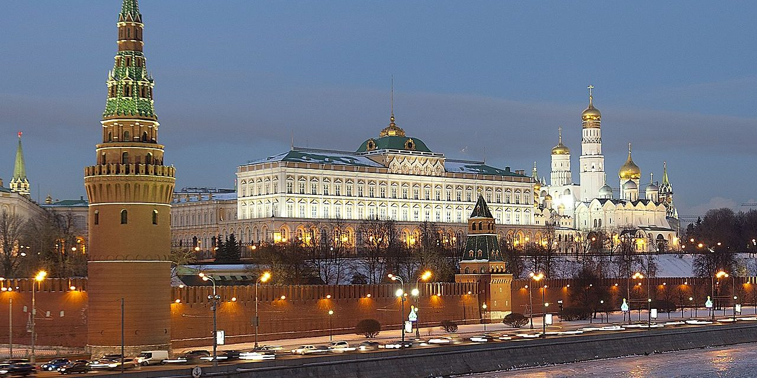
Characteristics
Government controlled and bought most of the heavy industry produced
Like Western Europe Russia developed a positive feedback loop
Coal->Iron/steel->Railroad ->Coal

Slide 17
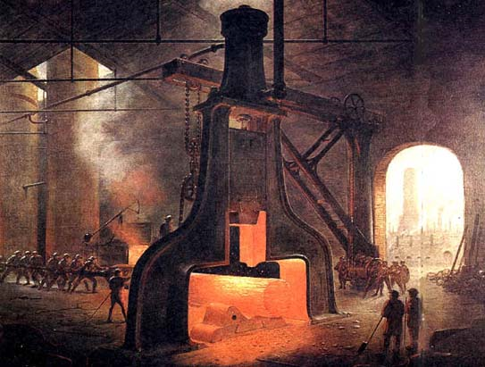
Characteristics
Factory workers made about 5% of total Russian population
Factory and urban life were AWFUL
13-hour work day
Ruthless discipline and constant disrespect from supervisors
Lived in poorly constructed dorms
Most lived in large, unsanitary barracks
Unions and political parties illegal
Only way to protest was through large-scale strikes

Slide 18
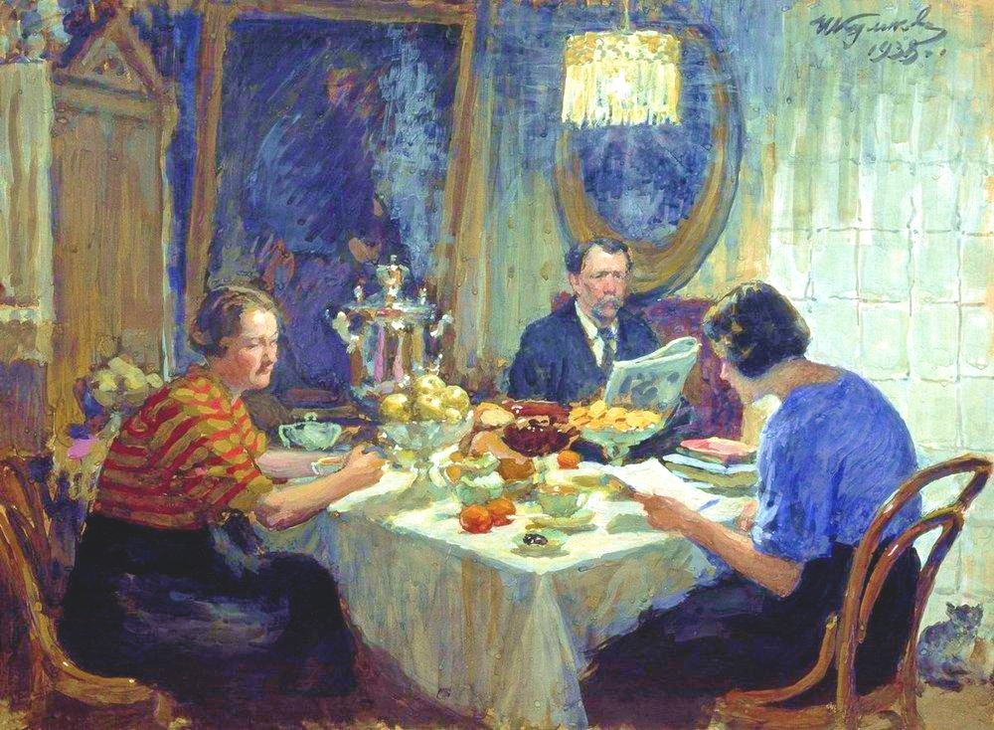
Characteristics
Growing middle class, comprised of businessmen and professionals developed
Many objected to tsarist Russia and wanted a greater role in political life
But, the middle class was also dependent on the state for: contracts, jobs, and suppressing the growing radicalism of the workers
A Family at Table, 1938
Painting of a Middle-Class Russian Family

Slide 19
Characteristics
Many workers and educated Russians turned to Marxist socialism
1898 = illegal Russian Social-Democratic Labor Party created
Got involved in: workers’ education, union organizing, and revolutionary action
1905 = a revolution in Russia erupted

