Slide 1
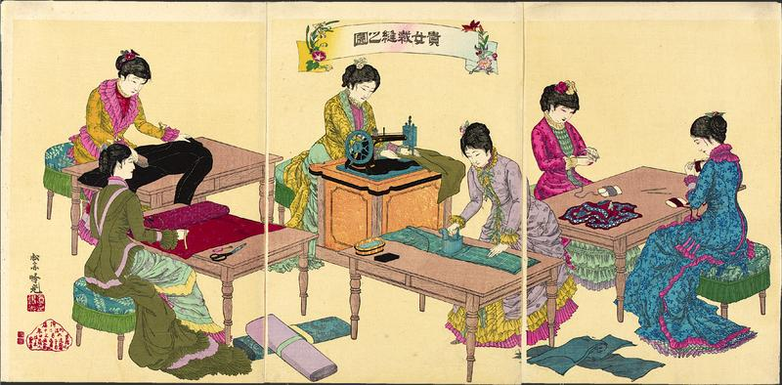
Causes
Government set up enterprises and sold them to private investors to start industrialization
DID NOT rely on foreign investment/resources

Slide 2
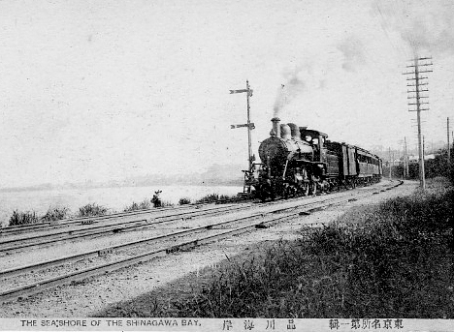
Causes
The Japanese government created:
Railroads
Postal system
National currency
National banking system
Japanese Steam Train (1872)

Slide 3
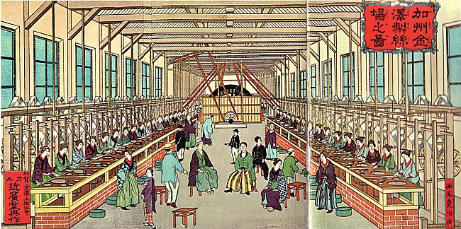
Characteristics
Major exports:
Silk Textiles
Coal
Iron/Steel
Bamboo Products
Painting of a Western-Style Japanese Factory from the 1880s

Slide 4
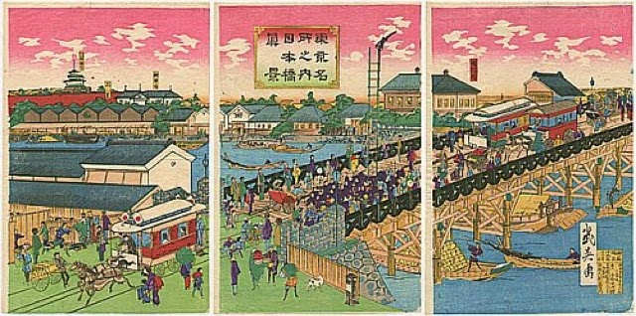
Characteristics
Practiced STATE-SPONSORED INDUSTRIALIZATION

Slide 5
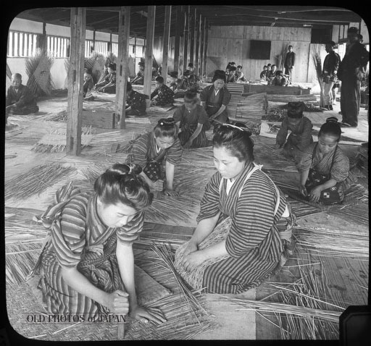
Characteristics
Many peasant families slid into poverty
Taxed too much to pay for Japan’s modernization
Protests with attacks on government offices and bankers’ homes
Low pay and terrible working conditions for factory workers (mainly women)
Female Workers in a Japanese Bamboo Basket Factory (1904)

Slide 6
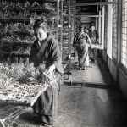
Characteristics
Overall very successful
Caused Imperialism and eventually conflict with USA and other Western Powers

Slide 7
Characteristics
Anarchist and socialist ideas developed among intellectuals
Efforts to create unions and organize strikes met with harsh opposition

