Slide 1
Tang and Song Dynasty Bellwork
What piece of infrastructure was made during these dynasties dramatically improved trade?
The Grand Canal
What VERY uncomfortable custom was often practiced by women starting in the Song Dynasty?
Footbinding

Slide 2
Theme Tuesday Bellwork
What is an example of Development and Interaction of Cultures during the Crusades?
Answers Vary
What is an example Creation, Expansion and Interaction of Economic Systems during the Han Dynasty?
Answers Vary

Slide 3
Objective
WWBAT: Discuss the reunification of China and the accomplishments of the “Golden Age”

Slide 4
Interactive Notebook Setup
11/16/2017
Golden Age of China
This will be one page

Slide 5
Reunification of China
The “Golden” Age of China

Slide 6
The Reunification of China
After the collapse of the Han Dynasty China again fell into a time disunity and division
This lasted for almost 300 years
Time period was known as the period of Sixteen Kingdoms

Slide 7
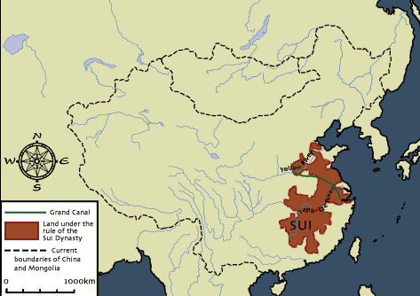
The Reunification of China
China regained its unity under the Sui dynasty (589-618)
Reunified China with the construction of the Grand Canal
Short-lived dynasty
Ruthless emperors = unpopular
Failed attempt to conquer Korea → wasted resources and upset people
Sui dynasty = overthrown

Slide 8
The Reunification of China
The Sui Dynasty undertook massive building projects
Made additions to the Great Wall
Developed the Grand Canal
A combination of slave labor, military, and conscripted labor were used for these building projects
Conscripted labor=Required work done for the government

Slide 9
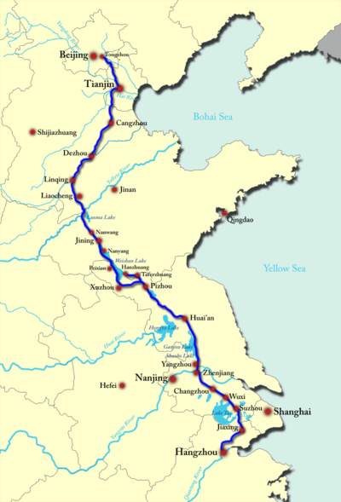
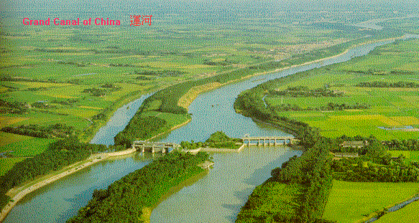
The Grand Canal

Slide 10
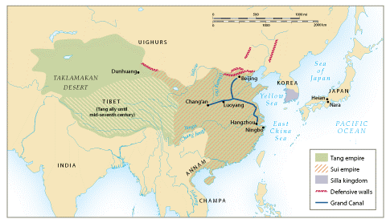
.
The Sui and Tang dynasties, 589-907 CE

Slide 11
The Reunification of China
Sui dynasty was followed by: the Tang dynasty (618-907) and the Song dynasty (960-1279)
Both used the same state structure:
Centralized government
6 major departments = personnel, finance, rites, army, justice, and public works
Censorate = agency that watched over the rest of government to make sure everything ran smoothly
Government officials chosen based on a revived Confucian-based examination system

Slide 12
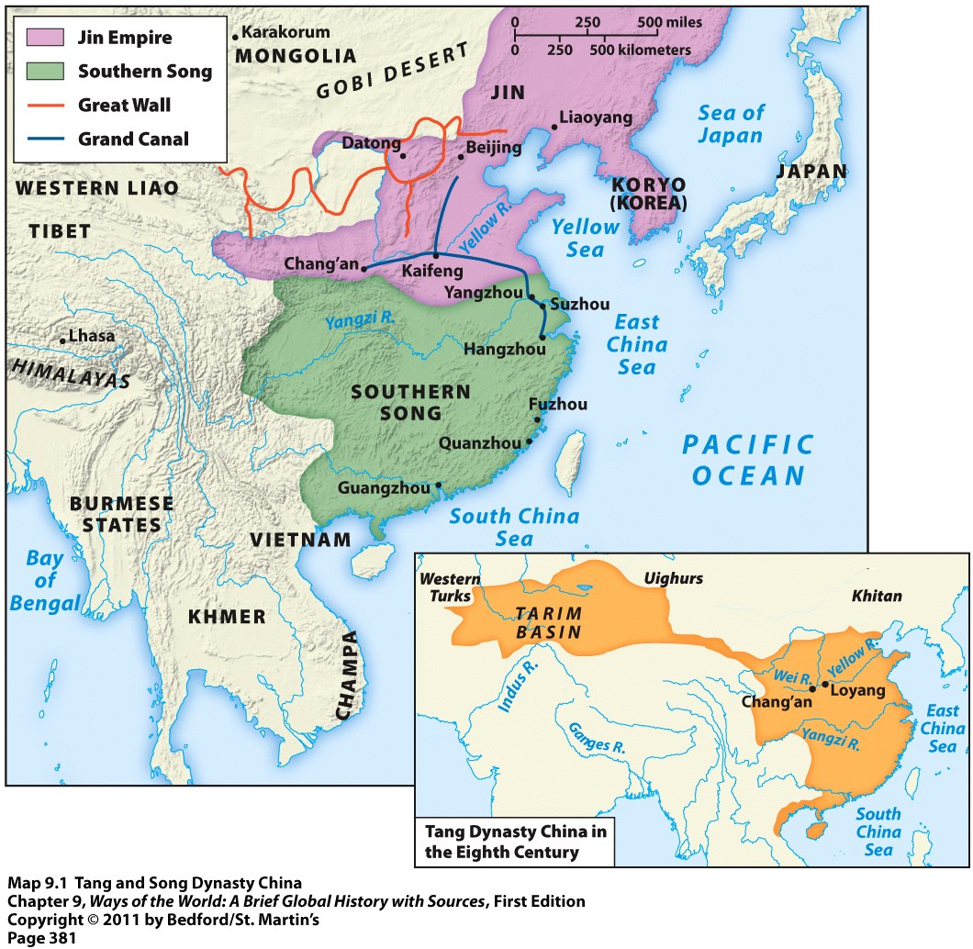
Tang and Song Dynasties

Slide 13
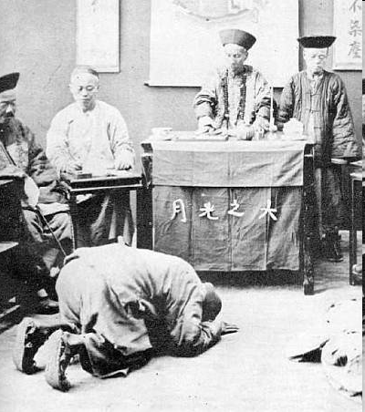
The “Golden Age” of China
Foreigners Present their tribute from their homeland
In return, the Chinese emperor would grant foreigners permission to stay & trade in China
Tang China began calling itself as the “Middle Kingdom”

Slide 14
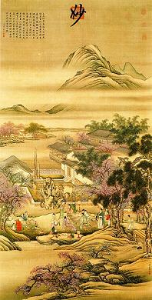
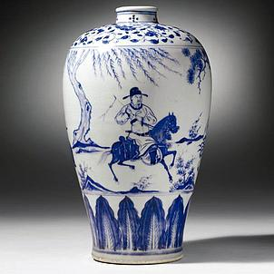
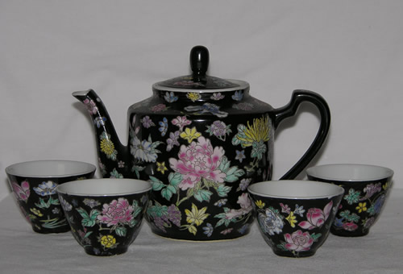
The “Golden Age” of China
Focus on arts and literature
Excellence in poetry, landscape painting, and ceramics
Neo-Confucianism = revival of Confucianism mixed with Buddhist and Daoist elements

Slide 15
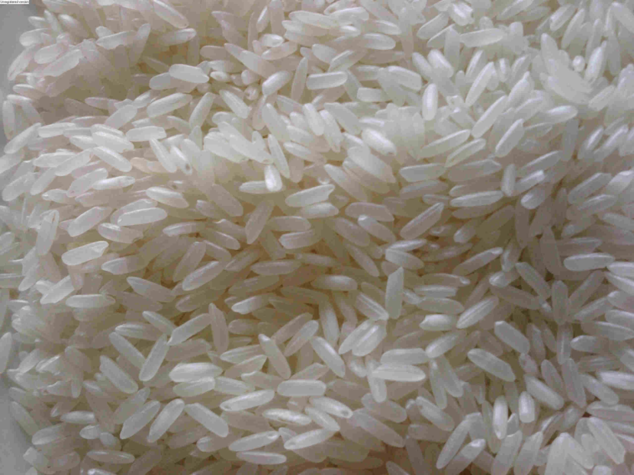
The “Golden Age” of China
Advancements in agriculture
Most important = adoption of a fast-ripening and drought-resistant strain of rice from Vietnam
Result = rapid population growth
Jumped to 120 million people by 1200 CE

Slide 16
The “Golden Age” of China
Many people began to move to cities
Dozens of Chinese cities numbered over 100,000 people
Capital of Song dynasty called Hangzhou
Had over 1 million people
Modern picture of Hangzhou

Slide 17
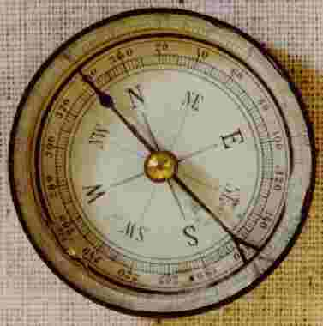
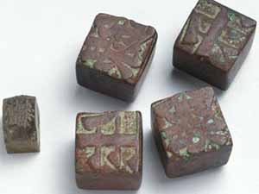
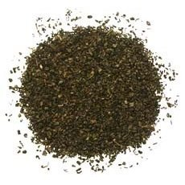
The “Golden Age” of China
Woodblock and moveable type → led to the first printed books
Larger ships and magnetic compass
Gunpowder

Slide 18
The “Golden Age” of China
Merchants from the Abbasid Dynasty interacted with Tang Dynasty on the Silk Road
Islam and knowledge of medicine was introduced into China by the 8th Century
Abbasid learned paper making, gunpowder, woodblock printing, and botany

Slide 19
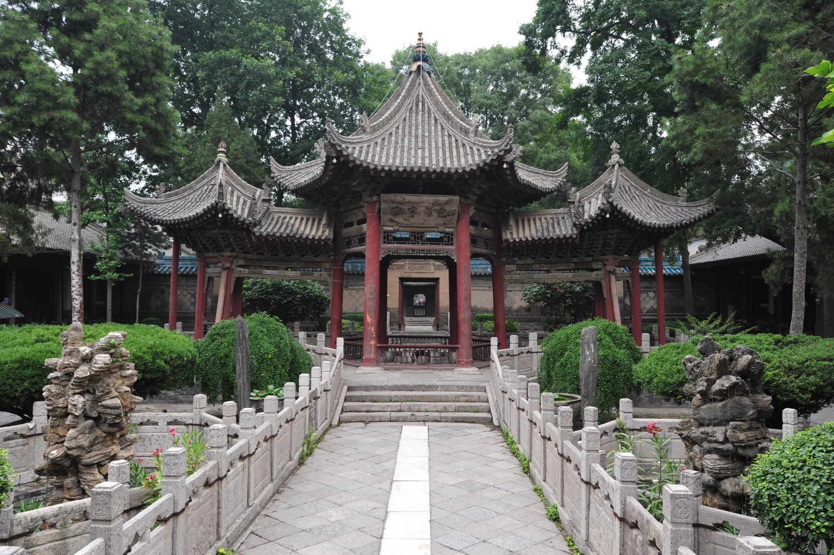

Slide 20
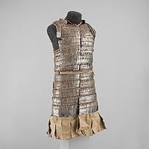
The “Golden Age” of China
Iron industry boomed
Used to make: suits of armor, arrowheads, coins, tools, bells in Buddhist monasteries, etc.

Slide 21
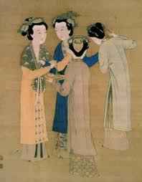
The “Golden Age” of China
Chinese women HAD been enjoying a looser patriarchal system in disunity
With Song dynasty = major revival of Confucianism = belief in female subordination
Patriarchal restrictions began to tighten again

Slide 22
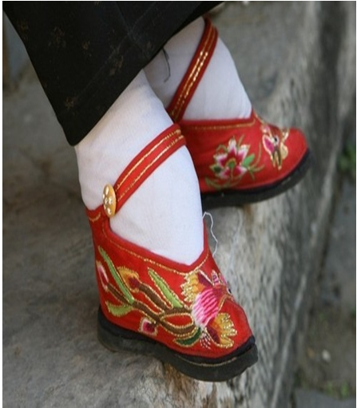
Foot Binding
Began between the ages of 4 and 7
Involved the tight wrapping of young girls’ feet
Broke the bones and caused intense pain
Goal = to make the feet small and delicate
Sign of female beauty
Kept the women at home
Began with just elite women, but soon became a common practice with all classes

Slide 23
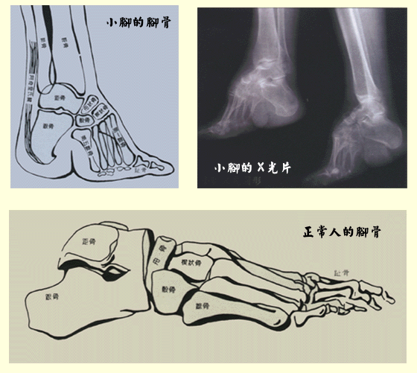
Foot Binding

Slide 24
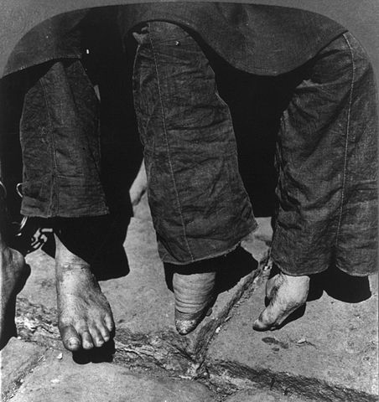

Slide 25
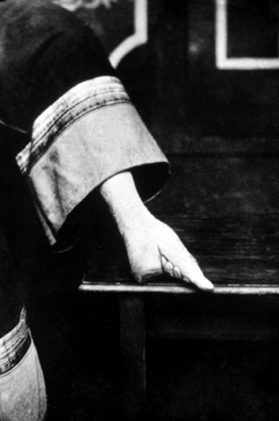
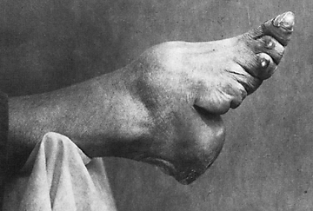
Foot Binding

Slide 26
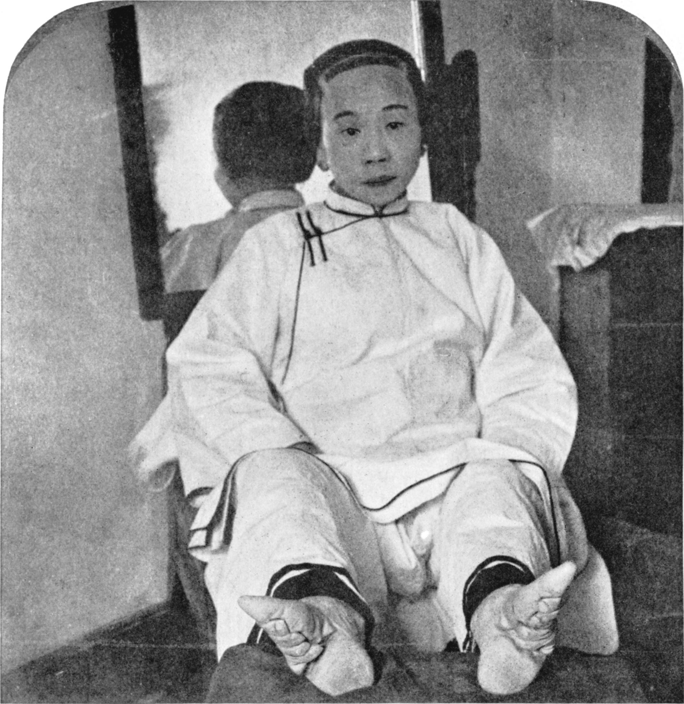
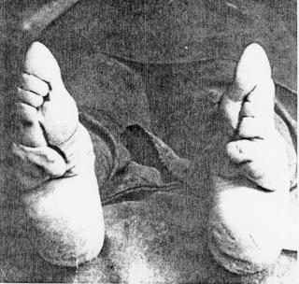
Foot Binding

Slide 27
Sui Dynasty Bellwork
What are at least three ways that the Sui Dynasty and Qin Dynasty are similar?
Unified China, Short rule, Unpopular building projects, Failed expansions, Forced labor

Slide 28
Objective
WWBAT: Discuss the accomplishments of China’s Golden Age and continue gathering info on Tang and Song China

