Slide 1
TWO WEEKS Bellwork
We have TWO weeks of Content left in class. We are at about 1950 in American History
What are THREE things you REALLY want to learn about in those two weeks?
Answers Vary

Slide 2
Objective
WWBAT: Introduce the GI Bill and its effects on African-Americans and Women

Slide 3
Interactive Notebook Setup
5/7/2018
GI BILL and Effects
This will be one page

Slide 4
GI BILL & Effects
Black Americans & GI BILL
Women & GI BILL

Slide 5
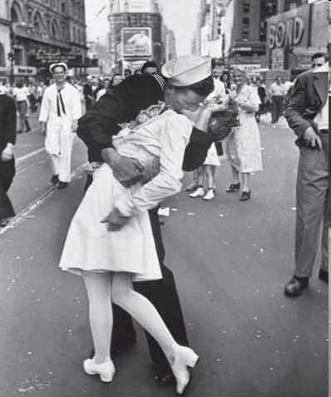
The U.S. after world war II
The U.S. economy grew greatly during the war
There were many who feared that with the end of the war would sink the U.S. back into the Great Depression
Thankfully these fears would be proven wrong

Slide 6
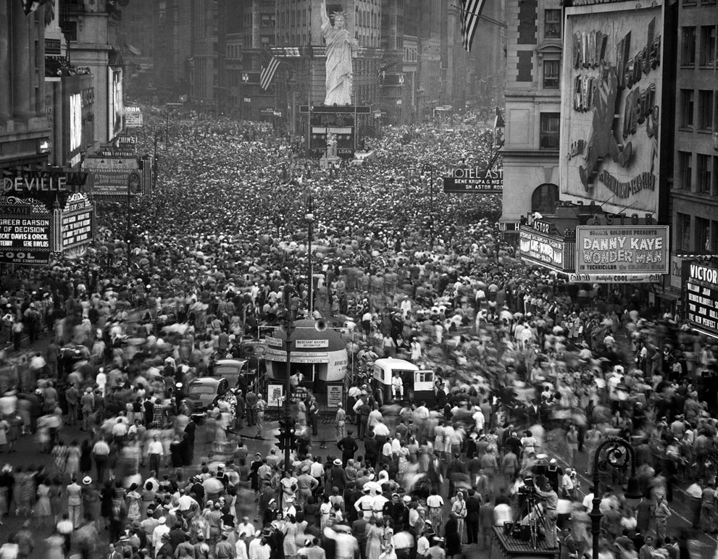

Slide 7
Financial Cost of WWII
U.S. $288,000,000,000
Germany $212,336,000,000
France $111,272,000,000 U.S.S.R. $93,012,000,000
Britain $49,786,000,000
Japan $41,272,000,000
Direct economic costs of WWII $1,600,000,000,000

Slide 8
World War II Casualties
World War II was by far the most devastating war in history
Over 60 millions people died as a result of World War II!
Almost 24 million Soviets died alone

Slide 9
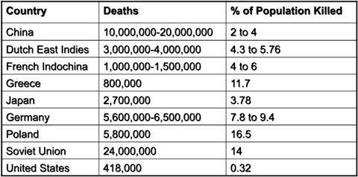

Slide 10
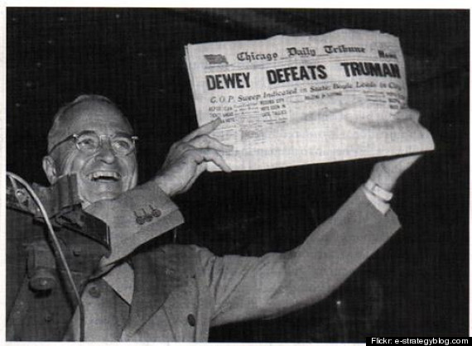

Slide 11
The G.I. BILL & EFFECTS
As the end of World War II seemed close to ending the U.S. gov. wanted to ensure the veterans of World War II were cared for
Something that not historically happened
In 1944 a monumental piece of legislation was passed
The Servicemen’s Readjustment Act of 1944 was passed
As known as the G.I. Bill

Slide 12
The Bonus Army
Patman Bill was to move up WWI veteran’s bonus payments from 1945 to 1933
Veterans camped near the Capitol to support the bill
Bill failed in Congress
Hoover’s removal of vets made Hoover appear heartless
With the U.S. capitol visible in the distance, shacks erected by the Bonus Expeditionary Force burn
Notes:
The U.S. government had promised World War I veterans a bonus, to be paid in 1945. Most veterans would have received a payment of approximately $500. However, when the Depression hit, Texas Representative John Wright Patman introduced a bill in Congress that would move the bonus payment up to 1933. In support of the Patman Bill, nearly 10,000 World War I veterans came to Washington D.C. Calling themselves the “Bonus Expeditionary Force,” they were led by a former Army sergeant, Walter W. Waters.
The Patman Bill passed in the House but failed in the Senate. Some marchers left and went home, while others remained in the Anacostia Flats camp near the U.S. capitol. President Herbert Hoover believed that the criminals and political radicals had infiltrated the remaining marchers, so he ordered Douglas MacArthur, the military commander of the District of Columbia, to remove them. MacArthur, along with his second in command Major Dwight D. Eisenhower, sent troops in to disperse the BEF. In the ensuing action, two veterans were shot and killed, tear gas asphyxiated two infants, several others were injured, and the Bonus Army camp burned down. Many people across the country saw Hoover as heartless and unsympathetic to the veterans’ plight because of the excessive force he used to remove the BEF. His actions contributed to his loss in the 1932 presidential election.

Slide 13
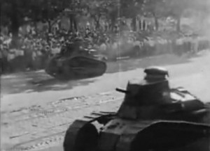
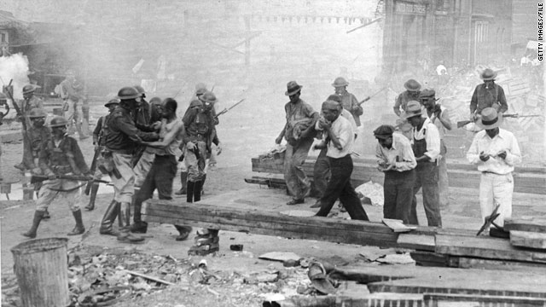

Slide 14
The G.I. BILL & EFFECTS
There was a great fear of what over 12 million veterans returning to the workforce would do to the economy
There was also a great sense of obligation to reward the veterans of World War II
As a result they sought a plan to help these veterans transition back to life in after the war

Slide 15
The G.I. BILL & EFFECTS
The G.I. Bill had a few major parts that would reshape the U.S. forever:
Essentially free college tuition and vocational training
Free student housing, books, and materials as well
Free medical benefits and protection
Low interest loans/mortgages to purchase houses and business
Interest rates would be protected by the U.S. government
Unemployment benefits
$20 dollars a week for 52 weeks
The 52/20 club

Slide 17
The G.I. BILL & EFFECTS
One million veterans attended colleges and universities
3.5 million mortgages and loans were given as a result of the bill
In 1947 this made up forty percent of all housing starts!
A huge reason that the U.S. was so successful economically after World War II was the G.I. Bill

Slide 18
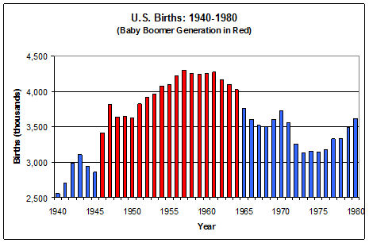
It seems to me that every other young housewife I see is pregnant. British visitor to America, 1958

Slide 19
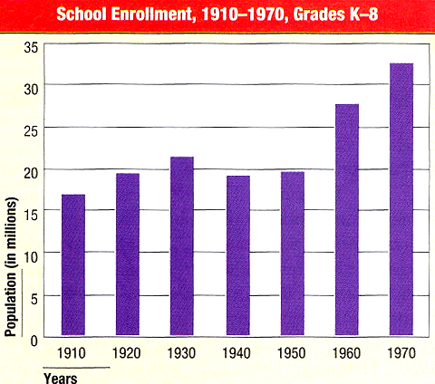

Slide 20
Suburban Living
Levittown, L. I.= “The American Dream”
1949 → William Levitt produced 150 houses per week.
$7,990 or $60/month with no down payment.

Slide 21
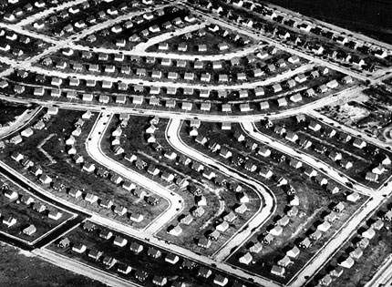
1950s, 85% of new homes built in suburbs By 1960 → 1/3 of the U. S. population in the suburbs.
The G.I. BILL & EFFECTS
The G.I. Bill

Slide 22
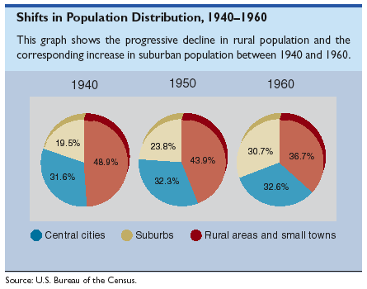

Slide 23
The G.I. BILL & EFFECTS
By 1956, majority of Americans not in blue-collar (industrial) jobs
By 1956 → more white-collar than blue-collar jobs in the workforce
More in higher-paying, white-collar (office, professional) positions
Many in services, like sales, advertising, insurance, communications

