Slide 1
Document Based Question
15 minute reading period
45 minutes suggested for writing
You must do the following in your essay:
State a relevant thesis that directly addresses ALL parts of the question
Support the thesis with evidence from all, or all but one, of the documents
Incorporate analysis of all, or all but one, of the documents

Slide 2
*
Focus your analysis of each document on one of the following: historical context, intended audience, purpose, and/or point of view (HIPP-)
Support your argument with analysis of historical evidence outside the documents (-O)
Connect historical phenomena relevant to your argument to broader events of processes
Synthesize the elements above into a persuasive essay that extends your argument, connects it to a different historical context, or accounts for contradictory evidence on the topic
*

Slide 3
Step 3:
The Documents…
Note the order- chronological? No? – does their order help in applying the historical thinking skill?
Read the documents quickly and carefully
READ THE SOURCE!!!!! Author, date, place it came from
Underline key words
Note point of view
Summarize in a few words the main idea of the doc
ADDRESS AT LEAST ONE OF THE FOLLOWING:
Historical Context, Intended Audience, Purpose, Point of View
Note any additional outside info that comes to mind at this point

Slide 4
Document Based Question
15 minute reading/planning period
45 minutes suggested for writing

Slide 5
Essay Prompt:
Using the following documents and your knowledge of history, analyze the responses to the spread of Buddhism in China prior to the 10th Century C.E.

Slide 6
Essay Prompt:
Evaluate the extent to which spread of Buddhism in China prior to the 10th Century C.E.

Slide 7
Step 1:
Read all parts of the question carefully
Identify type of essay/task verb
Underline key words
Identify/underline themes/essay topics
CIRCLE TIME FRAME
Make sure you know WHAT IS BEING ASKED

Slide 8
Essay Prompt:
Using the following documents and your knowledge of history, compare methods of establishing and legitimizing power used by Land Based Empire between 1450-1750.

Slide 9
Step 2:
Write down any outside information you know about the time period or theme BEFORE you start reading the documents.
Brainstorm about any potential arguments/ideas that come to mind right away
Write them down!

Slide 10
Step 3:
The Documents…
ANNOTATE THE DOCUMENTS!!!
Underline or circle key ideas that relate to the focus on the prompt
Identify Author, date, place it came from, document type, ect for potential HIPP/SOURCING
Comments/observations in the margins that will help with analysis
BE CLEAR ENOUGH YOU CAN COME BACK AND READ AND UNDERSTAND ANNOTATION
GROUP DOCUMENTS BASED ON ARGUMENTS!

Slide 11
LEFT-RIGHT SIDE ANNOTATION
LEFT MARGIN:
Annotations relating to key ideas of documents
RIGHT MARGIN:
Sourcing documents(HIPP!)

Slide 12
Step 4:
Re-read the prompt
Write your thesis

Slide 13
DBQ Essay Format
Paragraph 1 –
Provide the historical context – what’s going on?
Example: what major events/moments in history led to what you are discussing
Thesis Statement
Fully addresses the question
Takes a position
Include 3 arguments
Provides organizational categories (social, economic, political)

Slide 14
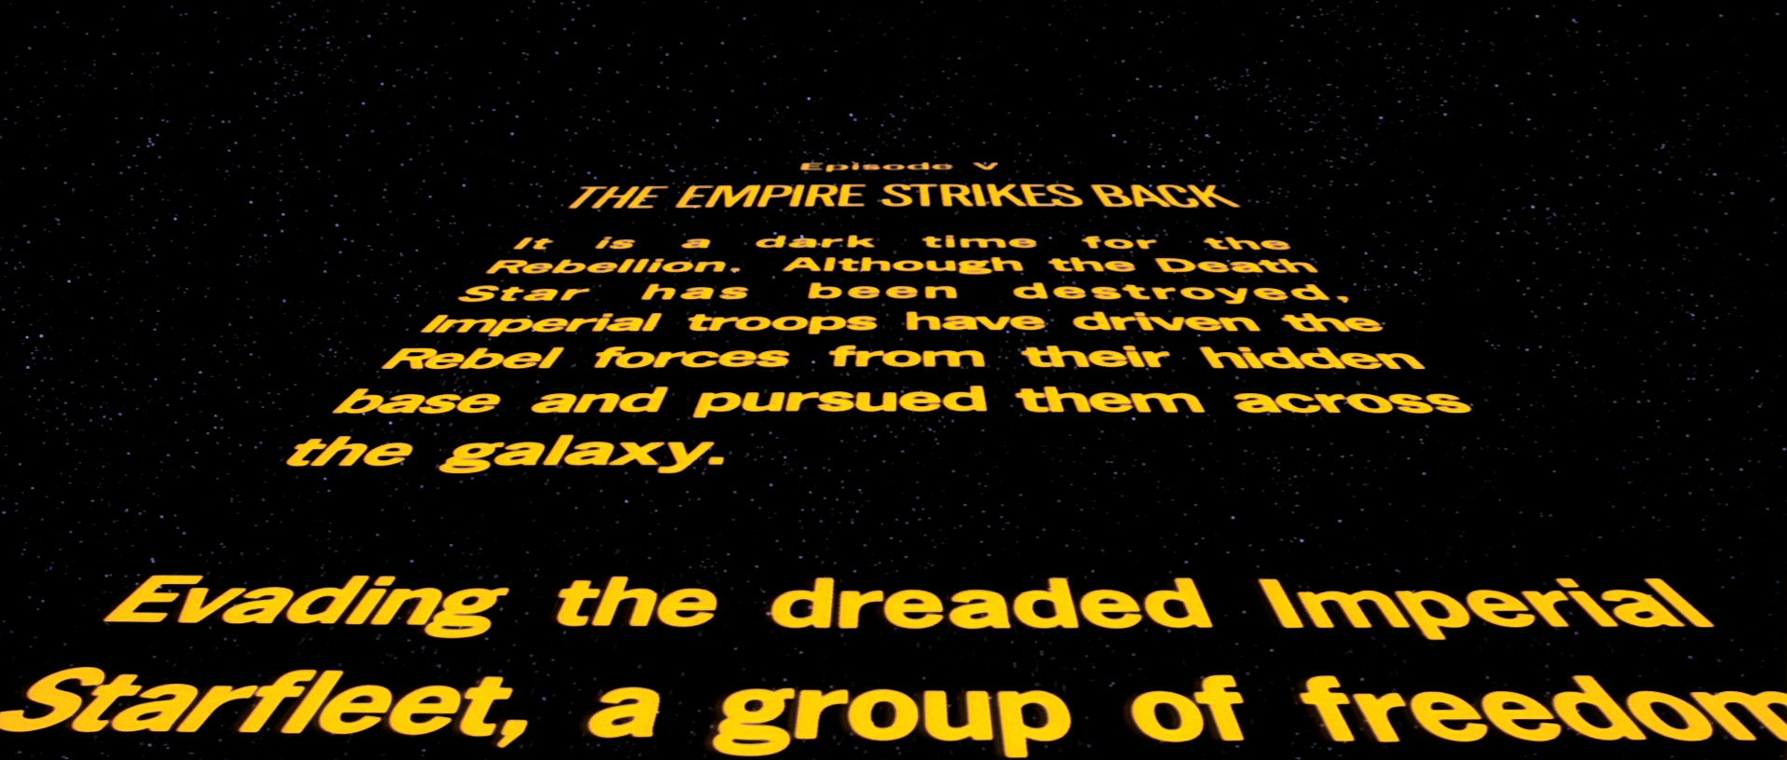

Slide 15
Paragraph 2,3&4 – Body Paragraphs
Each paragraph is based on one of your arguments
Introduced with a topic sentence
Always connect to your thesis – what does this paragraph have to do with the point you’re trying to make?

Slide 16
Paragraph 2,3&4 – Body Paragraphs
For DBQs:
Use documents to support your arguments
Include Sourcing/HIPP
Be SPECIFIC with MULTIPLE examples/pieces of evidence from documents

Slide 17
Paragraph 2,3&4 – Body Paragraphs
Be SPECIFIC with MULTIPLE examples/pieces of evidence from documents
ONE piece of OUTSIDE EVIDENCE

Slide 18
Paragraph 5 – Conclusion
RESTATE THESIS
Do not add any additional support/info to your argument
Make a connection to another time, event in history (PAST OR PRESENT!!)
OR
Concede – point out an argument from the “other side” (this may not be an option for all essay prompts, so it’s not always possible/required)

Slide 19
Citing a DBQ Document
This method is best for all DBQ essays
IDENTIFY it, VERB it, EXPLAIN it. (#)
Identify it – Say what DOC is/who made it
(DON’T SAY “In document 1…”)
Example:
The political cartoon created by the New York Times …
The letter written by Louis XIV…

Slide 20
Verb it- Say what DOC is doing!
(states, explains, says, argues, etc.)
Example:
The political cartoon created by the New York Times shows anti-immigrant attitudes in the USA…
The letter written by Louis XIV states his views on the powers of kings…

Slide 21
Explain it – finish your thought!
YOUR ANALYSIS!
EXPLAIN HOW THE EVIDENCE SUPPORTS YOUR THESIS/ARGUMENT
Think of this as the YOU in your essay, these are your Ideas, interpretation, ect
Use intro phrase like “which demonstrates” or “this shows”

Slide 22
Explain it –
*At the end of the sentence you can cite the document by putting the NUMBER in parenthesis – example: (1)

Slide 23
Example:
The political cartoon created by the New York Times shows anti-immigrant attitudes in the USA, which demonstrates that some people opposed migration during the late 1800’s based on ideas of nationalism and racist ideas.
The letter written by Louis XIV states his views on the powers of kings, this shows the use of Divine Right and Absolute Monarchy that many European kings uses to centralize power.

Slide 24
REMEMBER:
Do not quote long passages of the documents if you have to quote at all; it’s better to summarize in your own words
Note relationships: similarities, differences, causes/effects of all of the documents in the group
NEVER USE I, IN MY OPINION, OR ANY FIRST PERSON!!!

Slide 25
REMEMBER:
The DBQ ABOUT YOUR ARGRUMENT NOT THE DOCUMENTS!
Documents are there as evidence and to help you… which can be guided but should not be only based on the documents.
Must use all or all but 1 of the documents.

Slide 26
Important final step for Documents:
After incorporating your analysis be sure to write a sentence that does ONE of the following:
Explains why the source is important in relation to the question being asked
OR
Explains what the source has to do with the question being asked

