Slide 1
European Imperialism Bellwork
What are the three motivations for New Imperialism we discussed in class?
Raw materials, new markets, and nationalism
How did Europeans attempt to justify their New Imperialism?
Social Darwinism and “science” of “Racial Superiority”

Slide 2
Objective
WWBAT: Discuss colonial rule and economic practices in Africa and Asia

Slide 3
Interactive Notebook Setup
4/13/2016
European Colonies and Economies
This will be one page

Slide 4
Force Labor
Path of Colonial Status
Under European Rule
Cash-Crop Agriculture
Wage Labor

Slide 5
A Second Wave of European Conquests
First Wave of European Colonialism | Second Wave of European Colonialism
1500s - 1600s | 1750 – 1900
In the Western Hemisphere (Americas) | In Africa and Asia
Spain and Portugal = were major players; NOT ANYMORE DUN DUN DUN | New countries involved = Germany, Italy, Belgium, the U.S., Japan
Devastated native populations | No massive devastation done to native peoples
Europeans chose the path of conquest and outright colonial rule | Europeans preferred informal control (cheaper & less likely to cause war)
Construction of 2nd-wave European empires in Africa and Asia involved military force or the threat of using it
Although they would have preferred non-violent takeovers, Europeans often had to fight in wars of conquest to create their empires
Always won in the end → superior militaries and weapons

Slide 6
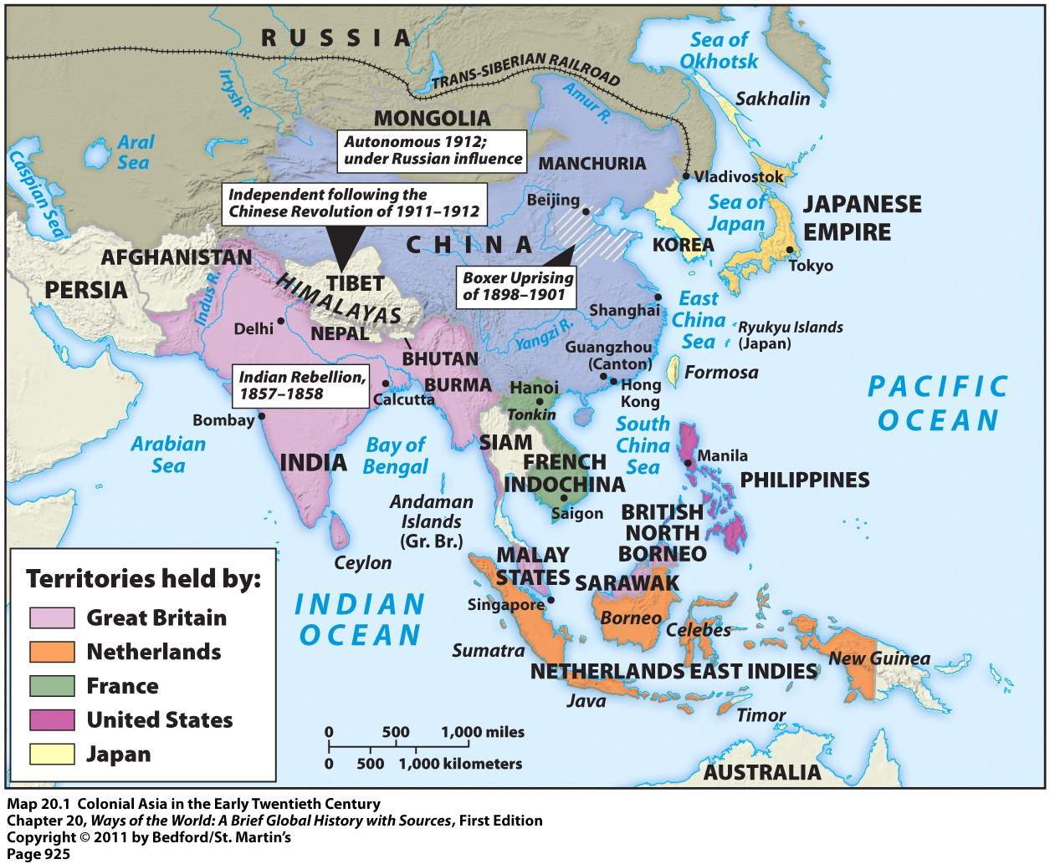
Colonial Asia in the Early 20th Century

Slide 7
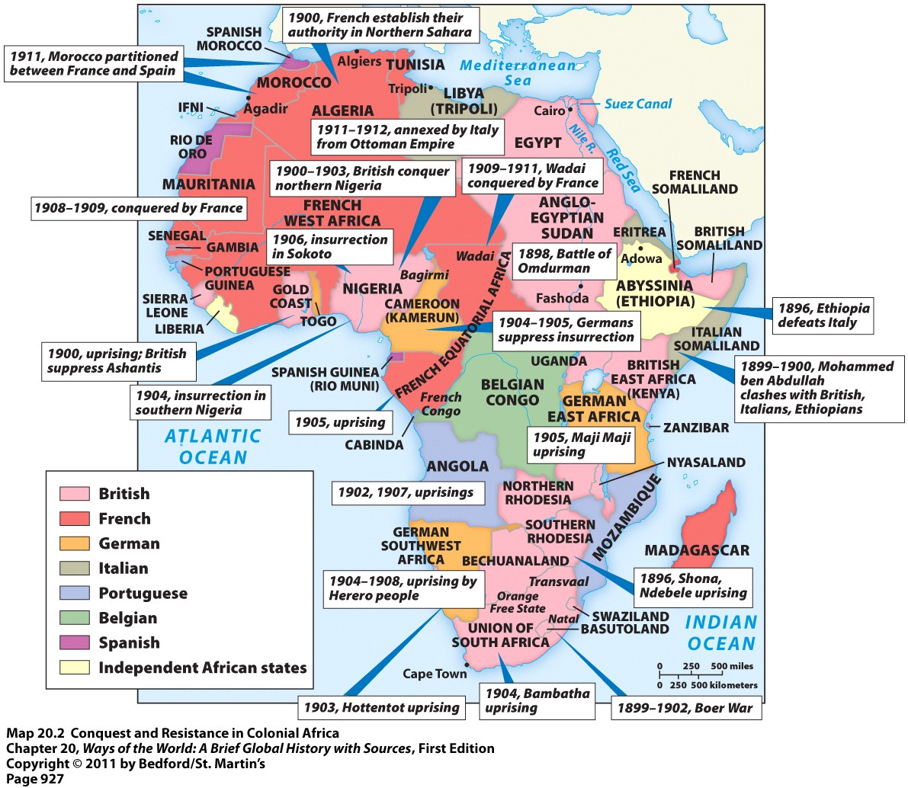
Colonial Africa in the Early 20th Century

Slide 8
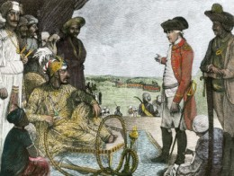
Paths to Colonial Status
In India and Indonesia colonial conquest grew out of earlier interactions with European trading companies
India became controlled by Britain
Indonesia became controlled by the Dutch
Conquest evolved slowly as local authorities and European traders made and unmade a variety of alliances
Acquisition of India and Indonesia = fairly easy because both were fragmented territories with no political unity
British authorities meeting with Mughal leaders

Slide 9
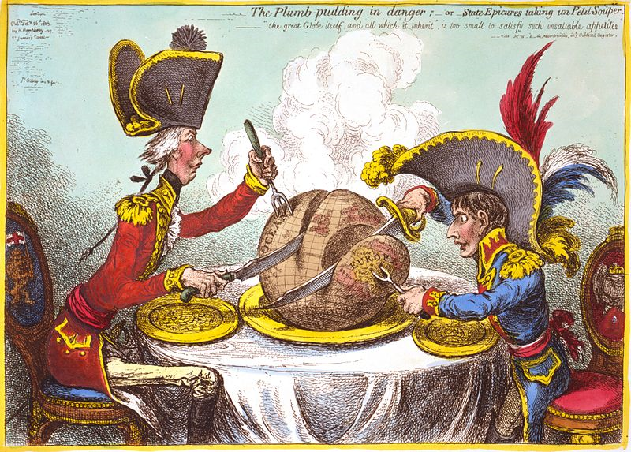
Paths to Colonial Status
Africa, mainland Southeast Asia, and the Pacific islands = occurred later = in the 2nd half of the 19th century
More abruptly and deliberately than anywhere else

Slide 10
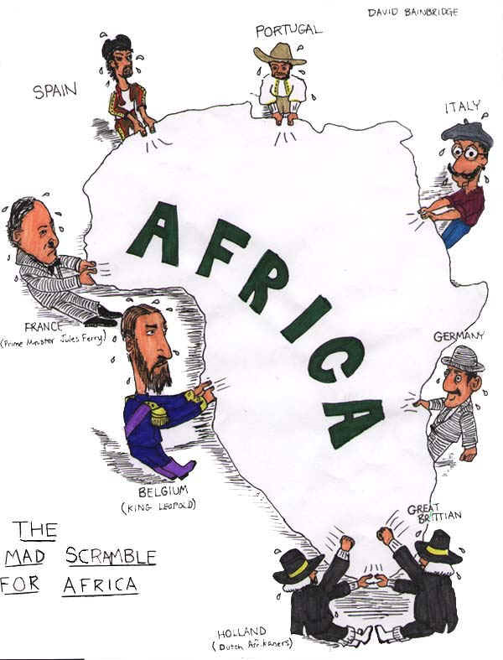
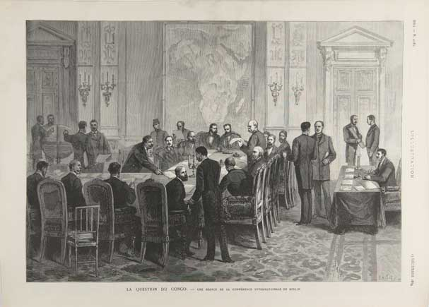
Paths to Colonial Status
One European country after another began to claim parts of Africa
Able to take African territories easily because they had superior weapons and a lot of money
In 1885 several European nations met at Berlin Conference to decide how to divide up Africa
No African leaders invited
Peaceful negotiations made between the European powers that officially decided “who got what”
By 1914 Europeans controlled 90% of Africa
European powers often had to use extensive and bloody military action to maintain control within their acquired African territories
The Berlin Conference

Slide 11
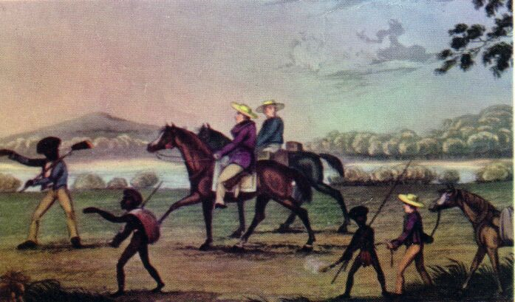
Paths to Colonial Status
Australia and New Zealand were both taken over by the British
Similar to the earlier colonization of North America
Conquest accompanied by massive European settlement and diseases that reduced native numbers
Became settler colonies with thousands of Europeans settling = “neo-European” societies in the Pacific
White Settlers in Australia

Slide 13
Under European Rule
Many groups and individuals willingly cooperated with colonial authorities
Many men found employment, status, and security in the European-led armed forces
Colonial rulers = expensive, in short supply, and could rarely communicate with their subjects
Local intermediaries needed
Local intermediaries typically from elite or governing families used as representatives of European powers
Local intermediaries could retain their status and gain wealth by exercising authority at the local level

Slide 14
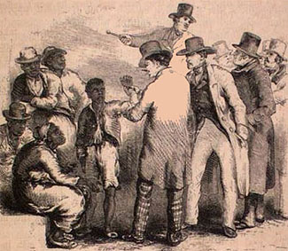
Under European Rule
Major factor distinguishing the rulers from the ruled was race
Education for colonial subjects was very limited
Limited to practical subjects
Europeans were afraid that education and knowledge would lead to power for colonial subjects

Slide 15
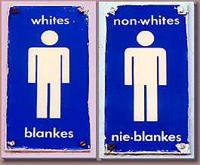
Under European Rule
Colonies with large European settler populations created blatant pattern of racial segregation
Example :
Apartheid or racial segregation in South Africa
Racial system provided for separate: “homelands,” educational systems, residential areas, public facilities, etc.

Slide 16
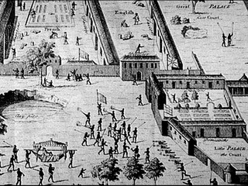
Under European Rule
European powers were much more involved and “hands on” with their colonial states in the 19th century
Affected the daily lives of people far more than empires had in the past
Centralized tax-collecting agencies
New modes of transportation and communication created
Imposed changes in landholding patterns
Integration of colonial economies into global trade network
Public health and sanitation measures
European factories on the west coast of Africa

Slide 17
Under European Rule
European colonizers felt the need to count, classify, and organize their colonial subjects
Wanted a way to manage the unfamiliar, complex, varied, and changing societies that they now controlled
Made colonial administration easier, but often disregarded tribal histories/relationships
Ex: In African colonies, Europeans identified and sometimes even invented distinct tribes → each with its own territory, language, customs, chief, etc.

Slide 18
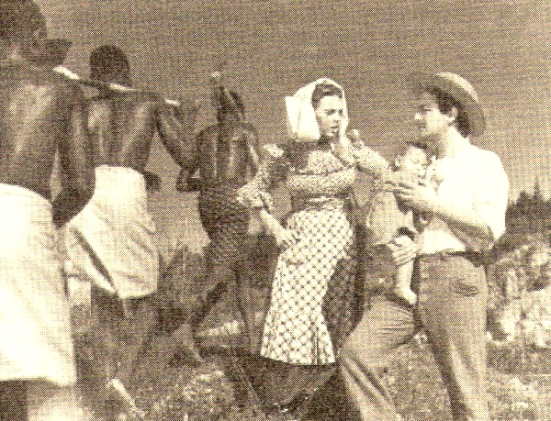
Forced Labor in Colonies
Forced labor was often used to meet the demands of the colonial state
Examples:
Building railroads
Constructing government buildings
Transporting goods

Slide 19
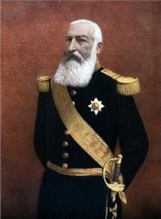
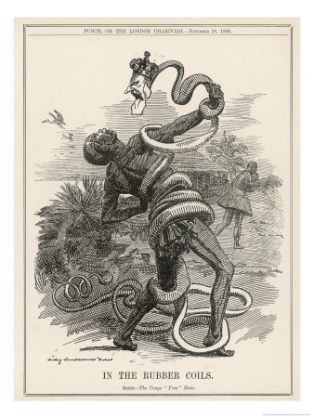
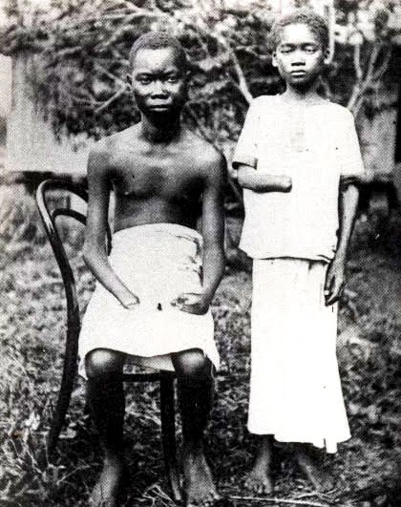
Forced Labor in Colonies
Most infamous cruelties of forced labor = in the Congo in the early 1900s
Governed by King Leopold II of Belgium
Forced villagers to collect rubber → they had daily rubber quotas
If rubber quotas were not met, villagers were tortured and/or killed
Shot, ears/limbs cut off, tied up with ropes around their necks and dragged away, etc.

Slide 20
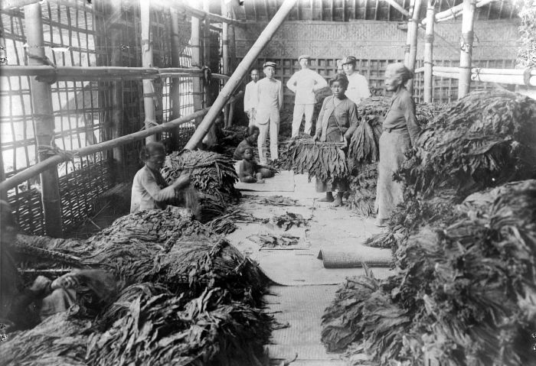
Forced Labor in Colonies
Several colonial states used “cultivation systems”
Peasants required to cultivate 20% or more of their land in cash crops such as sugar or tobacco to meet their tax obligation
Cash crops sold to government contractors at fixed, low prices
Cash crops resold in the world market for a very high profit
Sorting Tobacco Leaves in Java, 1930s

Slide 21
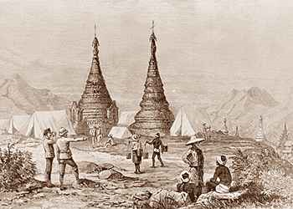
Cash-Crop Agriculture
In some places, colonial rule/policies increased cash-crop production to the advantage of local farmers in West Africa and Southeast Asia
Example: British authorities in Burma encouraged rice production among small farmers
Ended the prohibition on rice exports
Provided irrigation and transportation facilities
Passed laws that encouraged private ownership of small farms
British Authorities Surveying Rice Production in Burma

Slide 22
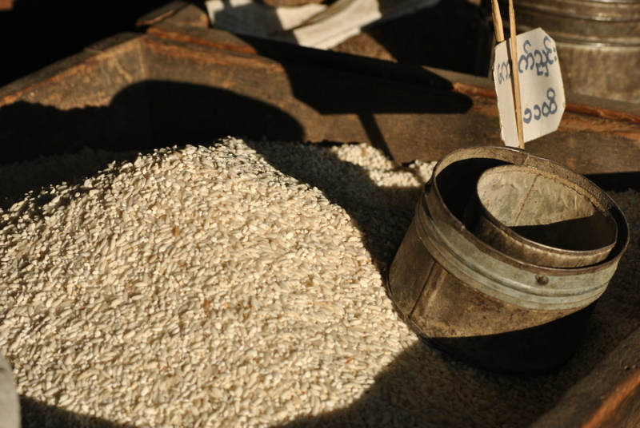
Economies of Cash-Crop Agriculture
Results of these policies in Burma:
Population boomed → in Burma AND in other parts of Asia
Rice exports soared
Small farmers able to buy their own land, build nice homes, buy imported goods, etc.
Standards of living improved sharply

Slide 23
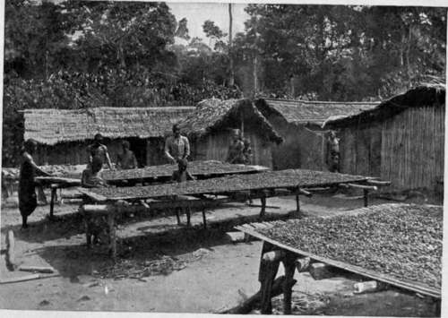
Cash-Crop Agriculture
Profitable cash-crop farming in the southern Gold Coast
British territory in West Africa
Modern-day Ghana
African farmers themselves developed this export agriculture
Planted cacao trees in huge quantities and became the world’s leading supplier of cocoa by 1911
Drying Cocoa Beans in the Gold Coast

Slide 24
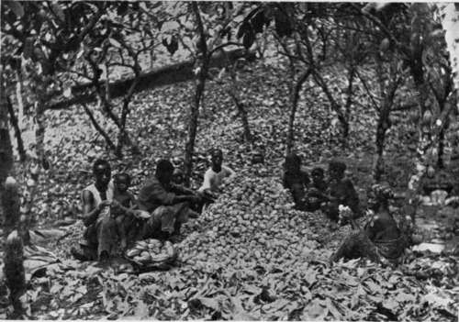
Cash-Crop Agriculture
Problems with this success:
Labor shortages caused:
Led to employment of former slaves who were exploited
Led to migration of workers from the interior of Africa to the Gold Coast which caused ethnic and class tensions
Some men married women for their labor power, but didn’t take care of them
Many colonies only specialized in one or two cash-crops which made regions vulnerable to world market prices drops
Breaking Open (Cracking) the Pods

Slide 25
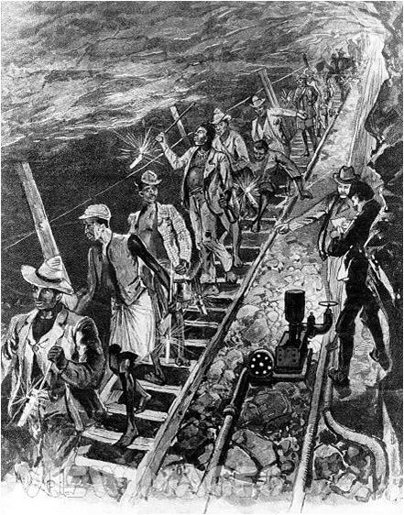
Wage Labor
Millions of colonial subjects across Asia and Africa sought employment in European-owned plantations, mines, construction projects, and homes
Needed money
Lost land they needed to support their families
Sometimes forced by colonial authorities
Workers in a South African Mine

Slide 26
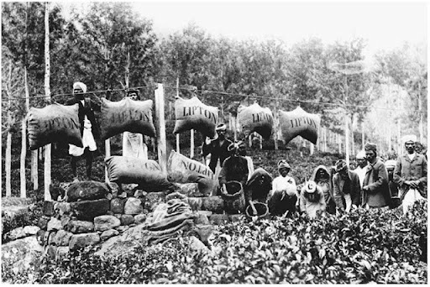
Wage Labor
European-financed plantations in Southeast Asia that grew sugarcane, rubber, tea, tobacco, ect and employed hundreds of thousands of workers
Workers = subject to very strict control
Often housed in barracks
Paid very little (and women made even less)
Disease was common → high death rates
Tea Plantation in Ceylon

Slide 27
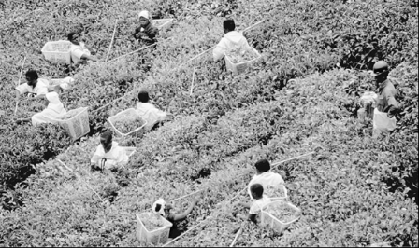
Wage Labor
Even more land taken from local people in Africa than in Southeast Asia
Ex: South Africa in 1913 → whites were 20% of the population, but controlled 88% of the land
“Squatters” = Africans who stayed and worked for the new landowners as the price of remaining on what had been their own land
Workers Harvesting Leaves on an African Tea Plantation

Slide 28
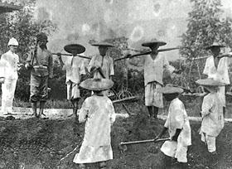
Wage Labor
Many colonial subject worked in mines for gold, silver, tin, diamonds, ect
Worked in awful and dangerous conditions for small wage
Worked on strictly-controlled 3-year contracts
Horrible living conditions
Rampant diseases
High death rates
Chinese Tin Miners

Slide 29
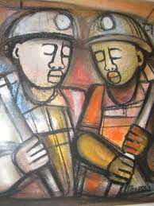
Economies of Wage Labor: Working for Europeans
Recruited on short-term contracts
Lived in all-male prison-like barracks surrounded by barbed wire
Forced to return home periodically so they didn’t establish a permanent family life near the mines
Painting of Two African Miners

