Slide 1
Neolithic Age Bellwork
What were three impacts of the Neolithic Revolution?
CA: Sedentary Communities, Craft Specialization, Population growth, Food Surplus, lead to domestication of animals

Slide 2
Objective
WWBAT: Define civilizations and create examples of the 5 characteristics of civilization

Slide 3
Today’s Activity
Today we are going to talk about civilizations and the characteristics which make a civilization
But first we must define civilization
My Definition:
A complex culture in which large numbers of humans share a number of common characteristics

Slide 4
What are the 5 key components of a civilization?
To be considered a “civilization,” certain characteristics must exist within a group of people
In your rows take a few minutes to come up with at least 5 characteristics that you think an area/group of people need to be considered a civilization

Slide 5
Today’s Activity
I will provide you with each of the 5 characteristics of civilization
For each characteristic you will need to Include:
At least two bullets of information
An Example
An Example in Tucson

Slide 6
Advanced Cities
The people of a civilization must be living in a given location – namely, a city
Today, people live in cities as well as towns and villages.

Slide 7
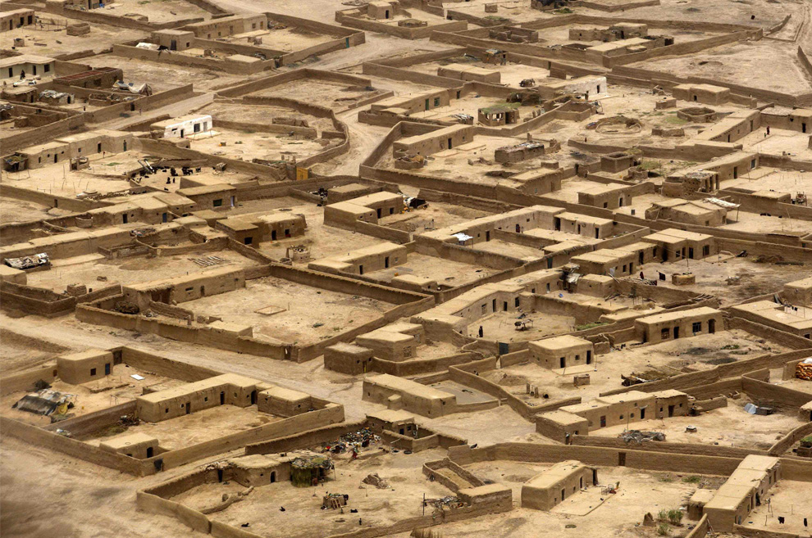
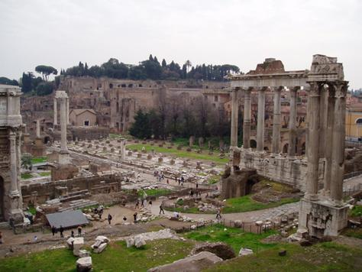
Ancient Cities
Ancient cities became the center of trade for a large
area of land

Slide 8
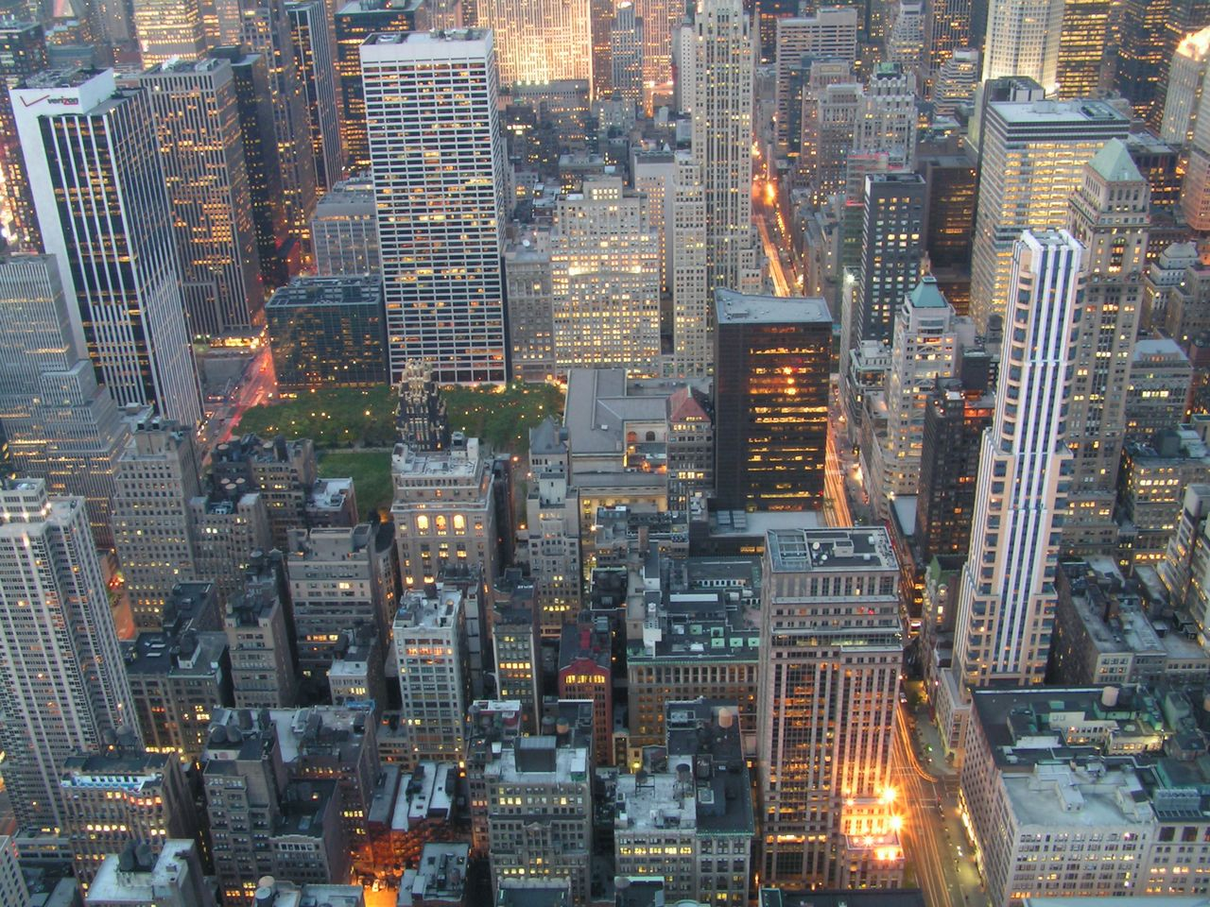
Modern Cities

Slide 9
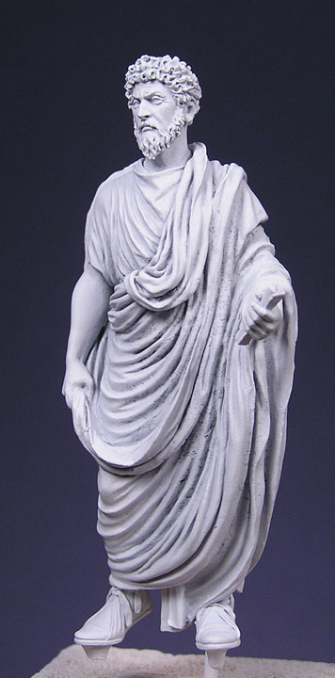
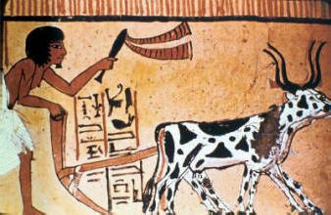
Specialized Workers
People within civilizations have specific roles within their city.
What roles might there be in ancient civilizations?

Slide 10
Specialized Workers
As cities grew, individuals took on specific roles in society
Government officials
Priests
Artisans (skilled workers – jewelry, pottery, weapons)
Food surplus led to specialization. How?
Fewer people needed in the fields

Slide 11
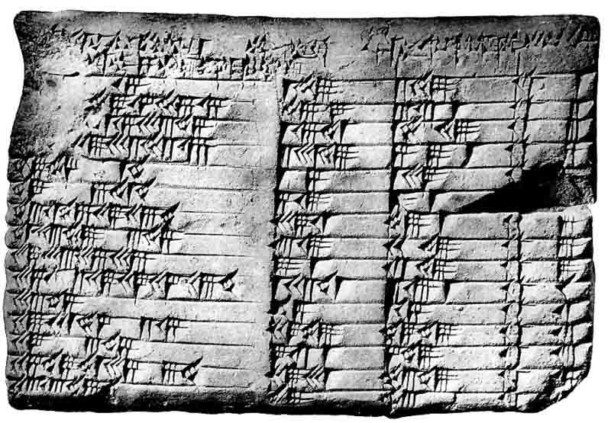
Record Keeping
Civilizations must have a way to keep records.
What does this require?
What might a civilization keep records of?

Slide 12
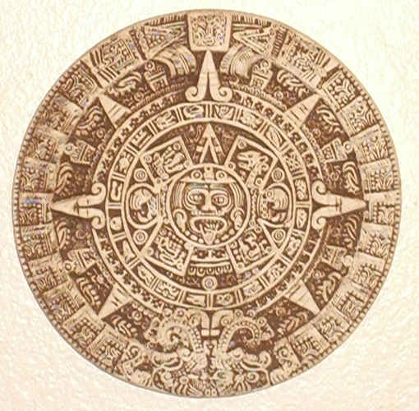
Record Keeping
Government
Tax collection
Laws
Grain storage
Priests
Calendar
Yearly rituals (sacrifices!)
Merchants
Debts and payments

Slide 13
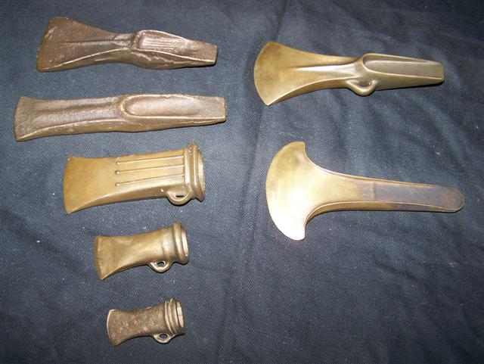
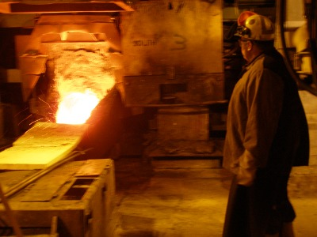
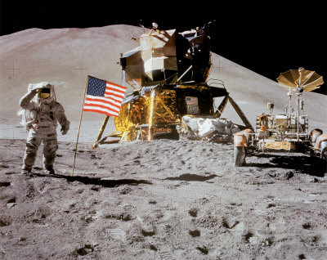
Advanced Technology
A civilization must have the skills and means to use, modify, and improve resources.

Slide 14
Advanced Technology
What were some early technologies?
Examples:
Plows
Irrigation
Potter’s wheel
Bronze (alloy of copper and tin)
Bronze Age: lasted while people used bronze as the primary metal to make jewelry, tools, and weapons

Slide 15
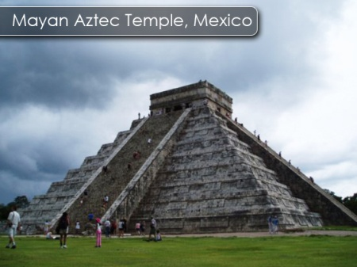
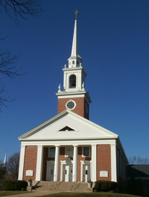
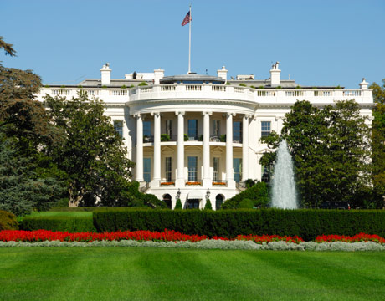
Complex Institutions
Civilizations must have a system made
up of complex institutions.
What is an institution? Give some examples.
A significant organization in a society
Examples:
Government
Religion
Education

Slide 16
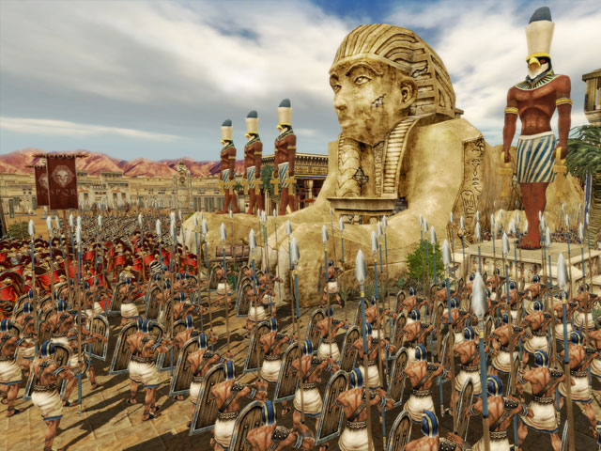
CIVILIZATION!

Slide 17
Civilization
Complex Institutions
gov't, religion, education, etc.
Record Keeping
food supplies, laws, tax collection
Advanced Technology
Specialized Workers
Advanced Cities
tools, metalworking
leaders, farmers, soldiers, artisans
large centers of trade

Slide 18
Civilization Readings
We are now going to do some reading on some of the earliest civilizations
The Ancient Mesopotamian Civilizations and the Ancient Egyptians
While you are reading I want you to look for examples of the five characteristics of a civilizations in these two ancient civilizations

Slide 19
Civilization Readings
You will use your textbooks to find these examples
For each example you find you must also give me a couple sentences to explain how it represents the characteristic of civilization
Read from pages 18-26 in your books

Slide 20
Our New Unit
We are going to start looking at the earliest civilizations now
We will examine Mesopotamia, Egypt, India, and China
Before we talk about these civilizations we must first define what a civilization is

Slide 21
Today’s Activity
Our goal is to be able to decide if Tucson has the characteristics of a civilization
By the end of the period we will have enough information to make this decision

