Slide 1
Interactive Notebook Setup
9/17/2018
Classical Empires Characteristics
This will be one page

Slide 2
Background and Motivation for Expansion
Classical Empire Characteristics
Effects of Development of Empires

Slide 3
Background and Motivation for Expansion
During period 1 states controlled relatively small territory and conquest/conflict tended to stay relatively local
The Egyptians and the Assyrians were really the only group to create true empires, but even they were centered in Middle East
That would change in Period 2
Major empires would develop for the first time and reach heights never seen before

Slide 4
Background and Motivation for Expansion
An empire checklist:
Multi-Ethnic or Multi-Cultural
Some sort of unifying government
Usually, but not exclusively centralized
Large population and territory
Established by conquest or diplomacy

Slide 5
Background and Motivation for Expansion
Reasons empires were established:
Secure borders/territory
Often from rivals or nomadic groups on the edge of territory
Gain access and control of resources
Gain wealth from taxes/trade

Slide 6
Classical Empire Characteristics
Empires are difficult to established and control, due to their diversity
New forms of government/administration were established in order to maintain control of these empires

Slide 7
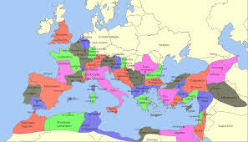
Classical Empire Characteristics
Many empires relied on bureaucrats and provincial leaders to help run and administer the government

Slide 8
Classical Empire Characteristics
Bureaucrats were often given positions based on ability
Provincial leaders were often given positions to win loyalty of conquered people/reward military leaders

Slide 9
Classical Empire Characteristics
Legal systems/codes became more complex as empires grew in size/population
Incorporated conquered laws
Many empires allowed conquered people to maintain some laws/customs

Slide 10
Classical Empire Characteristics
Classical age empires developed major capital imperial cities
Roles of Imperial cities:
Centers of trade
Areas of religious worship/customs
Often location of major temples/churches
Centers of political administration
Central government offices/areas of paying political tribute

Slide 11
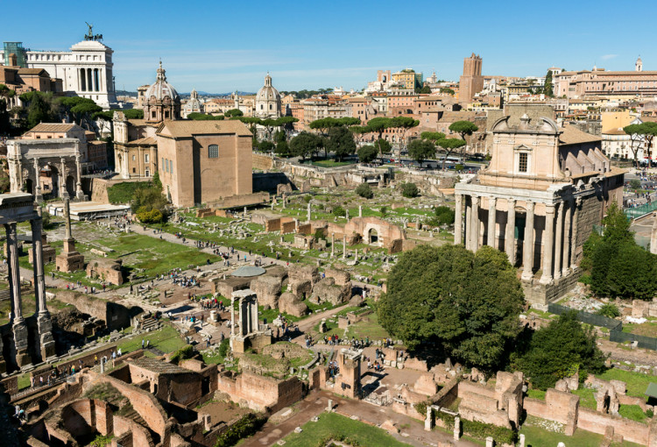

Slide 12
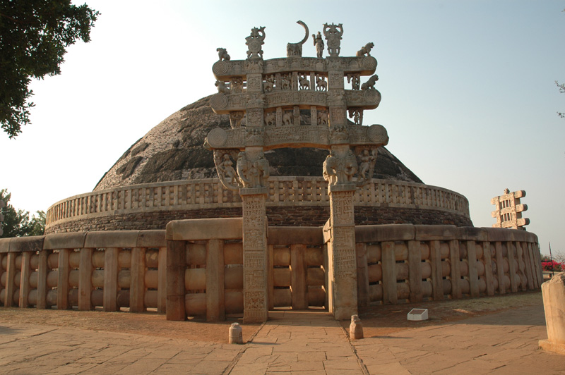

Slide 13
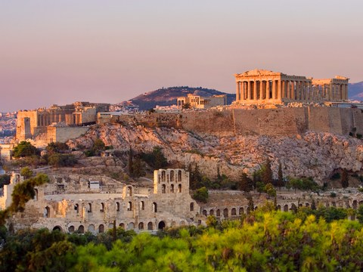

Slide 14
Effects of Development of Empires
Imperial growth/expansion spread:
Religious traditions and practices
Most notably Christianity and Buddhism
Sometimes by force
Languages
Latin, Sanskrit, Farsi/Persian, ect
Styles of Art and Architecture
Often blended with local cultures
SYNCRETISM!!!

Slide 15
Effects of Development of Empires
Empires helped increase long distance trade:
Building Roads/Rest houses
Persian Royal Road, Roman Imperial Road
Military Support
Issuing currencies
Made exchange of goods much easier

Slide 16
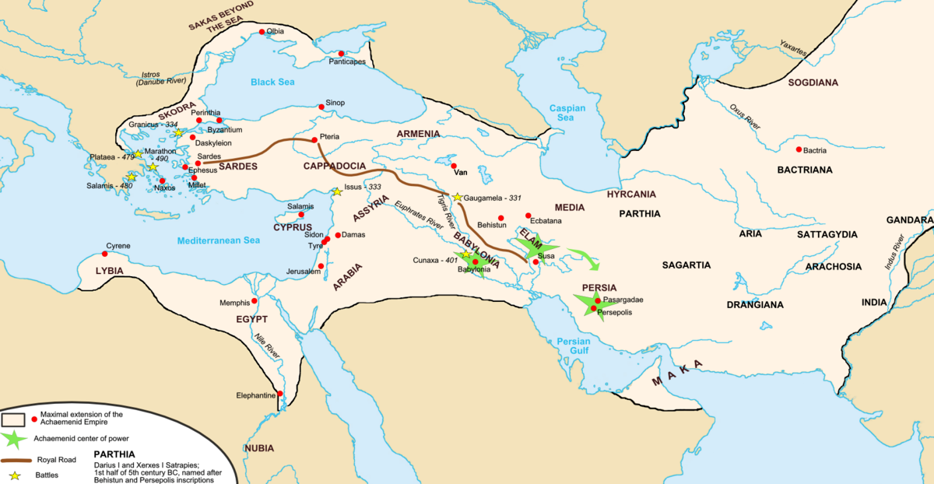
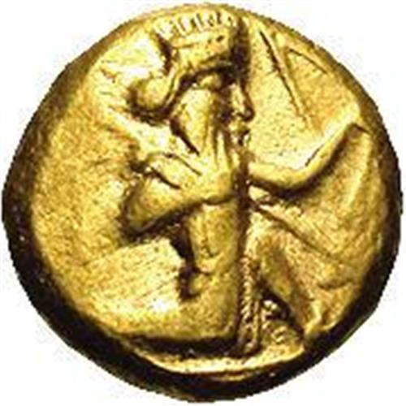
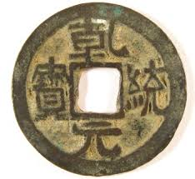
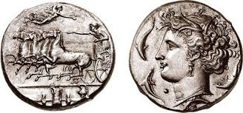
Effects of Development of Empires

Slide 17
Effects of Development of Empires
Social Hierarchies became more complex and diverse
New groups and types of jobs had to be incorporated and this often made things more complicated
Some empires were not as willing to make these adjustments

Slide 18
Effects of Development of Empires
Agricultural/Food Production had to increase to serve larger population
Due to:
New technology & agricultural practices
New labor system

Slide 19
EMPIRES TO CHOOSE FROM
Roman Empire
Archimedean Persians
Maurya Empire
Gupta Empire
Han Dynasty
Qin Dynasty
Mayan Empire
Macedonian/Hellenistic Empire

