Slide 1
Interactive Notebook Setup
9/7/2017
Main Ideas of Buddhism
This will be one page

Slide 2
Background
Core Beliefs
Split in Buddhism

Slide 3
BRING BOOKS TOMORROW!!!

Slide 4
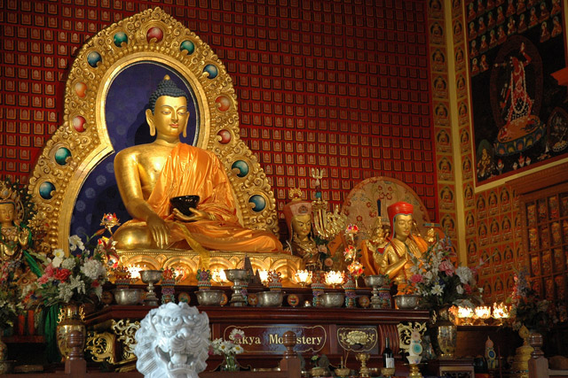
Buddhism

Slide 5
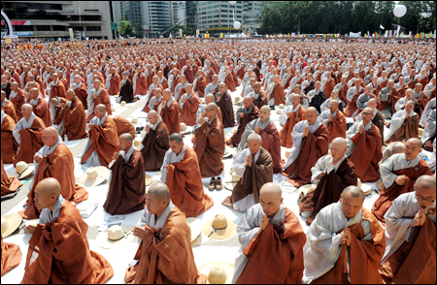
Buddhism
Today we are going to begin our section on Buddhism
Buddhism is a fascinating religion, because it is quite different than the monotheistic religions that we might be more familiar with

Slide 6
Buddhism
Buddhism is the 4th largest religion in the world
It is a major force in the world, especially in Asia
We are going to start our examination of Buddhism by looking at the origins

Slide 7
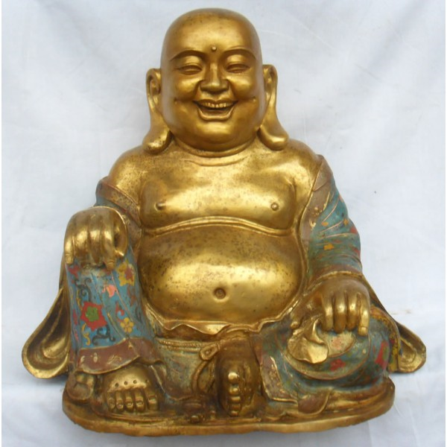
East Asian Buddha

Slide 8
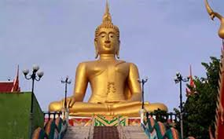
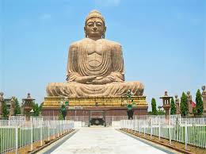
Indian Buddha

Slide 9
Background
Developed in India during the 6th Century BCE
Founder = Siddhartha Gautama (Buddha)
Abandoned comfortable life to become a monk to end suffering
Developed from Hinduism

Slide 10
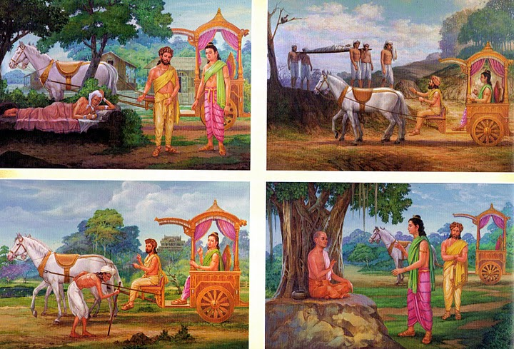
FOUR SIGHTS

Slide 11
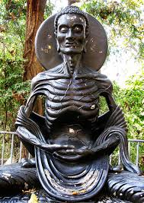
Background
Lived as an extreme ascetic in search of Enlightenment
Discovered and taught the Middle Way, a life moderation, to reach enlightenment

Slide 12
Core Beliefs
Brought in major aspects from Hinduism, such as: Karma and Reincarnation
MAIN IDEAS=The Four Noble Truths
There is suffering
The origin of suffering is craving/attachment
There is an end to suffering
Suffering ends via Eightfold Path/Middle Way

Slide 13
The Eightfold Path
Right views
Right intention
Right speech
Right conduct
Right livelihood
Right effort
Right mindfulness
Right meditation

Slide 14
Core Beliefs
Meditation and self reflection is key
No caste system, dependence on priests, or rituals
Use of vernacular language to spread message, not Sanskrit
Reject material world/possessions

Slide 15
Core Beliefs
Teachings of Buddhism called The Dharma
Important writing called Sutras
Like Hinduism one can only break out of the cycle of reincarnation by achieving Enlightenment or Nirvana is the state of perfect spiritual independence

Slide 16
Split in Buddhism
Theravada Buddhism:
The oldest school of Buddhism.
The “Way of the Elders” or the “Small Vehicle.”
Found in S/S.E. Asia
The monastic life is the best way to achieve nirvana
Focus on wisdom and meditation.
Goal is to become a “Buddha,” or “Enlightened One.”
Philosophy not religion

Slide 17
Split in Buddhism
Mahayana Buddhism:
Founded in E. Asia
Buddhism “for the masses.”
Seek guidance from Boddhisatvas, wise beings.
Goal: Not just individual escape from the wheel, but to seek salvation of all humanity through self-sacrifice of those enlightened few
Buddha is a god
More like a religion

