Slide 1
WESTERN EUROPEAN INDUSTRIALIZATION

Slide 2
Causes
Western European nations had lots of capital from successful history of trade
Western Europe had established banks to fund development and creation of factories
Benefited from recently agricultural successes leading to population boom

Slide 3
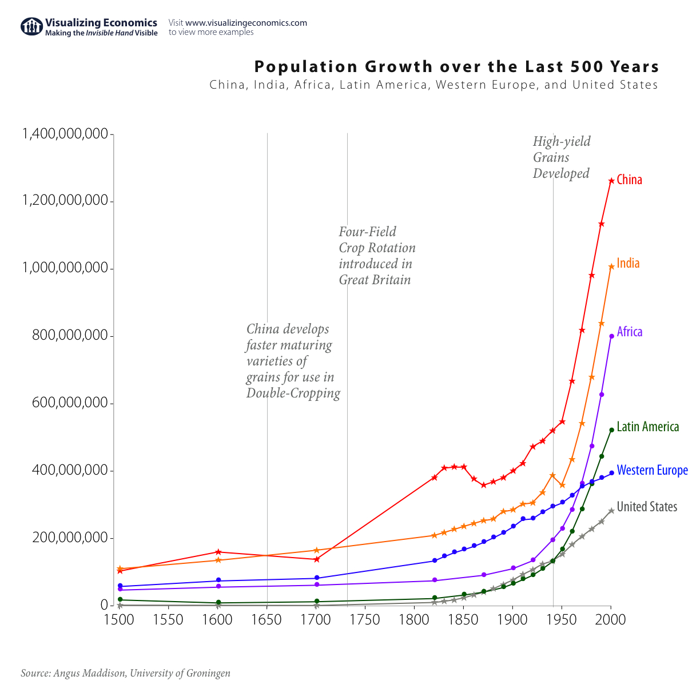

Slide 4
Causes
New nation-states were emerging in W. Europe as old empires were collapsing
Ex:
Germany, Belgium, and Italy
Some new Nation-states fought wars of expansion and gained major territory and access to resources

Slide 5
Characteristics
Major products of the Western European economies were:
IRON
TEXTILES
Coal
Chemicals
Many nations created positive feed back loops

Slide 6
Characteristics
Many Western European nation began process of QUICKLY colonizing much of Africa and Asia
Gained access to RAW MATERIALS and new markets
This was brutal and violent process that would continue to grow and expand until WWI
Called the Scramble for Africa

Slide 8
Characteristics
Many Western Europe nations benefited from government support
Most notably in the form of LLC laws, stock markets, and supporting monopolies
Many nations developed what were called cartels
Cartels increased production (Not THAT kind of Cartel…)
Set prices, share markets/profits, set volume limits, ect

Slide 9
Characteristics
One of the most successful industries in Western Europe was chemical production
Produced THREE types of chemicals:
Heavy Chemicals
Used for metal production, plastics, detergents, ect
Agricultural Chemicals
Fertilizers
Miscellaneous Chemicals
Used for Cosmetics, explosives, dyes, ect

Slide 10
United States of America Industrialization

Slide 11
Causes
Like Britain the U.S. had major advantages :
Country was large in both geography and population
Ready availability of natural resources
Iron, Coal, Cotton, and precious metals
Beneficial geography
Notably coast and rivers/canals
Growing domestic market
Political stability or the very least distance from the chaos of Europe and Latin America in 19th Century

Slide 12
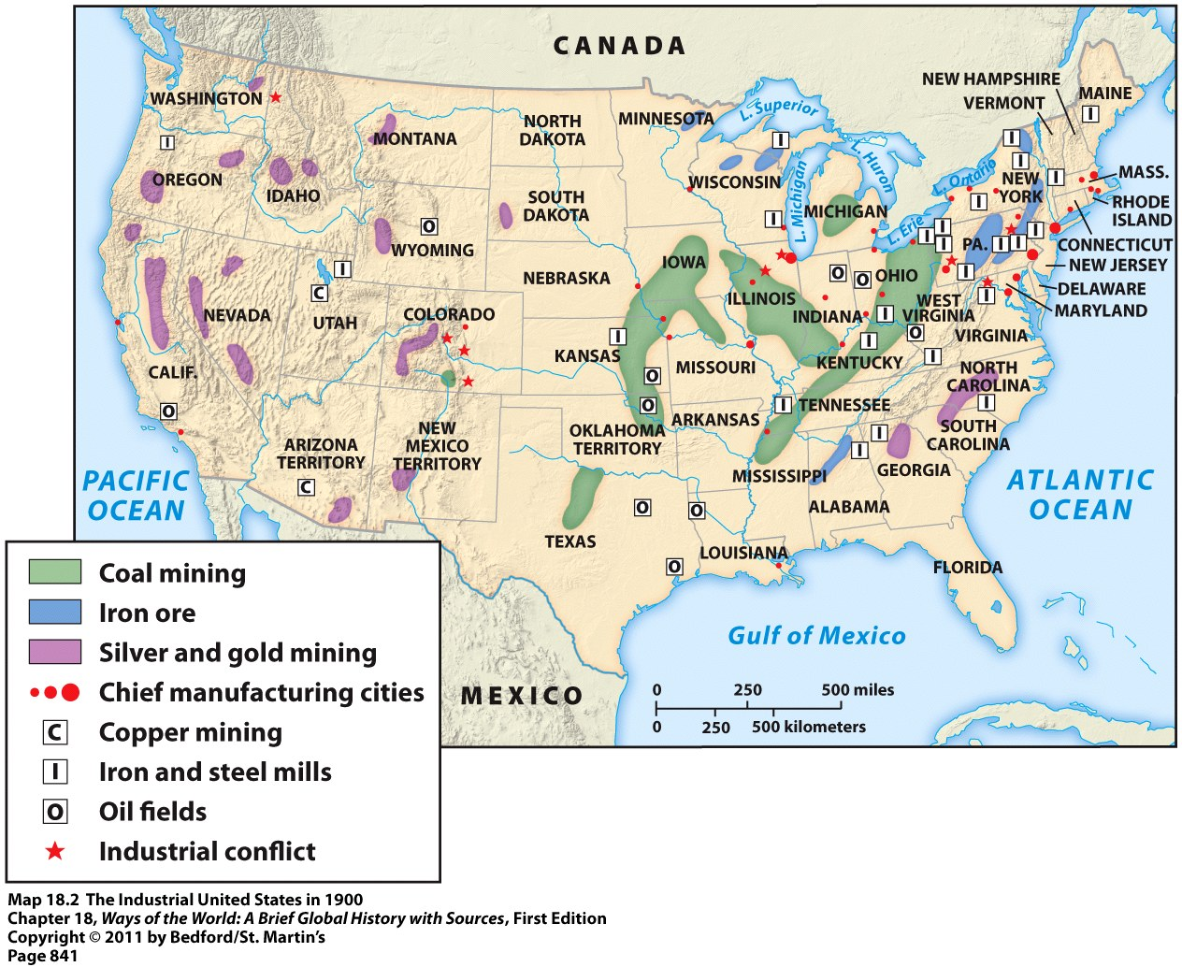
The Industrial United States in 1900

Slide 13
Causes
Slave labor= MASSIVE amounts of cheap cash crops for internal use and export to foreign countries
Most important crops were:
Tobacco
Wheat
COTTON
Huge profits used to invest in expansion of agricultural products

Slide 15
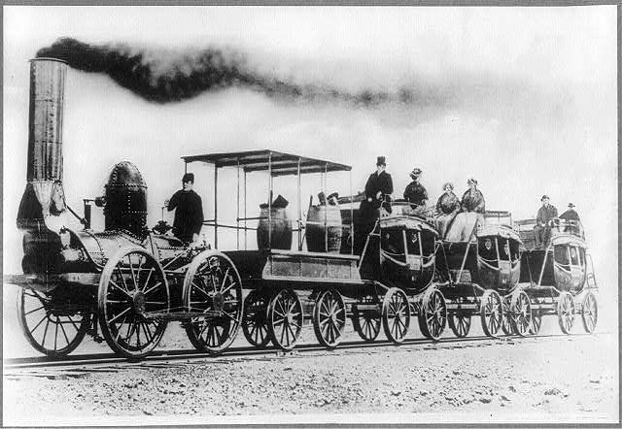
Causes
Government supported industrialization with:
Tax breaks and friendly laws for businesses
Little regulation of industry
Public land grants to railroad companies
Laws that allowed easy formation of companies

Slide 16
Characteristics
American companies pioneered many of the major new development in technologies/practices
Major products/industries were:
Steel
Cotton
Electricity
Copper Mining
Automobiles
Banking

Slide 17
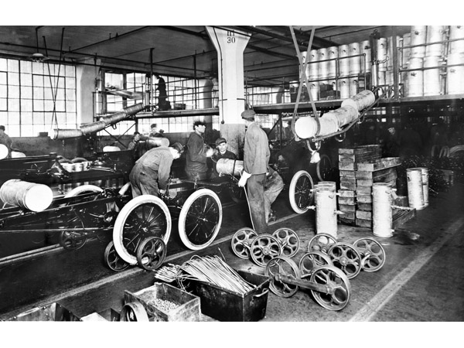
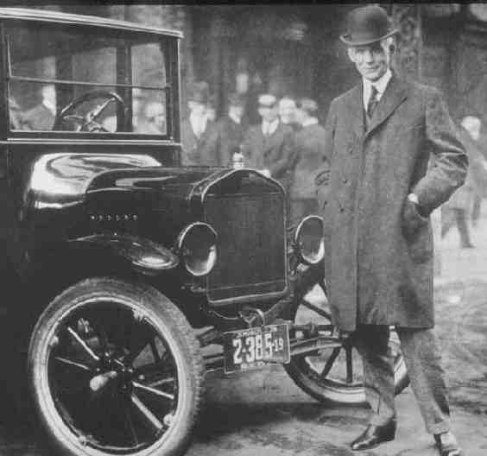
Characteristics
The U.S. pioneered several new mass production techniques:
Interchangeable parts
Assembly lines
“Scientific management”
Henry Ford = famously brought these techniques to the automobile industry in the early 1900s

Slide 18
Characteristics
The United States expanded to the West, created colonies, and used investment in Latin America
Often led to conflict with Native American tribes
Served the same purpose as Western European Colonies
Used to gain access to raw material and create markets

Slide 19
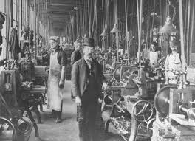
Characteristics
Widening gap between the classes
Many in the middle class getting richer and richer
The poor are getting poorer
Opposing views on these social divisions:
Lower class view=A betrayal of American ideals
Economic growth of the U.S. created an overall higher standard of living nation-wide than in most parts of Europe

