Slide 1
Memory Bellwork
Do all people remember historical events the same way?
NO
What might impact the way people remember things?
Personal history, nationality, what is more exciting, ect

Slide 2
Objective
WWBAT: Discuss the Persian War and assess the quality of Persian Government

Slide 3
Here Come the Persians
We have seen that the Greek city-states were quite different and far from a unified
This was in largely because of the geography of Greece
However the Greek city-states would unify from time to time

Slide 4
Here Come the Persians
We saw that the Greeks unified to fight the Trojans
One things that absolutely unified the Greeks, they HATED the Persians
Also they were terrified of the Persians
That’s what we will be talking about today, the Greeks and the

Slide 5
Here Come the Persians
We will discuss some of the major battles of the Persian War today
We will also discus some of the major impacts of the Persian war
Specifically how the Persian made the city-state of Athens a world power

Slide 6
REVOLT!
By the 7th and 6th century Greek city-states had created colonies and cities along the Ionian Coast
In the 6th century many of these Greek cities fell under control of the Persian Empire
In 499BCE the Ionian Greeks lead a failed revolt against the Persian Empire

Slide 7
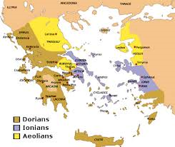
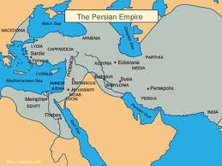

Slide 8
REVOLT!
The Athenians provided naval assistance to this revolt
This revolt and the assistance by the Athenians greatly upset the Persian ruler, Darius
Darius vowed to make the Athenians pay for their part in the revolt

Slide 9
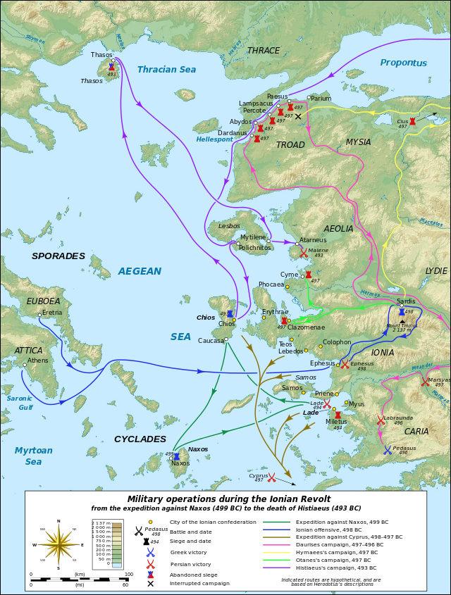

Slide 10
Battle of Marathon
In 490 BCE the Persian Army landed at Marathon with plans to invade and destroy Athens
The Persian forces numbered around 25,000
The Greek forces numbered only 10,000 by comparison

Slide 11
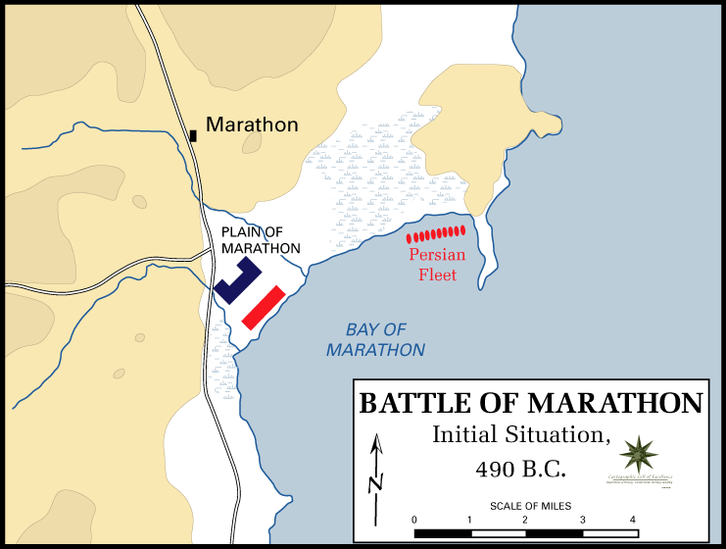
Battles of Marathon

Slide 12
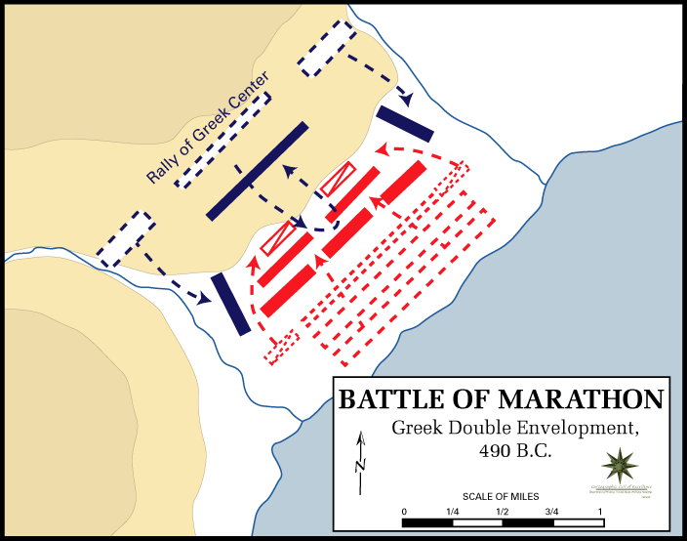
Battles of Marathon

Slide 13
Battles of Marathon
The Greeks were extremely well trained and organized
This gave them an advance facing the Persian Army
The Persians were decisively defeated by the Greeks

Slide 14
Battles of Marathon
Legend has it that Pheidippides ran the full 26 miles from Marathon to Athens to announce the Greek victory
He arrived in Athens declared “Victory, we win” and died
The modern marathon takes it’s name from Pheidippides epic run

Slide 15
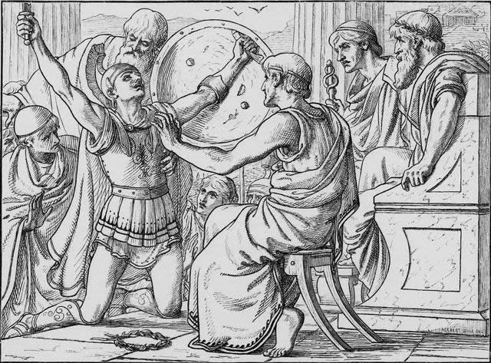

Slide 16
Battle of Thermopylae
In 480 BCE Xerxes(son of Darius) invaded Greece with more than 150,000 troops
Greeks attempted to delay the Persians at pass of Thermopylae
The Battle of Thermopylae was fought in 480 BCE

Slide 17
Battle of Thermopylae
A force of between 5-7,000 Greek attempted to stall the massive Persian Army
Around 300 Spartans lead the Greeks and fought to the death
Leonidas( the Spartan King and leader) is said to have responded “That is good news. We will fight in the shades” when told the arrows of the Persian army would block out the sun

Slide 18
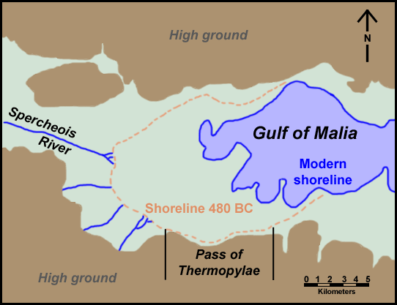
The Pass of Thermopylae

Slide 19
Battle of Thermopylae
The Greeks were defeated when a traitor informed the Persians of a mountain pass which could be used against the Greeks
The Greek defeat at Thermopylae made Athens very nervous

Slide 20
Battle of Salamis
The Battle of Salamis was a naval battle lead primarily by the Athenians in Fall of 480 BCE
There are similarities between the Battle of Salamis and the Battle of Thermopylae
The Persians had hundreds more ships than the Greeks
The Greeks used geography and the size of the Persian fleet to their advantage

Slide 21
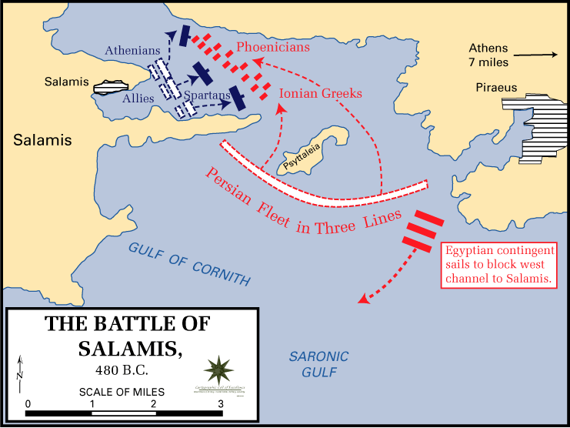
Battle of Salamis

Slide 22
Battle of Salamis
The Persians were defeated by the Greek fleet
After the defeat Xerxes returned to Asia leaving only small number of troops under the control of Mardonius
Many historian call the Battle of Salamis the most important battles in World History

Slide 23
Battle of Palataea
Mardonius and the remaining Persians faced one of the largest forces assembled by the Greeks
Around 40,000
The Greek defeated the Persians for the same reasons as at the Battle of Marathon
Superior tactics, organizations, and weaponry

Slide 24
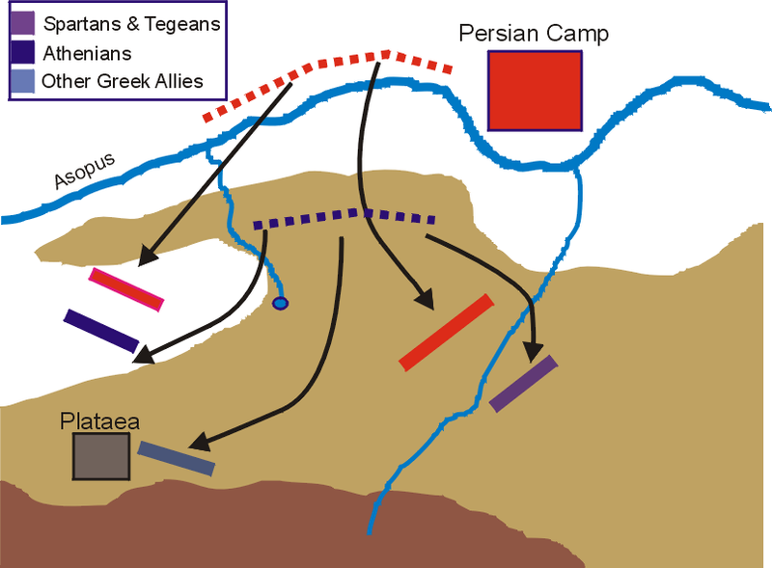
Battle of Palataea

Slide 25
Battle of Palataea
The Greek victory at Palataea ended the Persian War once and for all
The Athenians lead the Greek forces at Palataea and thus collected most of the glory for the victory

