Slide 2
WWBAT: Begin working on a worksheet to introduce Hinduism

Slide 3
For each statement write a C for Confucianism or a D for Daoism.
____ Founded by Laozi (Lao-tzu)
____ Stresses family piety & education
____ Analects
____ Stresses inaction
____ Influenced civil service system in China
____ Scholars were attacked under the Qin Dynasty
____ Founder rumored to have been born aged 72
____ Developed in the Zhou – Period of Warring States

Slide 4
For each statement write a C for Confucianism or a D for Daoism.
__D__ Founded by Laozi (Lao-tzu)
__C__ Stresses family piety & education
__C__ Analects
__D__ Stresses inaction
__C__ Influenced civil service system in China
__C__ Scholars were attacked under the Qin Dynasty
__D__ Founder rumored to have been born aged 72
__C__ Developed in the Zhou – Period of Warring States

Slide 5
TESTING BELLWORK
ANSWER: TESTING
CORRECT ANSWER: TESTING
OBJECTIVE: WWBAT: Introduce the Indo-Aryan and Vedic peoples of Ancient India and the beginnings of the Caste System

Slide 6
Interactive Notebooks Set Up
9/10/2015
Confucianism and Daoism chart
This will be one page

Slide 7
Confucius Bellwork
ANSWER: ACTIVITY
CORRECT ANSWER: ACTIVITY
You will be in groups of three or four and I will have you match Confucius quotes to situation

Slide 8
Objectives
WWBAT: Introduce the Indo-Aryan and Vedic peoples of Ancient India and the beginnings of the Caste System

Slide 9
Interactive Notebooks Set Up
9/10/2015
Vedic India Notes
This will be one page

Slide 10
Background
The Vedas
Caste System
Varnas

Slide 11
Background
This time period lasted 1500 BCE - 500 BCE
Around 1500 BCE a group from Indo-Europe began moving into the Indian subcontinent
They called themselves the Ayra(or Aryan)

Slide 12
Background
Root of the word is arya meaning “noble” or “pure”
Spoke an early form of Sanskrit
This Indo-European language is closely related to Persian, Latin, Greek and modern Romance languages
Nazis glorified Aryans as a superior race because they were credited with this important language development

Slide 13
Aryan Migration
Were pastoral, meaning they were depended on their cattle
Were warriors who used horse-drawn chariots

Slide 14
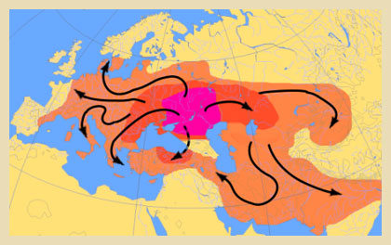
Part of a larger Indo-European Class

Slide 15
Background
We are not totally sure why the Aryans migrated
It could have because their grazing fields were depleted
Might have simply been because of warrior tribes expanding

Slide 16
Background
Aryans did not spread through India quickly, did not carry out well organized military campaigns
Aryans were a collection of tribes who gradually, over generations of warring with each other came to power in North India
Eventually they would conquer the areas of the Indus Valley

Slide 17
Background
Introduced the use of iron tools to India
Using these tools they were able to clear & populate the forests in Indo- Gangetic Plain
Beginning of sedentary agrarian civilization in this region

Slide 18
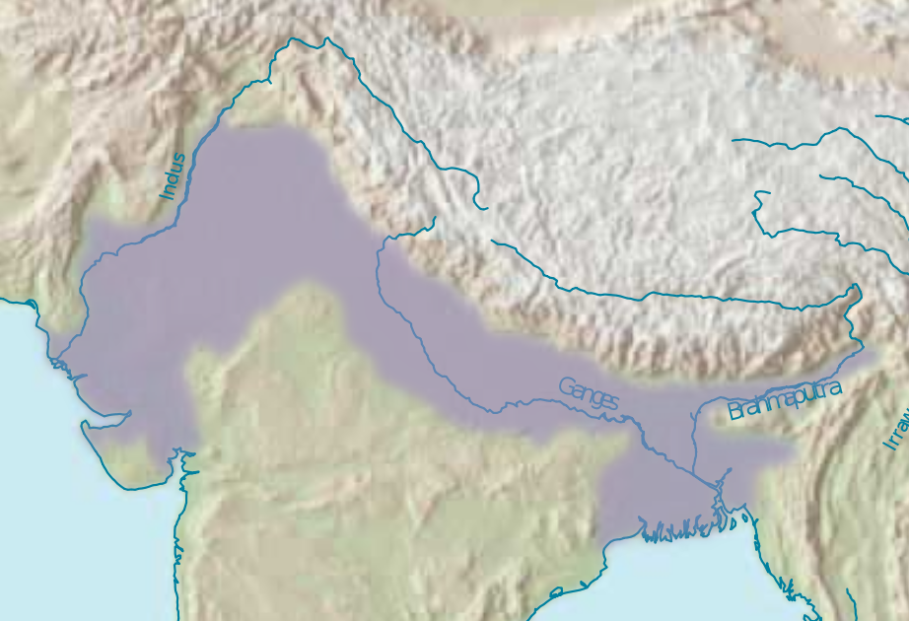
Indo- Gangetic Plain

Slide 19
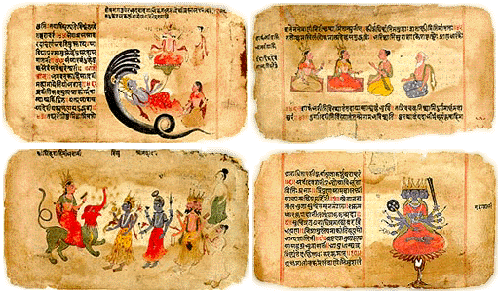
The Vedas
A major source of information on the Aryans comes from 4 books of Hymns and spells called the Vedas
Thus this time period is often called the Vedic Era or the peoples are called the Vedic Civilization

Slide 20
The Vedas
Rig Veda was the earliest Veda
Originally was recited orally and passed down generation to generation
Children began learning the Rig Veda at an early age, would learn to chant each syllable in perfect order

Slide 21
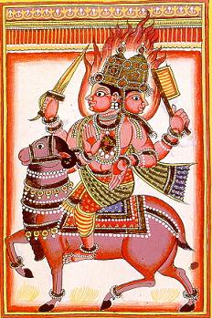
The Vedas
Many of the gods in the Vedas were heroic figures
Gods were associated with sometimes destructive forces of nature
Such as the fire god, Agni
The vedas and their gods form the basis of Hinduism
The fire god, Agni

Slide 22
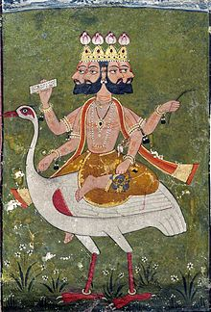
The Vedas
These are the oldest texts of Hinduism
Tradition holds that these texts were created by the god Brahma

Slide 23
Caste System
With the Aryan invasion they created a very specific social order
People were placed into four varnas
Varna literally means colors/outward appearance
This implies that race played a role in the original varnas

Slide 24
Caste System
Caste defined occupation, diet, social interactions, style of dress, ect
Duty put on the monarch to maintain system
Lead to a lack of individualism

Slide 25
Caste System
Brahmans
Kshatriya
Vaishya
Shudra

Slide 26
Varnas
Brahman was at top
Made up of Aryan priests who supported the growth of royal power
The only caste that was permitted to perform important, sacred, daily religious rituals

Slide 27
Varnas
Kshatriya
Made up of warriors and kings
These were the people that kept order and helped maintain the caste system

Slide 28
Varnas
Vaishya
Made up of the farmers, merchants artisans of communities
They were the largest population in the caste system

Slide 29
Varnas
Shudra
Made up of servants and peasants
Primary made up of conquered Dasas, darker skin people from Southern India

Slide 30
Varnas
The Untouchables or Harijans
These people weren’t even in the caste system
They were unable to hear/read the vedas
Also unable to participate in religious ceremonies

Slide 31
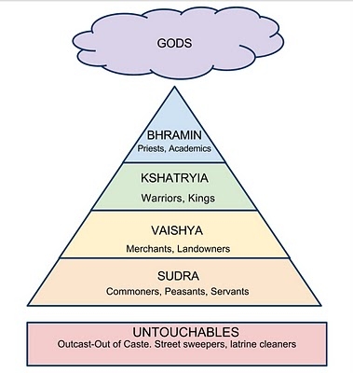

Slide 32
“The Hymn of the Primeval Man” from the Rig Veda
When they divided the Man into how many parts did they divide him?
What was his mouth, what were his arms, what were his thighs and his feet called?
The brahmin was his mouth, of his arms was made the warrior, His thighs became the vaisya, of his feet the sudra was born.

Slide 33
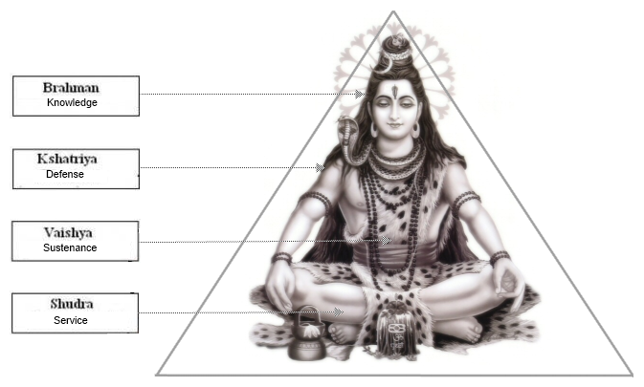

Slide 34
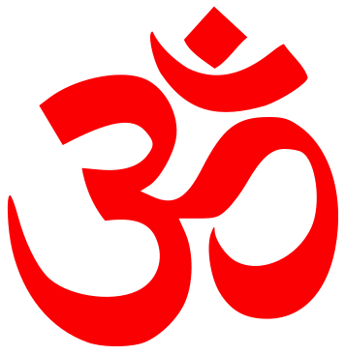
Hinduism
We will begin working with our first major world religion today
Hinduism

Slide 35
Hinduism
Hinduism is the oldest continually practiced religion in the world
It is also the third largest religion in the world
80% of the Indian population identify as Hindu
That’s about 1,010,000,000 people

