Slide 1
JEOPARDY!
Click Once to Begin

Slide 2
JEOPARDY!
Byzantine and Russia
Gunpowder Empires
More Gunpowder Empires
Ming Dynasty
European States and Reformation
Random
100
100
100
100
100
100
200
200
200
200
200
200
300
300
300
300
300
300
400
400
400
400
400
400
500
500
500
500
500
500

Slide 3
Daily Double Graphic and Sound Effect!
Daily Double!!!
DO NOT DELETE THIS SLIDE! Deleting it may cause the game links to work improperly. This slide is hidden during the game, and WILL not appear.
In slide view mode, copy the above (red) graphic (click once to select; right click the border and choose “copy”).
Locate the answer slide which you want to be the daily double
Right-click and choose “paste”. If necessary, reposition the graphic so that it does not cover the answer text.

Slide 4
Religion of both Russia and Byzantine Empire

Slide 5
Russian Policy addressing conquered Siberians

Slide 6
Byzantine idea that emperor is head of both the church and political state

Slide 7
Methods of Legitimizing power used by Byzantine Empire

Slide 8
Method of Legitimizing Power used by Peter the Great

Slide 9
Sunni Islamic Gunpowder Empires

Slide 10
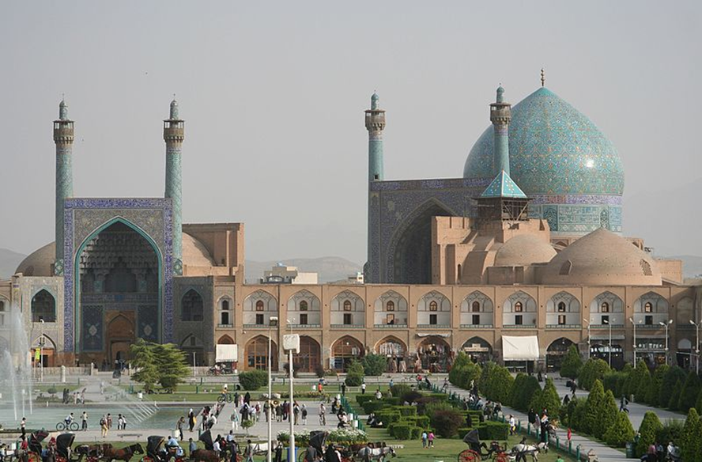

Slide 11
Janissaries

Slide 12
Popular syncretic religion that developed during the Mughal Empire

Slide 13
Two ways that Safavid Empire used Shia Islam to establish power

Slide 14
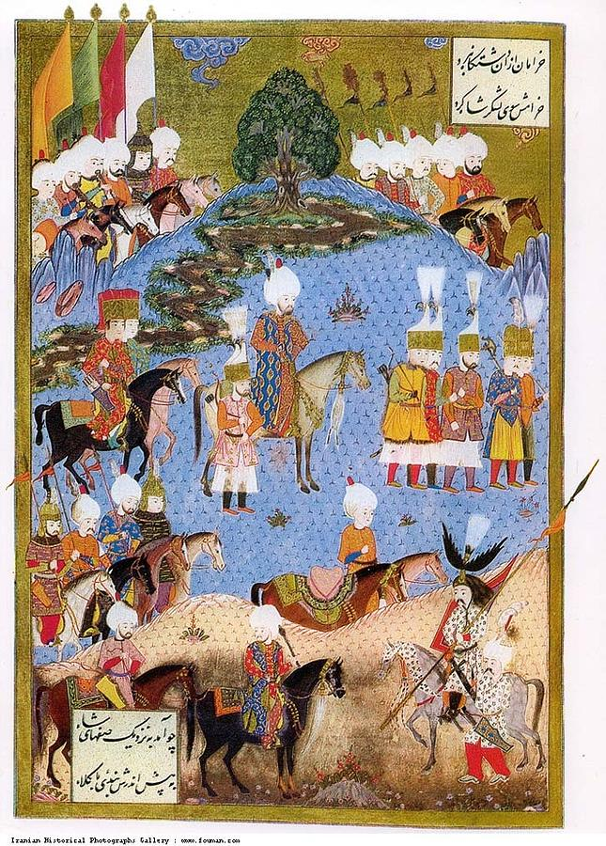

Slide 15
Millet System

Slide 16
Ottoman Iltizām

Slide 17
Mughal method of establishing and legitimizing power

Slide 18
Two major impacts of Ottoman Safavid Conflict

Slide 19
Hard Currency

Slide 20
Ming Dynasty brought this back to centralize government

Slide 21
Official state language

Slide 22
Ming Dynasty Trade Policy

Slide 23
Two Ming methods of establishing power

Slide 24
Invention that helped spread Protestant Ideas

Slide 25
Two Complaints of Protestant Reformation

Slide 26
Divine Right

Slide 27
Two major effects of the Protestant Reformation

Slide 28
Two Methods of Establishing & Legitimizing power in Europe

Slide 29
New Jersey Musician known as “the Boss”

Slide 30
RZA, GZA, Method Man, Raekwon, Ghostface Killah, Inspectah Deck, U-God, Masta Killa, and O.D.B

Slide 31
The UWNT won this competition for the FOURTH time this summer

Slide 32
The only state whose name is a single syllable

Slide 33
The second largest city in the United States

