Slide 1
Columbian Exchange Bellwork
What kind of items were created by Europe as part of the triangular trade?
Manufactured goods
What are two adjectives you would use to describe the Middle Passage?
Answers Vary

Slide 2
Objective
WWBAT: Introduce and discuss major characteristics of Toltec civilization

Slide 3
Interactive Notebook Setup
1/29/2016
The Toltec and Aztec Civilizations
This will be one page

Slide 4
Background
The Toltec were a nomadic people who moved into southern Mexico from north
Moved in around the time of the Mayan collapse in the 8th century CE
Took over and expanded Mayan centers
Built capital city of Tula using Mayan architectural and construction techniques

Slide 5
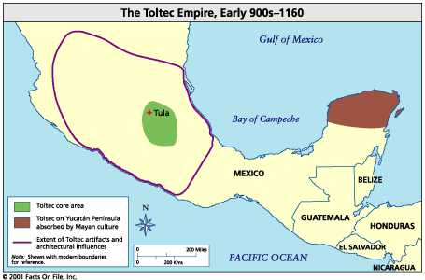

Slide 6
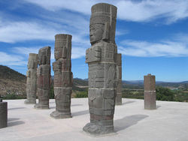
Background
Name means: an “urbanite,” a “cultured” person, and the “reed people”
The language of the Toltec was called Nahuatl
Dominated Mexico between 10th and 12th century AD

Slide 7
Background
Brought in own ideas and mixed with those of the previous inhabitants of the region
Most notably the Maya and the Teotihuacán
Most prominent ideas brought related to military and political organizations
Also added to the already prominent practice of human sacrifice

Slide 8
Background
Capital city was called Tula
Lasted from around 900-1200 CE
Developed north of Teotihuacan
Located on the Tula river and near the Lerma rivers for easy communication with others
This new capital was closer to the northern limits of agriculture

Slide 9
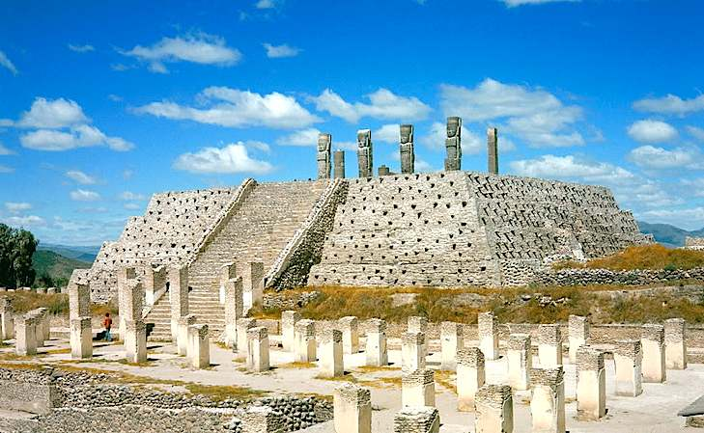
TULA

Slide 10
Economy
As with much of the region agriculture was essential to the Toltec
The primary crop and major food source was maize
Maize was supplemented with beans, chili peppers, amaranth, squashes, and agave
Irrigation was an essential part of Toltec agriculture

Slide 11
Economy
Developed impressive metal-working industry
Specialized in jewelry
Established trade network which stretched from northern South America and into the American Southwest
Possibly even into the Ohio and Mississippi River Valleys
Traded with obsidian mined in the region for other precious materials
Most notably turquoise

Slide 12
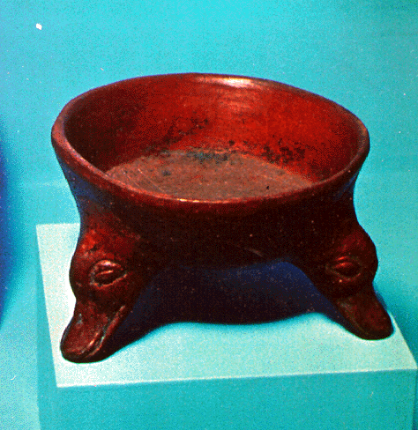
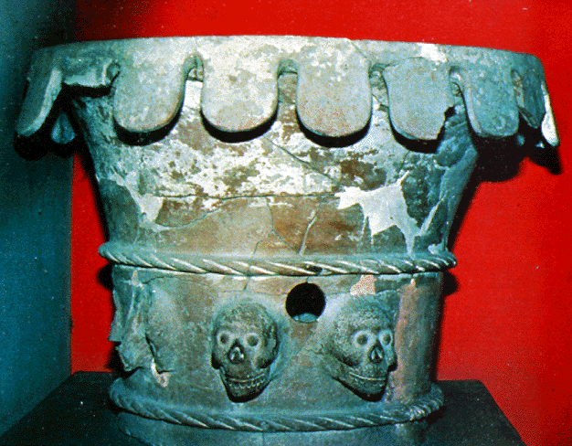
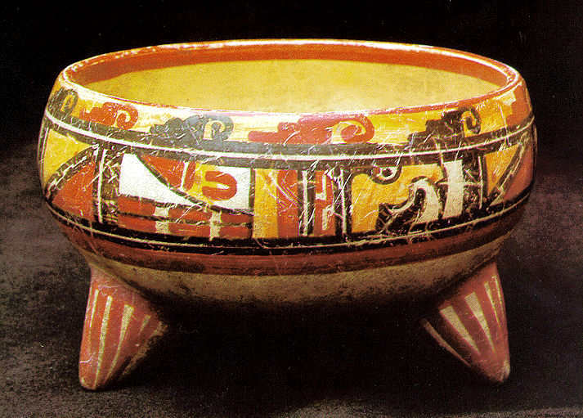
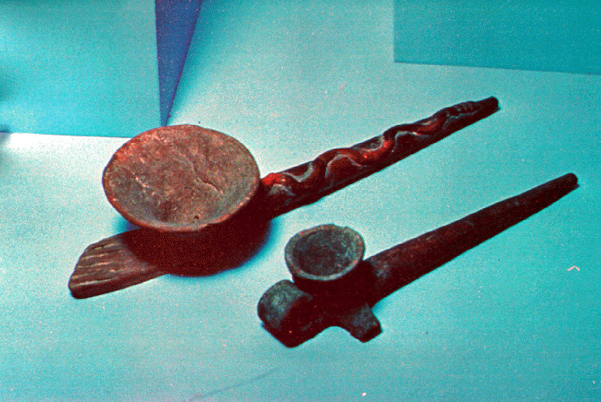
Artifacts: Pottery
Brazier with skulls
Duck effigy bowl
Pipes
Papagayo polychrome bowl

Slide 13
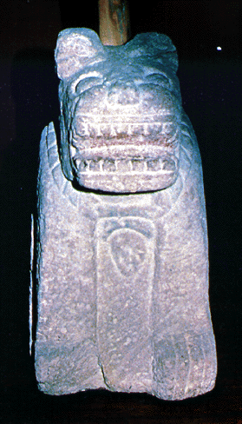
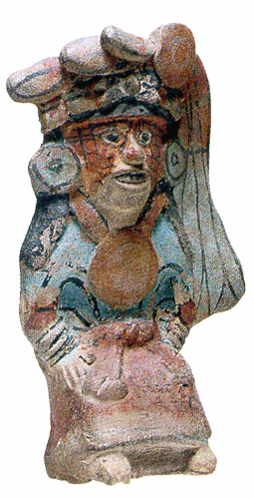
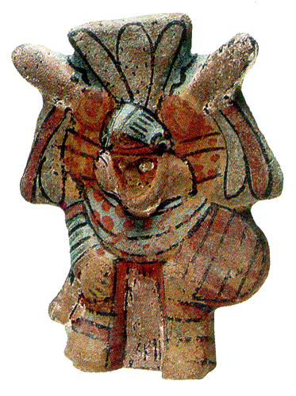
Artifacts: Stone Carvings
Jaguar statue
Figurines

Slide 14
Religion
The Toltec were polytheistic like the other major culture of Mesoamerica
Gods represented different important aspects of life that was important to the Toltec
Gods represented things such as fertility, rain, water, vegetation, etc..

Slide 15
Religion
The two most important gods of the Toltec were Quetzalcoatl and Tezcatlipoca
They were brother gods and responsible for creating the earth
They were also thought to be eternal opposites
Quetzalcoatl represented: learning, fertility, holiness, gentility, culture, philosophy, as well as good
Tezcatlipoca represented: war, tyranny, and evil

Slide 16
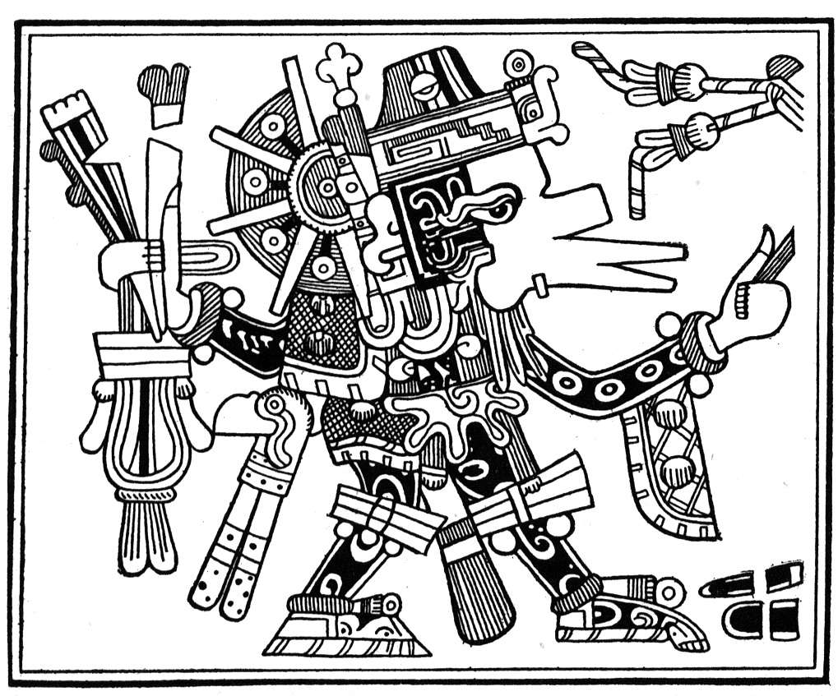
Quetzalcoatl

Slide 17
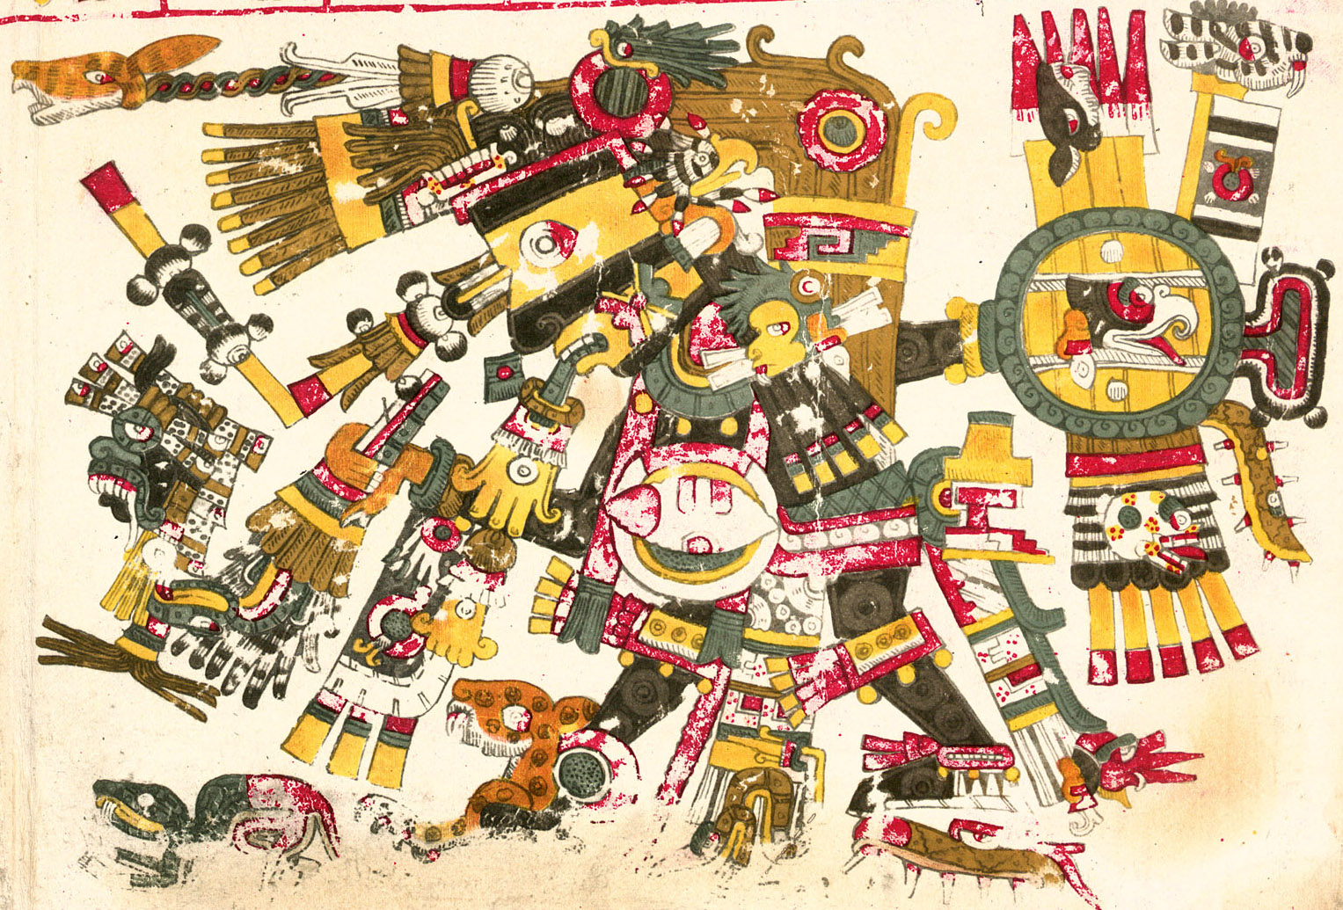
Tezcatlipoca

Slide 18
Toltec Art and Religious Piercings
Murals
Depicting gruesome battle scenes
Chief Bird Warriors
Piercing his own cheek for losing battle

Slide 19
Toltec Art and Religious Piercings
Strongly resembles an Aztec Eagle Warrior
Ceramic
Represents a Toltec priest
Drawing blood as an offertory sacrifice

Slide 20
Reasons for Collapse
Agriculture
agriculture was especially sensitive to drought
problem became critical with population growth
Tula may have become overpopulated by 1100
climate change and decrease in precipitation may have caused many years of famine
historical accounts contain many references to food problems
Conflicts
often coupled with stories of conflicts and battles over land, famine may have coincided with period of greatest influx of population
Social integration
problems of multi-ethnicity
continual flow of migrants into the city caused strains
migrants may have been toughened and warlike

Slide 21
The Aztecs
Rise of the Aztecs Page 237-239
Aztec Religion Pages 239-240
Aztec Economy 240-241
Aztec Social Structure Pages 241-243
Aztec Empire and Political Organization pages 243-244

Slide 22
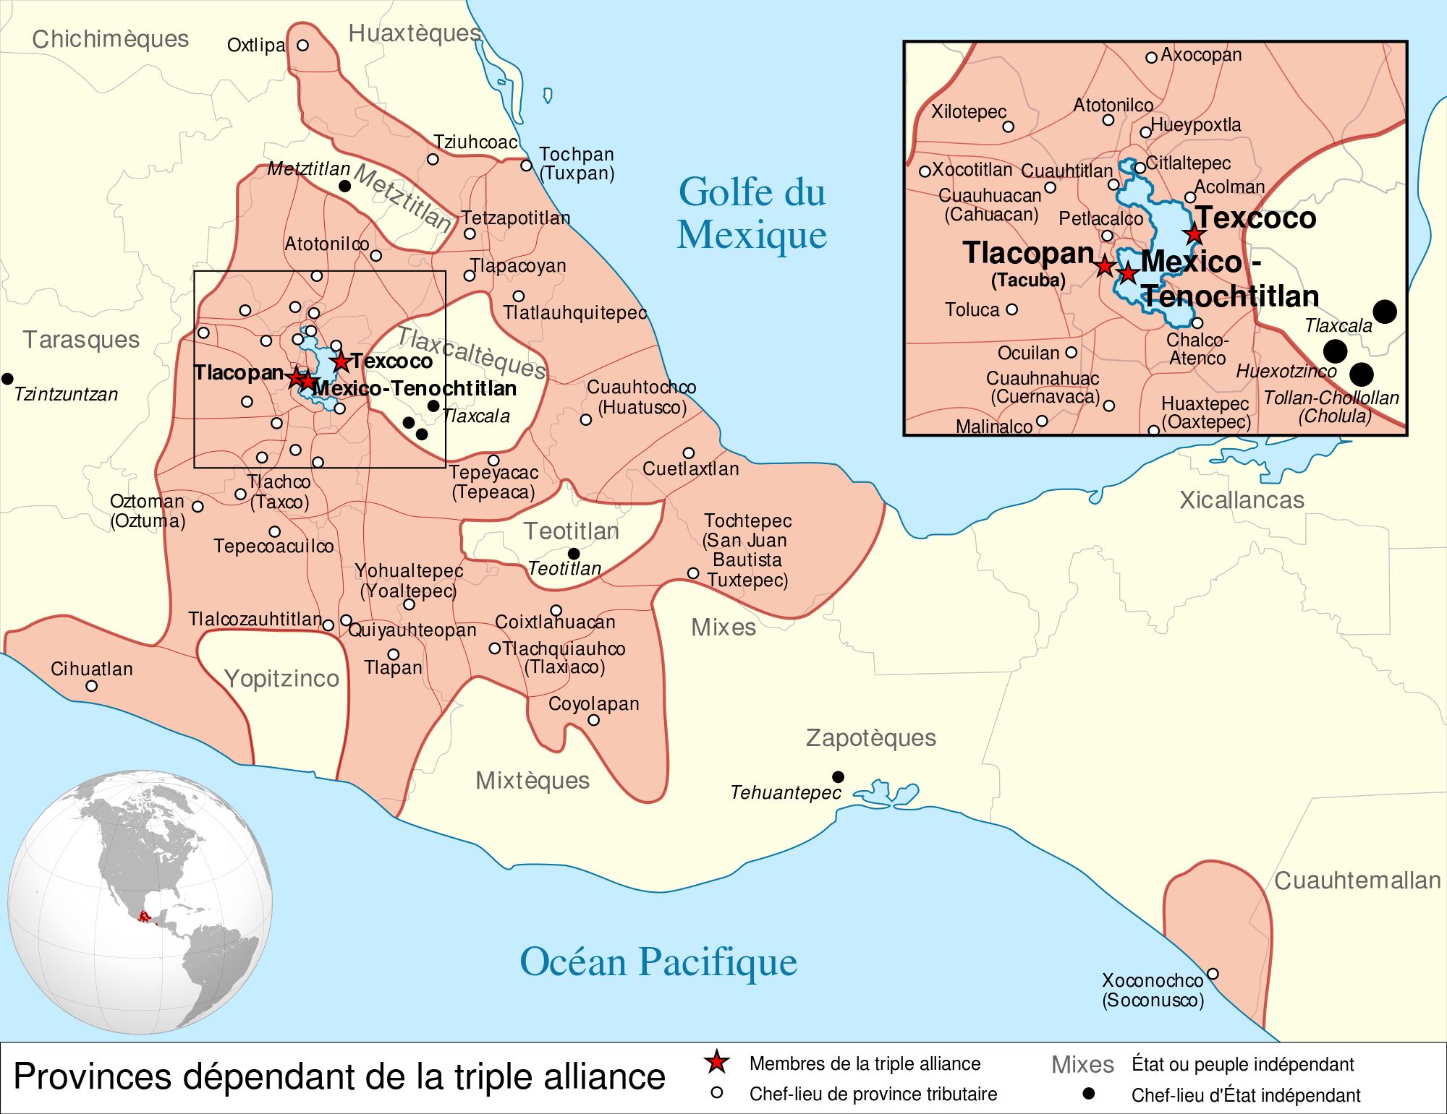

Slide 23
