Slide 1
Mughal Empire
When you here the term Mughal(also known as Mogul) what comes to mind?
Answers Vary(Mongols)
What has long been the dominate religion of India?
Hinduism

Slide 3
Objective
WWBAT: Introduce the origins of the Mughal Empire and major leaders of the Mughal Empire
WWBAT: Complete a group simulation on the trade of the Indian Ocean and profit making in import/export trade

Slide 4
Theme Tuesday Bellwork
What is an example of Creation, Expansion and Interaction of Economic Systems in the Safavid Empire?
Answers Vary
What is an example of Development and Interaction of Cultures in the Ottoman Empire?
Answers Vary

Slide 5
Objective
WWBAT: Introduce the origins of the Mughal Empire and major leaders of the Mughal Empire

Slide 6
InterACTIVE Notebook Setup
2/14/2017
Mughal Empire and Leaders
This will be one page

Slide 7
Mughal Empire
Akbar
Babur
Aurangzeb

Slide 8
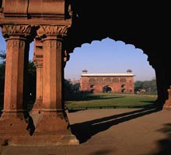
The Mughal Empire
There had been Muslims in India long before the Mughals
The first Muslims arrived in the 8th century
In the first half of the 10th century, a Muslim ruler of Afghanistan invaded the Punjab eleven times, without much political success, but taking away a great deal of loot
A more successful invasion came at the end of the 12th century
This eventually led to the formation of the Delhi Sultanate
A later Muslim invasion in 1398 devastated the city of Delhi

Slide 9
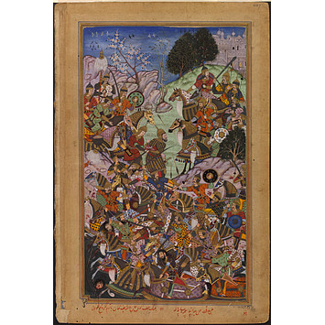
The Mughal Empire
The Mughal Empire grew out of descendants of the Mongol Empire who were living in Turkestan in the 15th century
They had become Muslims and assimilated the culture of the Middle East, while keeping elements of their Far Eastern roots
They also retained the great military skill and cunning of their Mongol ancestors, and were among the first Western military leaders to use guns

Slide 10
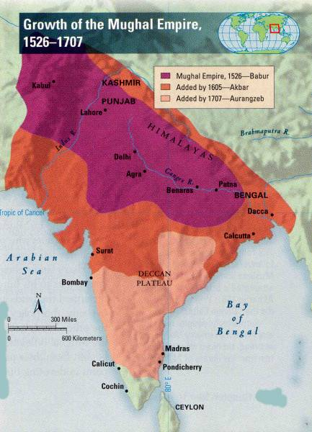
The Mughal Empire
The Mughal (or Mogul) Empire ruled most of India and Pakistan in the 16th and 17th centuries
It consolidated Islam in South Asia, and spread Muslim (and particularly Persian) arts and culture as well as the faith
The Mughals were Muslims who ruled a country with a large Hindu majority
However, for much of their empire they allowed Hindus to reach senior government or military positions

Slide 11
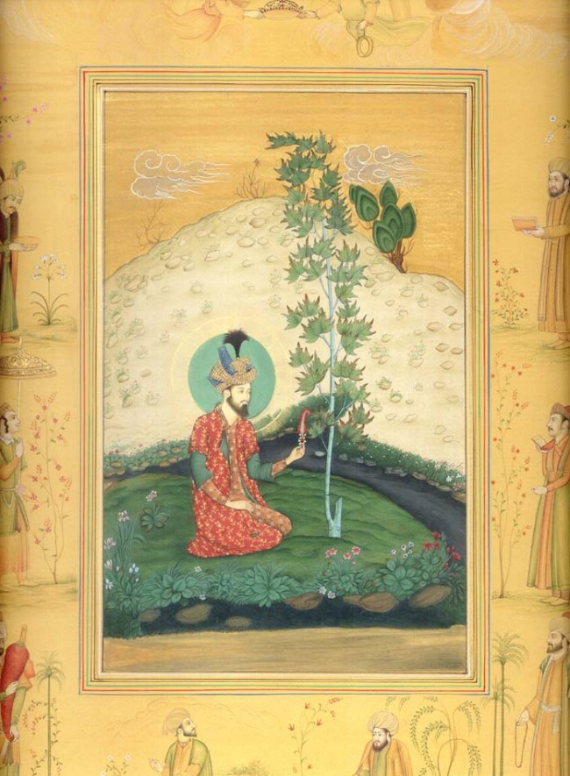
Babur
Babur the first Mughal Emperor
was a descendent of Genghis Khan and Tamerlane
Babur succeeded his father as ruler of the state of Farghana in Turkestan when he was only 12, although he was swiftly deposed by older relatives
Babur moved into Afghanistan in 1504
Then moved on to India, apparently at the invitation of some Indian princes who wanted to dispose of their ruler

Slide 12
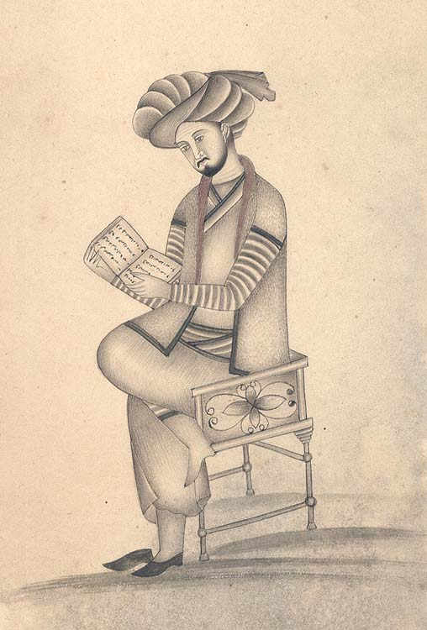
Babur disposed of the ruler, and decided to take over himself
He captured the Turkic Ghur'iat Sultanate of Delhi in 1526, imposing his rule on most of Northern India
The Empire he founded was a sophisticated civilization based on religious toleration
It was a mixture of Persian, Mongol and Indian culture
Under Babur, Hinduism was tolerated and new Hindu temples were built with his permission

Slide 13
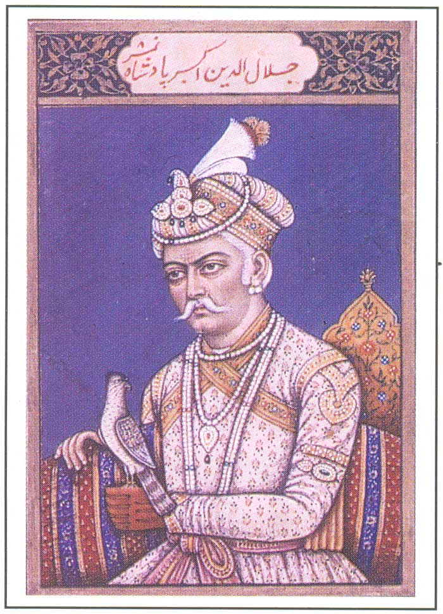
Abu AKBAR
The third Emperor, Abu Akbar, is regarded as one of the great rulers of all time, regardless of country
Akbar succeeded to the throne at 13, and started to recapture the remaining territory lost from Babur's empire
By the time of his death in 1605 he ruled over most of north, central, and western India

Slide 14
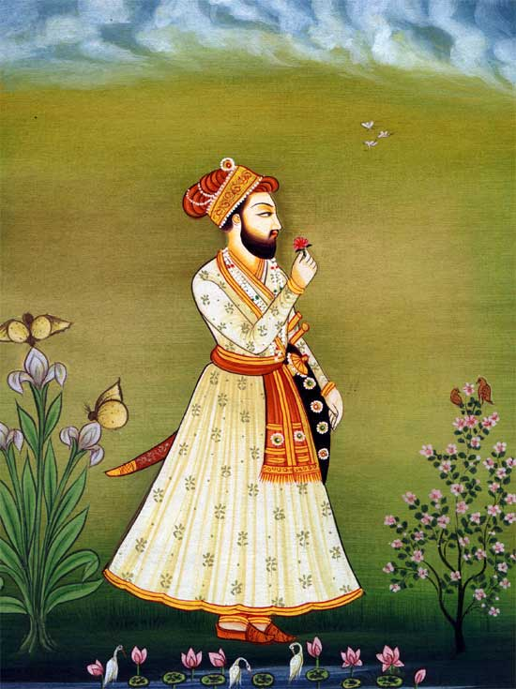
Akbar worked hard to win over the hearts and minds of the Hindu leaders
While this may well have been for political reasons - he married a Hindu princess (and is said to have married several thousand wives for political and diplomatic purposes) - it was also a part of his philosophy
Akbar believed that all religions should be tolerated, and that a ruler's duty was to treat all believers equally, whatever their belief
He established a form of delegated government in which the provincial governors were personally responsible to him for the quality of government in their territory

Slide 15
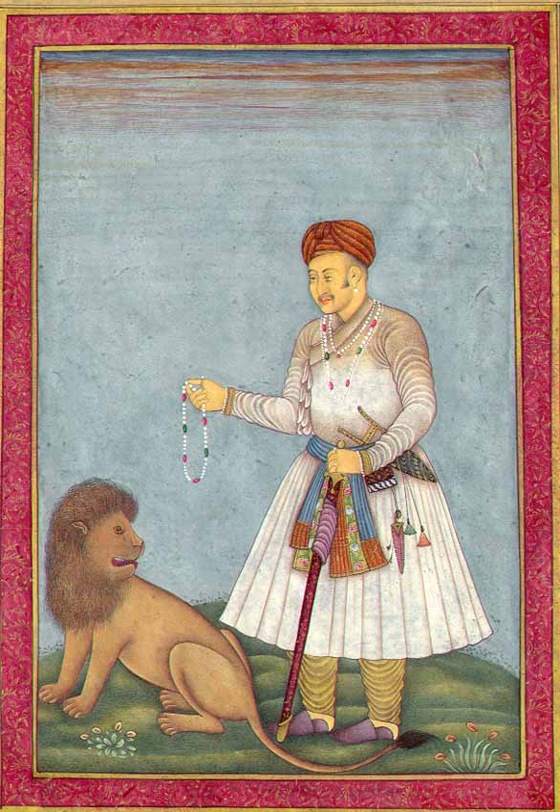
Akbar's government machine included many Hindus in positions of responsibility - the governed were allowed to take a major part in the governing
Akbar also ended a tax (jizya) that had been imposed on non-Muslims
This discriminatory tax had been much resented, and ending it was a popular move
An innovation was the amount of autonomy he allowed to the provinces
For example, non-Muslims were not forced to obey Islamic law (as was the case in many Islamic lands), and Hindus were allowed to regulate themselves through their own law and institutions

Slide 16
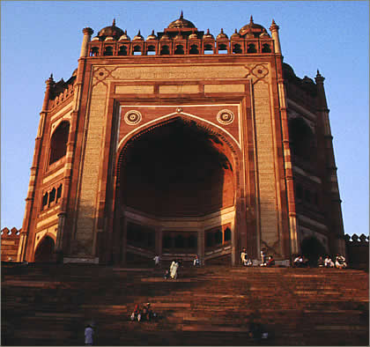
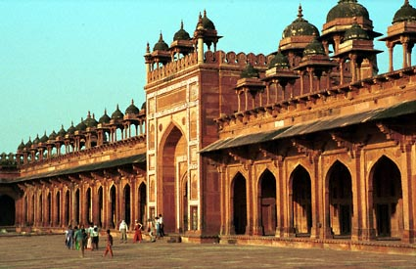
Akbar took the policy of religious toleration even further by breaking with conventional Islam
The Emperor proclaimed an entirely new state religion of 'God-ism' (Din-i-ilahi)
A jumble of Islamic, Hindu, Christian and Buddhist teaching with himself as deity
It never spread beyond his court and died when he did
Fatehpur Sikri was the new capital built by Akbar, as a part of his attempt to absorb other religions into Islam
Fatehpur Sikri is a synthesis of Hindu and Islamic architecture

Slide 17
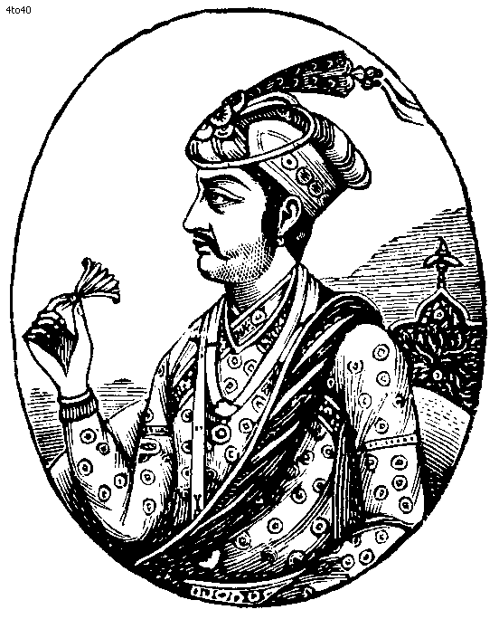
Akbar's son, Emperor Jahangir, readopted Islam as the state religion and continued the policy of religious toleration
His court included large numbers of Indian Hindus, Persian Shi'a and Sufis and members of local heterodox Islamic sects
Jahangir(Akabar’s Son) began building magnificent monuments and gardens the Mughals are chiefly remembered for today, importing hundreds of Persian architects to build palaces and create magnificent gardens
Jahangir's approach was typified by the development of Urdu as the official language of Empire
Urdu uses an Arabic script, but Persian vocabulary and Hindi grammatical structure

Slide 18
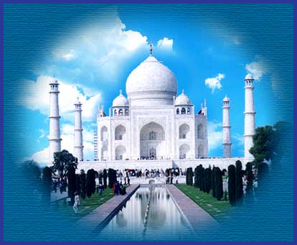
Jahan
The architectural achievements of the Mughals peaked between 1592 and 1666, during the reign of Jahangir's successor, Jahan
Jahan commissioned the Taj Mahal
The Taj Mahal marks the apex of the Mughal Empire; it symbolizes stability, power and confidence
The building is a mausoleum built by Jahan for his wife Mumtaz and it has come to symbolize the love between two people

Slide 19
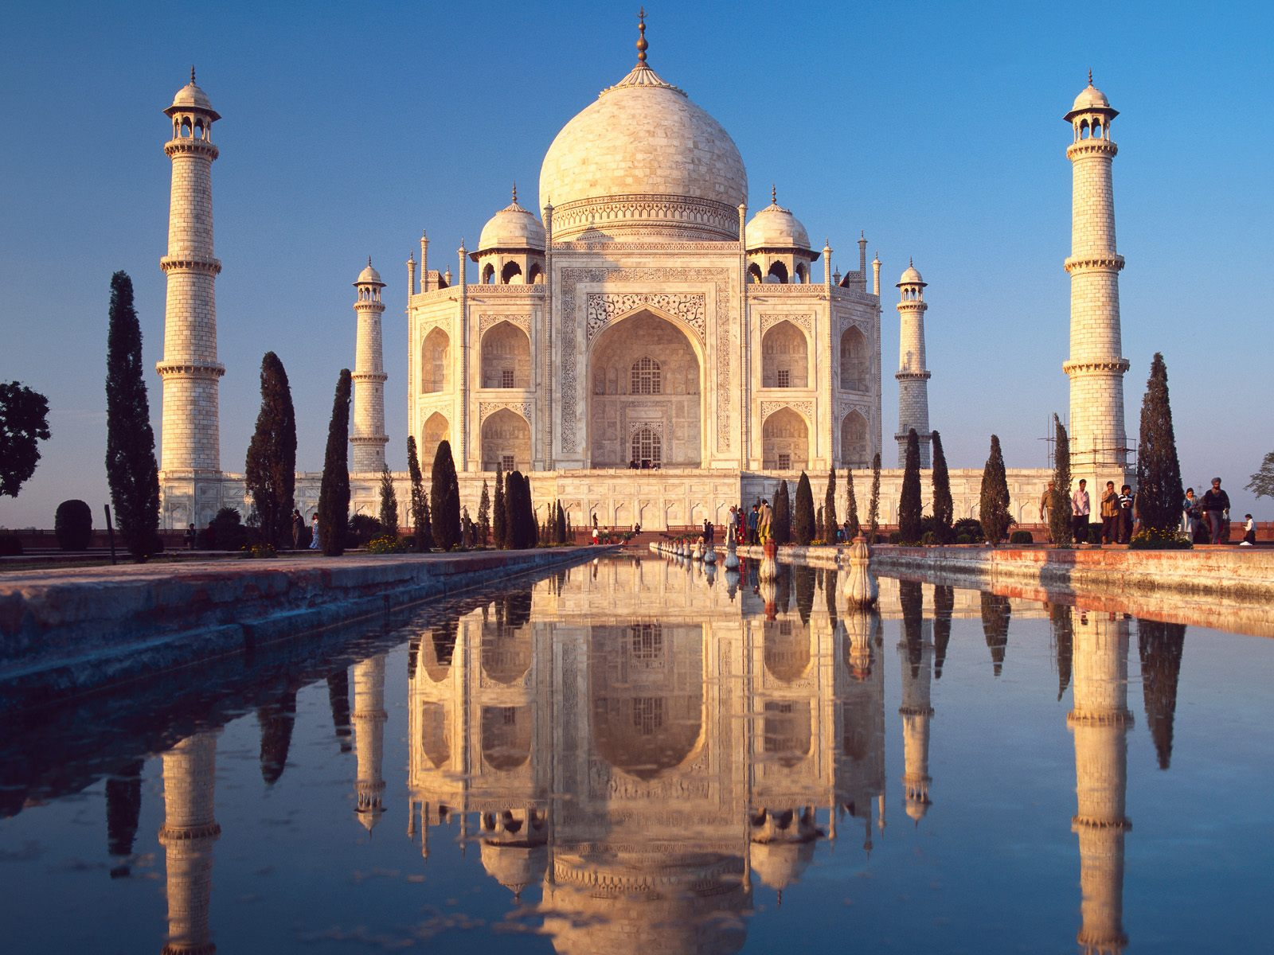
The Taj Mahal

Slide 20
The Taj Mahal
Built by Mughal Emperor Shah Jahan
Mausoleum for his 3rd wife
She died giving birth to their 14th child

Slide 21
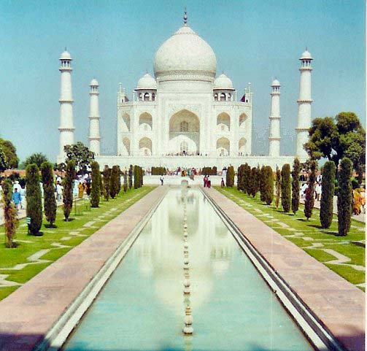
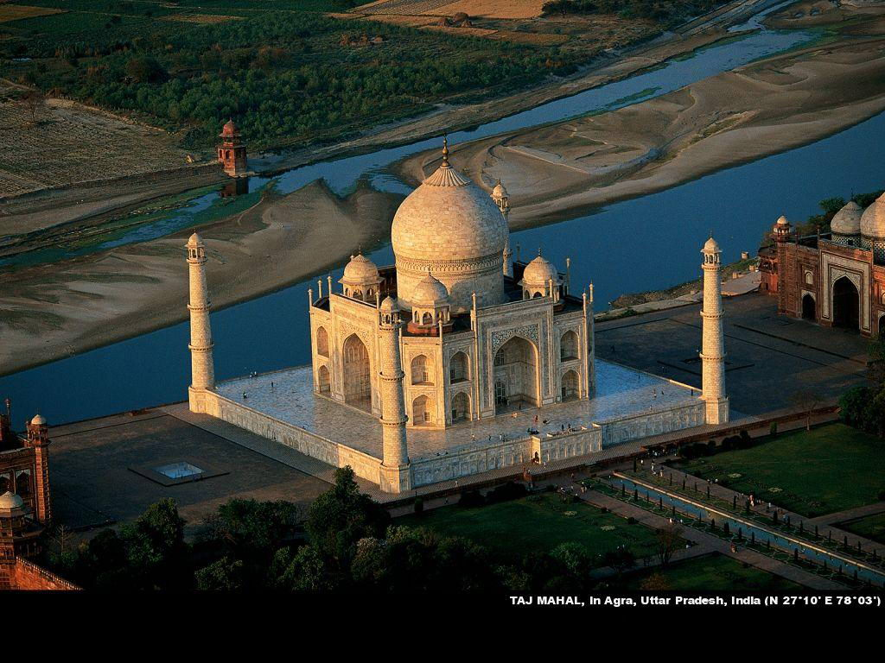

Slide 22
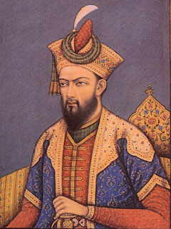
Aurangzeb
Jahan's son Aurangzeb was the last great Mughal Emperor
History's verdict on Aurangzeb largely depends on who's writing it; Muslim or Hindu
Aurangzeb ruled for nearly 50 years
He came to the throne after imprisoning his father and having his older brother killed

Slide 23
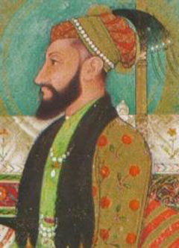
He was a strong leader, whose conquests expanded the Mughal Empire to its greatest size
Aurangzeb was a very observant and religious Muslim who ended the policy of religious tolerance followed by earlier emperors
He no longer allowed the Hindu community to live under their own laws and customs, but imposed Sharia law (Islamic law) over the whole empire
Thousands of Hindu temples and shrines were torn down and a punitive tax on Hindu subjects was re-imposed

Slide 24
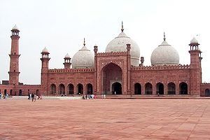
Under Aurangzeb, the Mughal empire reached the peak of its military power, but the rule was unstable
This was partly because of the hostility that Aurangzeb's intolerance and taxation inspired in the population, but also because the empire had simply become too big to be successfully governed

Slide 25
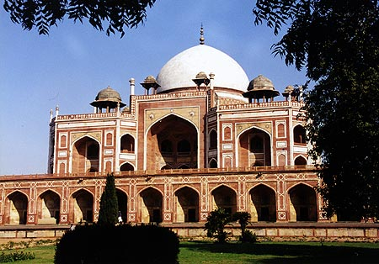
Aurangzeb's extremism caused Mughal territory and creativity to dry up and the Empire went into decline
The Mughal Emperors that followed Aurangzeb effectively became British or French puppets
The last Mughal Emperor was deposed by the British in 1858

Slide 26
