Slide 1
Interactive Notebook SetUP
11/7/2017
Sub-Saharan Africa Notes
This will be one page

Slide 2
Sub Saharan Background
Bantu Migration
Common Societal Characteristics

Slide 3
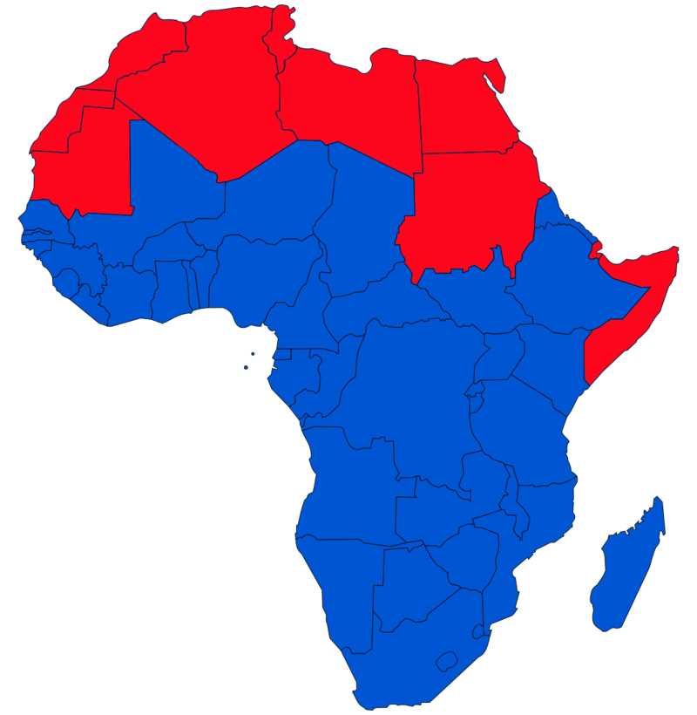

Slide 4
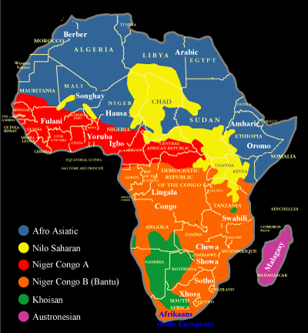
Sub-Saharan Africa Background
In sub-Saharan Africa, the development of strong, sizable political units occurred later and more slowly than in many other parts of the world
Much of this was due to the tremendous varieties of ethnicity and language in sub-Saharan Africa
For example, more than 2,000 languages and dialects are spoken in the region

Slide 5
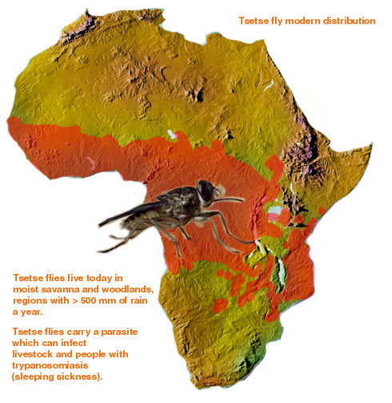
Sub-Saharan Africa Background
Another factor limiting the growth of major states was environmental
The fluctuating climate of sub-Saharan Africa and human susceptibility to various insect- and animal-borne diseases in sub-Saharan regions were both obstacles to increasing the size of local populations and the number of workers available to cultivate the land

Slide 6
Bantu Migrations
Around 1000 B.C.E., People left West Africa for less populated areas in Central and Southern Africa
Called the Bantu Migrations because - descendants of the people that migrated shared elements of a language known as Bantu
These people brought their culture & knowledge as they migrated
Bantu languages became dominant south of the Sahara

Slide 7
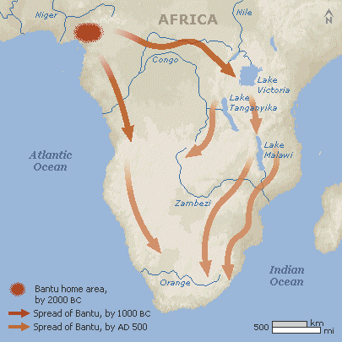
Bantu Migrations

Slide 8
Bantu Migrations
Bantu people were able to displace, absorb, or eliminate hunter-gatherers they encountered due to:
1) Agriculture - they had a productive economy and could sustain a larger number of people in a small area
2) Iron -- used it to make tools and weapons
3) Disease -- they brought infectious diseases (like malaria) with them

Slide 9
Bantu Migrations
Farming largely replaced foraging in South
-Agriculture generated a more productive economy
-Farmers brought with them both parasitic and infectious diseases to which foragers had little immunity
-Iron was introduced to the region by Bantu migrants
Bantu migrants also brought a common set of cultural and social practices

Slide 10
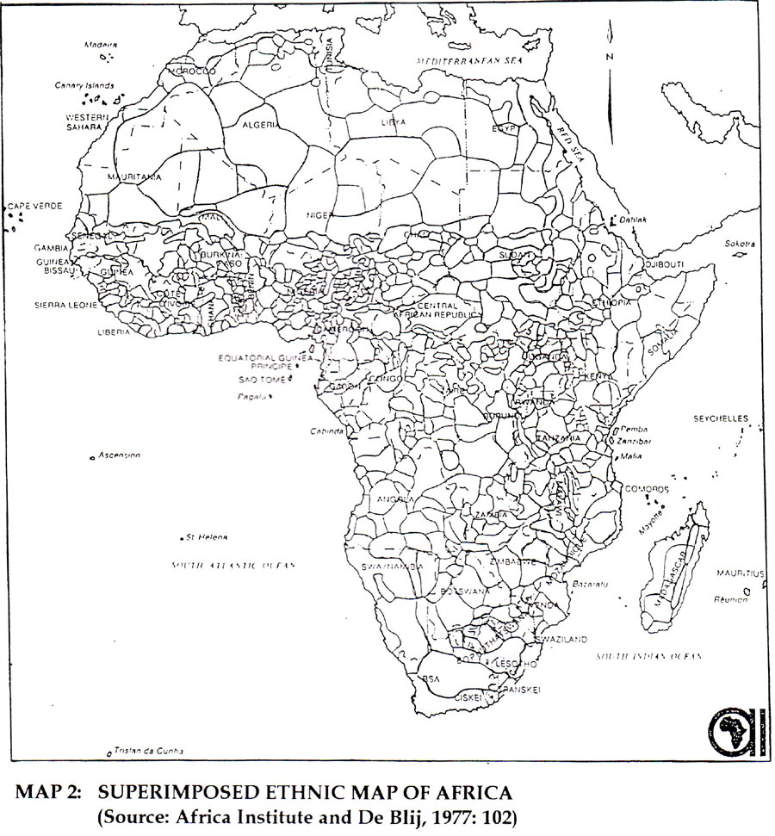
Bantu Migrations
Bantu-speaking people became divided into hundred of ethnic groups

Slide 11
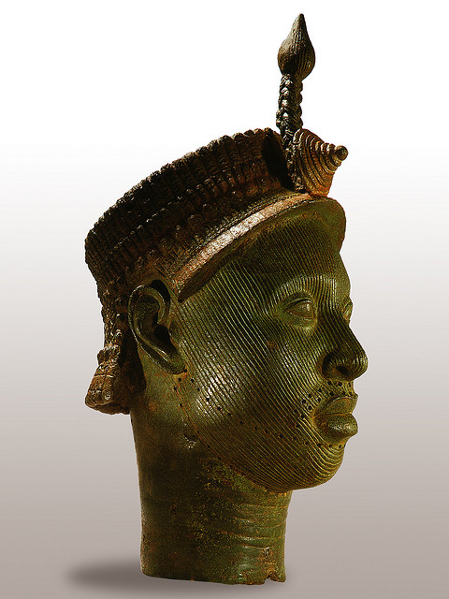
Common societal characteristics
Most sub-Saharan communities were small
Called Stateless societies, meaning there is no powerful central authority
Political/Social life revolved around the village
Kinship relationships were the most important way people were organized

Slide 12
Common societal characteristics
Food was provided by means of a combination of hunting, herding, and small-scale agriculture
It appears that most African societies developed metalworking independently, rather than having it taught to them by outsiders, as was commonly thought until recently
Animistic polytheism was the dominant religion present in the region

Slide 13
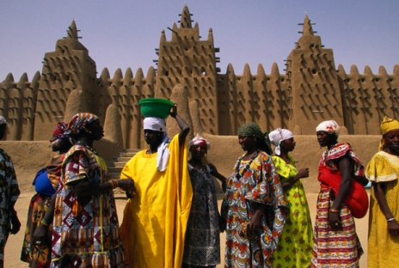
Common societal characteristics
Women in sub-Saharan Africa tended to be treated as subservient to men
However, women were often valued for their labor as fieldworkers (while men tended cattle) and for producing heirs

Slide 14
Common societal characteristics
Women were also respected for their storytelling abilities and their role in educating young people about moral values and religious beliefs
Interestingly, unlike in most other societies, in Africa, lineage was sometimes matrilinear, rather than patrilineal
Women often inherited property and the husband was required to move into his wife’s house

