Slide 2
Random Review ATTACK!!!
The Hindu concept of samsara is BEST described by which of the following statements?
(A) a belief that the wicked are punished by everlasting torment after death
(B) a belief that one's soul lives, dies, and is reborn many times, until it is pure enough to escape the cycle of rebirth
(C) a doctrine that justifies the caste system of India
(D) a belief that all actions, good and evil, have consequences in future lives to come

Slide 3
Random Review ATTACK!!!
The map above shows
(A) Indian Ocean Trading System
(B) The Silk Road
(C) The Han Empire system of roads
(D) The Amber road
(E) Trans-Saharan trade routes.

Slide 4
Impacts of Industrialization Bellwork
What were two problems/complaints faced by working class people after the Industrial Revolution?
Low wages, dangerous working conditions, long hours, awful living conditions
Which group benefited the most from Industrialization?
Middle Class

Slide 5
Objective
WWBAT: Introduce the development of Industrialization in Russia and compare it to Western European Industrialization
WWBAT: Examine primary sources on impacts and reactions of Industrialization

Slide 6
Interactive Notebook Setup
4/7/2017
Russian and Latin American Industrialization
This will be one page

Slide 7
Russia’s Industrial Revolution
Latin American & The World Economy
Impacts of Industrialization
Impacts on Class
Different Economic Development

Slide 9
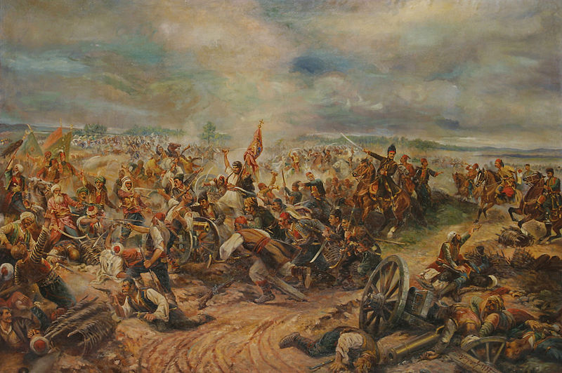
Causes
Russian Empire lost the Crimean War to an alliance of Western Europe, largely due to their industrial and technological weakness
Motivated Russian government to initiate industrialization

Slide 10
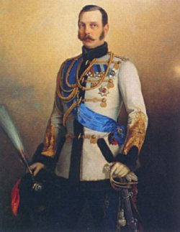
Causes
1861 = Russian state abolished serfdom (by Alexander II)
Stimulated by its defeat in the Crimean War
Tsar Alexander II saw the defeat of Russia’s serf-army at the hands of FREE British and French troops as a sign to end serfdom
Hoped that recently free peasants would succeed in agriculture and created capital for industrialization

Slide 11
Causes
After the abolition of serfdom, Russia began a program of industrial development
Government made policy to encourage industrialization
Began the Trans-Siberian Railroad
Encouraged foreign investment
Switched to the gold standard

Slide 12
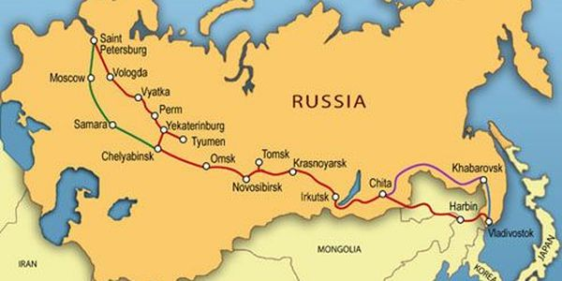

Slide 14
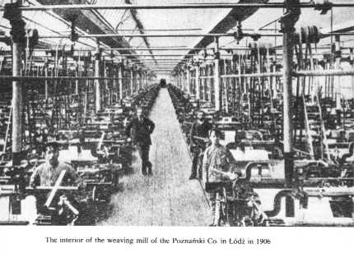
Characteristics
1890s = industrialization under way and growing rapidly
Focused on railroads and heavy industry
By 1900 = Russia ranked 4th in the world in steel production
Had major industries: iron/steel, coal, textiles, and oil

Slide 15
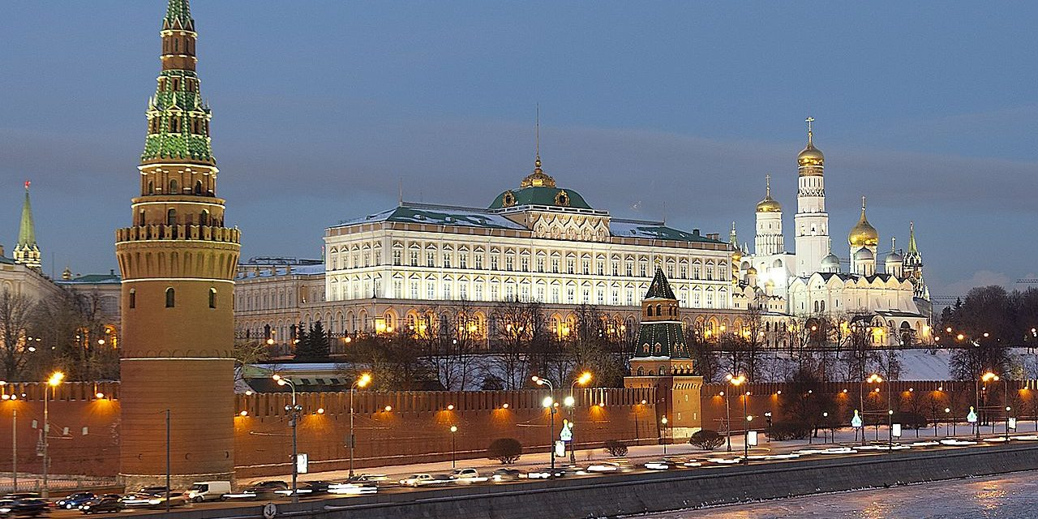
Characteristics
Government controlled and bought most of the heavy industry produced
Like Western Europe Russia developed a positive feedback loop
Coal->Iron/steel->Railroad ->Coal

Slide 16
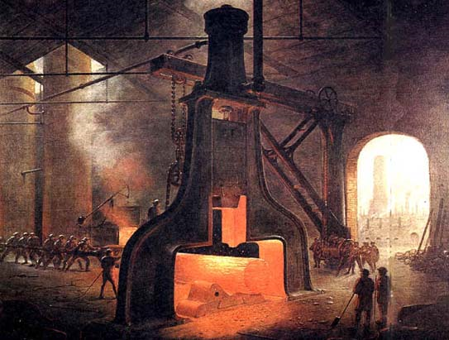
Characteristics
Factory workers made about 5% of total Russian population
Factory and urban life were AWFUL
13-hour work day
Ruthless discipline and constant disrespect from supervisors
Lived in poorly constructed dorms
Most lived in large, unsanitary barracks
Unions and political parties illegal
Only way to protest was through large-scale strikes

Slide 17
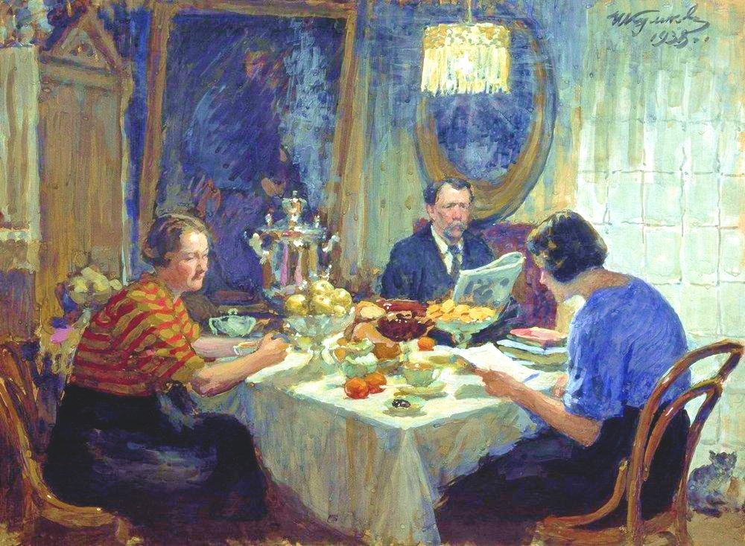
Characteristics
Growing middle class, comprised of businessmen and professionals developed
Many objected to tsarist Russia and wanted a greater role in political life
But, the middle class was also dependent on the state for: contracts, jobs, and suppressing the growing radicalism of the workers
A Family at Table, 1938
Painting of a Middle-Class Russian Family

Slide 18
Characteristics
Many workers and educated Russians turned to Marxist socialism
1898 = illegal Russian Social-Democratic Labor Party created
Got involved in: workers’ education, union organizing, and revolutionary action
1905 = a revolution in Russia erupted

