Slide 1
Interactive Notebook Set Up
3/5/2020
Russian Industrialization and Imperialism
This will be TWO pages

Slide 2
Russian Industrialization
Russian Imperialism

Slide 3
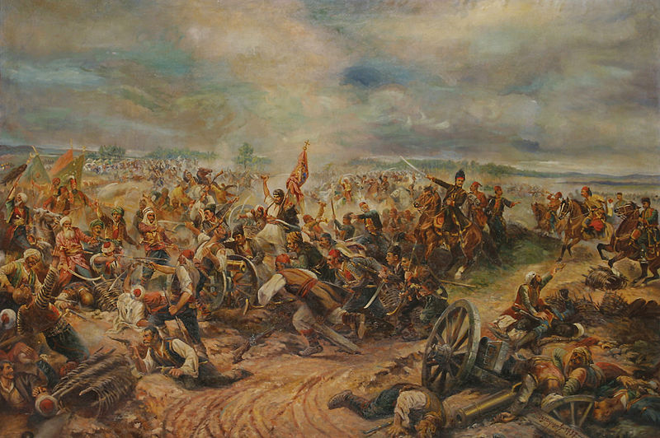
Russian Industrialization
Russian Empire lost the Crimean War to an alliance of Western Europe, largely due to their industrial and technological weakness
Motivated Russian government to initiate industrialization

Slide 4
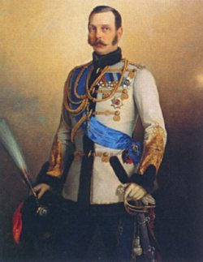
Russian Industrialization
1861 = Russian state abolished serfdom (by Alexander II)
Stimulated by its defeat in the Crimean War
Tsar Alexander II saw the defeat of Russia’s serf-army at the hands of FREE British and French troops as a sign to end serfdom
Hoped that recently free peasants would succeed in agriculture and created capital for industrialization
Government, not local landlord now controlled serfs

Slide 5
Russian Industrialization
VERY dependent on European investment/capital to build initial coal mines, factories, ect

Slide 6
Russian Industrialization
After the abolition of serfdom, Russia began a program of industrial development
Government Supported Industrialization:
Began the Trans-Siberian Railroad
Encouraged foreign investment
Government controlled production and bought most of the heavy industry produced

Slide 7
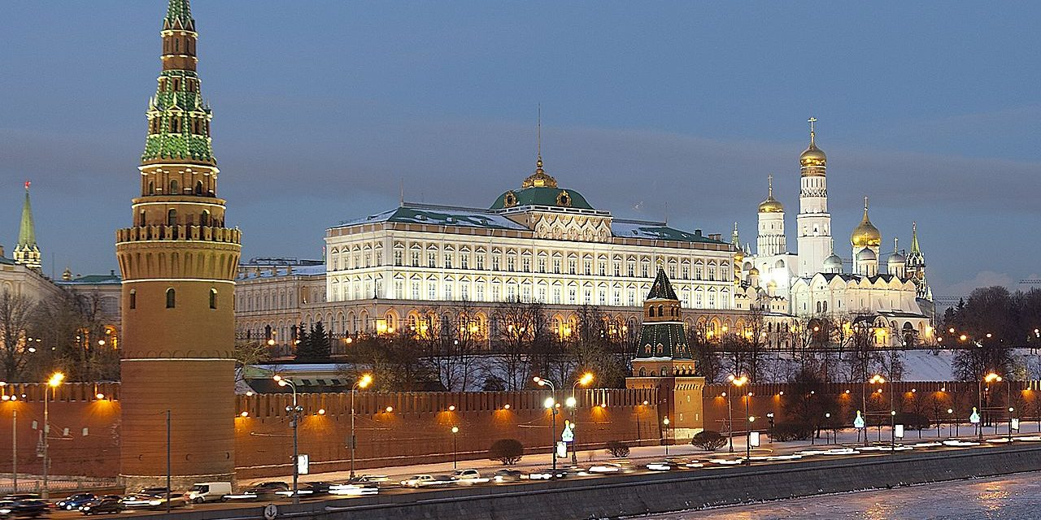
Russian Industrialization
STATE-GUIDED INDUSTRIALIZATION!!!!

Slide 8
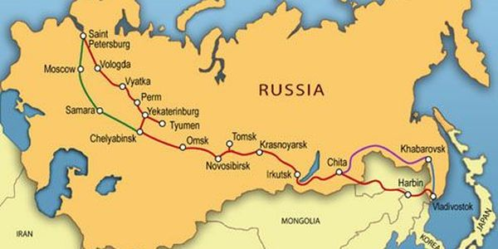

Slide 10
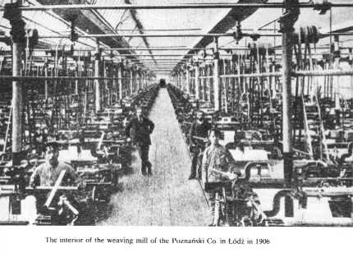
Russian Industrialization
1890s = industrialization under way and growing rapidly
Focused on railroads and heavy industry
By 1900 = Russia ranked 4th in the world in steel production

Slide 11
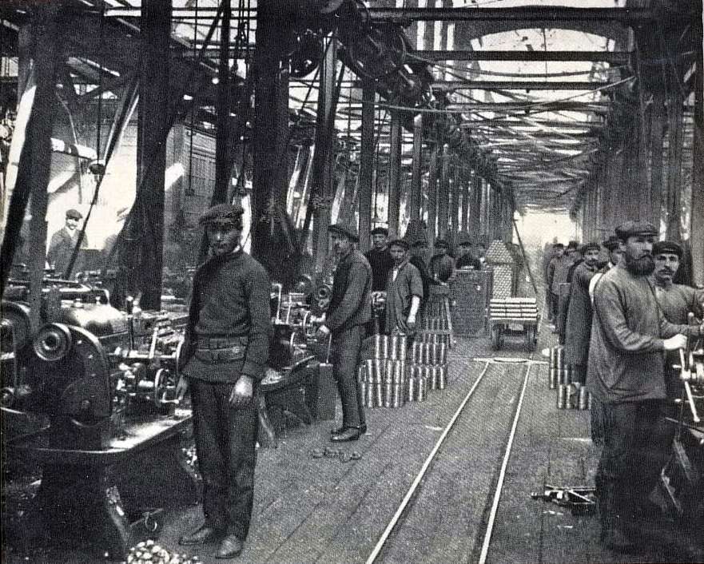
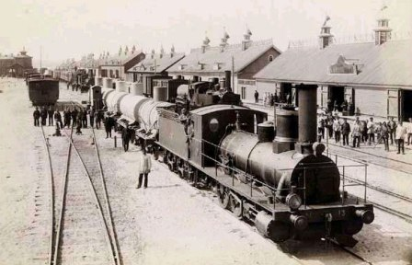
Characteristics
Had major industries:
iron/steel, coal, textiles, and oil

Slide 12
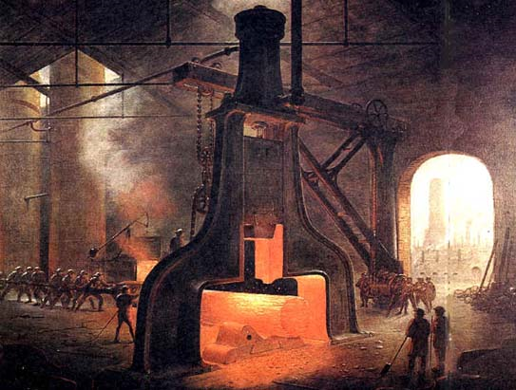
Russian Industrialization
Factory workers made about 5% of total Russian population
Factory and urban life were AWFUL
13-hour work day
Ruthless discipline and constant disrespect from supervisors
Lived in poorly constructed dorms
Most Peasants forcibly relocated & lived in large, unsanitary barracks
Urban population skyrocketed in major cities

Slide 13
Russian Industrialization
Unions and political parties illegal
Only way to protest was through large-scale strikes
Many workers and educated Russians turned to Marxist socialism
1898 = illegal Russian Social-Democratic Labor Party created
Got involved in: workers’ education, union organizing, and revolutionary action
1905 = a revolution in Russia erupted

Slide 14
Russian Imperialism
Built on history of conquest dating as far back as Ivan the terrible
Entirely focused on conquering neighboring territories
Focused primarily on Central Asia and East Asia/Siberia

Slide 15
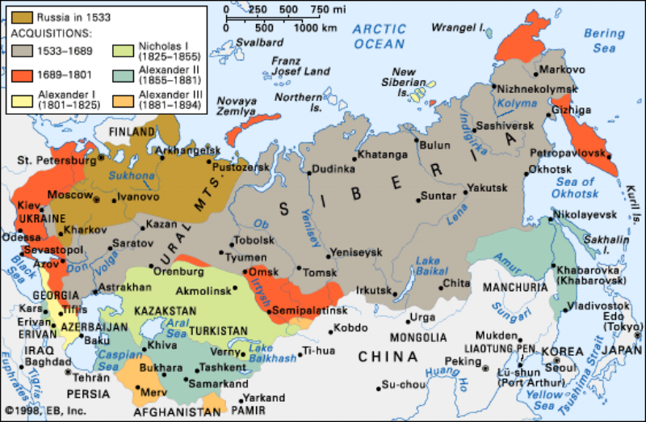

Slide 16
Russian Imperialism
Goals:
Gain access to new markets to sell industrial goods
Gain better access to ports/waterways to increase exports
Gain land to feed urban population

Slide 17
Russian Imperialism
Russian Imperialism brought them into direct tension/conflict with Japan and Western European Powers
Construction of Trans-Siberian Railroad seen as a threat by Japan
Control of oil in Manchuria

Slide 18
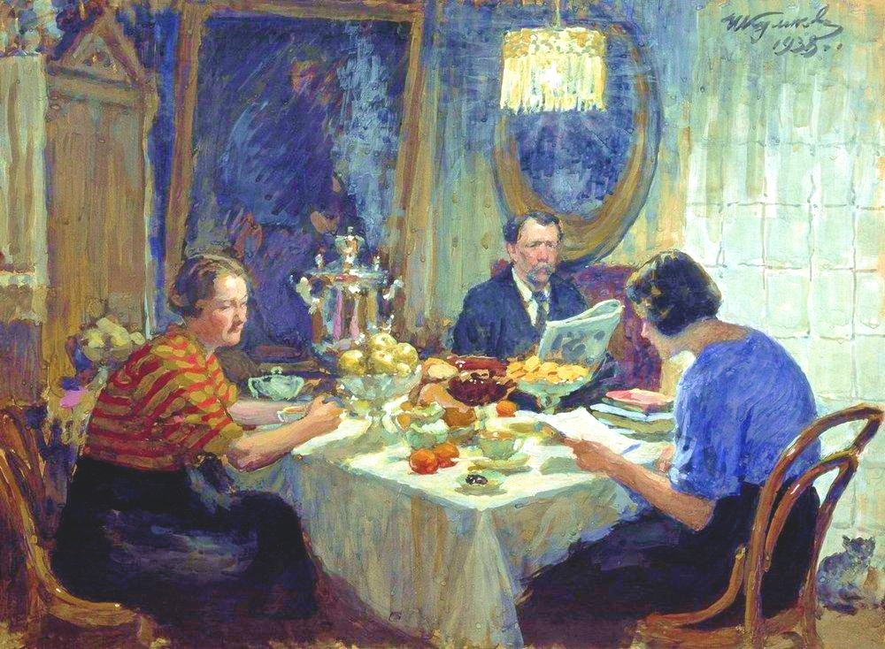
Characteristics
Growing middle class, comprised of businessmen and professionals developed
Many objected to tsarist Russia and wanted a greater role in political life
But, the middle class was also dependent on the state for: contracts, jobs, and suppressing the growing radicalism of the workers
A Family at Table, 1938
Painting of a Middle-Class Russian Family

