Slide 1
Interactive Notebook Setup
4/4/2018
Struggles of Ottoman and Qing Empires
This will be two page

Slide 2
Causes of Territorial Losses
Economic Problems
Attempts at Reform
Supporters of Reform

Slide 3
The Crisis Within
Taiping Rebellion
Western Pressures & the Opium Wars
Failures to Modernize

Slide 4
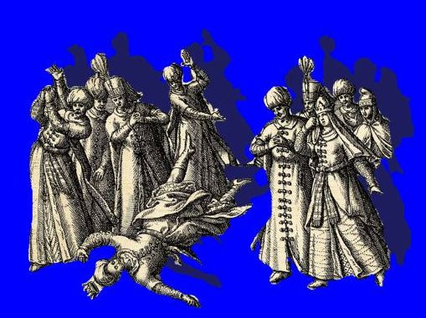
The Ottoman Empire: “Sick Man of Europe”
In the 1800s= the Ottoman Empire went from being a great power in the world to one of the weakest territories
Could no longer keep up with Western Europe
Unable to prevent region after region from falling under European control

Slide 5
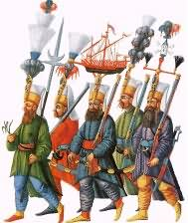
More Problems for the Ottoman Empire
Weak central government
Increasing power of local authorities and rulers
Unable to effectively raise revenue (taxes)
Growing technological and military gap with Europe
Decreasing power of the Janissaries (elite infantry units of the Ottoman Empire)

Slide 6
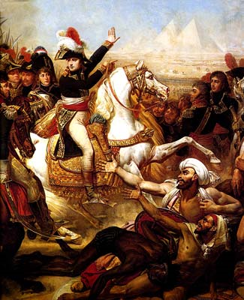
Causes of Territorial Losses
Cause #1 = European aggression
Invasions from Russia, Britain, France, and Austria
Example: one of the earliest invasions = in 1798 = Napoleon’s invasion of Egypt
Cause #2 = Nationalism and independence movements by different groups within the Ottoman Empire
Independence achieved by: Greece, Serbia, Bulgaria, and Romania (with help of European militaries)
Driven by nationalism
Napoleon’s Invasion of Egypt

Slide 7
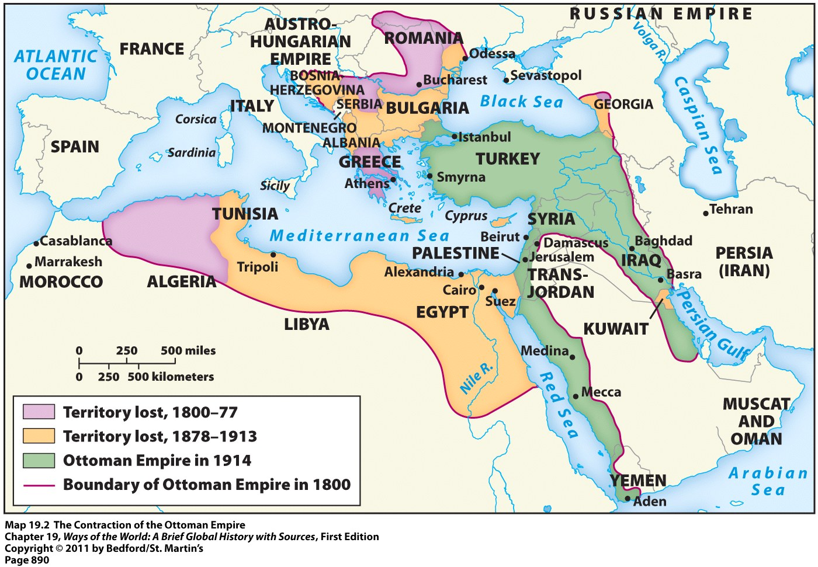
The Contraction of the Ottoman Empire

Slide 8
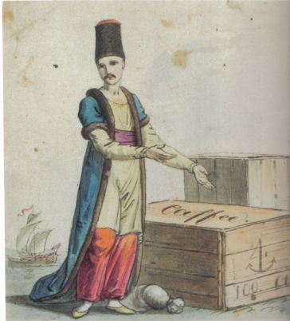
Economic Problems
The economy of the Ottoman Empire weakened for several reasons:
Europeans achieved direct sea access to Asia which cost Ottomans revenue
No longer a need for them to go through the Ottoman and Arab land routes to get there = loss of revenue for those groups
Ottoman artisans and workers hurt by competition from cheap European manufactured goods
An Ottoman Merchant in Istanbul
(with no customers) ☹

Slide 9
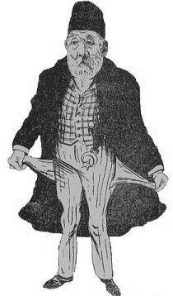
Economic Problems
Series of unbalanced trade agreements between European powers and the Ottoman Empire = allowed Europeans many exemptions from Ottoman law and taxation
Allowed these Westerners to easily “infiltrate” the Ottoman economy
Ottoman Empire came to rely on foreign loans to sustain itself
Unable to repay those debts OR the interest on them
Led to foreign control of much of its revenue-generating system

Slide 10
Attempts at Reform
Ottoman Empire began programs of “defensive modernization”
Earlier, more sustained, and more vigorous than the “self-strengthening” policies of China
Several factors contributed to this:
The Ottoman Empire
No internal upheavals
Only nationalist revolts on edges of empire
No explosive population growth
Ottoman leaders = Turkic and Muslim (similar to their people)

Slide 11
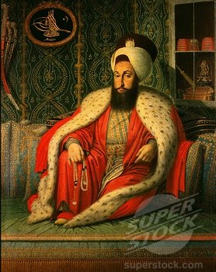
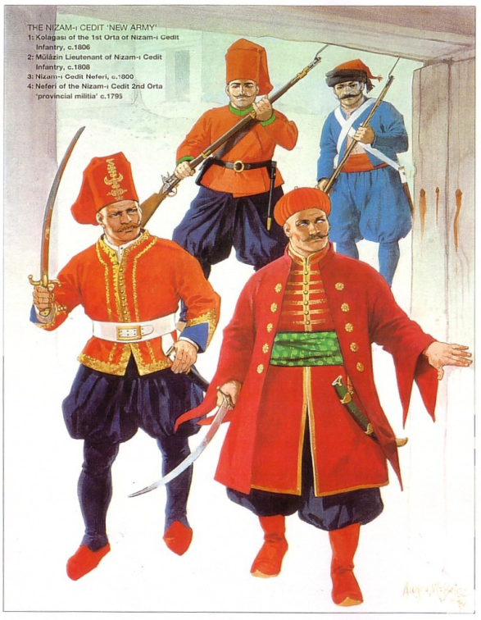
Attempts at Reform
Reforms began in the late 1700s with Sultan Selim III
Wanted to reorganize and update the army
Wanted to draw on European advisors and techniques
Result = opposition from ulama (Muslim religious scholars) and the Janissaries
Believed these reforms would threaten their power and that they conflicted with Islam
Selim III = overthrown and murdered in 1807
Future sultans crushed the Janissaries and brought the ulama under state control

Slide 12
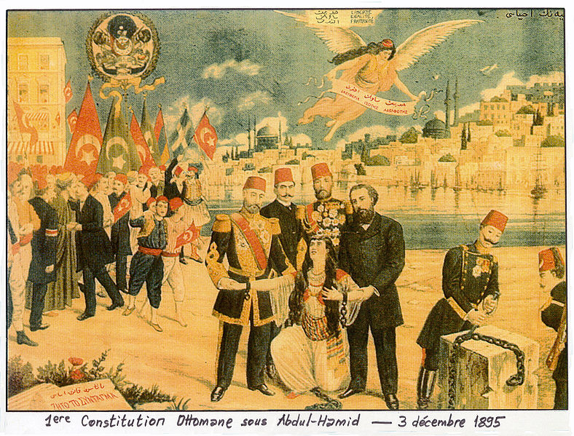
Attempts at Reform
Started the Tanzimat (reorganization) reform:
Factories making cloth, paper, and arms
Modern mining operations
Resettlement of agricultural land
Telegraphs, steamships, railroads, modern postal service
Western-style law codes and courts
New elementary and secondary schools
Equal rights (under law) for Muslims AND non-Muslims
The Ottoman Constitution, 1895
(Extended equal rights to all)

Slide 13
Supporters of Ottoman Reforms
Young Ottomans:
Wanted a European-style democratic, constitutional government
Only way to overcome “backwardness” and stop European aggression
“Islamic modernism” = Muslim societies can embrace Western technical and science, while rejecting materialism
Islam can be modern AND maintain its religious character
The Young Ottomans did not have much success → authoritarian rule continued in the Ottoman Empire

Slide 14
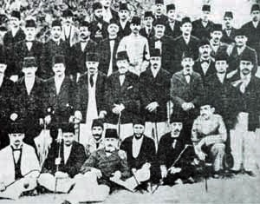
Supporters of Ottoman Reforms
“Young Turks”=military and civilian elites
Opposed this tyrannical rule
Wanted a completely secular (non-religious) law code
Supported continuing modernization based on European achievements
Viewed the Ottoman Empire as a “Turkish nation state”
This antagonized non-Turkic peoples and helped stimulate Arab and other nationalisms → contributed to disintegration of Ottoman Empire after WWI
A photograph of Young Turks from 1902

Slide 15
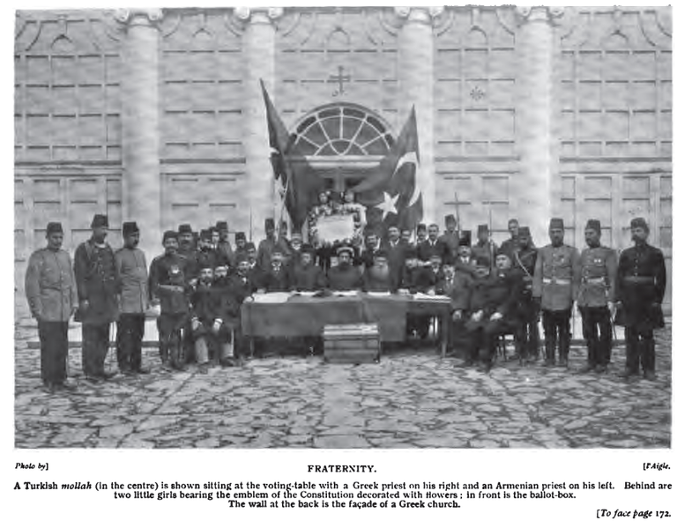
Supporters of Ottoman Reforms
1908=successful military coup by the Young Turks
Reforms that they implemented:
Secularized schools, courts, and law codes
Allowed elections and political parties
Opened up modern schools for women
Allowed women to wear Western clothing
Allowed women to get divorces in some situations
Encouraged Turkish as the official language
Declaration of the Young Turk Revolution

Slide 16
The Contraction of the Ottoman Empire

Slide 17
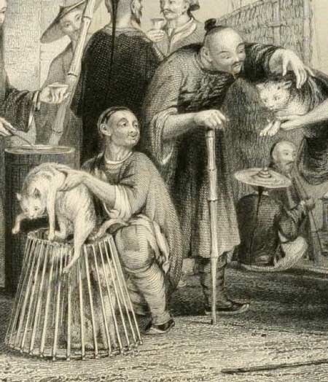
The Crisis Within
1700s to mid-1800s saw massive population growth
Results:
Growing pressure on the land
Smaller farms for China’s huge peasant population
Unemployment
Poverty
Starvation and misery
Poor Chinese Cat Merchants, 1843
(Sold for food, not as pets!)

Slide 18
The Crisis Within
China’s centralized government did not expand to cope with this growing population
Government became unable to effectively perform many functions
Tax collection
Social welfare
Flood control
Public security
The central government lost power to officials in the provinces and local landowners
Many were corrupt
Treated the peasants very harshly

Slide 19
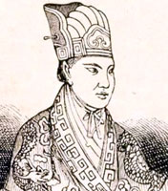
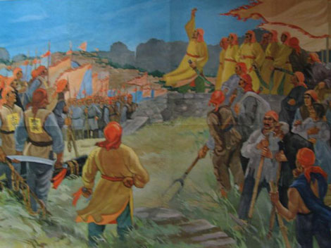
The Taiping Rebellion
Led to many peasant rebellions and uprisings
1850 – 1864
Leaders believed in a unique form of Christianity
Leading figure = Hong Xiuquan = proclaimed to be the younger brother of Jesus
Sent to establish a “heavenly kingdom of great peace” in the world
Painting of the Battle of Sanhe
A major engagement of the Taiping Rebellion
Notes:
“Taiping” = of Chinese origin; in that language, it refers to “peace”

Slide 20
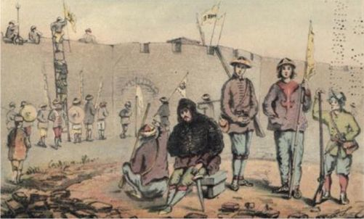
The Taiping Rebellion
Goals:
Abolition of private property
Radical redistribution of land
Gender Equality
End of foot binding, prostitution, and opium smoking
Sexually segregated military camps of men and women
Expulsion of all Qing dynasty “foreigners”
Industrialization of China
With railroads, health care for all, universal public education, etc.
Taiping Soldiers Outside Shanghai

Slide 21
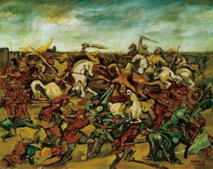
The Taiping Rebellion
Taiping forces and followers swept out from southern China and established their capital in Nanjing in 1853
Uprising eventually failed due to:
Divisions and indecisiveness within Taiping leadership
Inability to link up with other rebel groups throughout China
Western military support for pro-Qing forces
Rebel forces finally crushed in 1864
Painting of the Taiping Rebellion

Slide 22
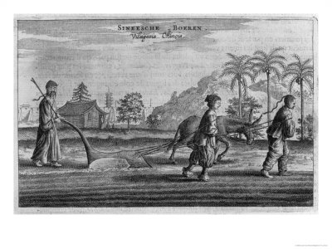
The Taiping Rebellion
Effects:
Weakened the Qing centralized government
Disruption and weakening of China’s economy
Destruction and devastation to the land
Estimated 20-30 million lives lost
Continued social instability
Chinese Peasants in the 19th Century

Slide 23
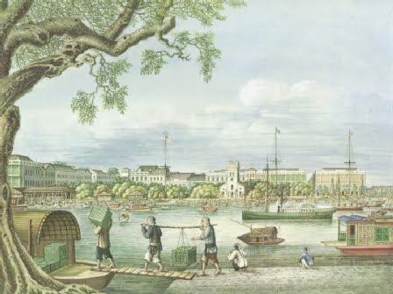
Western Pressures and Opium Wars
Shifting balance of power between Europe and China evident in the Opium Wars
Late 1700s British began to grow and process opium in India and illegally sell the drug to the Chinese to make up for its trade imbalance with them
By 1830 = very profitable market for British, American, and other Western merchants
“Factories” where British and American merchants sold opium in Canton, China

Slide 24
Chinese/British Trade at Canton (1835-1836)
 | Item | Value (in Spanish dollars)
British Exports to Canton | Opium | 17,904,248
 | Cotton | 8,357,394
 | All other items (ex: iron, tin, etc.) | 6,164,981
 | Total | 32,426,623
British Imports from Canton | Tea | 13,412,243
 | Raw silk | 3,764,115
 | Vermilion | 705,000
 | All other goods (gold, copper, etc.) | 5,971,541
 | Total | 23,852,899
What kind of shape would the British have been in without opium???
Notes:
Vermilion comes from cinnabar, a common ore of mercury mined in China
Has an orange-red pigment; used in dyes

Slide 25
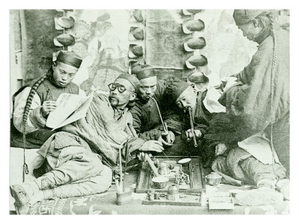
Western Pressures and Opium Wars
China had several problems with the opium trade:
Political problem = Opium was illegal & sale disregarded Chinese law
Led to the corruption of many Chinese officials who were bribed to turn a blind eye to the smuggling
Economic problem = Massive outflow of silver to pay for opium was causing serious economic decline
Social problem = Millions of men and women became addicted and couldn’t function as productive citizens
Chinese Opium Den

Slide 26
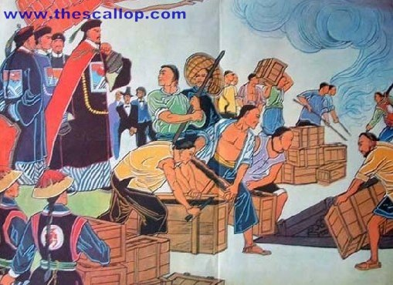
Western Pressures and Opium Wars
1836 Chinese emperor cracked down on opium use
Millions of pounds of opium seized from traders and destroyed without compensation
Western merchants expelled from the country
British sent Navy to China
Offended by violation of property rights
Wanted to end the restrictive conditions under which they’d long traded with China
Result 1st Opium War
Confiscated opium being burned

Slide 27
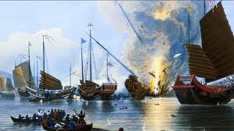
Western Pressures and Opium Wars
The British had superior military might and easily won
Treaty of Nanjing ended the war in 1842
Imposed restrictions on the power of the Chinese emperor
Opened 5 ports to European traders
The Outbreak of the First
Opium War

Slide 28
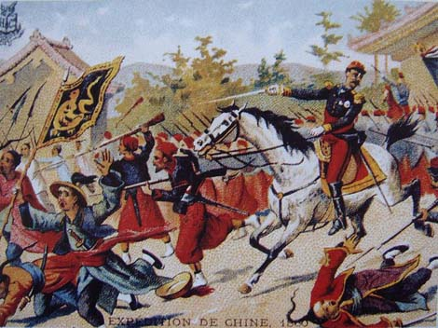
Western Pressures and Opium Wars
British forces were victorious once again
Treaty of Tientsin ended Second Opium War in 1858
10 more ports opened to foreign traders
Foreigners allowed to travel freely and buy land in China
Foreigners allowed to preach Christianity under the protection of Chinese authorities
Foreigners allowed to navigate along and patrol some of China’s major rivers
Chinese forbidden from referring to the British as “barbarians” in official documents
Painting of the Second
Opium War

Slide 29
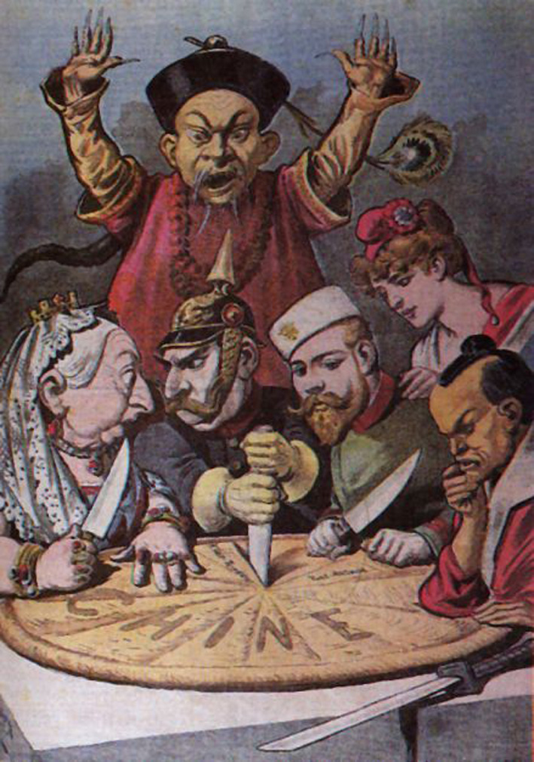
Western Pressures and Opium Wars
1885 = lost to the French in the Sino-French War
Lost territory of Vietnam to the French
1895 = lost to Japan in the Sino-Japanese War
Lost territories of Korea and Taiwan to the Japanese
By the end of the 1800s European powers, Russia, and Japan had all carved out spheres of influence in China
Established military bases
Extracted raw materials
Built railroads
Carving Up the Pie of China
French Political Cartoon, 1890s
Notes:
Left to right: Great Britain’s Queen Victoria, Germany’s Kaiser Wilhelm, Russia’s Tsar Nicholas II, a female figure representing France, and the Meiji emperor of Japan.
All are dividing up China; behind them is a Chinese figure trying helplessly to stop the partition of his country.

Slide 30
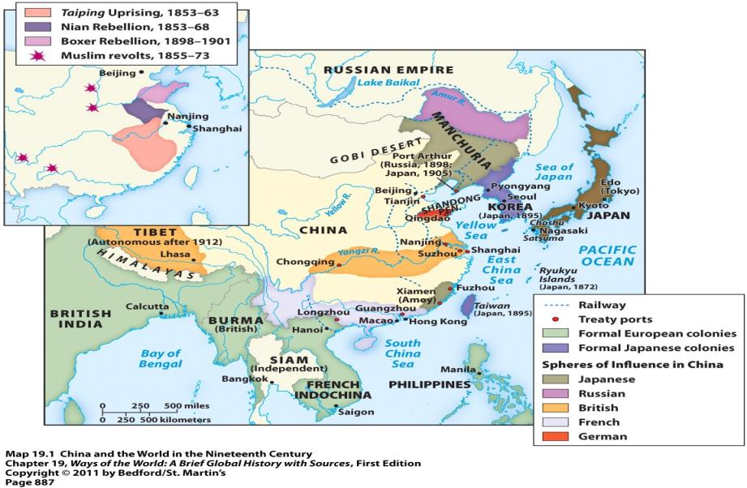
Spheres of Influence in China

Slide 31
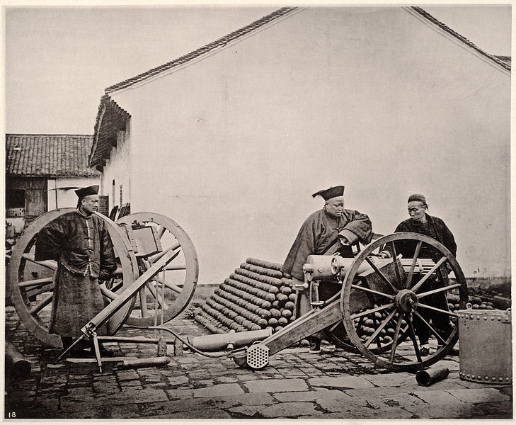
Failed Attempts at Modernization
1860s-1870s “self-strengthening” policies implemented to reinvigorate a traditional China
Overhauled examination system = designed to recruit qualified candidates for official positions
Support for landlords
Repair of irrigation systems
A few industrial factories=producing textiles and steel
Coal mines expanded
Telegraph system initiated
Creation of modern arsenals, shipyards, and foreign language schools
Nanjing Jinling Arsenal

Slide 32
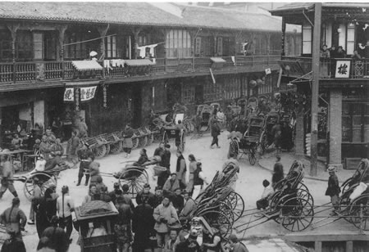
Failed Attempts at Modernization
Problems with China’s “self-strengthening” program that eventually led to its failure:
Little support from conservative leaders → feared urban, industrial, and commercial growth would hurt the power and privileges of the landlord class
New industries were largely dependent on foreigners for machinery, materials, and expertise
New industries only helped local authorities who controlled them, not the Chinese state
China during the time of the Self-Strengthening Movement

