Slide 1
DBQ Bellwork
How was last weeks DBQ compared to last time?
Opinion
Most of the documents were secondary sources, what aspect of the rubric did this make a little more difficult?
Point of view

Slide 2
Objective
WWBAT: Discuss the characteristics of the Mongol Khanates and their eventual collapse

Slide 3
Background
After the death of the 4th Kahn, Möngke Khan the Mongol empire fractured into four sections
Four section were called Khanates:
Khanate of the Great Kahn, AKA Yuan Dynasty
Golden Horde
Chagatai Khanate
Ilkhanate

Slide 4
Interactive Notebook Setup
1/20/2016
Mongolian Khanates
This will be one page

Slide 5
China and the Mongols
Persia and the Mongols
Russia and the Mongols

Slide 6
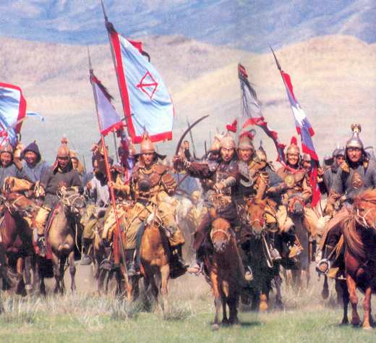
China and the Mongols
Most difficult and lengthy conquest for the Mongols
Took 70 years (1209 to 1279) to conquer
Violently conquered northern China → then controlled by various nomadic states
More peacefully conquered southern China → then controlled by the Song Dynasty
Unified a divided China
Gave the Mongols legitimacy
Believed they had earned the Mandate of Heaven

Slide 7
China and the Mongols
The Mongols gave themselves a Chinese dynastic title, the Yuan, meaning “great beginnings”
Goal was to extract wealth from China
In order to do so they had to accommodate the Chinese
Accommodations included:
Used Chinese administrative practices, taxation systems, and postal system
Moved capital from Karakorum in Mongolia to Beijing in China

Slide 8
China and the Mongols
Mongol rule in China was still harsh, exploitative, foreign and resented
Mongols did NOT become Chinese
Did not allow the Chinese to become high government officials
Chinese men could not participate in the government
However, the Chinese were allowed to maintain their cultural traditions

Slide 9
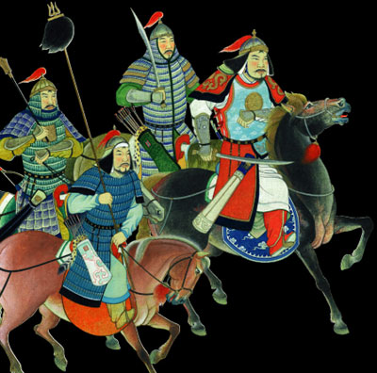
China and the Mongols
Mongol rule in China declined in the mid-1300s
Many factors of decline:
Division among the Mongols
Rising prices (inflation)
Epidemics of the plague
Growing peasant rebellions
1368 = all Mongols forced out of China and returned home to the steppe

Slide 10
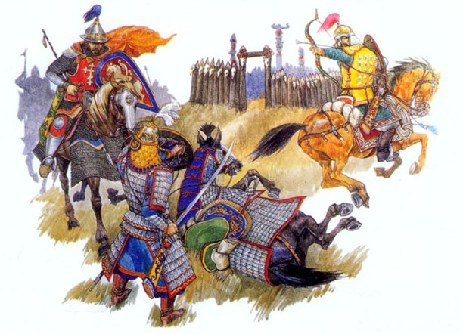
Persia and the Mongols
Conquest of Persia = much quicker and more violent than that of China
1258 = capital of Baghdad sacked
End of Abbasid dynasty
More than 200,000 people massacred

Slide 11
Persia and the Mongols
Peasants pushed off their land due to heavy taxation
Nomadic Mongols with their herds of animals turned agricultural land into pasture, wasteland, and desert
Irrigation channels = neglected

Slide 12
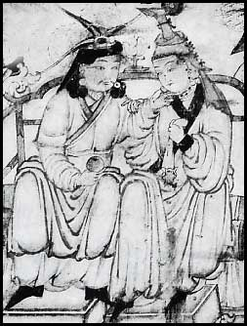
Persia and the Mongols
Many Mongols in Persia were heavily influenced by the Persians there:
Adopted Islam
Left government operation to Persian hands
Learned Persian
Some turned to farming and abandoned nomadic ways
Some married local people
Mongol man and Persian woman

Slide 13
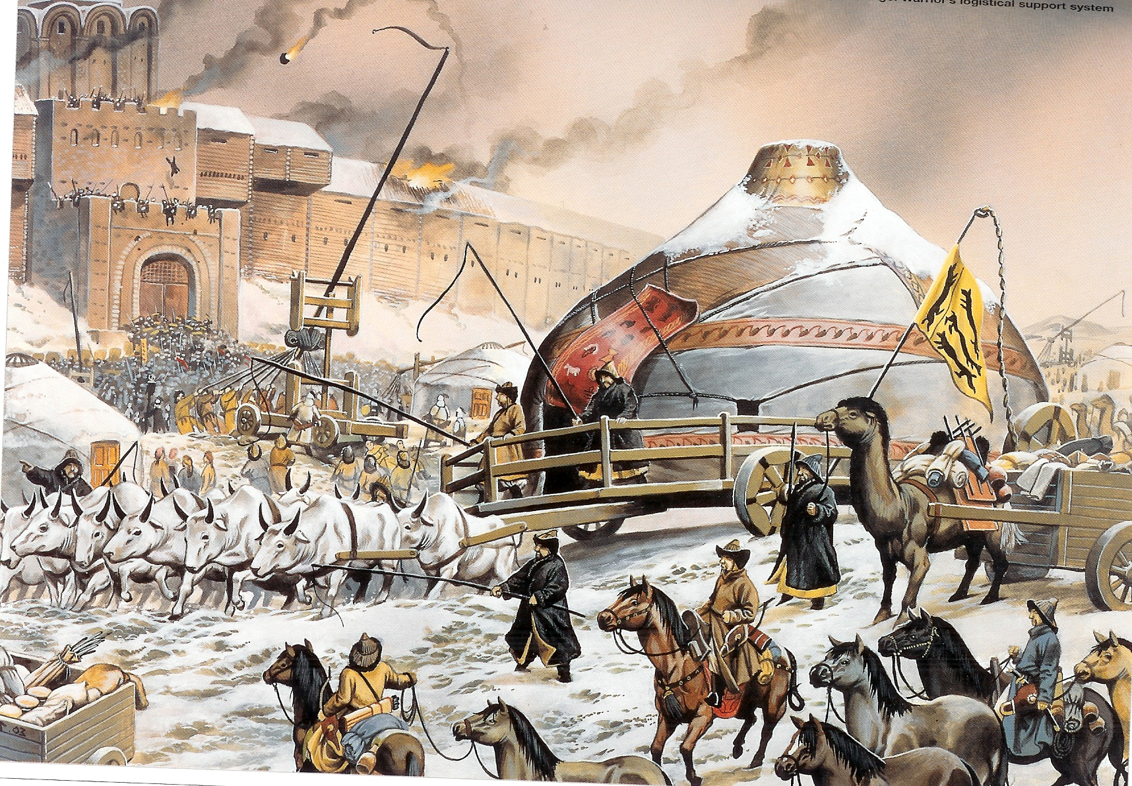
Russia and the Mongols
Heavy devastation to Russia → perhaps more than in Persia
Mongol conquest of Russia = called the “Khanate of the Golden Horde”
Mongols defeated the Russians, but did NOT occupy Russia
Russia had little to offer
Less developed economy
Not located along any major trade routes
Painting of the fall of Kievan Rus

Slide 14
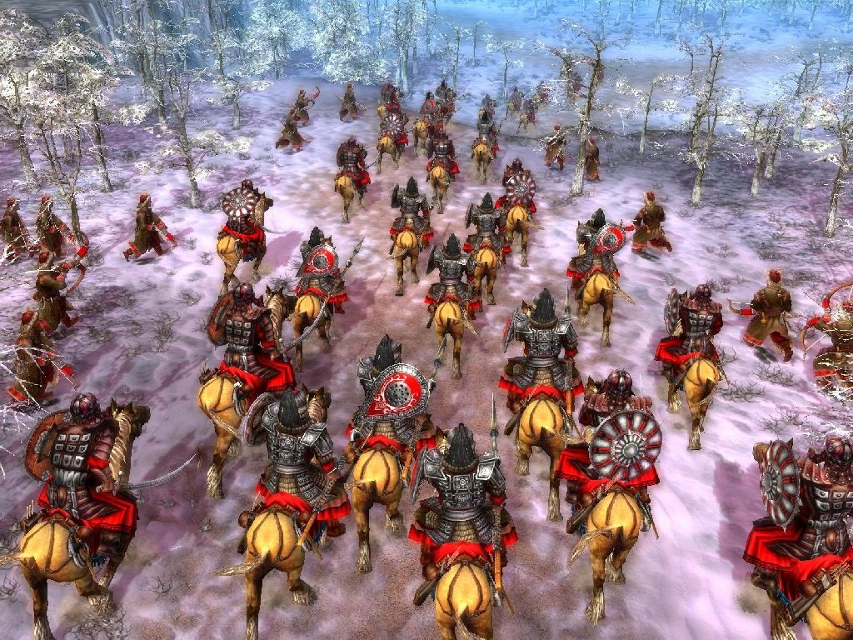
Russia and the Mongols
Russian princes required to send tribute to the Mongols
Variety of heavy taxes on Russian people
Continuing border raids
Tens of thousands of Russians sent into slavery

Slide 15
Russia and the Mongols
Although the Mongols weren’t influenced much by the Russians, the Russians were influenced by the Mongols:
Adopted Mongols’ weapons
Court practices
Diplomatic rituals
Taxation system
Military draft

Slide 16
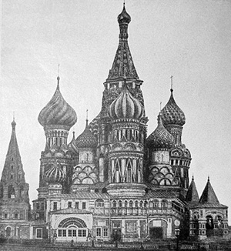
Russia and the Mongols
Mongol rule in Russia started to decline by the end of the 1400s
Major causes of this decline:
Divisions among Mongols
Growing strength of Russian state → now centered on the city of Moscow

