Slide 1
Colonial Rule Bellwork
Why were the colonies of New Zealand and Australia different than other colonies?
They were settler colonies
How was colonial rule established in India and Indonesia?
Based on previous interactions/trading presence
What industries did colonized people work for wage?
Plantations and mining

Slide 2
Obejctive
WWBAT: Discuss the economic modernization of Japan and how/why Japan became more of a global participant in the 19th century

Slide 3
Interactive Notebook Set Up
4/14/2016
Modernization of Japan
This will be one page

Slide 4
Economic and Urban Changes
Modernization in Japan
American Intrusion of Japan
State-Guided Industrialization
Japanese Imperialism

Slide 5
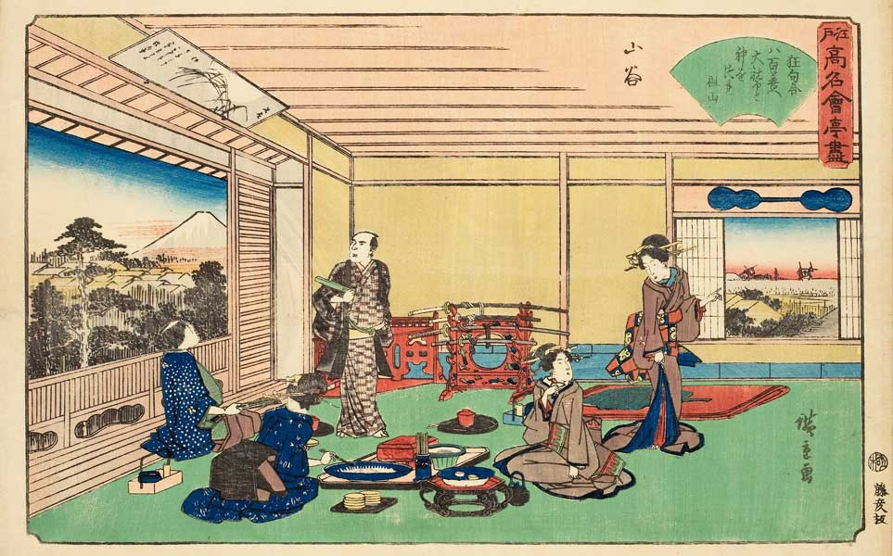
Economic and Urban Changes
Centuries of peace allowed for economic growth, commercialization, and urban development
By 1750 most people in Japan lived in large towns or cities
Emerging capitalism → markets linked urban and rural areas
Encouragement of education produced a very literate population
Japanese Teahouse during the Edo Period

Slide 6
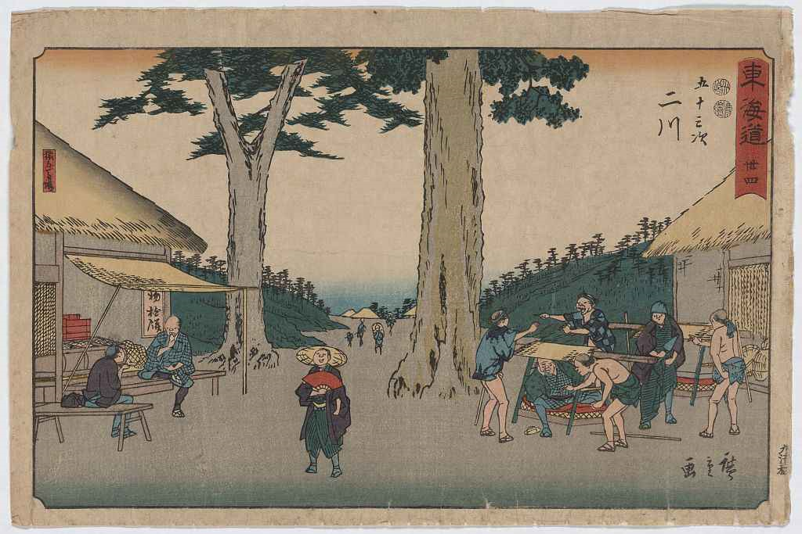
Economic and Urban Changes
Merchants thrived in commercial economy
Had wealth, but no status
still considered the lowest in society according to the Confucian hierarchy
Many daimyo and samurai found it necessary to borrow money from these “social inferiors”
Had high status, but no wealth
Japanese Merchants

Slide 7
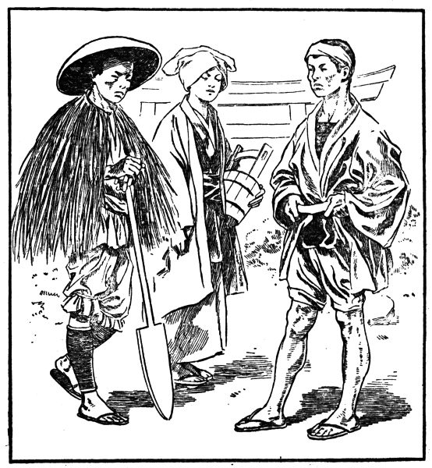
Economic and Urban Changes
Peasants supposed to: devote themselves to farming, live simply, and avoid luxuries
Many peasants ignored this “law” and moved to the cities to become artisans or merchants
Ignored their “status” and imitated their superiors → example: used umbrellas instead of straw hats in the rain
Japanese Peasants

Slide 8
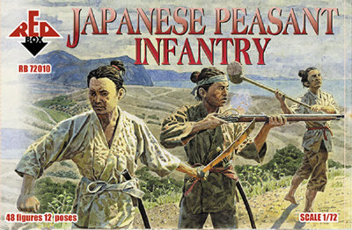
The Tokugawa Shogunate: Losing Control
In addition to these economic and social changes, other factors contributed to Shogunate’s loss of control in the early 1800s:
Corrupt and harsh officials
Severe famine in the 1830s that the shogunate could not deal with effectively
Expressions of frustration from the poor took form of peasant uprisings and urban riots
Japanese Peasant Infantry

Slide 9
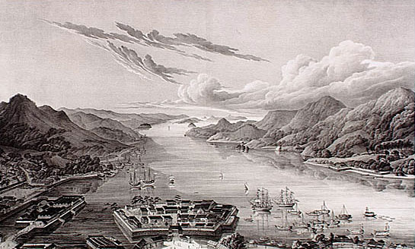
American Intrusion of Japan
Since the early 1600s Japan had deliberately limited its contact with the West
Expulsion of European missionaries
Harsh suppression of Christianity
Japanese forbidden from leaving
Only 1 port where the Dutch were allowed to trade
Early 1800s European countries and the U.S. were “knocking on Japan’s door” to persuade them to reopen contact with the West
All were turned away
Even shipwrecked sailors were jailed or executed
Nagasaki Bay
Dutch Port during Japanese Isolationism

Slide 10
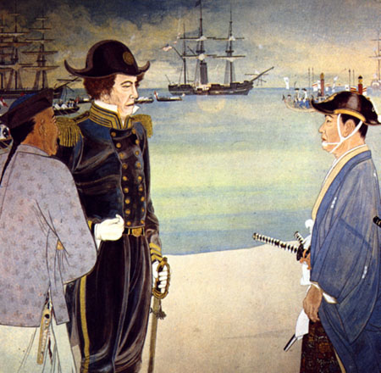
American Intrusion of Japan
1853 U.S. Commodore Matthew Perry “opened” Japan
Commodore Perry demanded:
Humane treatment of castaways
Right of American ships to refuel and buy supplies
Opening of Japanese ports for trade
He was authorized to use force if necessary, but Commodore Perry approached the Japanese with gifts and a white flag
War was avoided
Commodore Perry Lands in Japan

Slide 11
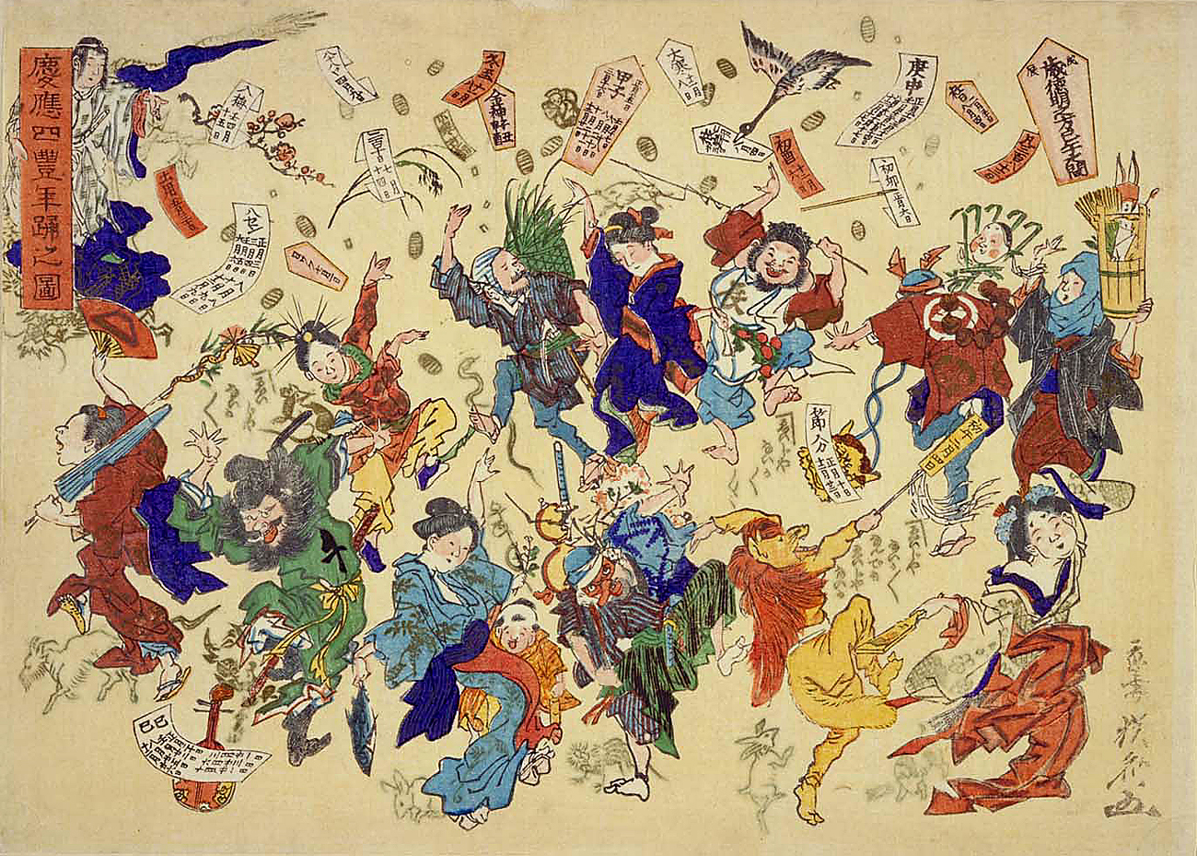
American Intrusion of Japan
Japan agreed to a series of unequal treaties with the U.S. and different Western powers
They knew what happened to China when it resisted European demands – did not want that outcome
Results of this decision:
Loss of support for the ruling shogunate
Brief civil war
1868 a political takeover by a group of samurai from southern Japan called the Meiji Restoration
“Eejanaika”
Dancing on the Eve of the Meiji Restoration

Slide 12
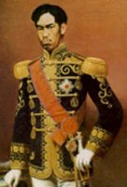
The Meiji Restoration
Goals of the Meiji Restoration:
Save Japan from foreign domination
Transform and modernize Japanese society by drawing upon Western achievements and ideas
This transformation becomes possible due to:
No massive violence or destruction in Japan as in China (Taiping Rebellion)
Less pressure from Western powers than in China and the Ottoman Empire
Japan = less sought after by Europeans because its location wasn’t very strategic and it didn’t have as many people or riches
U.S. ambitions in the Pacific = deflected by the Civil War and its aftermath
Emperor Meiji
(1867-1912)

Slide 13
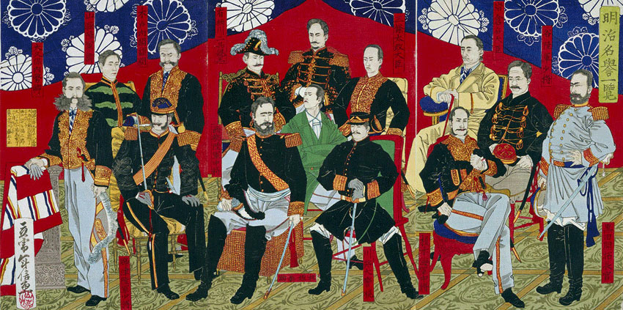
Modernization in Japan
First task was to create true national unity
Required an attack on the power and privileges of the daimyo and samurai
Ended the semi-independent domains of the daimyo
Replaced with governors appointed by and responsible to the national government
National government (not local authorities) now collected taxes and raised a national army
Japanese Color Woodblock Print of Meiji Dignitaries (1877)

Slide 14
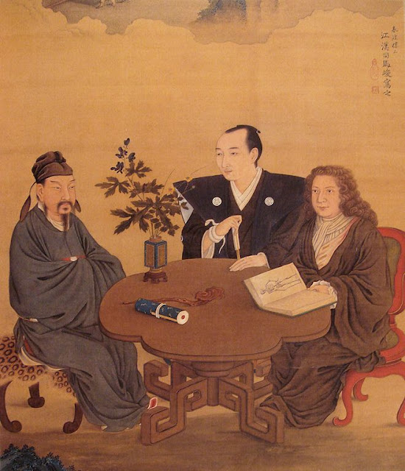
Modernization in Japan
Development of a nation-wide economy
Dismantling of old Confucian-based social order with its special privileges for certain classes
All Japanese became legally equal
Official missions to Europe and the U.S. to learn about the West
A Meeting of Japan, China, and the West

Slide 15
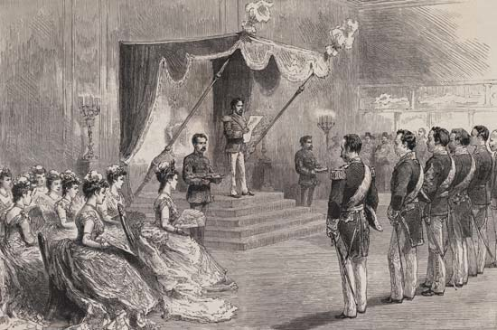
Modernization in Japan
Japan borrowed many ideas from the West and combined these foreign elements with Japanese elements
Goal was modernize and maintain unique culture
Ex: Constitution of 1889 included a parliament, political parties and democratic ideals, BUT the constitution was presented as a gift from a scared emperor descended from the Sun Goddess
Ex: Modern education system included Confucian principles
The Meiji Emperor Proclaiming the Meiji Constitution in 1889

Slide 16
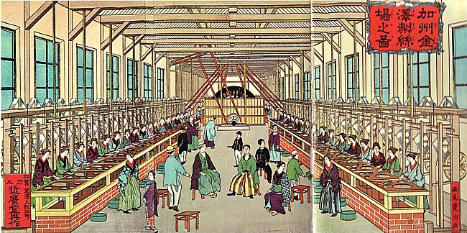
State-Guided Industrialization
Government set up a number of enterprises and later sold them to private investors
Used own resources when industrializing
Became a major exporter of textiles and was able to produce its own manufactured goods
Painting of a Western-Style Japanese Factory from the 1880s

Slide 17
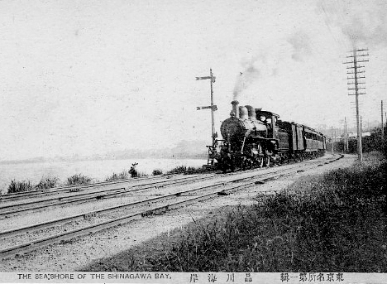
State-Guided Industrialization
The Japanese government also:
Built railroads
Created a postal system
Established a national currency
Set up a national banking system
Japanese Steam Train (1872)

Slide 18
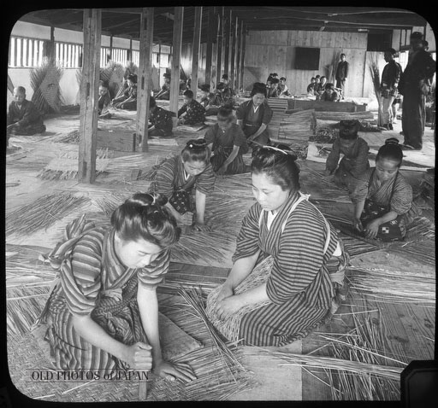
State-Guided Industrialization
Many peasant families slid into poverty
Taxed too much to pay for Japan’s modernization
Protests with attacks on government offices and bankers’ homes
Low pay and terrible working conditions for factory workers (mainly women)
Female Workers in a Japanese Bamboo Basket Factory (1904)

Slide 19
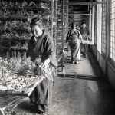
State-Guided Industrialization
Anarchist and socialist ideas developed among intellectuals
Efforts to create unions and organize strikes met with harsh opposition

Slide 20
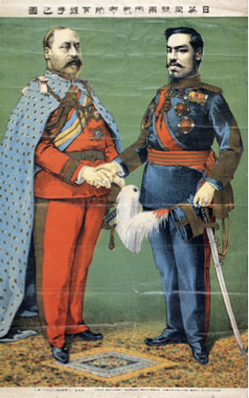
Japanese Imperialism
Western powers revised the unequal treaties they had with Japan
Anglo-Japanese Treaty (1902) acknowledged Japan as an equal player among the “Great Powers” of the world
Became a military competitor and imperialist power in East Asia

Slide 21
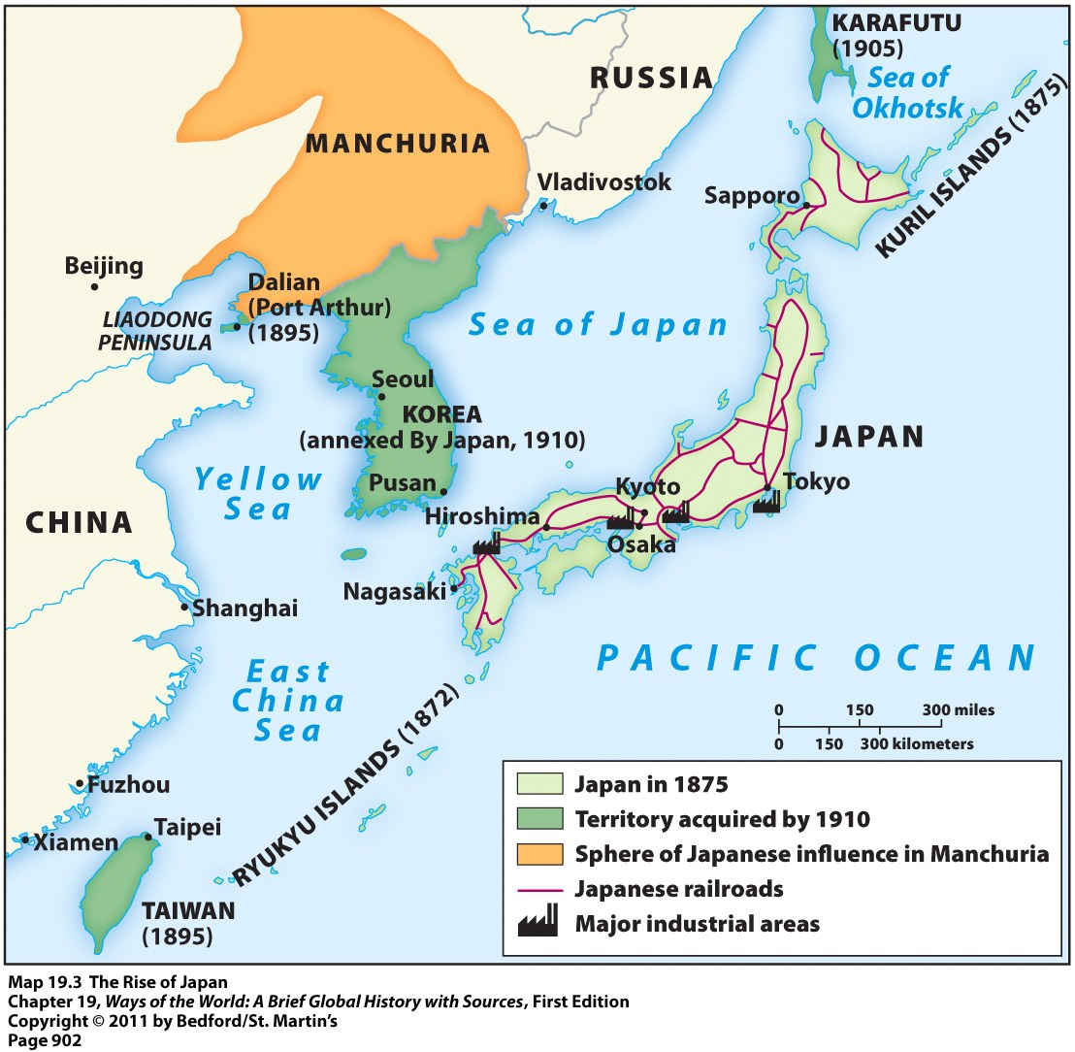
Japanese Imperialism
War with China gained lead to control of Taiwan and Korea
War with Russia (1904-1905) caused a gained a territorial foothold in Manchuria
Japan was the first Asian state to defeat a major European power

