Slide 1
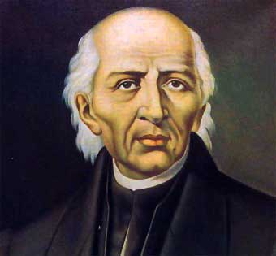
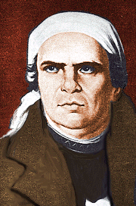
Causes/Background
Starting in 1810 Priests Miguel Hidalgo and Jose Morelos led the fight against Spanish rule in Mexico
Led a peasant revolt against the Creole and Peninsulare

Slide 2
Causes/Background
Believed revolt was the only way to achieve their 2 goals for Mexico:
1. Political freedom
2. End of slavery & improved living conditions for Mexico’s poor/Challenge Mercantilism

Slide 3
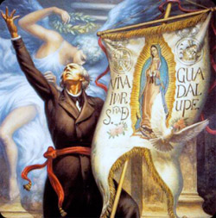
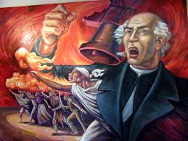

Slide 4
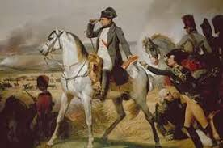
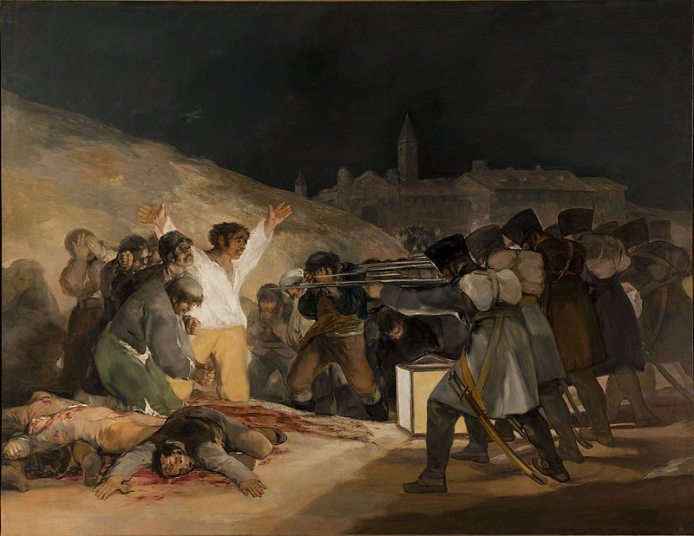
Causes/Background
Napoleon’s invasion and conquest of Iberian Peninsula led to chaos in Mexico

Slide 5
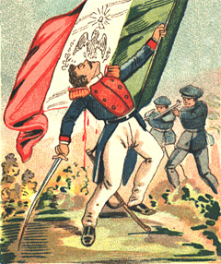
Causes/Background
An alliance of Church leaders and Creole elites joined and limited “radical” peasant rebellion
They brought Mexico to a more controlled independence

Slide 6
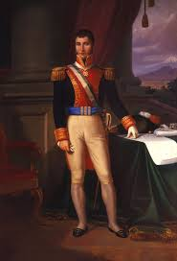
Major Changes/Effects
1821 Mexico declared its independence
Creole general Augustin de Iturbide (1783-1824) declares independence in 1821
Installs self as Emperor, deposed in 1823
1823 Mexico became a republic

Slide 7
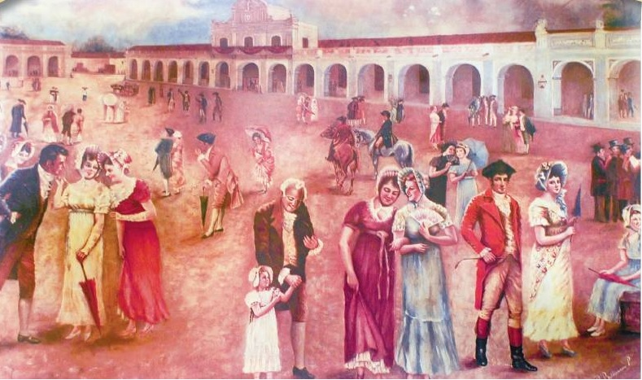
Major Changes/Effects
Racial castes were officially outlawed
However Creoles maintained political, social, and economic power

Slide 8
Major Changes/Effects
Native people, mestizos, & women=no significant political, social, & economic rights increase
Church remained a dominant force in Mexico
So many people were unsatisfied with the Revolution that there would be many reforms and even a second revolution in the early 1900’s

Slide 9
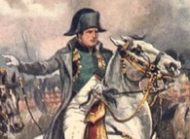
Causes/Background
Latin Americans took action and started working toward independence during chaos caused by Napoleon conquest of Iberian Peninsula
Royal authority in disarray
NOW would be the time to gain independence
Almost every Spanish American colony had achieved independence by 1826

Slide 10
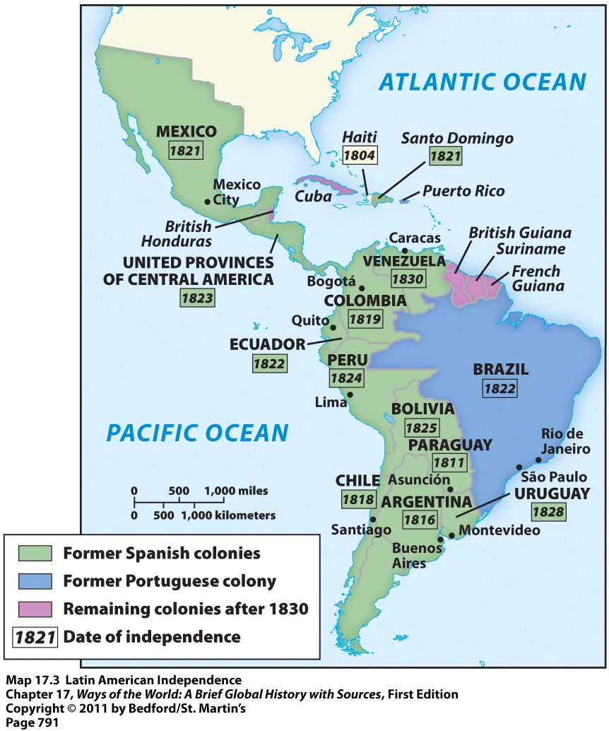
Causes/Background
Inspired by the American, French, and Haitian Revolutions
Intellectuals had become familiar with ideas from the European Enlightenment

Slide 11
Causes/Background
Complaints of people in Latin America:
Trade restrictions meant could only trade with the “motherland”
Greatly limited economic possibilities
High taxes they had to pay
Spain had a 20% tax on most its colonies
Creoles complained about limited political/economic power

Slide 12
Latin American Society
30,000 peninsulares, colonial officials from Iberian peninsula
3.5 million criollos (creoles), born in the Americas of Spanish or Portuguese descent
Privileged class, but grievances with peninsulares
1810-1825 led movements for creole-dominated republics
10 million others
African slaves, mixed-race populations

Slide 13
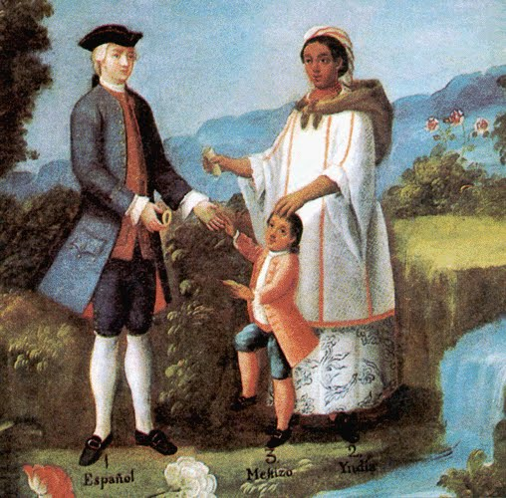
Causes/Background
The struggle for Latin American independence was difficult because of racial and social divisions
Internal violent conflict often broke out as they were trying to fight against Spanish rule simultaneously
Example: Creole elites versus peasants

Slide 14
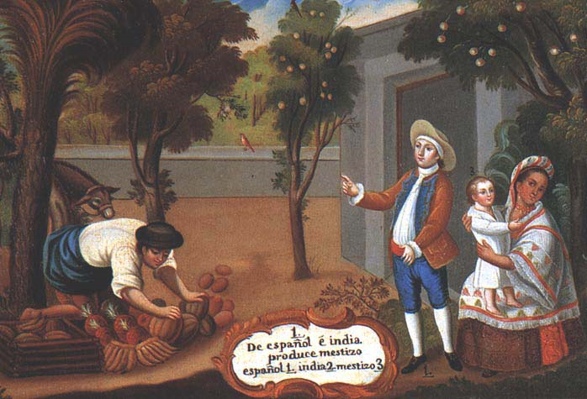
Causes/Background
It took the Spanish American colonies much longer to mobilize and move toward revolution than the colonies of North America
Had little tradition of self-government
Societies much more authoritarian and divided by class
Eventually became led by Creole

Slide 15
Major Changes/Effects
Led to the creation of numerous new states by 1830 Including:
Colombia
Bolivia
Venezuela
Peru
Argentina
Chile

Slide 16
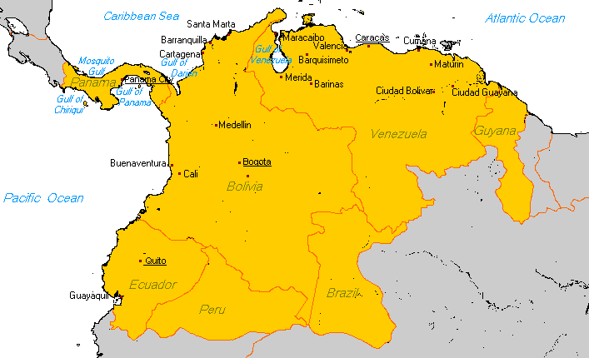
Major Changes/Effects
There were multiple failed attempts to create nations that unified all or part of South America
Most famously Gran Colombia

Slide 17
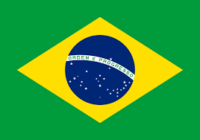
Major Changes/Effects
Brazil granted independence without fight
NO social change/maintained slavery

Slide 18
Major Changes/Effects
All the new nations created republics with some sort elected legislative branch
Women, Mestizos, and Indigenous people generally not given political or social rights

Slide 19
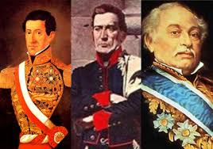
Major Changes/Effects
Militaries were the most successful part of all these new states
Caudillos, or military leaders took control of most areas

