Slide 1
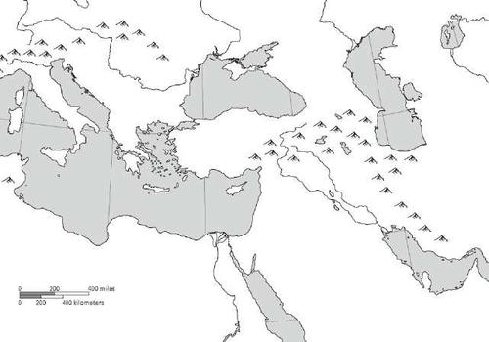
Mapping Monday Bellwork
1
2
3
6
5
4

Slide 2
Mapping Monday Bellwok
1: Black Sea
2: Caucasus Mountains
3: Caspian Sea
4: Red Sea
5: Tigris River
6: Euphrates River

Slide 3
objective
WWBAT: Introduce the major characteristics of the Olmec Civilization WWBAT: Summarize key information and characteristics of Chavin Culture

Slide 4
Western Hemisphere River Civs
While the Mesopotamians, Egyptians, Indus, and Zhou were develop unique civilizations in the Eastern Hemisphere so two were cultures in the Western Hemisphere
Today we will be focusing on the most prominent Western Hemisphere cultures that developed at the same time
The Olmec in Mesoamerica
The Chivan in South America

Slide 5
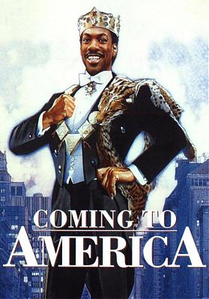

Slide 6
Interactive Notebook set up
11/21/2016
Olmec and Chavin Civilizations
This will be on two page

Slide 7
Background and Geography
Society
Religion

Slide 8
Background and Geography
Government and Economy
Religion

Slide 10
Background
The first complex society in Mesoamerica was the Olmec Civilization
The Olmec Civilization lasted from 1500BCE-200 CE
Extended from the Tuxtlas mountains in the west to the lowlands of the Chontalpa in the east
Olmec means “the rubber people” in Nahuatl, the language of the Aztec
Named after the practice extracting latex from trees and making rubber

Slide 11
Background
Many historians consider the Olmec civilization the “mother culture” of Mesoamerica
A mother culture is a way of life that strongly influences later cultures
The Olmec empire led to the development of other civilizations, such as the Maya and the Aztec

Slide 12
Map of Olmec Empire:

Slide 13
Geography
Developed along the Coatzacoalcos River
Area is fairly fertile naturally
Hot & humid area and covered with swamps and jungle
100 inches of rainfall per year
Somewhat reliable flooding

Slide 14
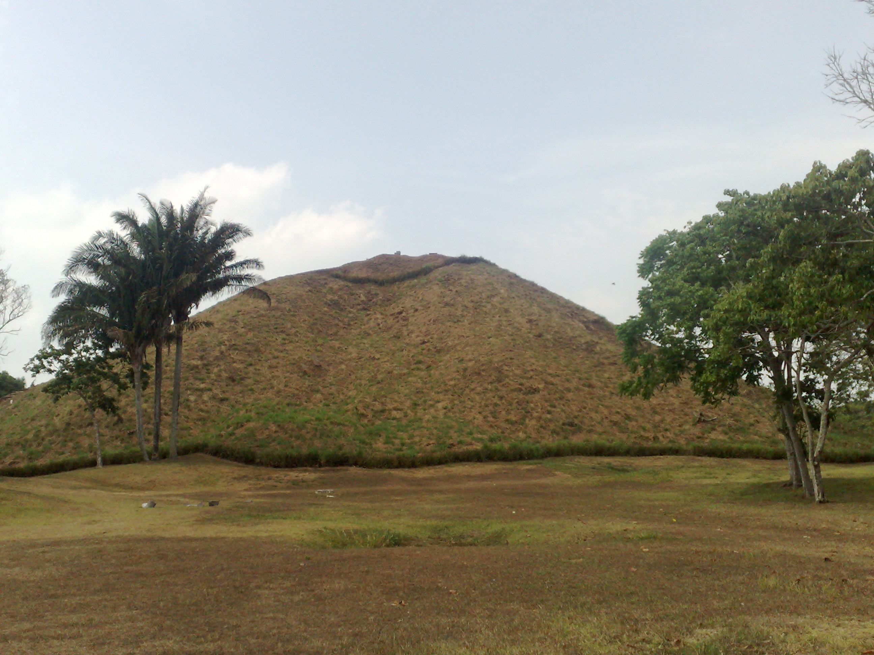
Olmec Society
Cities were religious and political centers
Most major cities were constructed around a central pyramid
Pyramids were used for religious ceremonies

Slide 15
four major centers
San Lorenzo(The Cultural Center)
La Venta(Replaced San Lorenzo)
Tres Zapotes
Laguna de Los Cerros
These cities had populations of around 5-10,000 people

Slide 16
Olmec Society
Like the other river civilizations the Olmec were an agricultural civilizations
Mostly grew Maize(Corn)
Began to be domesticated in around 3000BCE
Also domesticated:
Cotton
Rubber
Cocoa bean
Beans
Squash/Sweet Potatoes

Slide 17
Olmec Society
Men and women had distinctly different roles
Women/Older Girls were responsible for:
Housekeeping
Making Cloth/Clothing
Child Care
Gathering water & firewood
Men were responsible for:
Hunting and Fishing
Planted and Plowed Fields
Tended/cared for the fields

Slide 18
Olmec Society
Relied on flooding from river somewhat
However more likely than not the Olmec mostly depended on Slash and Burn agriculture
Way to clear the forests and shrubs, and to provide new fields once the old fields were exhausted
Agricultural fields were located outside the villages

Slide 19
Olmec Society
Large cities were centers for religious rituals and trading centers
Evidence of Olmec goods hundreds of miles north and south
Also iron ore and other stones from far off regions are found
Trade was a way to peacefully spread culture
Olmec society seemed to be lead by a wealthy elite class

Slide 20
Olmec Religion
Had an animal based polytheistic religion
Different gods were connected to different important aspects of life
Such as corn, fire, fertility ect
Made offerings and prayers to these gods

Slide 21
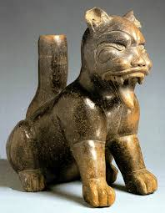
Olmec Religion
Most important god was a jaguar spirit
The jaguar spirit was thought to bring rain
The jaguar would continue to be important in many Mesoamerican cultures

Slide 22
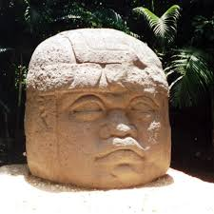
Olmec Art
One of the most well known aspects of Olmec Culture was their artistic accomplishment
Most famously the massive stone heads that have been found
These are carved out of quarries that are often miles away from where the heads are found

Slide 23
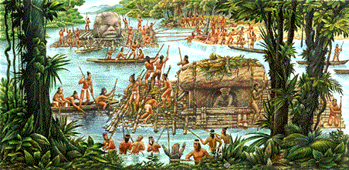
Olmec Religion
Buildings/Monuments included columns, altars, sculpted heads (heads may have represented particular rulers and could weigh as much as 44 tons).

Slide 24
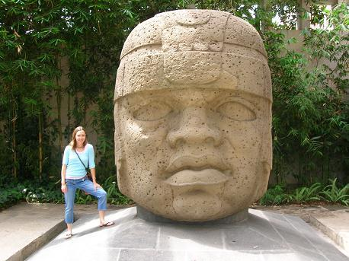
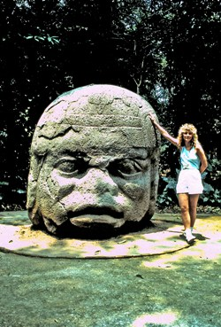
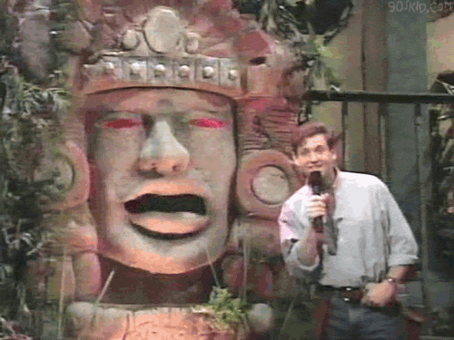

Slide 26
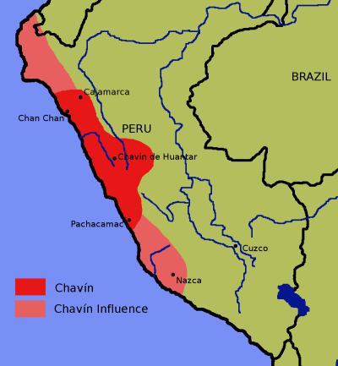
Background
This culture thrived from about 900–200 B.C.E.
Developed around the Mosna River Valley where the Mosna and Huachecsa rivers merge

Slide 27
Background
Developed at a very high elevation in the Andes Mountains
Many sites are found at about 10,000 above sea level or higher
Left no written record so we do not know what they called themselves

Slide 28
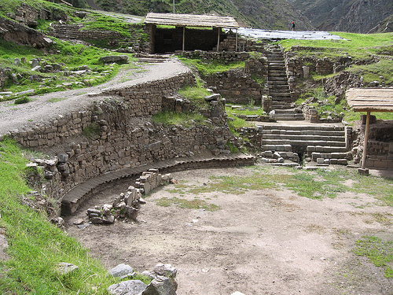
background
Most famous site is the city of Chavín de Huántar
This city is characterized by its two major temples

Slide 29
Theme Tuesday Bellwork
What is an example of Interaction Between Humans and the Environment in the Olmec Civilization?
Answers Vary
What is an Development and Transformation of Social Structures in the Umayyad Dynasty?
Answers Vary

Slide 30
Objective
WWBAT: Gather information and summarize the major characteristics of the Chavin Culture

Slide 31
Olmec Bellwork
What are three characteristics of the Olmec Civilization we have seen in other areas/civilizations?
Polytheism, developed along river, gender roles, dependence on agriculture, cultural diffusion via trade, religious worship sites

Slide 32
Objective
WWBAT: Read about politics and economics of Europe during the Middle Ages

