Slide 2
Interactive Notebook Setup
10/26/2017
Emergence and Teachings of Islam
This will be one page

Slide 3
Background on Arabia
Life and Message of Muhammad

Slide 4
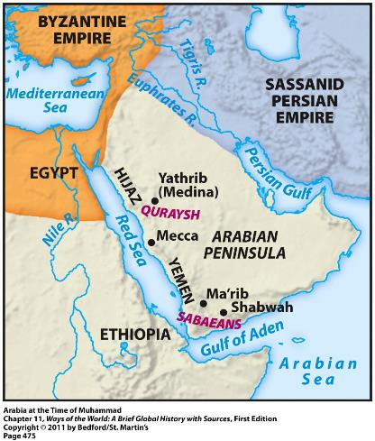
Background on Arabia
Region dominated by nomadic herding and trading groups called Bedouin
Located as a middleman of major trade networks such as the Silk Road, Indian Ocean Trade Network, and Mediterranean Sea trade

Slide 5
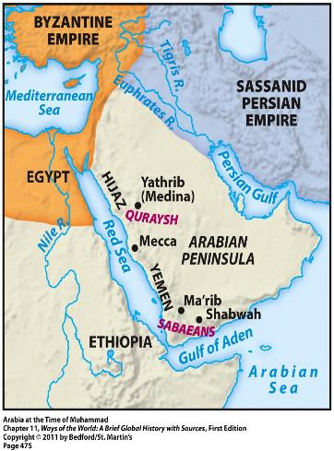
Background on Arabia
Participated in long-distance trade
Silk Road and Indian Ocean Trade especially
Location between the Byzantine Empire (to the northwest) and the Persian Empire (to the northeast)
Result = many Jews, Christians, and Zoroastrians lived among the Arabs in Arabia
Many of their monotheistic ideas began to influence the Arabs

Slide 6
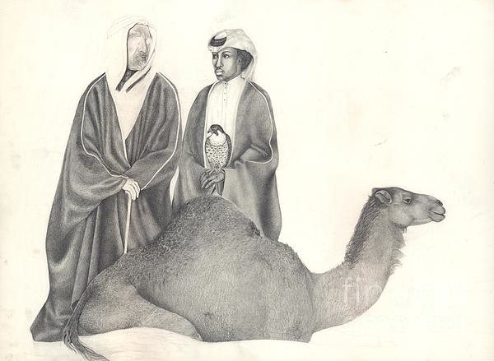
Background on Arabia
Pastoral and trading groups
Herded sheep and camels
Lived in fiercely independent clans and tribes
Often engaged in violent wars with each other
Practiced animistic polytheism and ancestor worship
Valued personal bravery and group loyalty

Slide 7
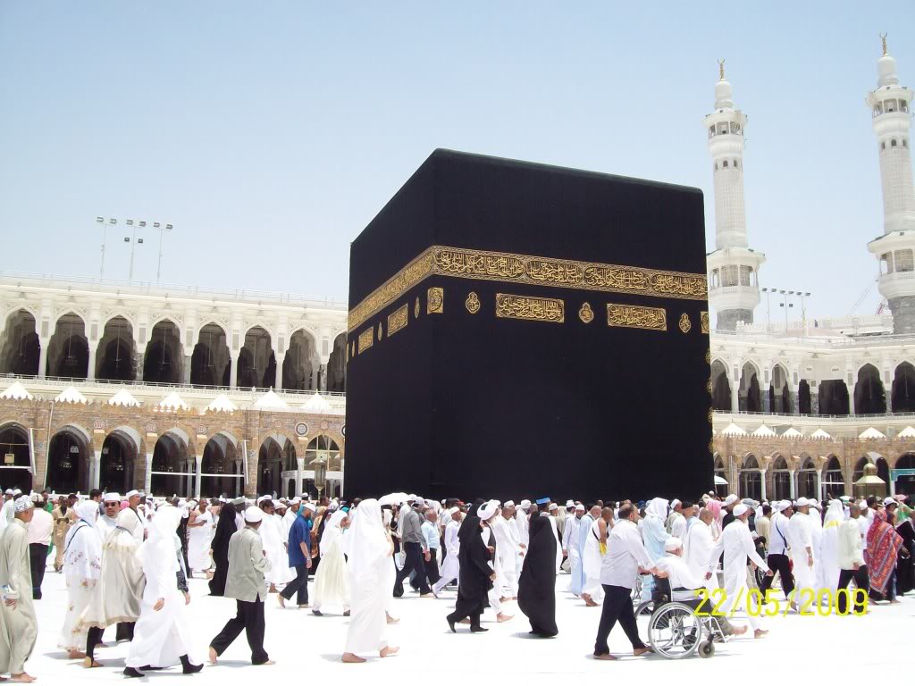
Background on Arabia
The Quraysh ruled Mecca
Controlled access to the Kaaba
Gained wealth by taxing local trade
Site of the Kaaba = most important religious shrine in Arabia
Housed representations of about 360 deities

Slide 8
Life and Message of Muhammad
Though some sources contain exaggerations on Muhammad’s life, there is MUCH more known about the Historical Muhammad than previous religion leaders(Siddhartha, Jesus, Abraham, ect)
Born in Mecca in 570 CE to a Quraysh family
Orphaned by age 8
Father died before he was born
Mother died at age of 6
Grandfather died at age 8
Lived and worked with merchant/tribal leader uncle

Slide 9
Life and Message of Muhammad
Merchant travels put him in contact with Jews, Christians, and Zoroastrians
Troubled by the religious corruption and social inequalities of Mecca
At 25, he married a wealthy merchant, named Khadijah
They had 2 sons who died in infancy and at least 4 daughters
Often withdrew into the mountains to meditate
610 CE he had a revelation that he was a had an overwhelming religious experience an
Similar to the Buddha and Jesus

Slide 10
Life and Message of Muhammad
Muhammad’s revelations began in 610 CE and continued for the next 22 years
Brought to him by the angel Gabriel
For first three years he told very few people of his revelations
Muhammad claimed to be the “seal of the prophets”
Meant he was the last in a long line of prophets, including Abraham, Moses, Jesus, and others
Said he had God’s FINAL revelation to humankind
Wasn’t trying to start a new faith
More of an invitation to return to the old and pure religion of Abraham

Slide 11
Life and Message of Muhammad
Islam is Monotheistic and worships the same god Judaism and Christianity
Islam teaches a belief in an afterlife, both a paradise and hell like punishment
Those who hope to achieve this afterlife must submit to the will of God
Muslims believe that Muhammad was NOT divine, they believe that he was a man and a messenger of God

Slide 12
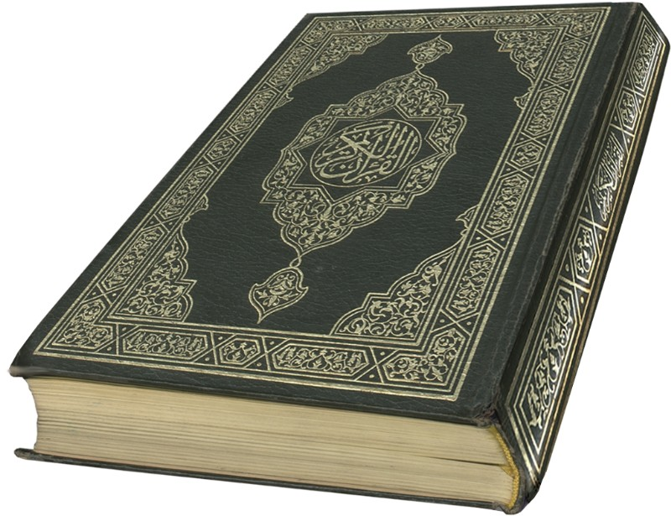
Life and Message of Muhammad
Recorded revelations in the Quran
The Quran rejects:
Hoarding of wealth and materialism
Exploitation of the poor
Corrupt business practices
Neglecting widows and orphans
Abuse of women
The Quran demands:
Social justice
Equality
Aid to the poor

Slide 13
Life and Message of Muhammad
Muhammad’s monotheistic and social justice message threatened the power and wealth of polytheistic tribal leaders
Muhammad and his follower moved to Medina in 622 CE & builtUmma (ummat al-Islamiyah or ummah), community of believers
Called the Hijarh
Marks year ZERO in the Islamic calendar
Muhammad became a political and military leader in addition to his position as a religion leader/prophet

Slide 14
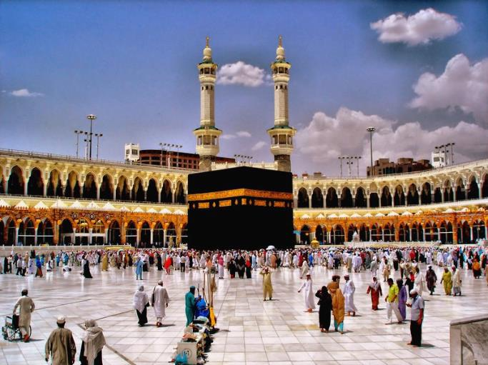
Life and Message of Muhammad
Took control of Mecca in 629, with little bloodshed, and reclaimed the Kaaba for God
Circled the Kaaba 7 times and then destroyed the idols for tribal gods

Slide 15
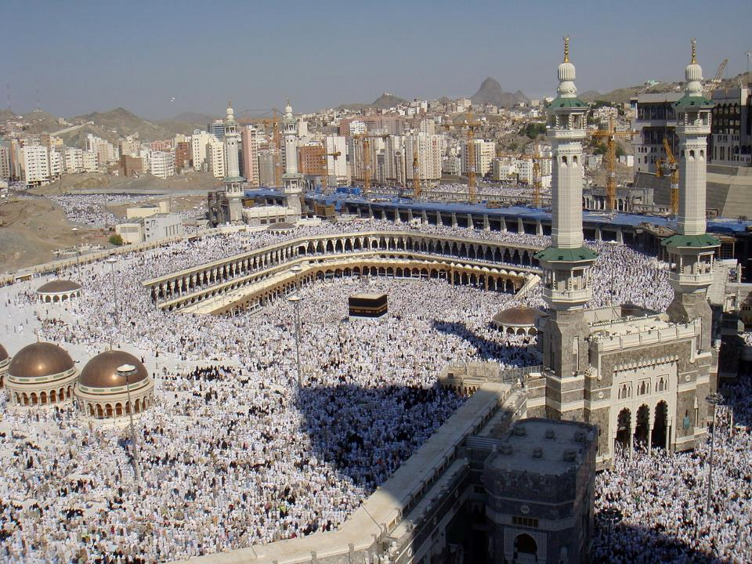

Slide 16
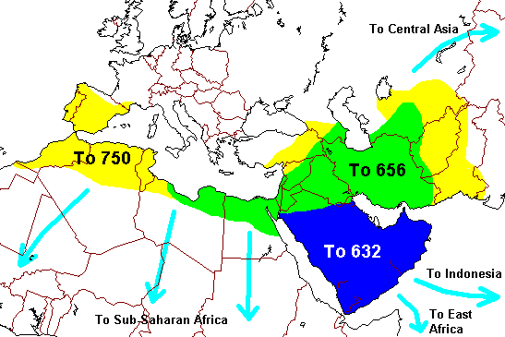
Life and Message of Muhammad
Islamic community expanded throughout Arabia by:
Military conquest
Marriage alliances with leading tribes
Voluntary conversion
By 632 (time of Muhammad’s death), most of Arabia had come under Islamic control

Slide 17
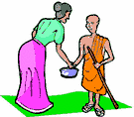
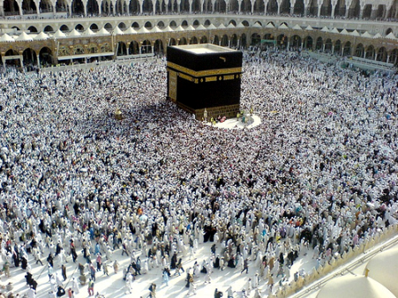
The Message: 5 Pillars of Islam
1) Faith: “There is no god but Allah, and Muhammad is the messenger of God.”
2) Prayer: Should be performed 5 times daily while facing in the direction of Mecca
3) Almsgiving: Supporting the poor and needy of the community
4) Fasting: Occurs during month of Ramadan; no food, drink, or sexual relations from dawn to sundown
5) The Hajj: Pilgrimage to Mecca

