Slide 1
Comparisons Bellwork
What is a major similarity between the Shang Dynasty and the Egyptian Civ?
Polytheism, Unified Government, Geographic boundaries, ect
What is a major similarity between the Shang Dynasty and the Sumerians?
Polytheism, Unreliable river, Social Hierarchy, ect

Slide 2
Objective
WWBAT: Introduce and discuss economic and social systems of the Indus Valley Civilization

Slide 3
Interactive Notebook Set-Up
8/16/2018
Indus Valley Civs
This will be on one page

Slide 4
Background
Cities
Society/Economy

Slide 5
Background
Called either Indus or Harappan Civilization
To this date the Harappan written language has not been deciphered
This limits the amount information that can be gathered about this civilization
Most understanding is based on physical artifacts and information passed along in oral histories

Slide 6
Background
Earliest Arrivals about 7000 B.C.E.
evidence of agricultural and domesticated animals
Farming began in this region around 3,200 BCE
Settled an area larger than Egypt or Mesopotamia
Both Population wise and geographical space wise
Civilization really began to flourish around 2,500 BCE until 1,700 BCE

Slide 7
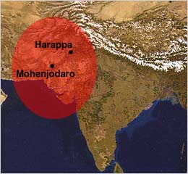
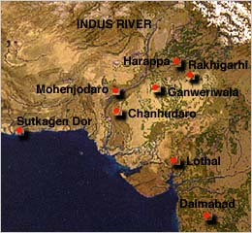
Harappan Civilization aka Indus River Civilizations

Slide 8
Background
Extremely dependent on the monsoons for flooding
Monsoons dominate India’s climate
Winter winds are dry; summer winds bring rain—can cause flooding
If monsoons come too early, there is flooding, if too late there is drought

Slide 9
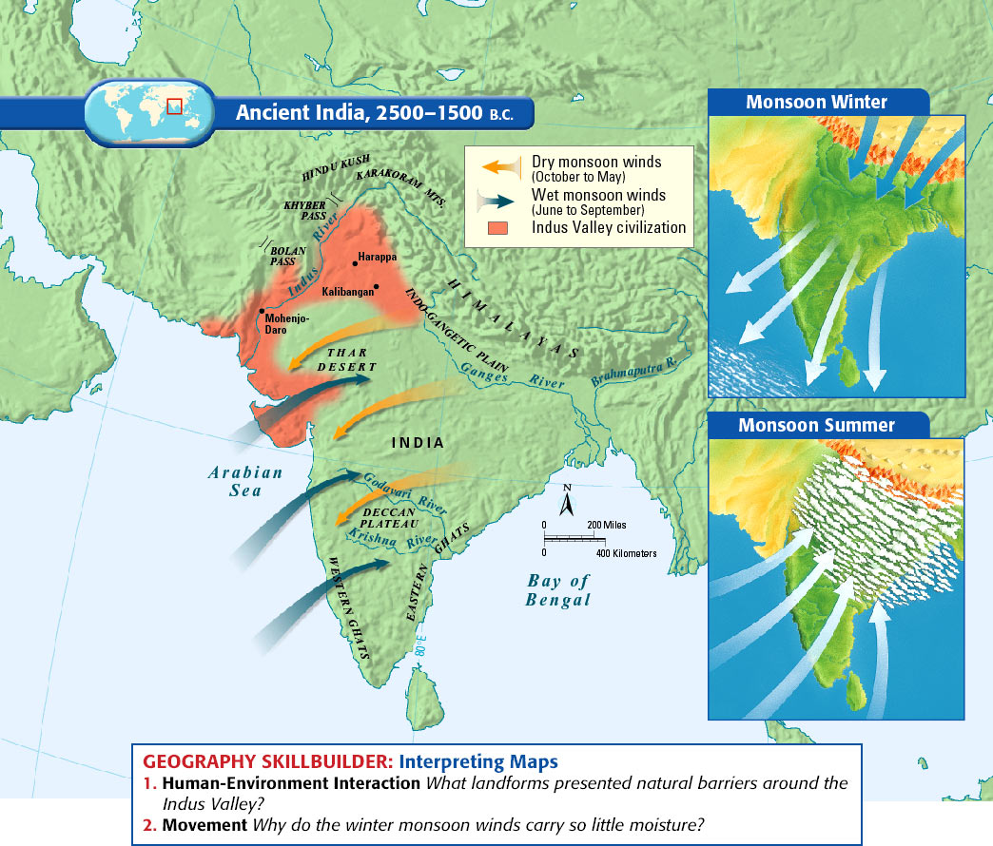

Slide 10
Cities
Two largest cities were Harappa and Mohenjo-Daro
Hundreds of other urban sites have been found!
Cities were incredibly well planned
Streets were organized in a grid system with streets uniformly 30 feet wide
Demonstrates an understanding of urban planning
Bricks are uniformly sized throughout cities

Slide 11
Cities
Each city must have had a strong and well organized government
In order to construct well planned cities there must have been a very high functioning government
Cities seemed to have had their own ruler unified under some central power
There is no evidence to support construction of large palaces or fortresses in any city

Slide 12
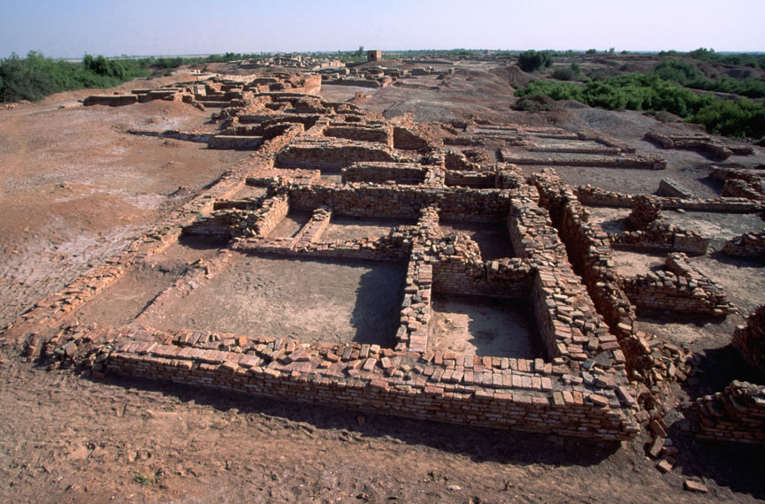

Slide 13
Cities
Cities built on mud-brick platform to protect against flood waters
Built brick walls to protect city and citadel
Engineers created a public plumbing and sewage systems that connected most houses in cities
HAD FLUSH TOILETS!

Slide 14
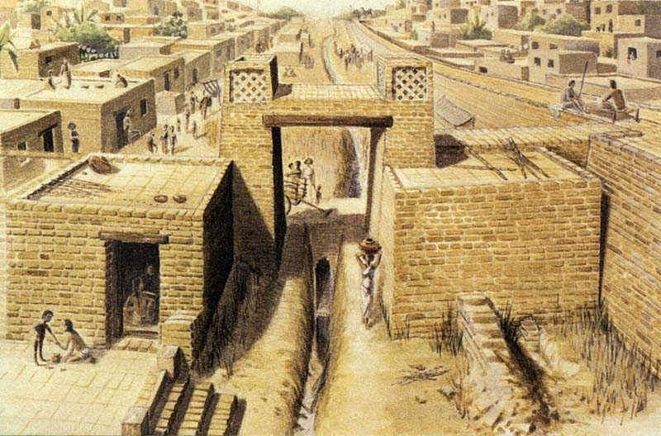

Slide 15
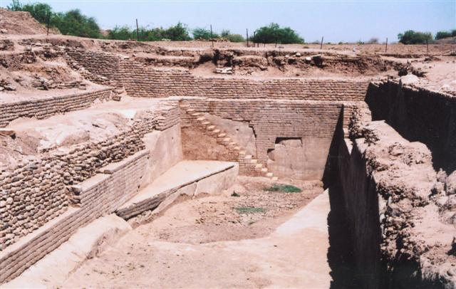
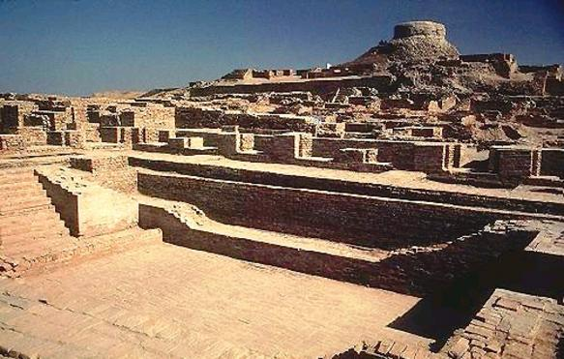

Slide 16
Cities
Cities were occupied by artisans and merchants/traders
City houses appear to be uniform
Implies there are no significant social/class distinctions
People lived in well-defined neighborhoods that seemed to be based on occupations

Slide 17
Indus Society/Economy
Religion was key aspect of life
Thought to be theocratic
The religion is the foundations of the modern Hinduism

Slide 18
Indus Society/Economy
The majority of people were involved in agriculture production
Most important crops were wheat, barley, and cotton
However rye, peas, and rice were also grown frequently

Slide 19
Indus Society/Economy
Very few weapons have been found
This implies they were generally a peaceful people
However there is overwhelming evidence the Indus interacted with foreign cultures

Slide 20
Indus Society/Economy
Traded with parts of the region of Mesopotamia
Mostly traded for precious materials, especially bronze not native in their region
Exported cotton cloth throughout Asia Minor and The Indian Subcontinent

Slide 21
Indus Society
One of the best sources of information come from seals
Seals were used to mark traded goods
By workshop, family, social standing, ect
They depict humans, animals, and super natural beings
Suggests there was a religion based on a belief on the supernatural

Slide 22
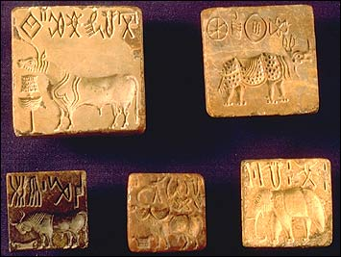

Slide 23
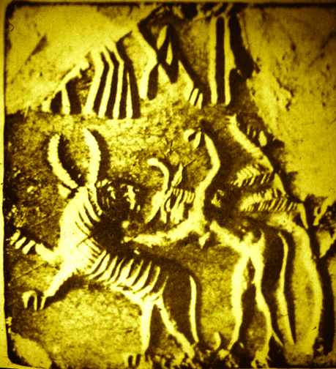
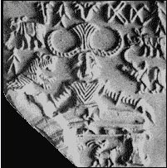

Slide 24
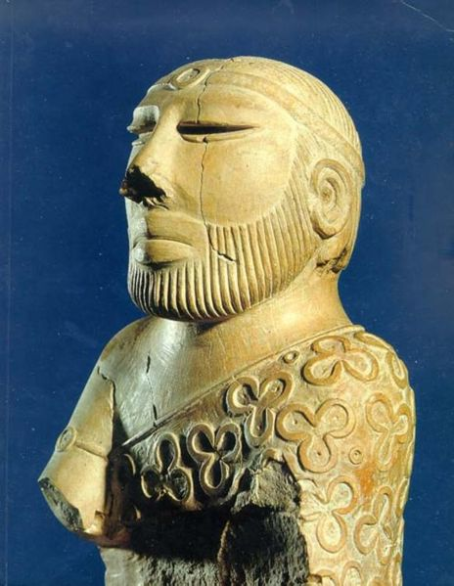
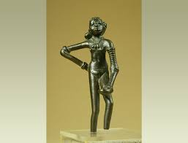
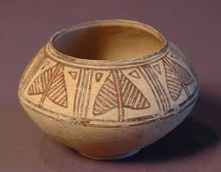

Slide 25
Theories for Collapse
The river may have changed course, natural disaster
(caused by heavy monsoons or an earthquake)
The people may have overworked the land
(overcutting trees, overgrazed, over farmed land depleting nutrients)
Invaders
(Aryan invaders destroyed the Indus River Society)

