Slide 1
Effects of Independence Bellwork
What are three issues facing Latin America after independence?
Few changes for women, poor treatment of native peoples, Creoles domination of politics, racial tensions remained, Caudillos leaders, Little experience with self governing

Slide 2
Nation and State Bellwork
What are three examples of Nations throughout the world?
Answers Vary
What are three examples of States throughout the world?
Answers Vary
Are states or nations more strictly defined?
States

Slide 3
Objective
WWBAT: Discuss the impacts and changes to social classes created by the Industrial Revolution

Slide 4
Interactive Notebook Setup
4/6/2016
Impacts of Industrialization
This will be one page

Slide 5
Society Prior to Industrial Revolution
The Middle Class
The Working Class
Workers Unite

Slide 6
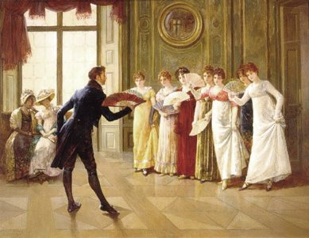
Society Prior to Industrial Revolution
Position in life determined at birth; no social mobility
Industrial revolution made it so talents and abilities COULD bring money and success

Slide 7
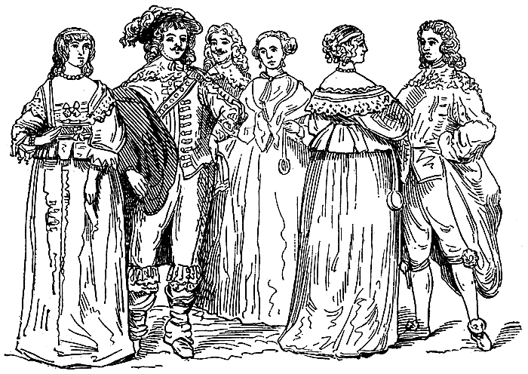
Society Prior to Industrial Revolution
Landowning aristocrats, on an individual basis did not suffer due to the Industrial Revolution
The aristocracy, as a class, declined
Declining political power
Urban wealth became more important
Land ownership no longer the basis of wealth

Slide 8
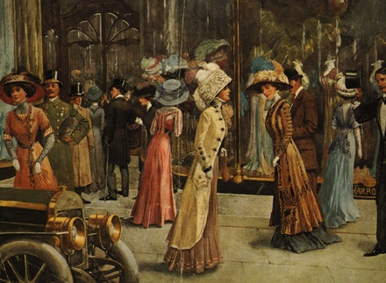
Development of Middle Class
Middle class benefited most from industrialization
Size, power, and wealth of the middle class increased
Upper levels = factory and mine owners, bankers, merchants
Middle levels = smaller businessmen, doctors, lawyers, engineers, teachers, journalists, scientists, other professionals
Lower levels = clerks, salespeople, bank tellers, secretaries, hotel staff, police officers

Slide 9
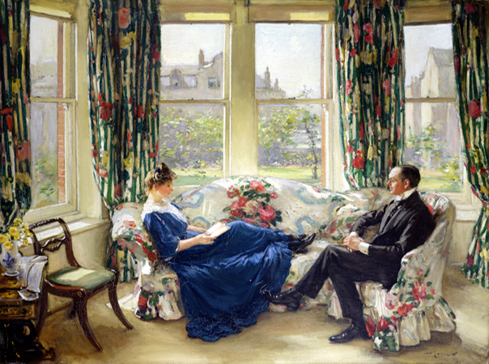
Development of Middle Class
Political values: constitutional government, private property, free trade, social reforms
Major social reforms in areas of: education, healthcare, prison reform, and sanitation
Cultural values: hard work, thrift, cleanliness, strict morality
“Respectability” becomes attached to ideas of social status and virtuous behavior
Believed education and hard work were the keys to success
Individuals are responsible for their own destiny
The poor are poor because of their own misconduct, Social Darwinism

Slide 10
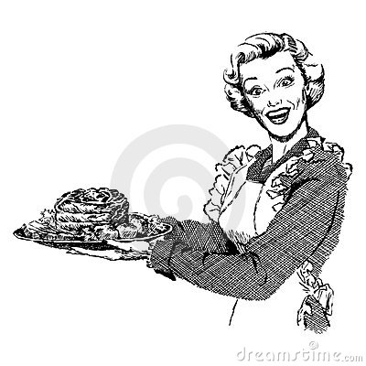
Development of Middle Class
Men and women has dramatically different roles
Men at work and women at home
Women’s roles at home:
Homemakers, mothers, wives
Create an “emotional haven” at home for their men
Moral center of the family
“Managers of consumption” = shoppers
Teach “respectability”

Slide 11
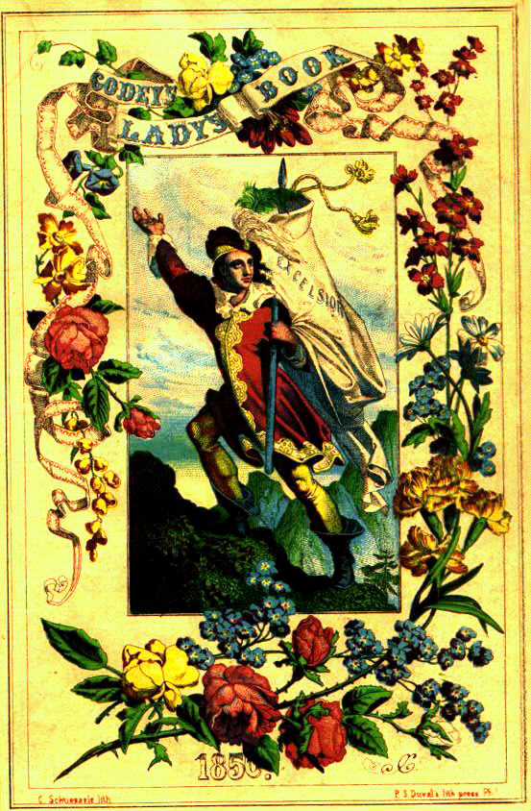
The Cult of Domesticity
Godey’s Lady’s Book was the most widely read magazine for women at the time
This was one of the many magazines at the time that helped encourage the principles of “true womanhood”

Slide 12
Godey’s proclaimed
"The perfection of womanhood... is the wife and mother, the center of the family, that magnet that draws man to the domestic altar, that makes him a civilized being, a social Christian."
"The wife is truly the light of the home."

Slide 13
Piety
Belief that women had a propensity for religion
Woman is with God to save the world through her pure, passionless love.

Slide 14
Purity and Virginity
Her greatest treasure
Once married, she has no legal or emotional existence
Her purity is a weapon, to keep men in control of their sexual needs
19th century purity fetish
Cover table and chair legs
Separate male and female authors
Stork and cabbage patch stories of babies

Slide 15
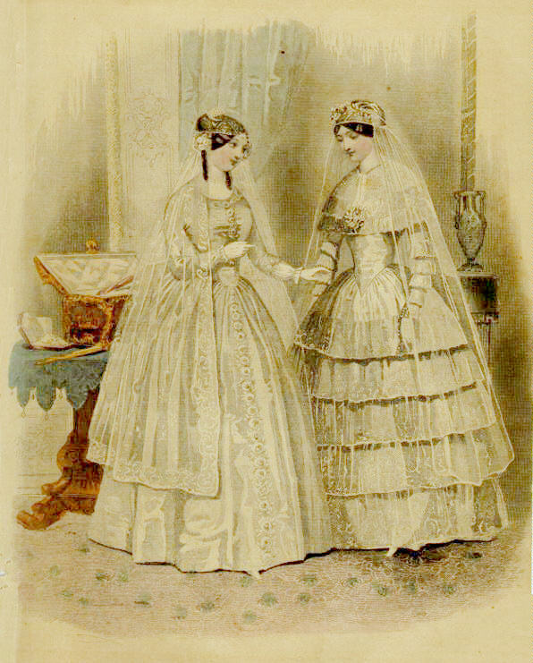

Slide 16
Submissiveness
Women to be passive, submissive to fate, duty, God and men;
Clothing emphasized passivity
Corsets closed off lungs and pinched inner organs
Large numbers of undergarments and weight of dresses limited mobility
“A really sensible woman feels her dependence. She does what she can, but she is conscious of her inferiority and therefore grateful for support.”

Slide 18
Domesticity
Housework is an uplifting task
Needlework and crafts approved duties;
Women make the home a refuge for men so that they can escape from the immoral world of business and industry

Slide 20
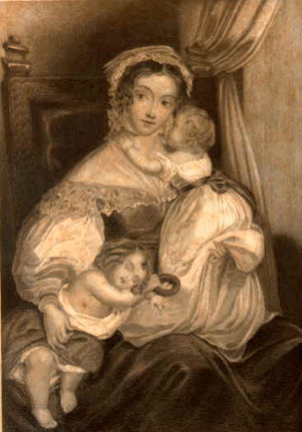

Slide 21
Truisms about Women
“A woman has a head almost too small for intellect but just big enough for love.”
“True feminine genius is ever timid, doubtful, and clingingly dependent; a perpetual childhood.”

Slide 22
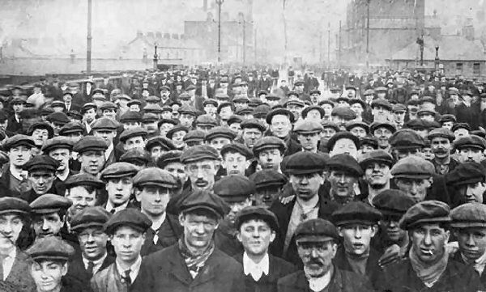
The Working Class
Grew in numbers
Few (if any) luxuries and benefits from Industrialization
Worked in factories
Dangerous work in the factories → had to work multiple machines as fast as possible

Slide 23
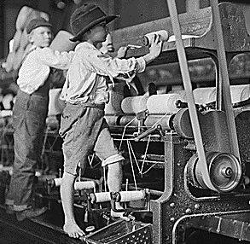
The Working Class
All members of the family worked in factories -- even children as young as 6
Children = 12-hour shifts; sometimes through the night
Often became crippled or ill
No school

Slide 24
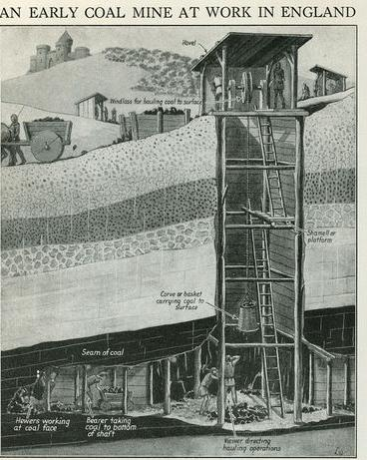
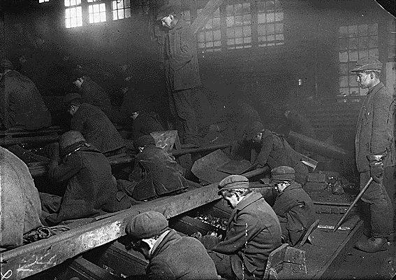
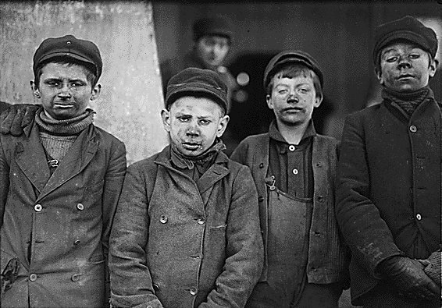

Slide 25
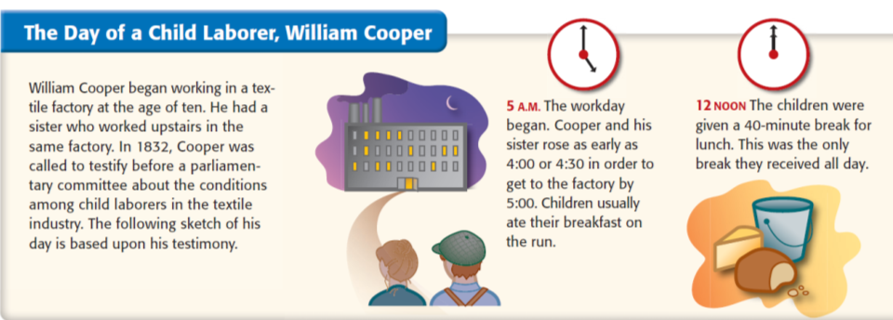
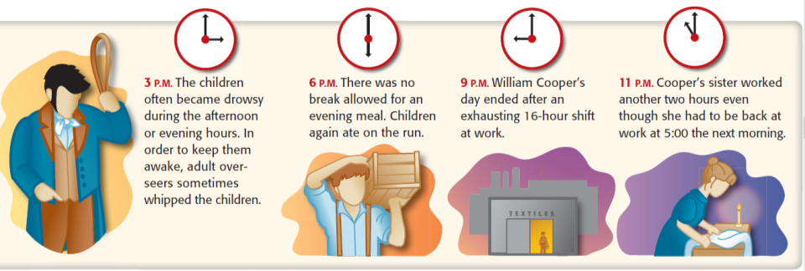
Child Labor

Slide 26
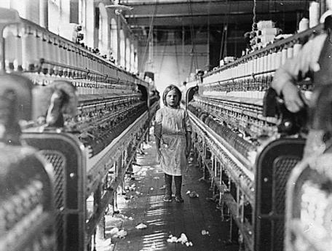
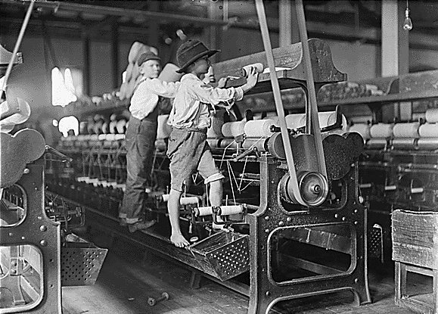
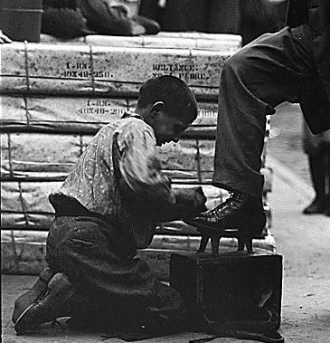
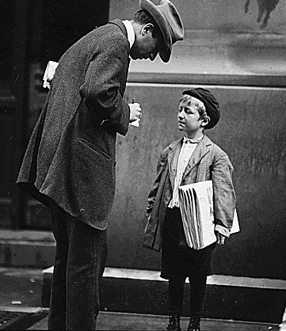
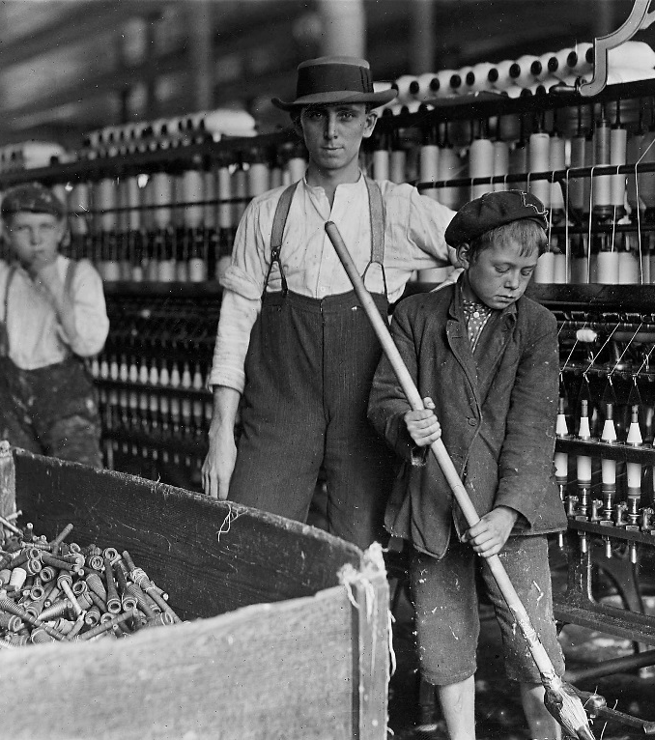

Slide 27
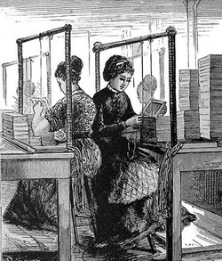
The Working Class
Women worked as well
Some women enjoyed the sense of independence
Made money and friends (called “mill girls”)

Slide 28
Factory Wages in Lancashire, 1830
Age of Worker | Male Wages | Female Wages
under 11 | 2s 3d. | 2s. 4d.
11 - 16 | 4s. 1d. | 4s. 3d.
17 - 21 | 10s. 2d. | 7s. 3d.
22 - 26 | 17s. 2d. | 8s. 5d.
27 - 31 | 20s. 4d. | 8s. 7d.
32 - 36 | 22s. 8d. | 8s. 9d.
37 - 41 | 21s. 7d. | 9s. 8d.
42 - 46 | 20s. 3d. | 9s. 3d.
47 - 51 | 16s. 7d. | 8s. 10d.
52 - 56 | 16s. 4d. | 8s. 4d.
57 - 61 | 13s. 6d. | 6s. 4d.

Slide 29
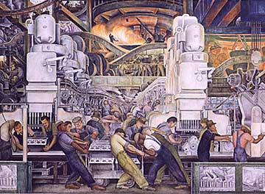
The Working Class
Accidents very common & no workers’ compensation for accidents
Monotonous work; noisy; heavy machines
Strict work schedules
10-14 hours a day in unventilated rooms
Diseases like pneumonia and tuberculosis = common
Wages extremely low & even lower for women and children

Slide 30
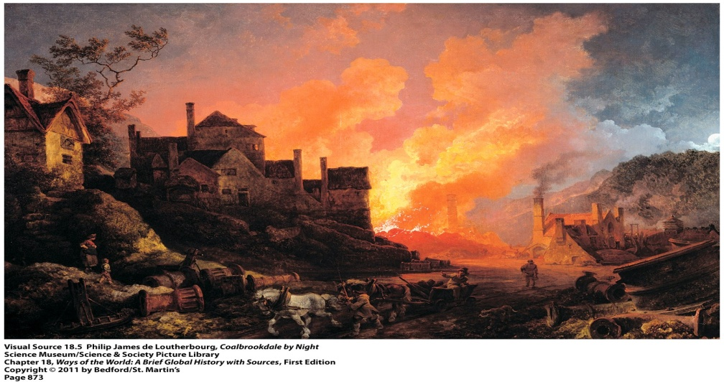
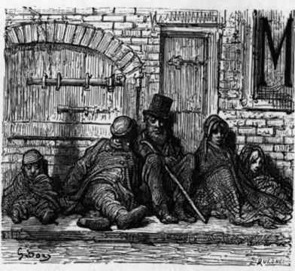
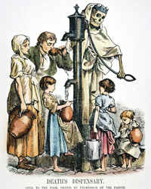
The Working Class
Lived in overcrowded, smoky cities
Lived in crowded, cold apartments near the factories
Whole families lived in 1 or 2 rooms
Human and industrial waste contaminated water supplies and spread disease
Few public services, such as sanitation

Slide 31
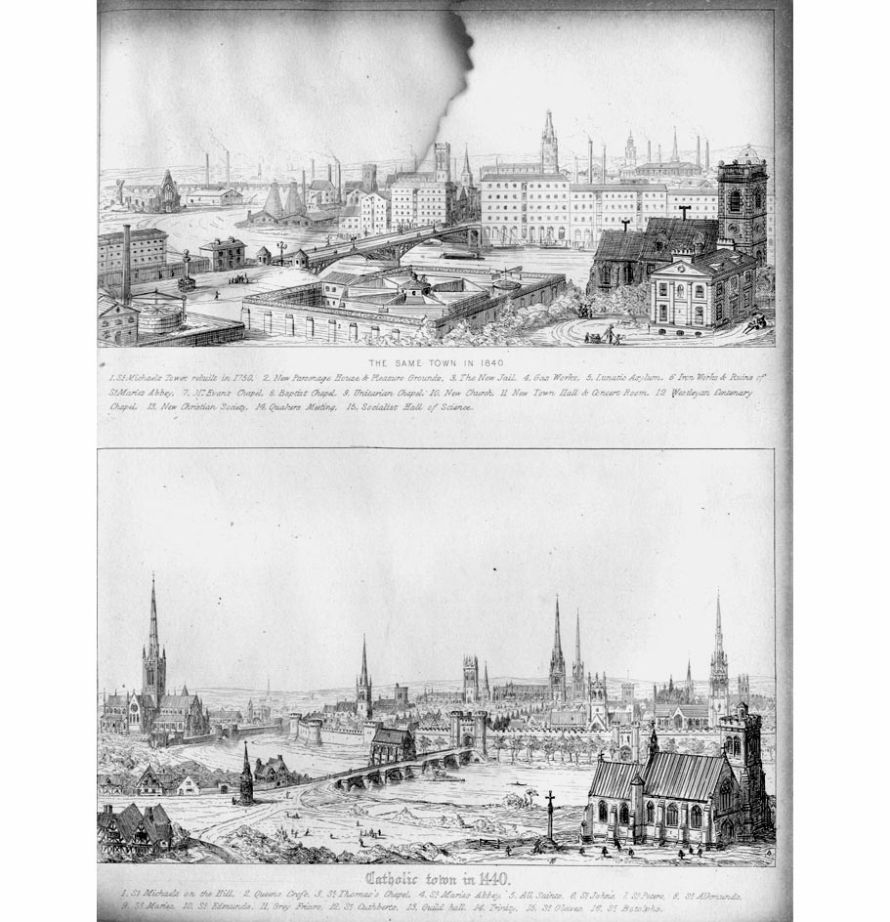

Slide 32
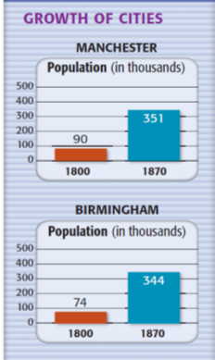
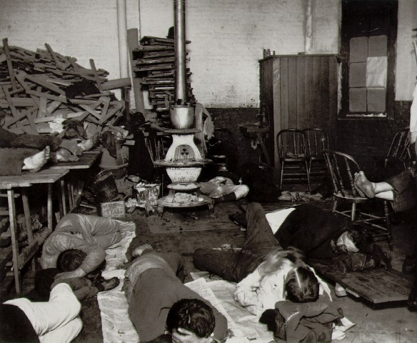
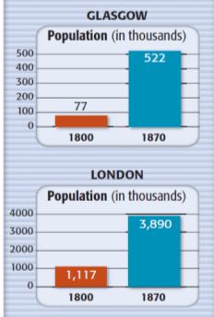
Urbanization

Slide 33
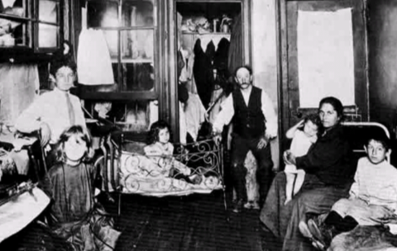
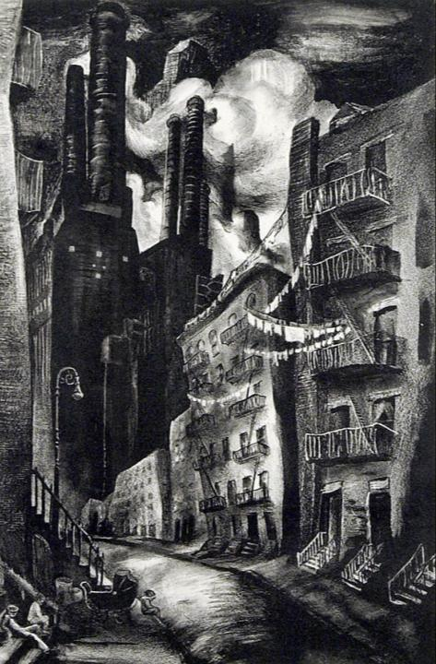
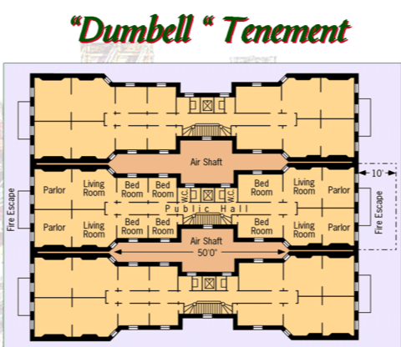

Slide 34
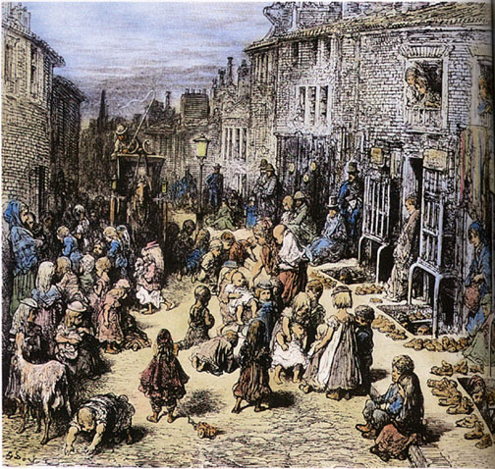
London Slums

Slide 35
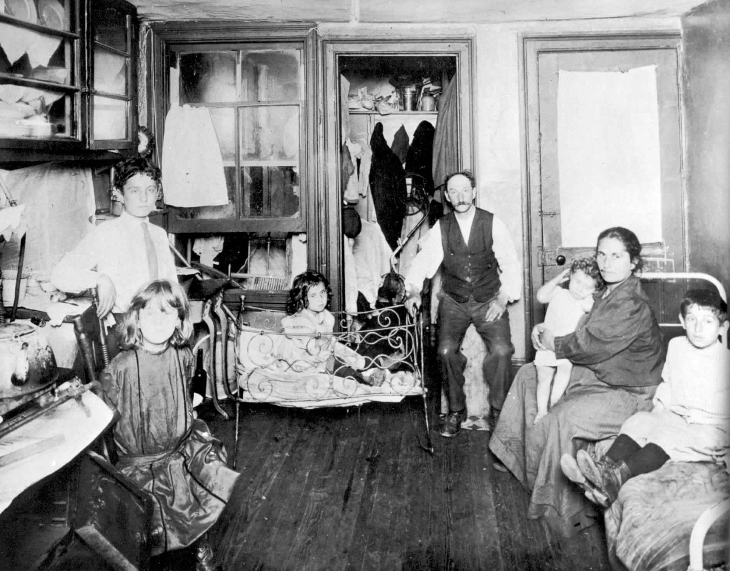
Overcrowded Apartment

Slide 36
Industrial Manchester

Slide 37
Industrial Staffordshire

Slide 38
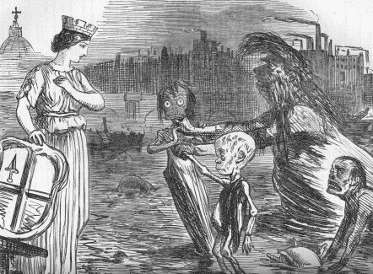
Problem of Pollution
The Silent Highwayman – 1858
Father Thames Introduces His Offspring (Diphtheria, Scrofula, and Cholera) to the Fair City of London

Slide 39
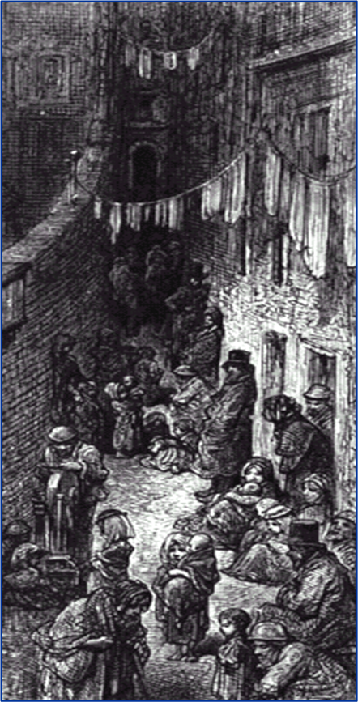
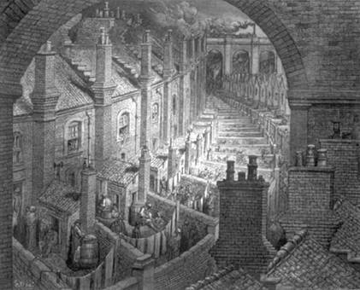
The New Industrial City
Above: Early 19th century London by Gustave Dore

Slide 40
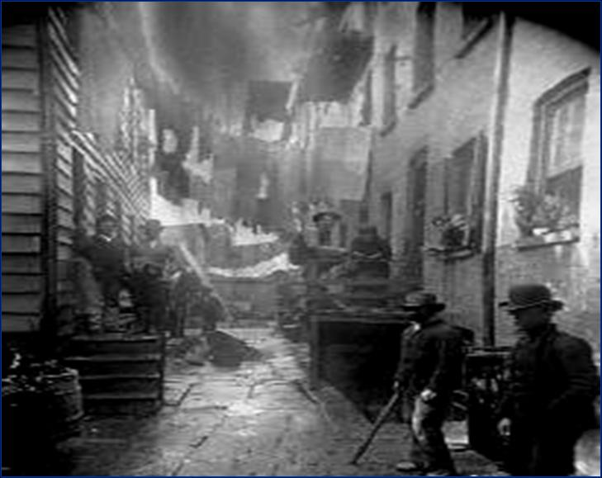

Slide 41
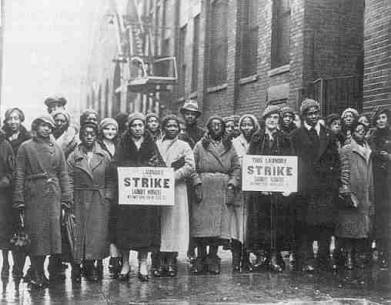
Workers Unite
Workers began to complain and demand better working conditions
Knew they were stronger as a group than as individuals
Labor unions created to pressure business owners to improve working conditions and wages
Not around until 1924 when trade unions were legalized

Slide 42
Workers Unite
Union tactics included:
Nationwide organization and cooperation
Strikes
Collective bargaining = union leaders and employers meet together to discuss problems and reach an agreement
Threat of violence

Slide 43
Workers Unite
Many workers joined self-help groups or other types of “friendly societies”
Paid dues
Benefits: Insurance against sickness, a decent funeral, a social life with people sharing common problems

