Slide 1
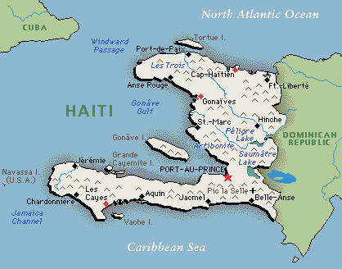
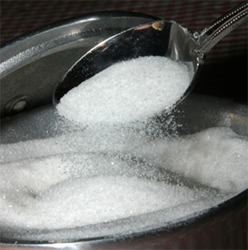
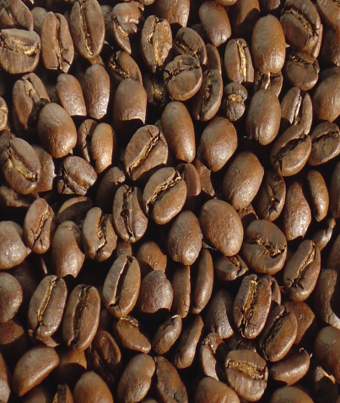
Causes/Background
Was originally called Saint Domingue by the French
French colony in the Caribbean
French owned colony’s purpose = plantations
Richest colony in the world at the time
8,000 plantations
Produced 40% of the world’s sugar
Produced 50% of the world’s coffee

Slide 2
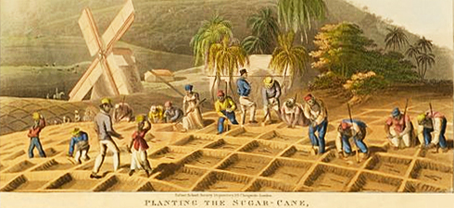
Causes/Background
500,000 of the 570,000 people living in the colony were slaves
Some of the most brutal conditions in the world
There were also 30,000 free people of color
Majority were small landowners

Slide 3
Haitian Revolution Background
Slaves in Haiti suffered under some of the harshest treatments found in the Caribbean
So many died from harsh conditions that 40,000 new slaves needed to brought a year
Slaves in Haiti were legally considered to be property of the public
This treatment evoked an often resentful and disobedient demeanor among the slaves

Slide 4
Causes/Background
White population was quite divided
40,000 white people in the colony
Divided into two groups:
“Grands blancs” = wealthy plantation owners, merchants, and lawyers
“Petits blancs” = poor whites

Slide 5
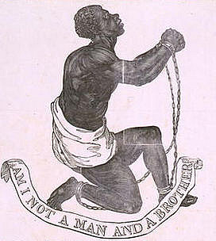
Causes/Background
All of these social groups were inspired by the French and American Revolutions
For “grands blancs” meant greater independence for the colony from France and fewer trade restrictions
For “petits blancs” meant equality of citizenship and economic opportunities
For free people of color meant equal rights and treatment for all free people, regardless of race
For slaves meant personal freedom

Slide 6
Causes/Background
Earliest revolts were lead by mulattoes and poor whites called “petit blancs” seeking more political/economic powers
These groups were seeking greater rights and more economic opportunities
The chaos lead to the eventual slave uprising that would define the Haitian Revolution

Slide 7
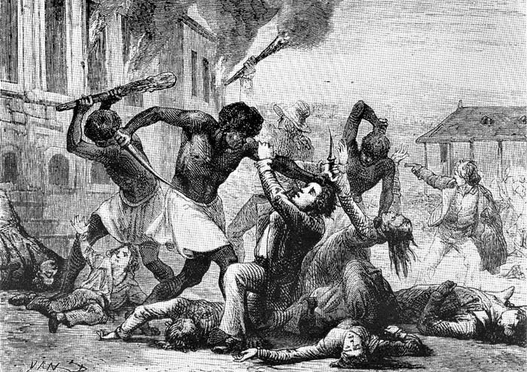
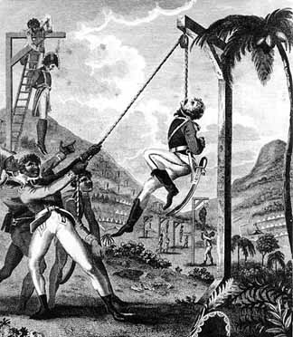
Causes/Background
First slave revolt took place in 1790
Triggered by rumors that the French king had declared an end to slavery
Slaves burned around 1,000 plantations and killed hundred of white and mixed-race people

Slide 8
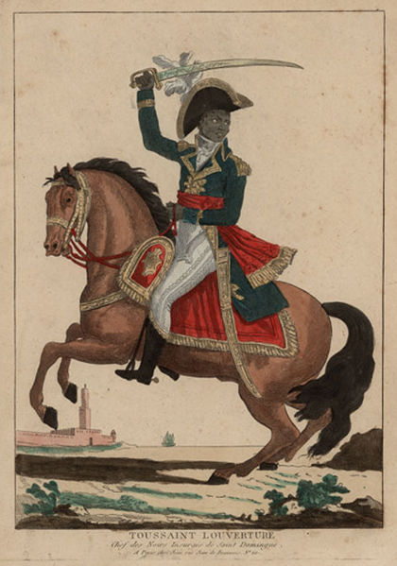
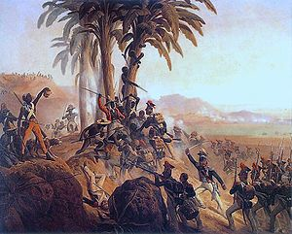
Causes/Background
First revolt was followed colony wide salve revolt
As the revolution continued, power gravitated toward the slaves
Leader became a former slave named Toussaint Louverture

Slide 9
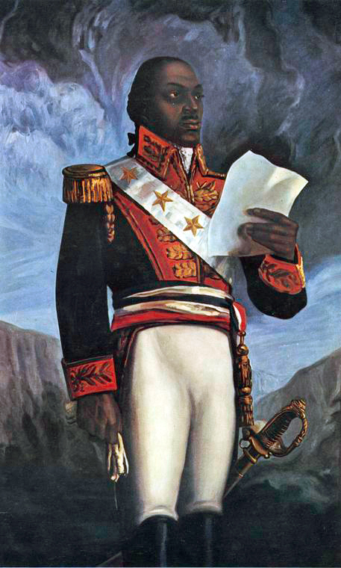

Slide 10
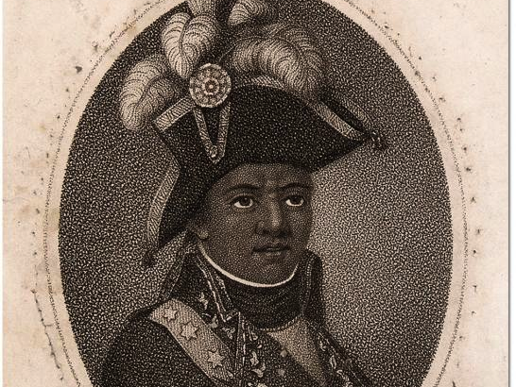
Toussaint Louverture(Revolution)
Son of an educated slave
Inspired by Enlightenment ideas and French Rev.
Very inspirational and charismatic
He formed his own army, inspiring hundreds to join him and displayed an impressive talent for designing and leading militaristic strategies and tactics that would enable him to make the slave insurgency one of the most successful in history.
Achieved aid from the Spanish and actually became an officer in the Spanish Military then when the slave were emancipated switched allegiance to French

Slide 11
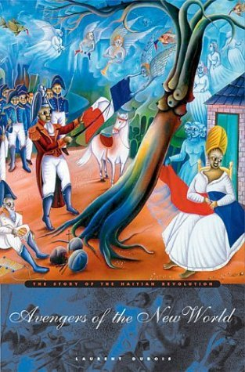
Major Changes/Effects
Only completely successful slave revolt in world history
Slaves became equal, free, and independent citizens almost immediately
Renamed area Haiti
means “mountainous” or “rugged” in the language of the original inhabitants

Slide 12
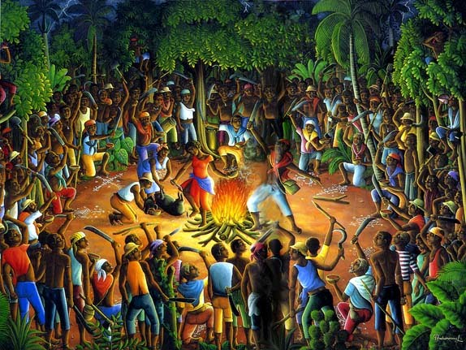
Major Changes/Effects
Formal declaration of independence January 1, 1804
Created 1st Black Republic in World History
A Celebration!

Slide 13
Major Changes/Effects
Effects:
Plantations destroyed
Most whites fled or were killed
Private and state lands redistributed among former slaves and free black people
Haiti became a nation of small-scale farmers producing for their own needs

Slide 14
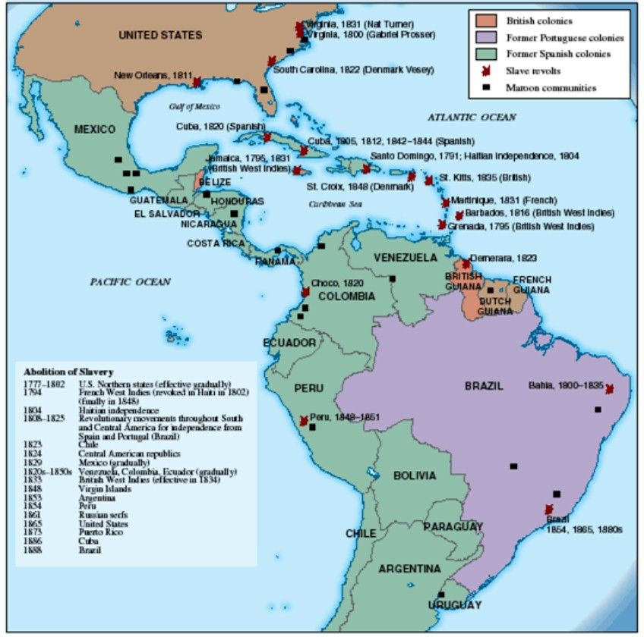
Major Changes/Effects
Inspired slave revolts throughout the Caribbean and Americas

