Slide 1
Interactive Notebook Set Up
11/28/2015
Feudalism Key Terms
This will be one page

Slide 2
Feudalism
Vassal
Fief
Manor
Serf

Slide 3
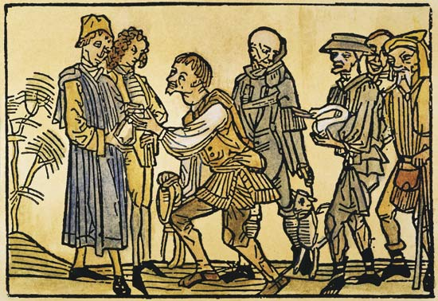
Key Terms
feudalism: a system of political organization involving mutual obligations among kings, nobles, knights, and serfs/peasants
Notes:
Feudalism emerged (a similar system emerged in Zhou China in the 11th to 3rd century B.C. and later in Japan from about A.D. 1200 to 1800)

Slide 4
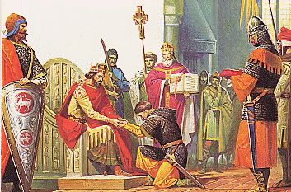
Key Terms
vassal: a person who received a grant of land from a lord in exchange for loyalty and military service

Slide 5
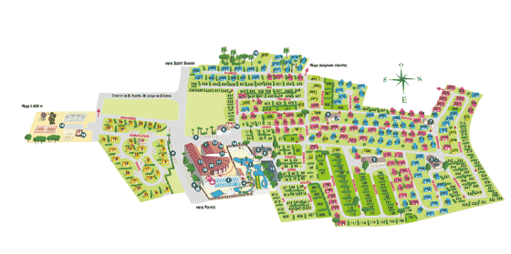
Key Terms
fief: a grant of land made to a vassal (subordinate)

Slide 6
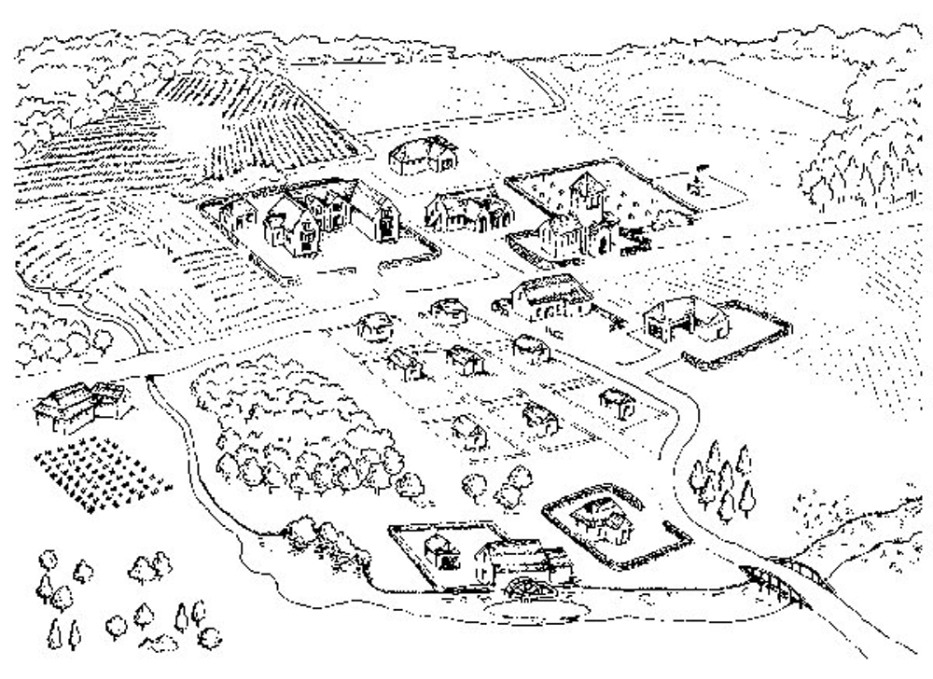
Key Terms
manor: a lord’s agricultural estate in medieval Europe

Slide 7
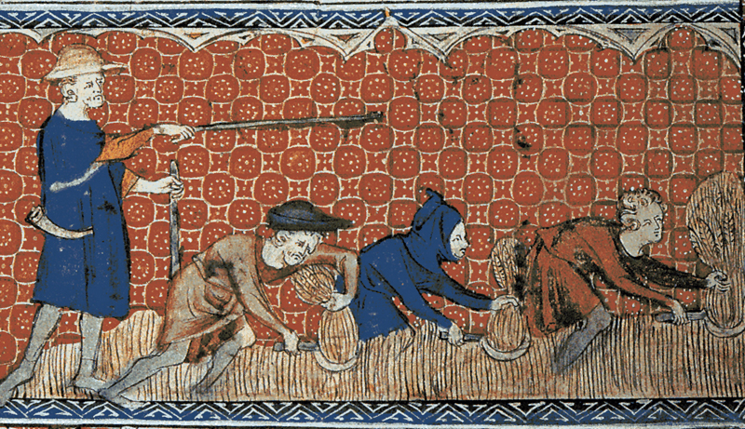
Key Terms
serf: a medieval peasant bound to live on a feudal estate

