Slide 1
Interactive Notebook Setup
1/30/2019
European and Asian Commerce
This will be TWO pages

Slide 2
Europe and Indian Ocean Trade
Changes in Indian Ocean Trade

Slide 3
MEr
Mercantilism
Joint Stock Companies

Slide 4
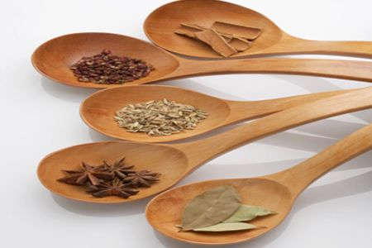
Europe and Indian Ocean Trade
First the Portuguese, then the Spanish, French, Dutch, and British got involved
Early 16th-19th Century
Motivations for European involvement in Asian commerce:
Avoid Ottoman taxes on goods
Exotic spices = cinnamon, nutmeg, mace, cloves, and pepper
Chinese silk
Indian cotton and rhubarb
Precious gems
emeralds, rubies, and sapphires

Slide 5
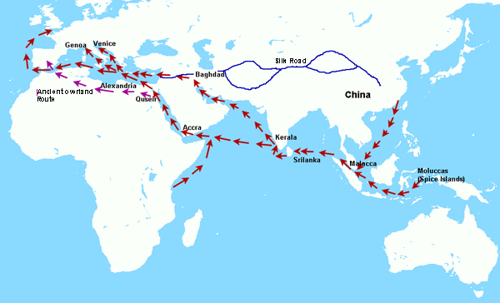
Europe and Indian Ocean Trade
Europeans had no valuable products to contribute
Paid for rather than exchanged goods
Many European merchants made profits by simply transporting goods for Asians, especially for Chinese

Slide 6
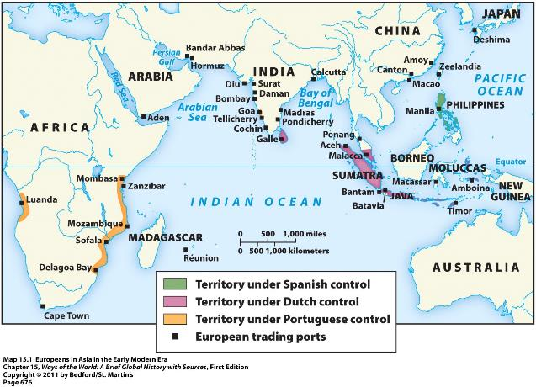
Europe and Indian Ocean Trade
Goal of Europeans in Asia was trade, not conquest empire-building

Slide 7
Europe and Indian Ocean Trade
Europeans did create TRADING POST-EMPIRES
Portuguese=Swahili Coast & W. Coastal India
Spanish= Philippines
British=Coastal India
Dutch=Indonesia(E. Indies) and Sri Lanka(Ceylon)

Slide 8
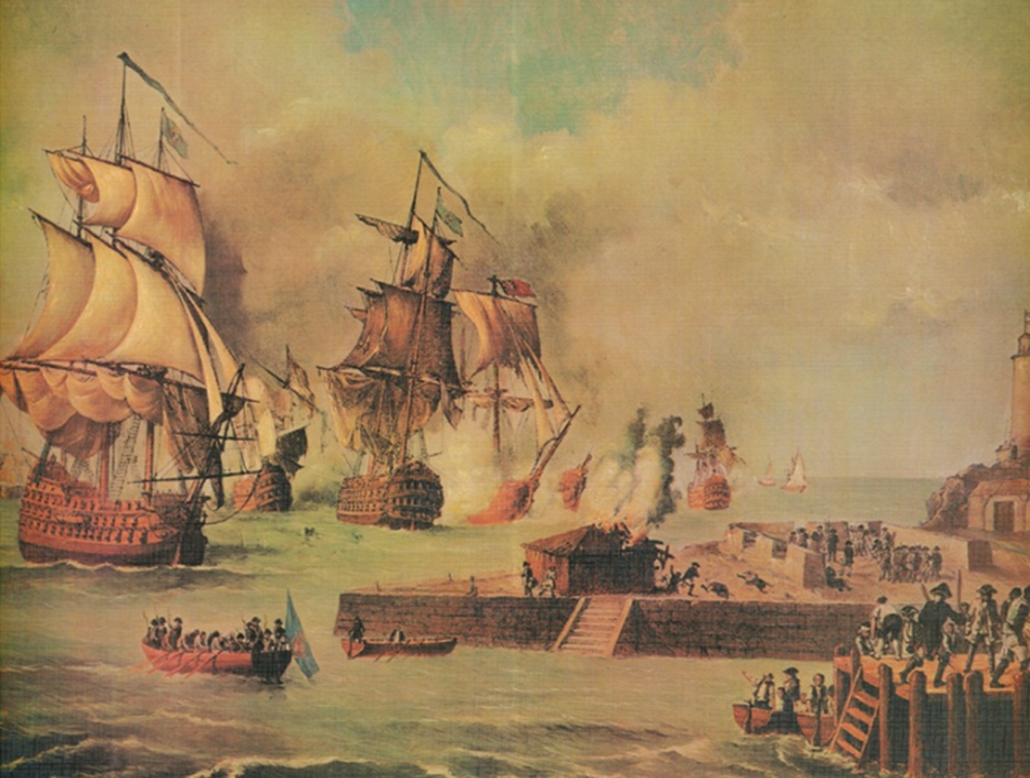
Changes in Indian Ocean Trade
Europeans sometimes used superior military power to attempt to control and tax trade
Often ending religious tolerance in trading cities
Rather than contribute to trade by providing desired goods

Slide 9
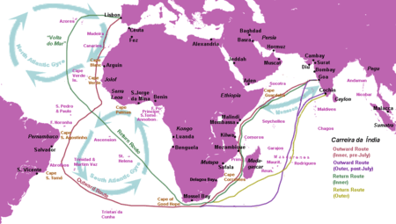
Changes in Indian Ocean Trade
Portuguese required merchant vessels to purchase a cartaz (pass) to sail throughout the region
Charged merchant vessels taxes of 6-10% of their cargoes
Blocked the Red Sea route to the Mediterranean Sea
Monopolized the trade route around Africa to Europe

Slide 10
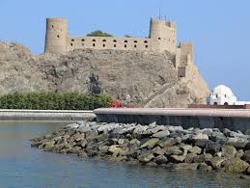
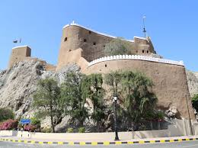

Slide 11
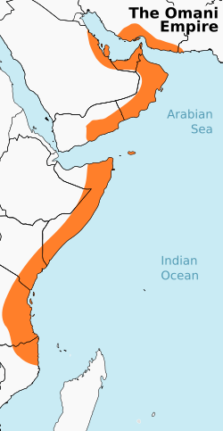
Changes in Indian Ocean Trade
New Arab group called the Omani Empire emerged to challenge Portuguese trade
Kicked Portugal out of Arab city of Muscat and the Swahili City-States

Slide 12
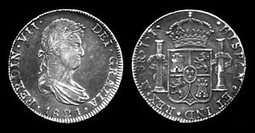
Changes in Indian Ocean Trade
Spanish developed process of amalgamation, used mercury to extract silver from ore
Production soared
Spanish peso de ocho, or "piece of eight," was the first currency in history to be used globally
Sped up transactions and provide standardized way for merchants to measure the value of products

Slide 13
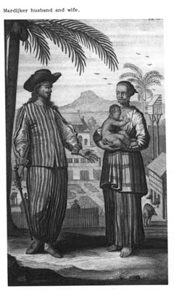
Changes in Indian Ocean Trade
Local women had long served an important role in IO Trade
SE Asian women and merchants practiced temporary marriage to make trade easier

Slide 14
Changes in Indian Ocean Trade
Merchants entered into relationships with local women that were mutually benefiting to both parties:
Merchants gained access to local markets and products, learned of indigenous practices and conditions, and gained sexual relations
The women gained gifts, support for their children, and connections to outside trading networks

Slide 15
Changes in Indian Ocean Trade
These marriages could be terminated and the women were free to pursue another such connection with no negative stigma or loss of social status
As European Christians and Chinese became more involved in IO Trade they sought to end temporary marriage
Based on their cultural views of marriage
Lead to development of prostitution and sex slaves in its place

Slide 16
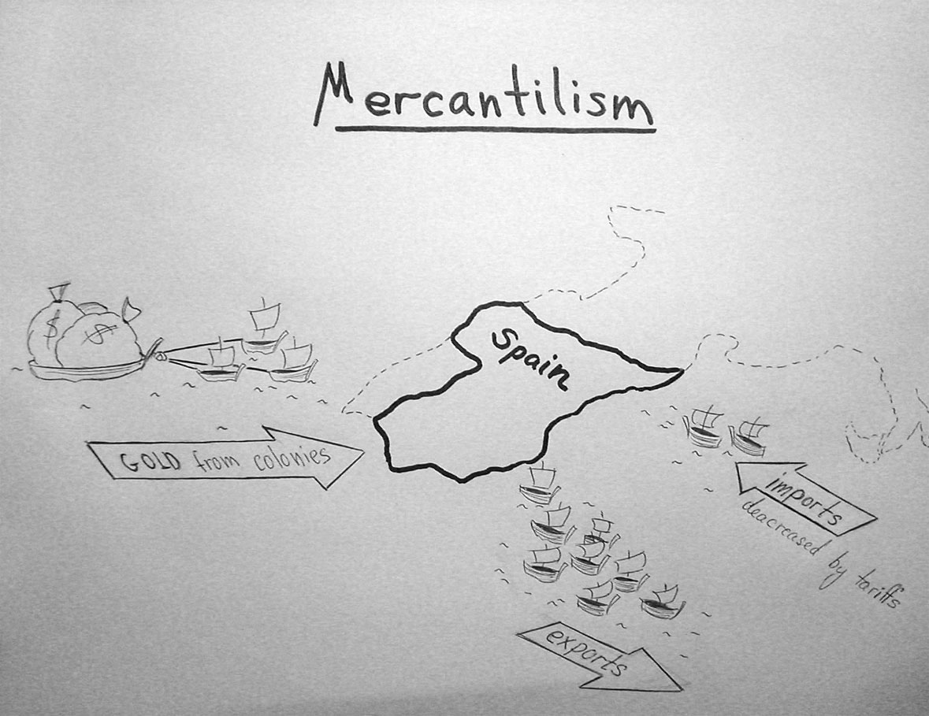

Slide 17
MERCANTILSM DEFINITIONS
A trade theory which holds that a government can improve the economic well-being of the country by encouraging exports and restricting imports to accumulate wealth in the form of precious metals
National policy of accumulating wealth, establishing colonies and a merchant marine, and developing industry and mining to attain a favorable balance of trade.
The setting of trade policies and other restrictions that favored the flow of wealth - especially gold and silver - from the colonies to the mother country

Slide 18
Statement # 1
Biggest goal of the colonies is the production of Raw Materials

Slide 19
Statement # 2
Individuals in colonies are free to produce whatever they want and sell to whomever they want

Slide 20
Statement # 3
Individuals in colonies are free to buy products from any country

Slide 21
Statement # 4
Colonies are for producing manufactured goods

Slide 22
Statement # 5
Creating a favorable balance of trade is important, but not essential

Slide 23
Statement # 6
Government doesn't control the economy but does regulate to make sure everyone participates fairly

Slide 24
Statement # 7
Goal is for the mother country to stockpile gold, silver, and raw materials

Slide 25
Joint Stock Companies
Created and supported by British and Dutch governments
Based on Mercantilism
Trading ventures were too expensive for most individuals to fund
Groups of investors began to put their resources together into organizations to fund trading expeditions

Slide 26
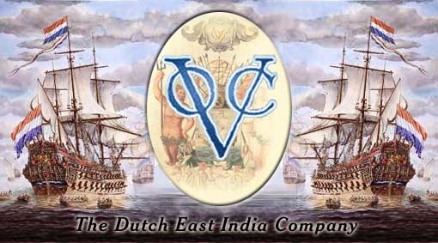
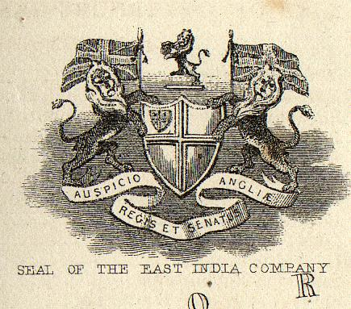
Joint Stock Companies
British=East India Company (EIC)
Dutch=Dutch East India Company(VOC)
“Verenigde Oost-Indische Compagnie”

Slide 27
Joint Stock Companies
These companies were allowed by government to:
Make war
Govern conquered peoples
Hold trading monopolies

Slide 28
Joint Stock Companies
These were more efficient and profitable than ventures those funded by monarchs
Unconcerned with conversion like Spanish and Portuguese ventures

Slide 29
Joint Stock Companies
Investors were protected by development of limited liability which lead to HUGE numbers of investors
Investor could never lose more than what they paid in

Slide 30
