Slide 1
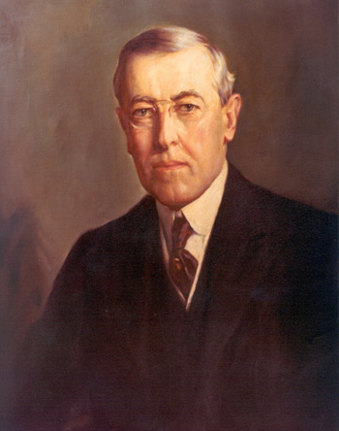
Wilson’s 14 Points: Trying to Restore the Peace
Freedom of the seas
Removal of international trade barriers
Reduction in arms
End to secret alliances
Adjustment of European boundaries according to nationality
League of Nations = “general association of nations”
14 Points = guiding framework for peace settlement

Slide 2
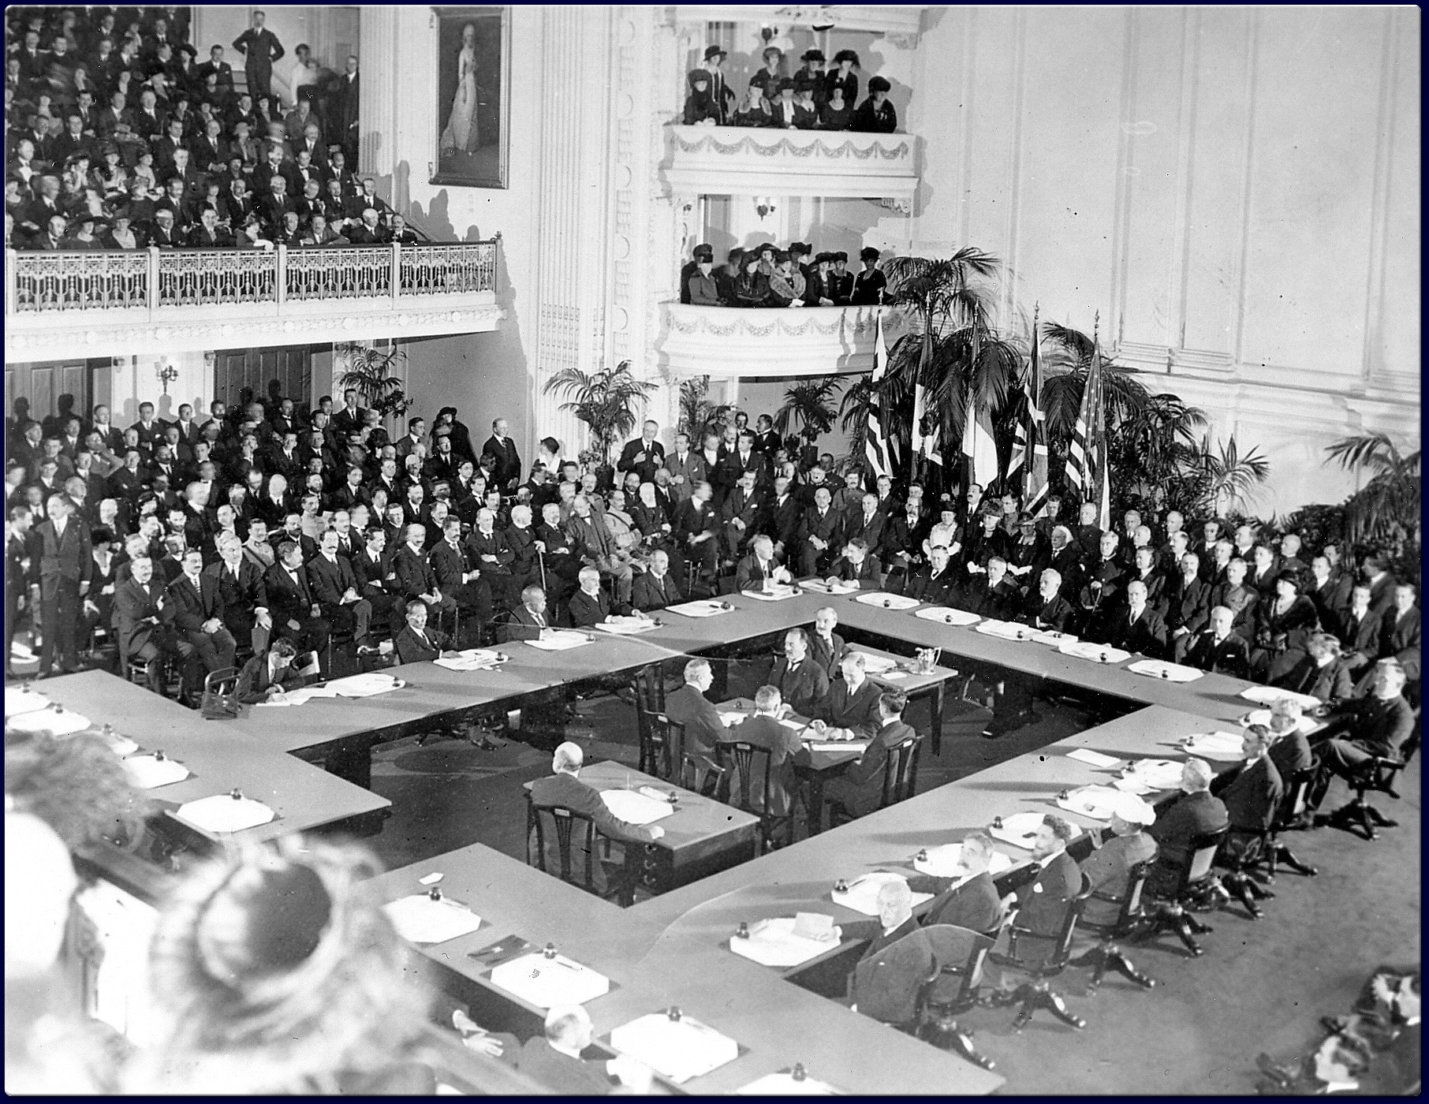
Paris Peace Conference
January 1919
Representatives from 27 nations met
No one from Central Powers or Russia invited
5 separate peace treaties signed
Biggest one = Treaty of Versailles
Most decisions made by the “Big Four”

Slide 3
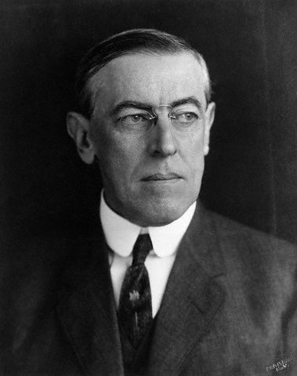
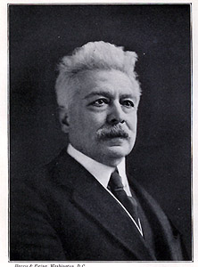
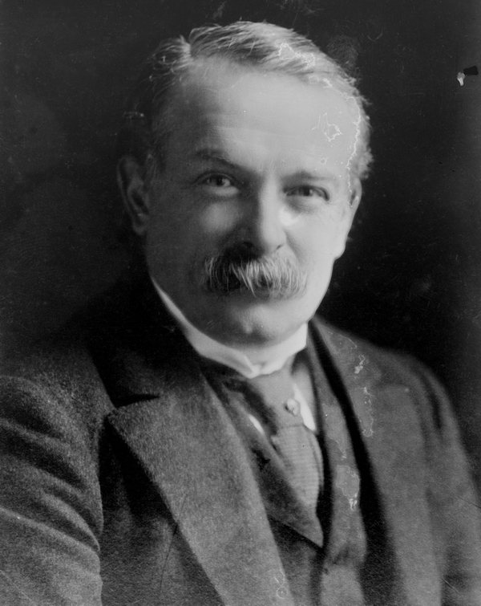
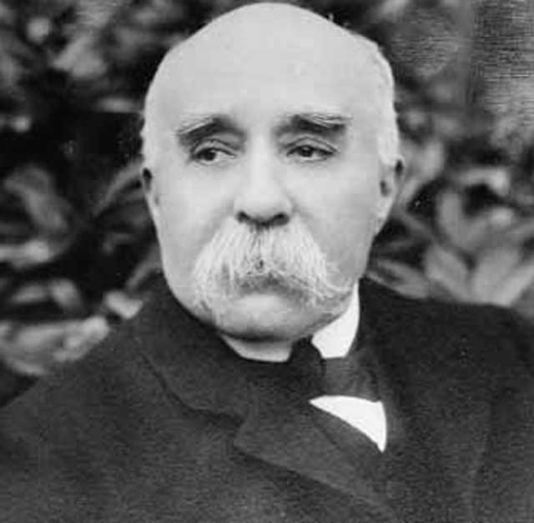
The “Big Four”
Prime Minister Vittorio Orlando (Italy)
President Woodrow Wilson (U.S.)
Prime Minister Georges Clemceau (France)
Prime Minister David Lloyd George (Britain)

Slide 4
SynThesis Thursday Bellwork
Write a synthesis statement for the following topic:
(Make the connection and explain it!)
The social and political effects of the Triangular Trade
Answers Vary

Slide 5
Objective
WWBAT: Discuss the effects of WWI and the Rise of the Great Depression

Slide 6
Interactive notebook Setup
4/20/2017
Results of WWI and The Great Depression
This will be two pages

Slide 7
Interactive notebook Setup
4/20/2017
Ism Chart
This will be two pages

Slide 8
Treaty of Versailles
Results of WWI

Slide 9
Lead up to the Great Depression
The New Deal
Capitalism Challenged
Path to WWII

Slide 10
Treaty of Versailles Signed June 28, 1919
Germany had to give up territorial provisions in Europe
- Germany gave Alsace-Lorraine to France
- Germany gave Saar coal mines to France
- Germany gave small areas on its border to Denmark and Belgium
- Other border changes were made based on nationality

Slide 11
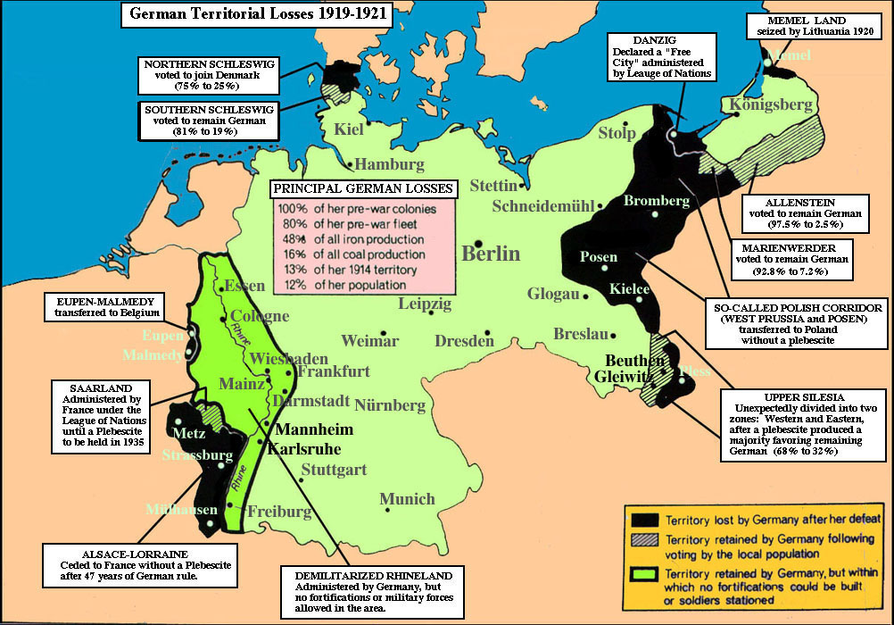

Slide 12
Treaty of Versailles
2) Germany was forced to give up ALL of its colonial holdings
- Germany had to give up all of its overseas colonies to the Allies
- Great Britain & France split Germany’s colonies in Africa
- Australia took German Pacific islands south of the Equator
- Japan took German Pacific islands north of the Equator

Slide 13
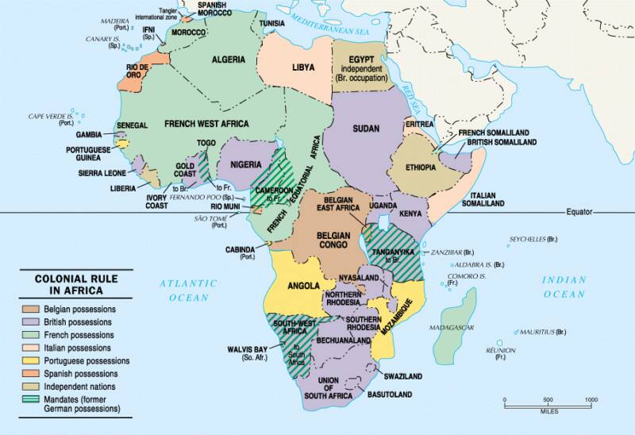
League of Nations Mandates in Africa

Slide 14
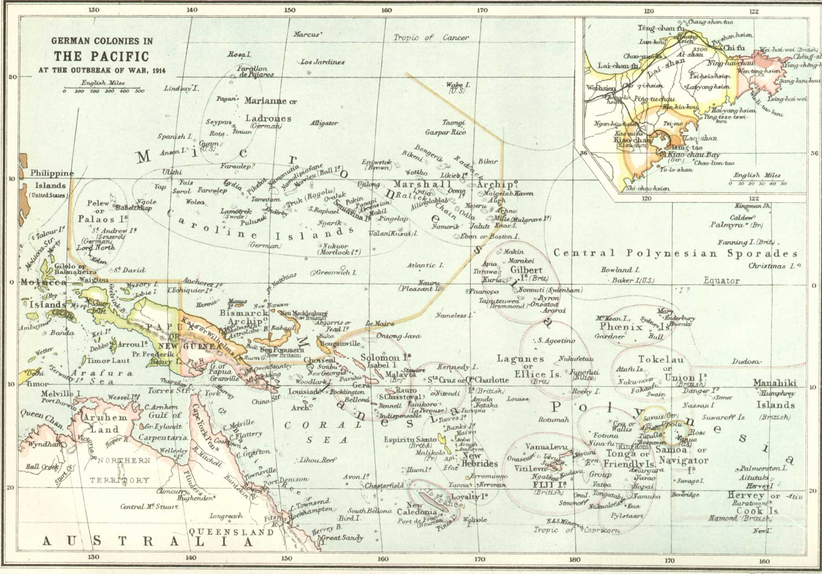
German Pacific Colonies Lost After WWI

Slide 15
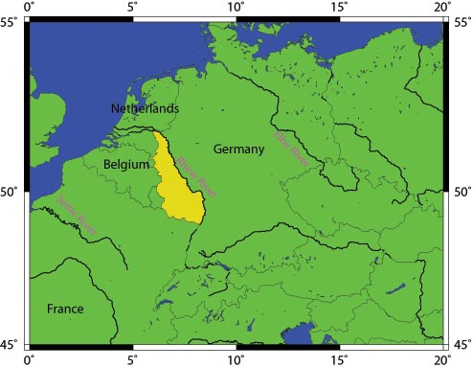
Treaty of Versailles
3) Germany was forced to disarm their military
German army limited to 100,000 volunteers
- Submarines & aircrafts banned in Germany
- Draft banned in Germany
- German navy reduced to a few small ships
- Demilitarization of the Rhineland in Germany

Slide 16
Treaty of Versailles
4) War Guilt Clause and Reparations
- Germany had to accept SOLE responsibility for the war
- Germany had to pay reparations = payments for all war damages

Slide 17
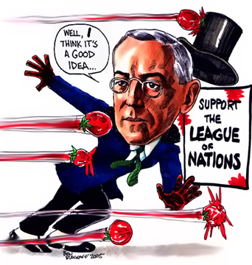
Treaty of Versailles
5) Creation of the League of Nations as a international organization
-Intended to maintain world peace
- Ended up being very weak
- U.S. Senate refused to join
- Not enforced well
- Not strong enough to stop WWII
- Collapsed in 1940

Slide 18
Treaty of Versailles
Austria-Hungary broke up
New nations emerged in Europe out of the old German, Russian, and Austro-Hungarian Empires
In the Middle East, the Allies divided up what was left of the Ottoman Empire

Slide 19
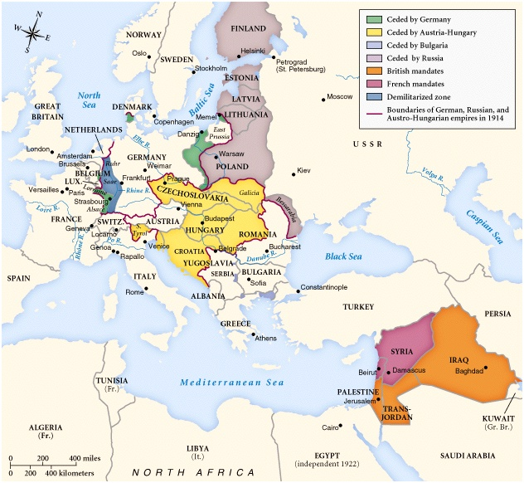
New Nations: 1923

Slide 20
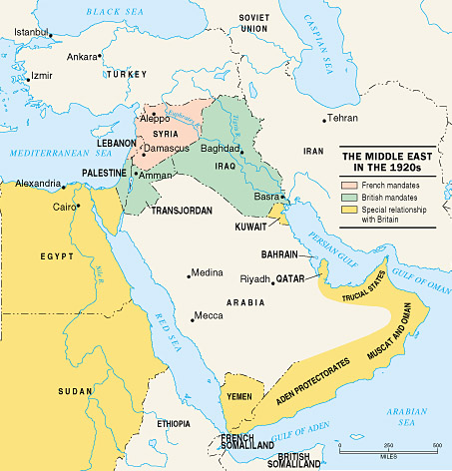
League of Nations Mandates in the Middle East
Mandate = a territory administered by another country

Slide 21
Results of WWI
WWI destroyed the lives and homes of millions of people
Many people found themselves to be minorities in newly formed nations
Many people who thought they would become citizens of independent nations saw their dreams dashed
Losing side was bitter about the outcome
Most bitter country after WWI = Germany
Left weak and humiliated as a result of the Treaty of Versailles

Slide 22
Results of WWI
Social Results
10 million soldiers killed
20 million soldiers wounded
13 million civilians died = from getting caught up in the war, disease, starvation, etc.
World left with hatred, intolerance, and extreme nationalism

Slide 23
Results of WWI
Political Results
U.S. emerged as a leading world power
Breakdown of empires & monarchies
New countries emerged in Europe
Many European countries would eventually turn to dictatorship
Italy, Germany, and Russia

Slide 24
Results of WWI
Economic Results
Total cost of WWI = $350 billion
Taxes increased in Europe to pay for the war
International trade declined
Economic issues eventually led to the Great Depression
Worldwide – not just in the U.S.

Slide 25
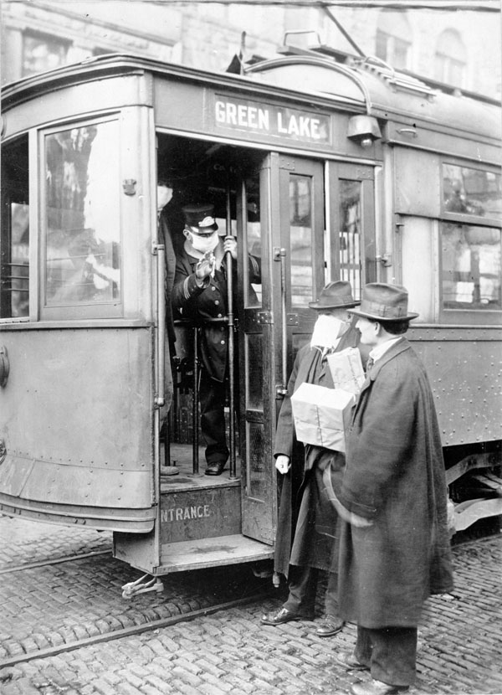
Historical factors may have also contributed to the spread of the
1918 -1919 flu:
Global war moving people great distances
Crowded conditions in troop ships
Modern transportation made it easier to spread the flu
Street car conductor from Seattle not allowing passengers aboard without a mask in 1918.

Slide 26
1918 Flu Pandemic Facts:
The flu targeted the young and healthy.
Half of all deaths in 1918 were of people between twenty and forty
May have killed as many people as the Black Death- bubonic plague
It killed between 2 and 20 % of those infected; normal mortality rate is 0.1 %
It may have killed as many as 25 million in the first 25 weeks, whereas HIV/AIDS has killed 25 million in the first 25 years.
The pandemic caused large business failures and stunted economic growth years after.

