Slide 1
Interactive Notebook Setup
8/21/2019
Confucianism and Daoism Main Ideas
This will be one page

Slide 2
Basics of Confucianism
Basics of Daoism

Slide 3
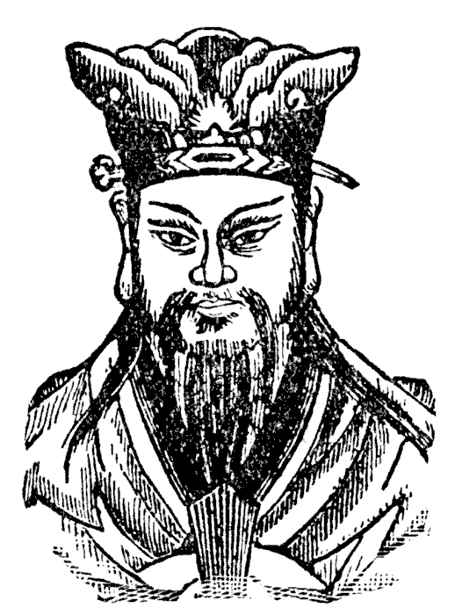
Basics of Confucianism
Founder=Confucius (551 – 479 BCE) during Era of Warring States
The most influential philosopher of China’s dynastic period
Sought a political position but did not find one
Spent his time as a thinker and teacher
Students collected his teachings in a book called the Analects
Later scholars elaborated on his ideas and developed a body of thought known as Confucianism

Slide 4
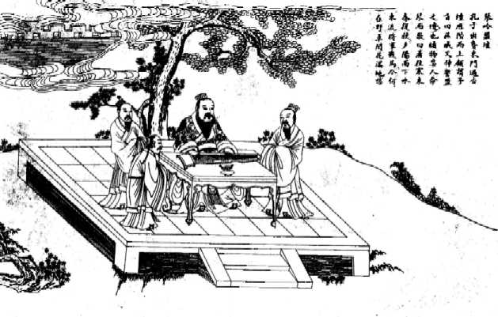

Slide 5
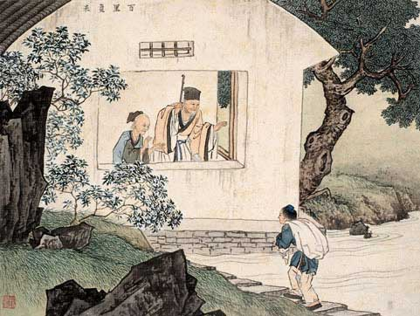
Confucius was concerned with human relationships, effective government, and social harmony.

Slide 6
Basics of Confucianism
Confucius emphasized education as the key to moral betterment
Confucius also said that learning is a life long process that never ends
Rituals and ceremonies were also important for they conveyed the rules of appropriate behavior

Slide 7
Basics of Confucianism
The examination system was established in which candidates for government service had to pass a rigorous examination
-A civil service exam for gov. positions based on skill/ability
-But opened the possibility of government service to ALL men by emphasizing intellectual achievement and the examination system

Slide 8
Basics of Confucianism
The family was the model for political life
-Filial piety or the honoring of one’s ancestors and parents was emphasized
Human society consisted of unequal relationships
Confucius said that there were FIVE Relationships that most people were part of

Slide 9
Basics of Confucianism
1. Ruler & Subject
“To govern is to correct. If you set an example be being correct, who would dare to remain incorrect?”
The Master said about government, “Encourage the people to work hard by setting an example yourself. Do not allow your efforts to slacken.”

Slide 10
Basics of Confucianism
2. Father & Son
“…Being good as a son and obedient as a young man is, perhaps, the root of a man’s character.”
“Simply by being a good son and friendly to his brothers a man can exert an influence upon government.”

Slide 11
Basics of Confucianism
3. Elder Brother & Younger Brother
• Ju Yu asked the Master, “Should one immediately put into practice what one has heard?”
Confucius responded “As your father and elder brothers are still alive, you are hardly in a position immediately to put into practice what you have heard.”

Slide 12
Basics of Confucianism
4. Husband Wife
“In one’s household, it is the women and the small men that are difficult to deal with. If you let them get too close, they become insolent (disrespectful). If you keep them at a distance, they complain.”

Slide 13
Basics of Confucianism
5. Friend & Friends
“Do not accept as friend anyone who is not as good as you. When you make a mistake do not be afraid of mending your ways.”

Slide 14
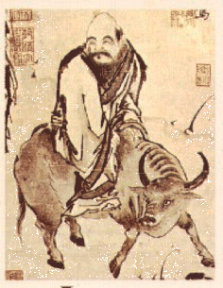
Basics of Daoism
Daoism is often associated with Laozi in 6th cent
According to tradition, Laozi was a sixth-century BCE archivist
Credited with writing the Daodejing (Tao Te Ching)=main text
Afterwards, it was rumored that Laozi abandoned civilization to live in nature
Daoist ideas were later-expressed in a more explicit fashion by the philosopher Zhuangzi (369-286 BCE)

Slide 15
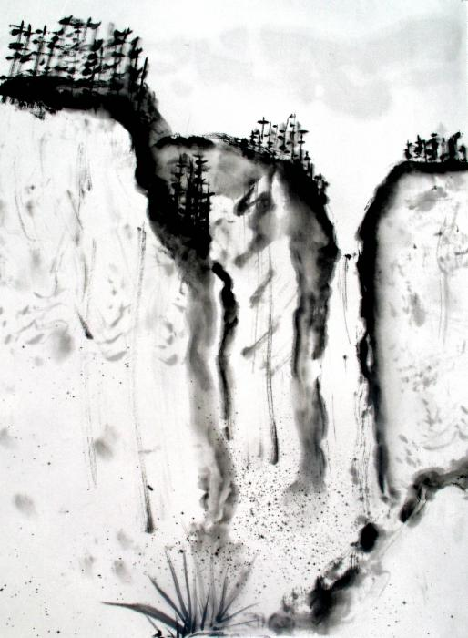
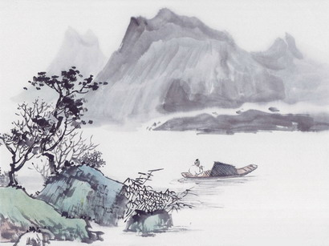

Slide 16
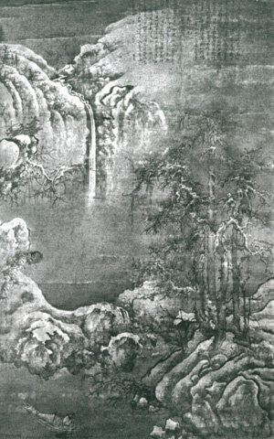
The central concept of Daoism is the Dao(WAY)
The original force of the cosmos that is an eternal and unchanging principle that governs all the workings of the world
Daoism encouraged withdrawal from the world of political and social activism
Called wuwei
Daoism encouraged people to live in nature and to live naturally

Slide 17
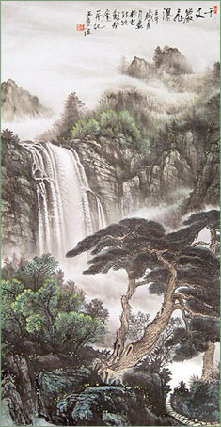
Daoists viewed education and desiring moral improvement as useless
Opposed many Confucian ideas
Believed that striving made things worse
In the face of disorder and chaos, urged withdrawal into the world of nature
Encouraged behavior that was spontaneous, individualistic, and natural
Emphasized nature and its mysterious patterns

Slide 18
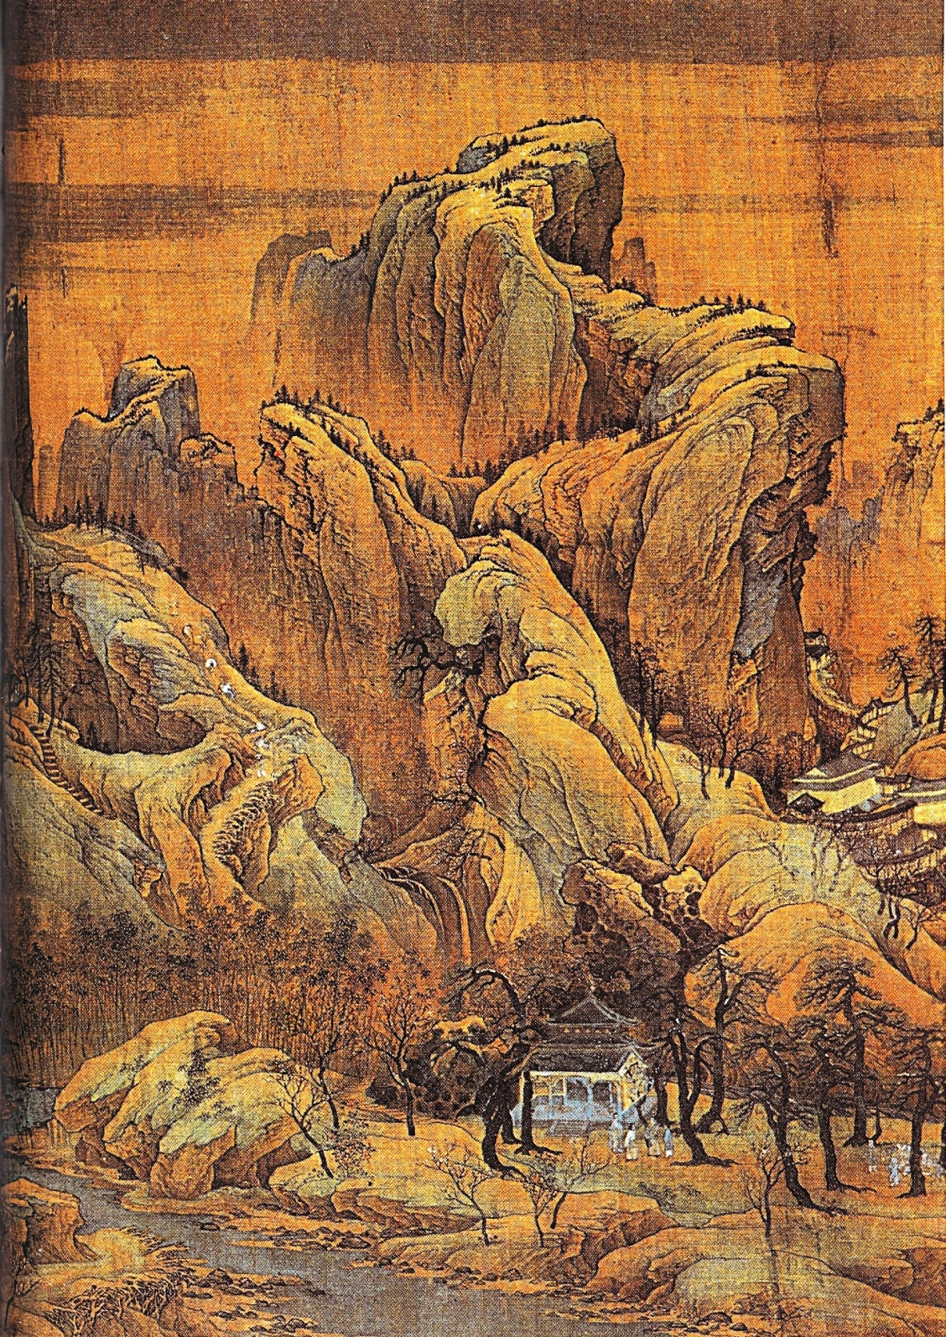

Slide 19
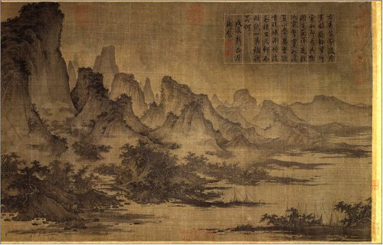

Slide 20
But despite differences, Daoism was regarded as complementing Confucianism
This attitude was encouraged by the ancient Chinese concept of yin and yang
The concept of yin and yang expressed a belief in the unity of opposites
A Confucian scholar during the day might practice Daoist meditation and breathing exercises as well as landscape painting at night

Slide 22
According to Confucius, since humans could not fully understand this life, they could not possibly know anything about the life beyond.

