Slide 1
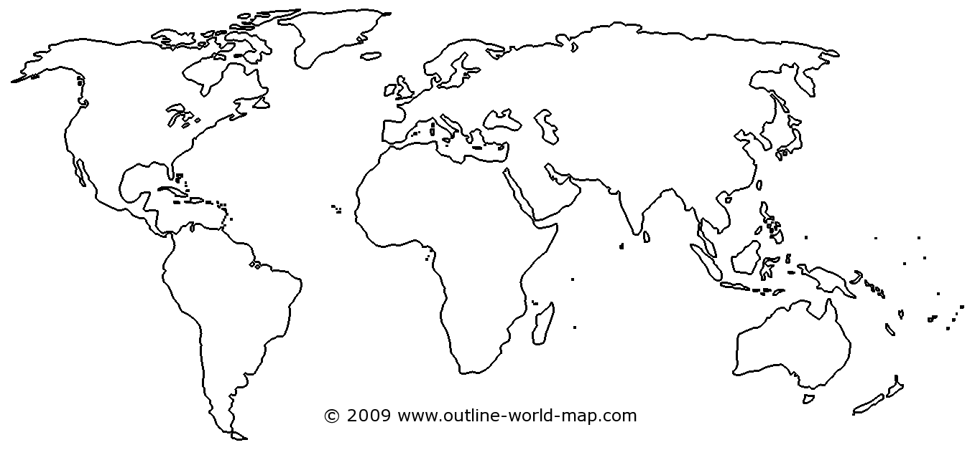
Mapping Monday Bellwork
3
7th-8th Century CE
5
11th Century-3rd Century BCE
1
10th-12th century CE
4
16th-6th Century BCE
2
28th-23th Century BCE

Slide 2
Mapping Monday Bellwork
1 Toltec
2 Old Kingdom Egypt
3 Umayyad Caliph
4 Vedic India
5 Zhou Dynasty

Slide 3
Objective
WWBAT: Introduce the rise of Absolutism and examine the different between state and nation

Slide 4
Interactive Notebook Setup
2/27/2017
European Absolutism
This will be one page

Slide 5
European State-Building
Absolutism

Slide 6
European State-Building
2nd half of 15th century = began to recover from the plague and rebuild its population
State-building occurred as Europe rebuilt politically after feudalism/plague
Fragmented system of many separate, independent, and highly competitive states
Examples: Spain, Portugal, France, England, etc.

Slide 7
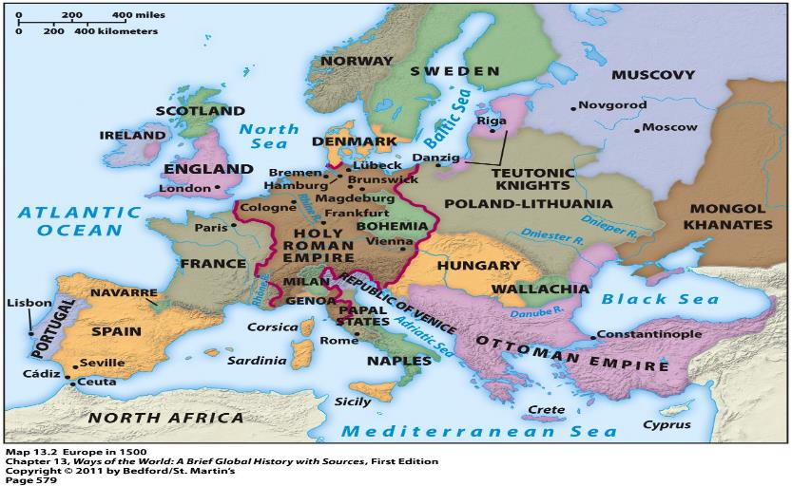
European State-Building

Slide 8
European State-Building
All of these states began to:
Tax their citizens more efficiently
Create more effective administrative structures
Raise large standing armies
State-building driven by:
The needs of war → warfare very frequent in such a fragmented and competitive political environment

Slide 9
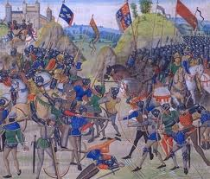
Hundred Years’ War (1337-1453)
Between England and France
Fought over rival claims to territories in France
Result = French victory

Slide 10
Absolutism
Absolutism
Conscious attempt by monarchs to extend their legal and administrative power over their subjects & over the social and economic institution
Age of Absolutism—1660-1789 (Height of it, but since 1500 rulers had been trying to make the state more powerful)

Slide 11
Absolutism
Absolutism
Conscious attempt by monarchs to extend their legal and administrative power over their subjects & over the social and economic institution
Age of Absolutism—1660-1789 (Height of it, but since 1500 rulers had been trying to make the state more powerful)

Slide 12
Absolutism
Wanted an end to the turbulence of religious wars and internal conflicts
Only strong central govs could provide domestic order and prosperity.
Rulers insisted it was their duty to teach subjects how to live, even against their will

Slide 13
Absolutism
Ruled through something called divine right
This meant that God wanted monarchs and their family to rule
This rule through divine right justified his power to be an absolute monarchy

Slide 14
Goals of Absolutism
1. Control & enlarge military
2. Control the administration of the legal system
3. Control the collection and distribution of taxes

Slide 15
Goals of Absolutism
4. Create an efficient bureaucracy whose allegiance was to the monarchy, not to other social or economic interests within the country
5. Create a set of institutions strong enough to withstand, if not destroy the private interests that had hindered royal power in the past
The Church
The Nobility
Semi-autonomous regions(feudal lords)
Independent representative bodies
These were all obstacles to achieving a strong centralized monarchical gov’t

Slide 16
SOVEREIGNTY
Supreme and independent power or authority in government

